Slide 1


Group 6
Alvaro Rodrigo Chavez
Nicholas Dibiase
Paolo Adrian Quezon
Denis Shwaloff
CEN322

Slide 2
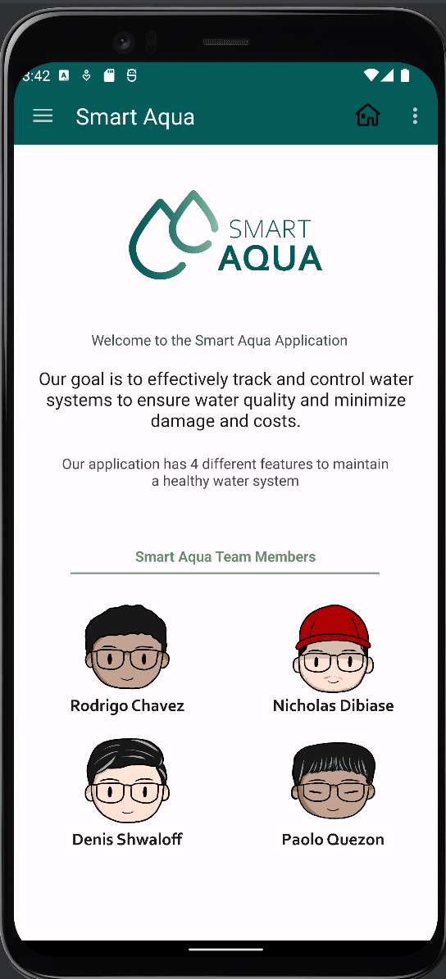
HOME PAGE
Group 6
Alvaro Rodrigo Chavez
Nicholas Dibiase
Paolo Adrian Quezon
Denis Shwaloff
CEN322

Slide 3
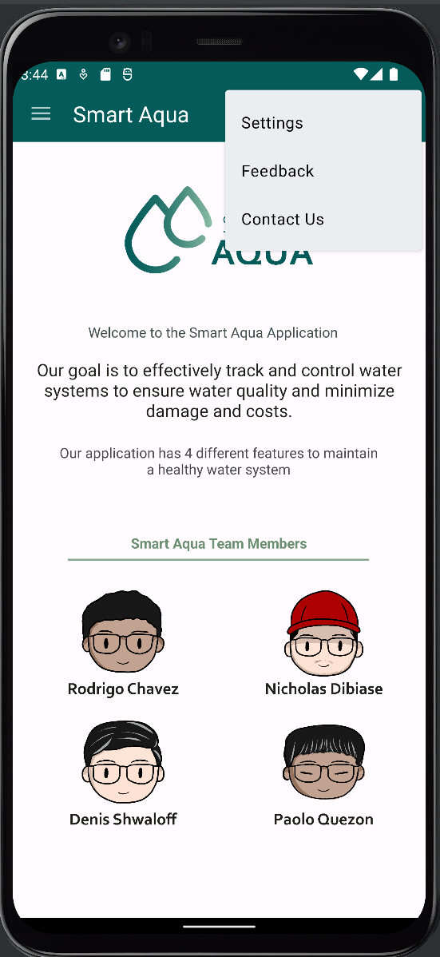
MENU
HOME PAGE
Group 6
Alvaro Rodrigo Chavez
Nicholas Dibiase
Paolo Adrian Quezon
Denis Shwaloff
CEN322

Slide 4
HOME PAGE
MENU
Group 6
Alvaro Rodrigo Chavez
Nicholas Dibiase
Paolo Adrian Quezon
Denis Shwaloff
CEN322

Slide 5
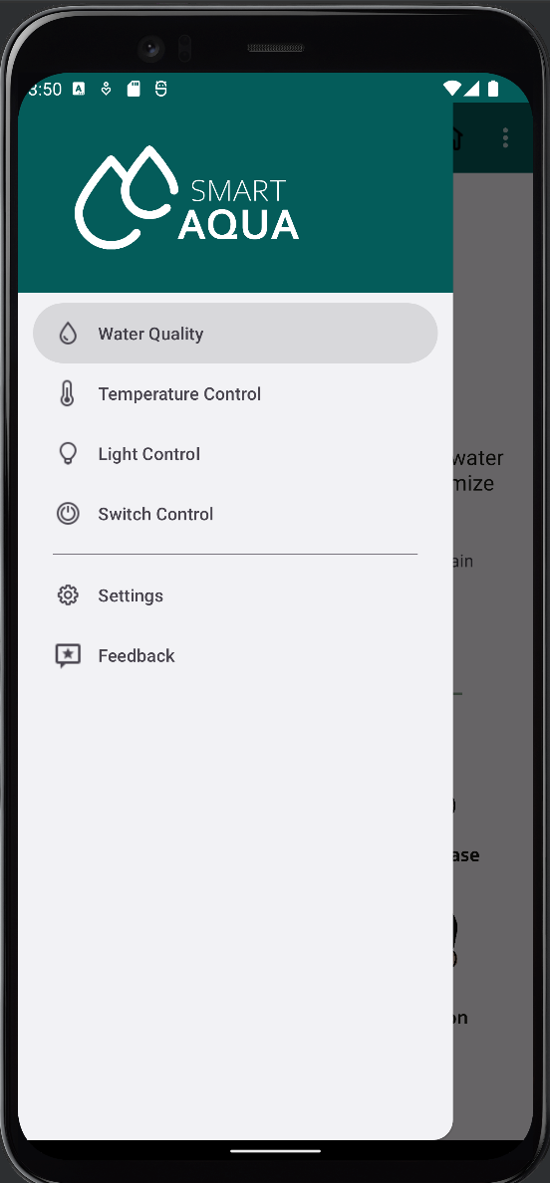
NAVIGATION DRAWER
MENU

Slide 6

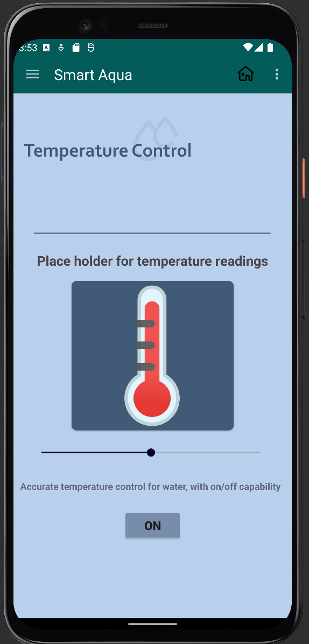
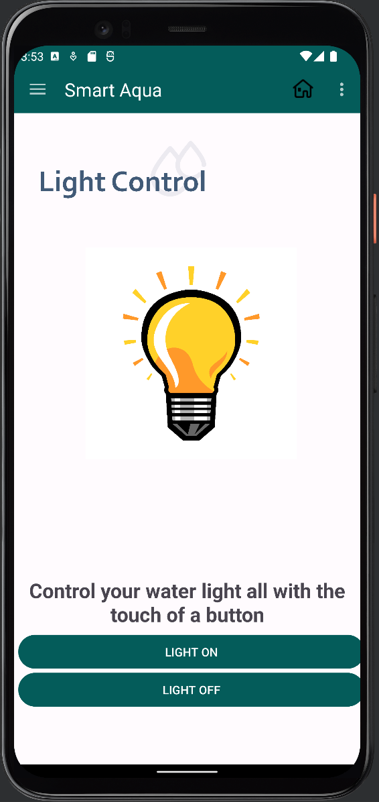
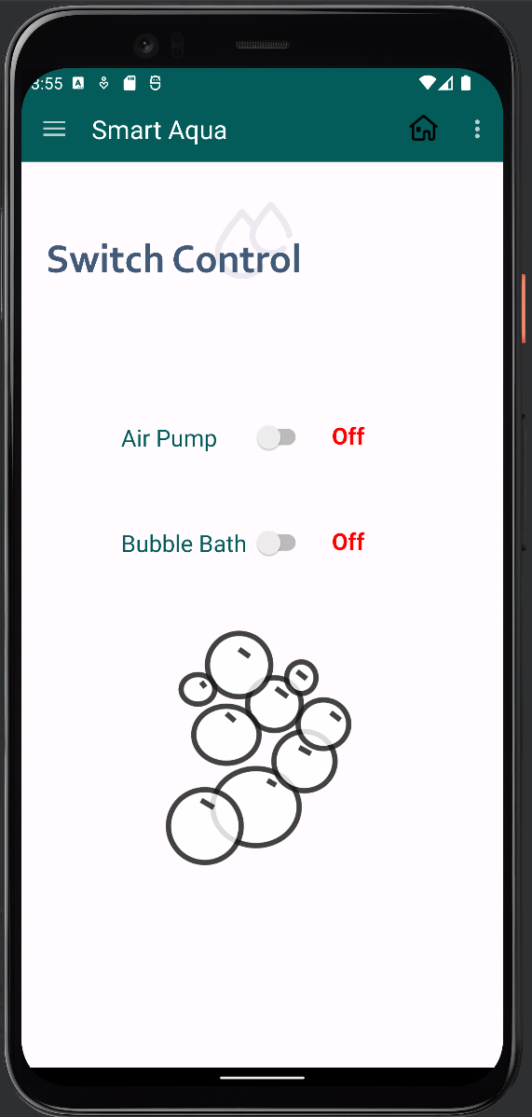
SENSORS
NAVIGATION DRAWER

Slide 7
NAVIGATION DRAWER
SENSORS

Slide 8
SENSORS

Slide 9
SENSORS

Slide 10
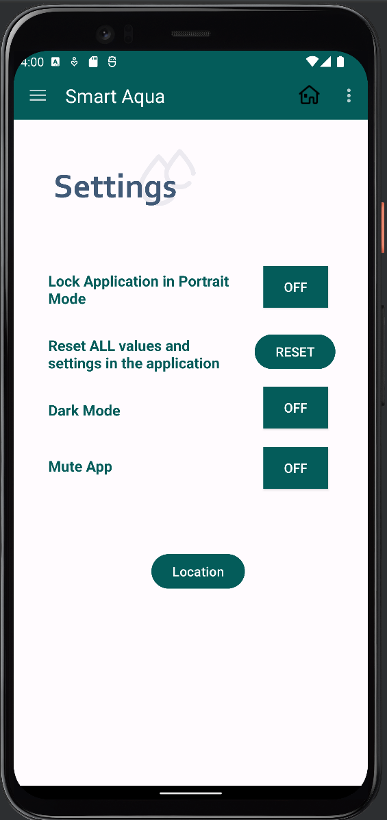
SETTINGS &
FEEDBACK
SENSORS

Slide 11
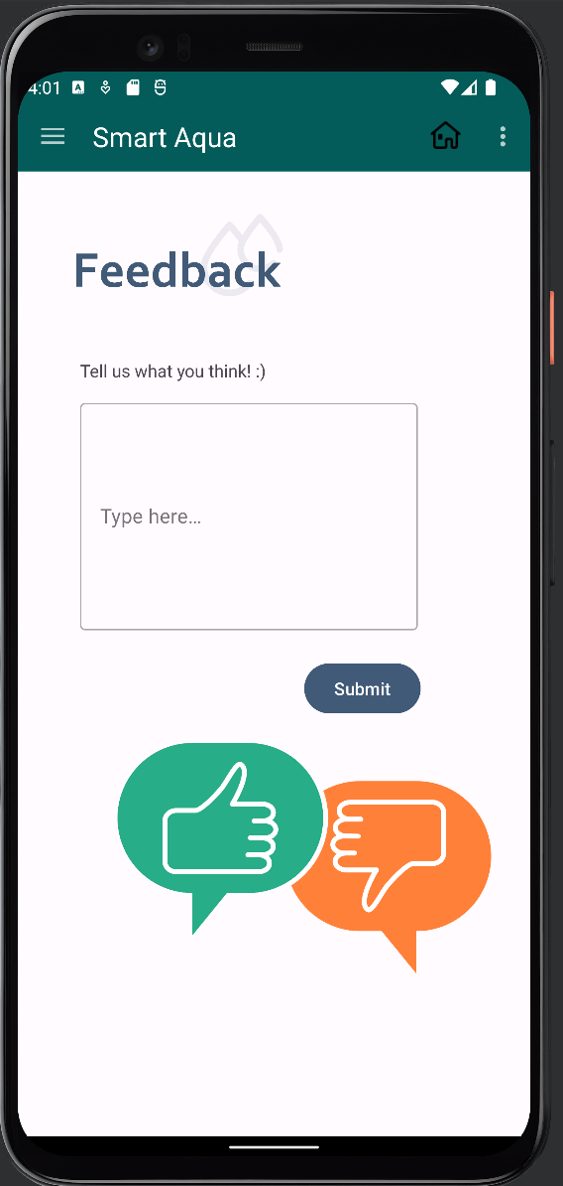
SETTINGS &
FEEDBACK
SENSORS

Slide 12
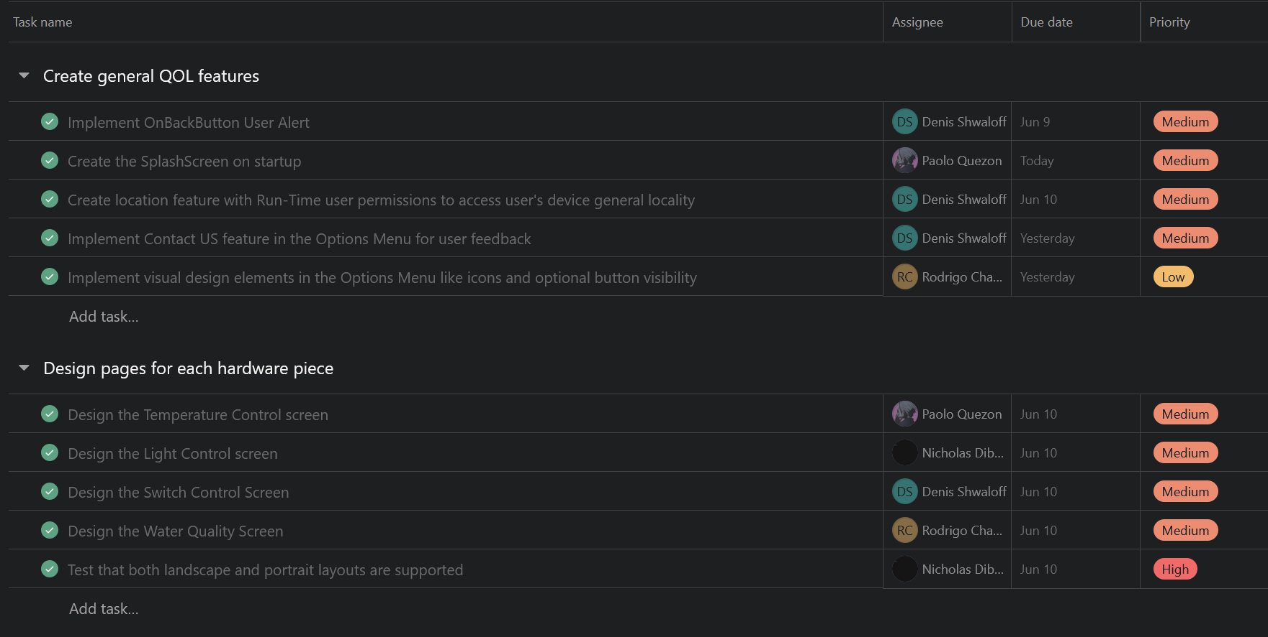
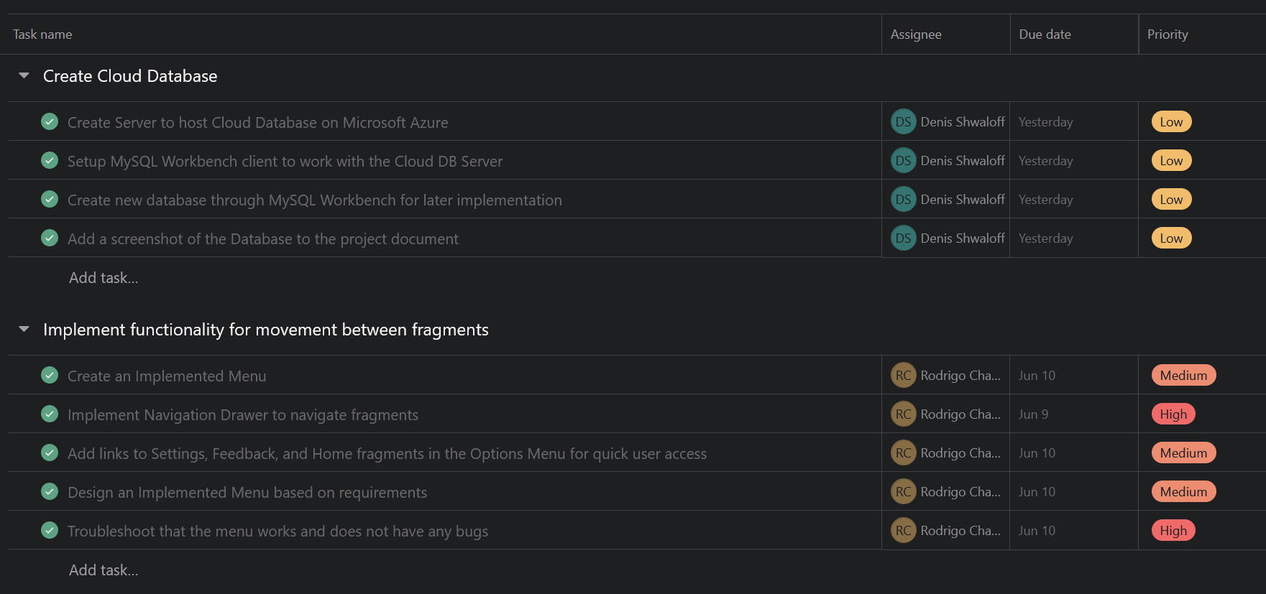
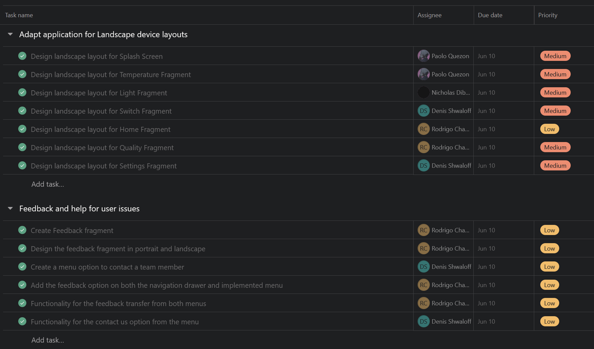
SPRINT DASHBOARD
SETTINGS &
FEEDBACK

Slide 13
SPRINT DASHBOARD
SETTINGS &
FEEDBACK

Slide 14
SPRINT DASHBOARD

Slide 15
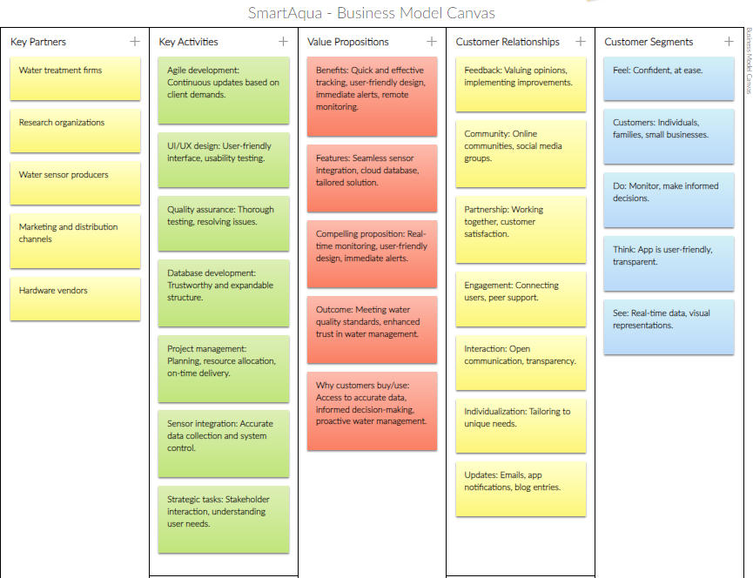
SPRINT DASHBOARD
BUSINESS MODEL
CANVAS

Slide 16
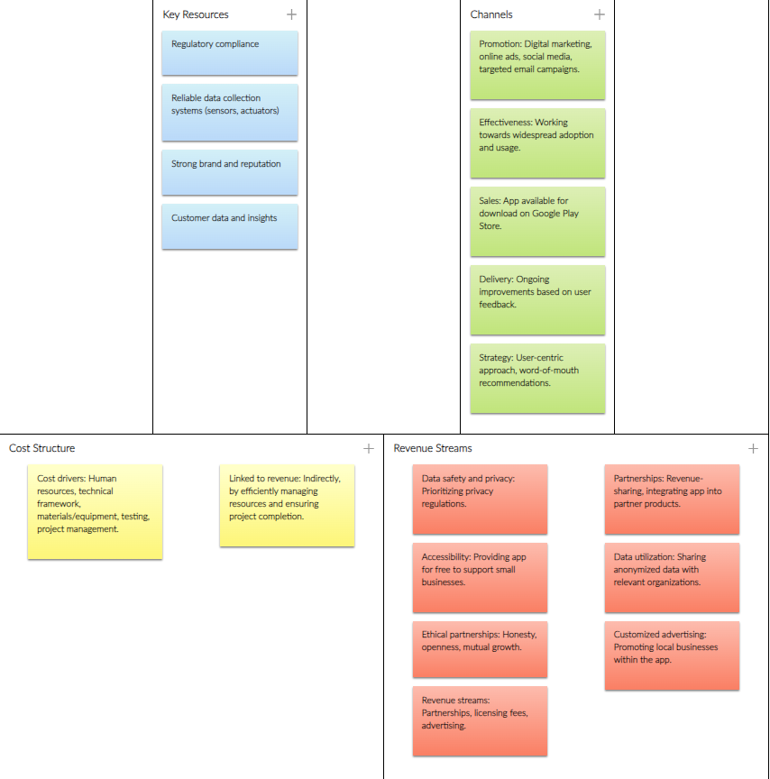
SPRINT DASHBOARD
BUSINESS MODEL
CANVAS

Slide 17
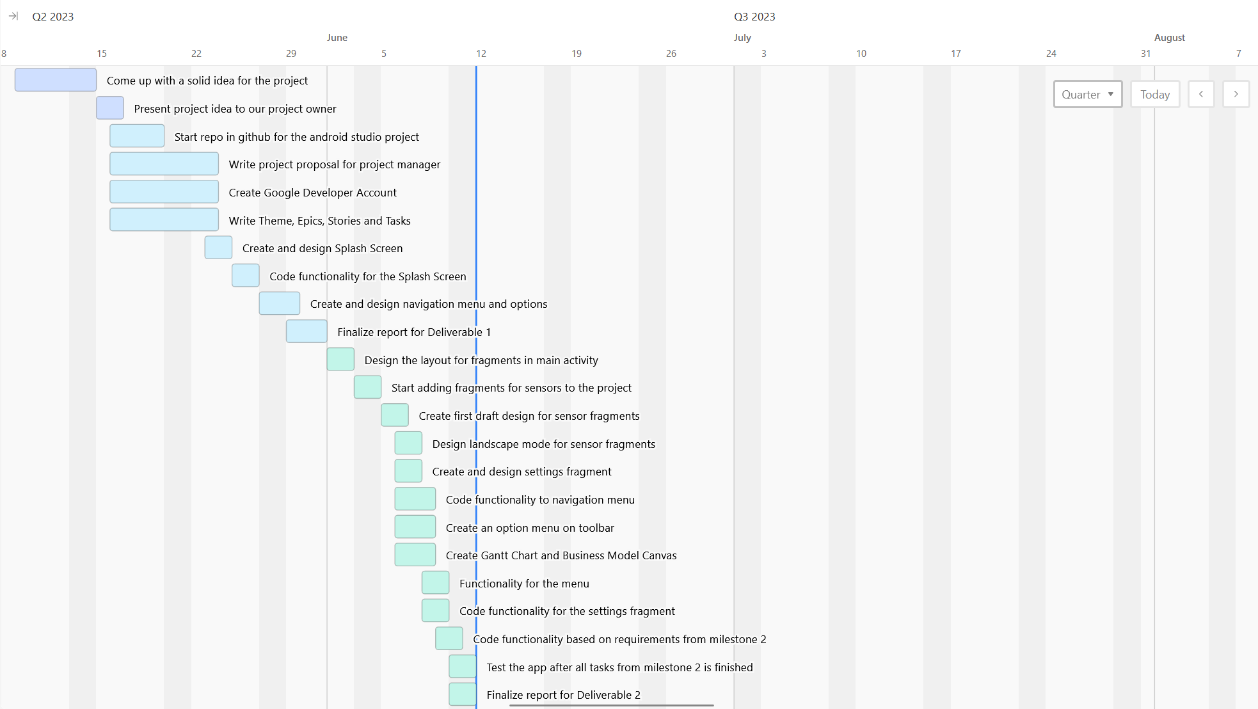
BUSINESS MODEL
CANVAS
GANTT CHART

Slide 18
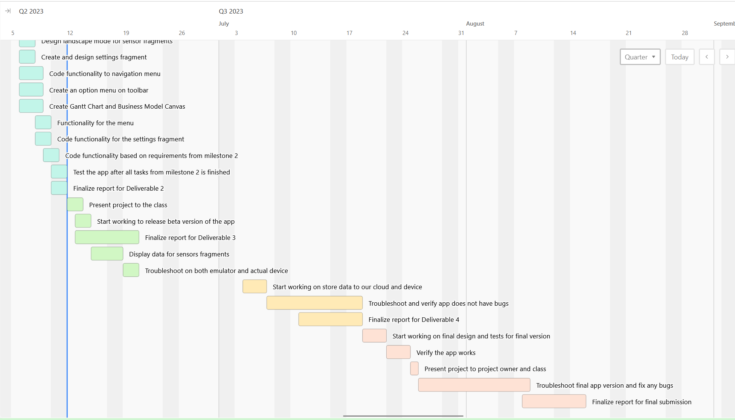
BUSINESS MODEL
CANVAS
GANTT CHART

Slide 19
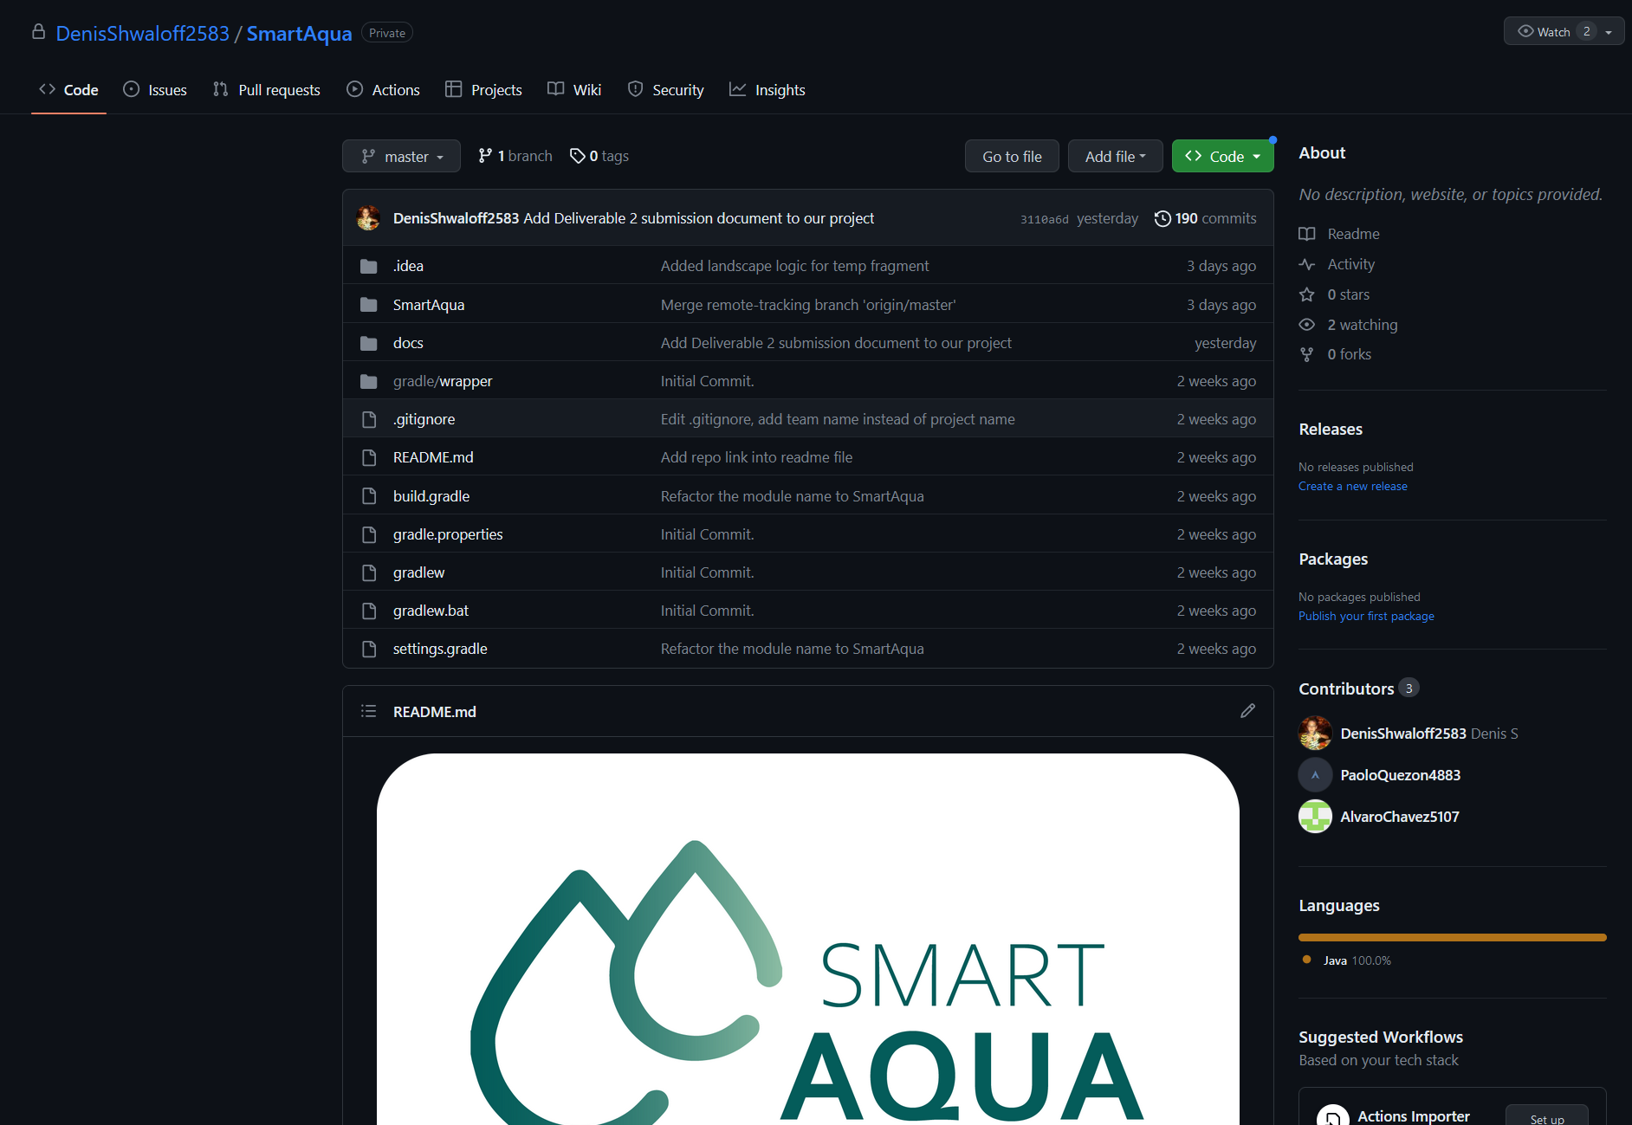
BUSINESS MODEL
CANVAS
GITHUB STRATEGY
GANTT CHART

Slide 20
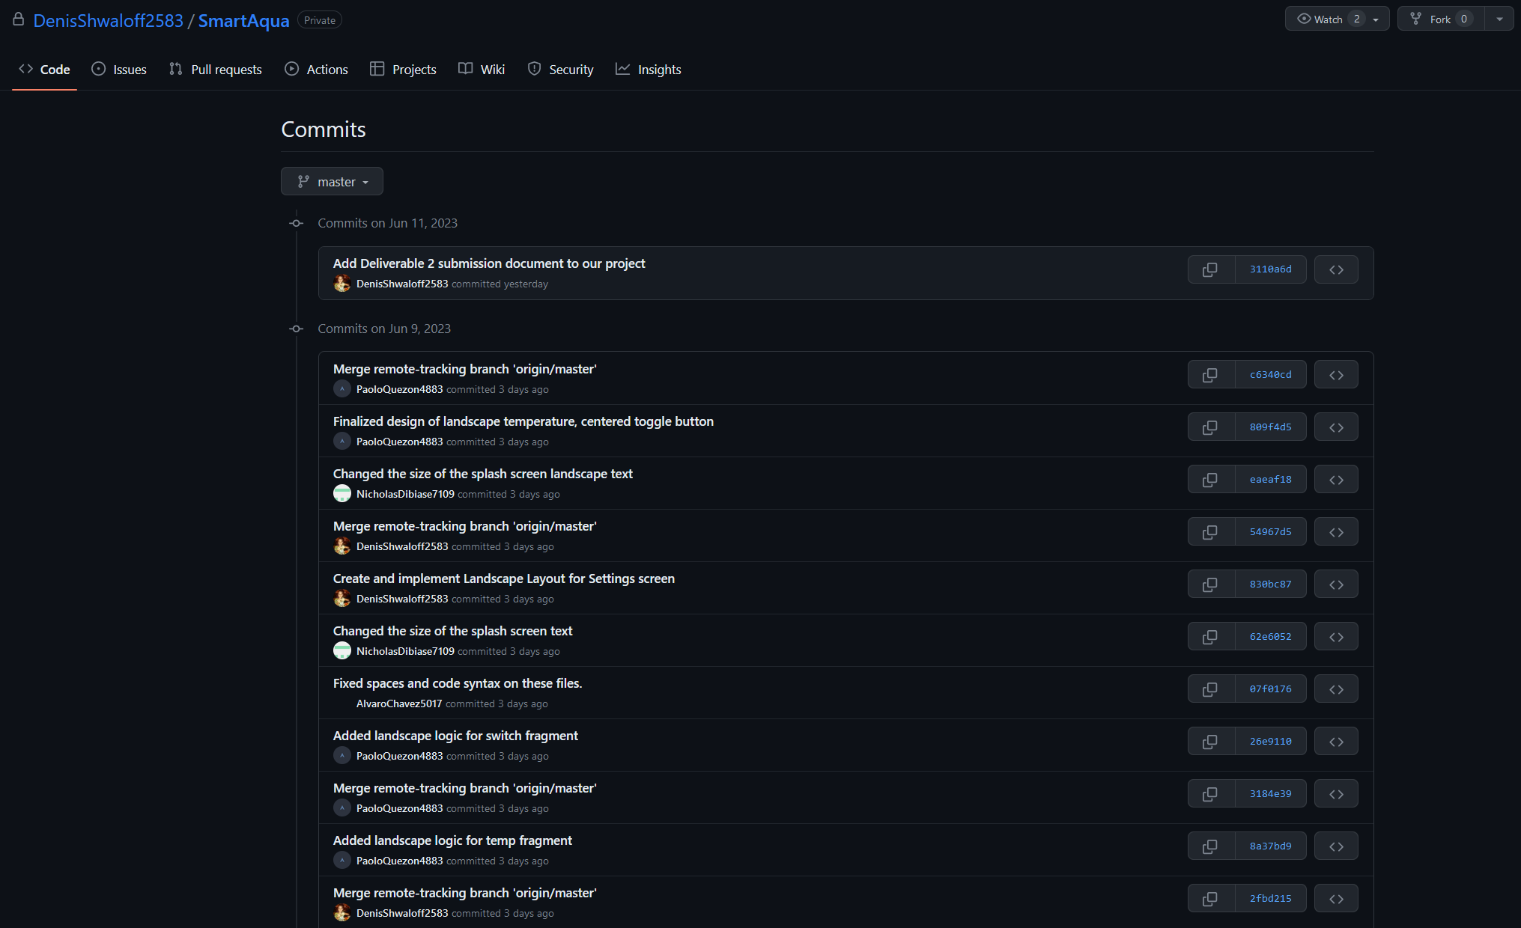
GITHUB STRATEGY
GANTT CHART

Slide 21
GITHUB STRATEGY
THANK YOU

Slide 22
GITHUB STRATEGY
THANK YOU

