Slide 1

OLA BIKE RIDE REQUEST FORECAST
INT254 PROJECT

Slide 2
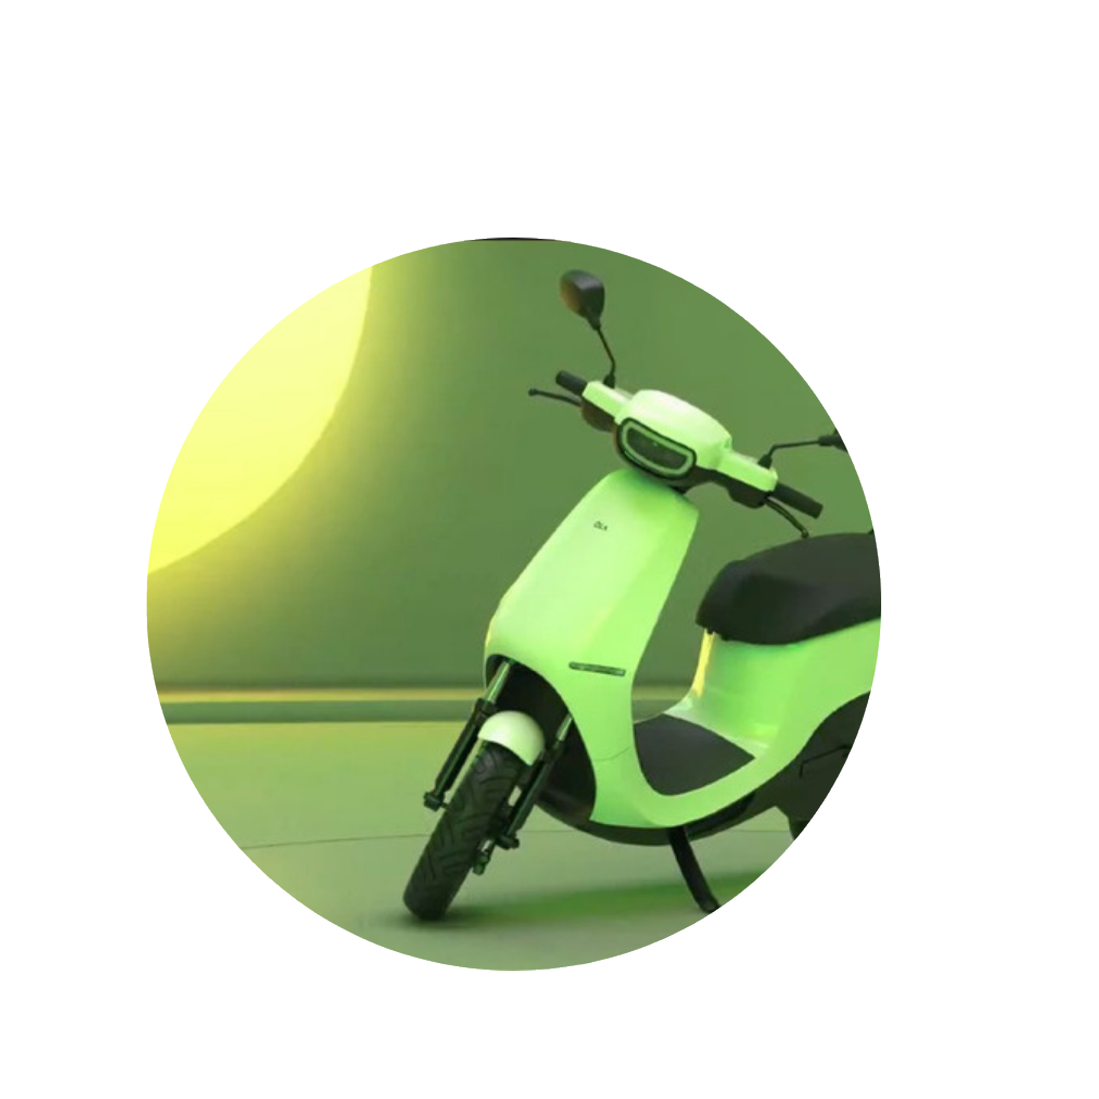
INTRODUCTION
The ride-hailing (Ola) service sector has been expanding for a few years, and it is anticipated to continue expanding in near future. Ola drivers must decide where to wait for passengers since they may arrive rapidly. Additionally, passengers like an immediate bike service whenever required. People who have issues with booking Ola bikes, which sometimes cannot be fulfilled or the wait time for the arrival of the trip is particularly lengthy owing to the lack of a nearby Ola bike. If you successfully reserve an Ola bike in one go, consider yourself fortunate. The percentage of Indians who travel by taxi, bus, or rail is among the highest in the world and few of the Indians 1.4 million residents own automobiles. The leading ride-hailing business in Bangalore, Ola, handles more than 1 lakh rides daily and gathers more than 5GB of data.

Slide 3
PROBLEM STATEMENT
In this article, we will try to predict ride-request for a particular hour using machine learning. It is essential for us to develop a model to forecast supply and demand mismatches using information from the leading ride-hailing company in India. This model is based on users' ride request dataset that is proposed to address these problems; it would include characteristics such as ride booking time, season, and weather, temp, humidity, windspeed, number of non-registered user rentals initiated, number of registered user rentals initiated, number of ride request raised on the app for that hour.

Slide 4

PROPOSED WORK
Ride hailing companies (such as Ola) are losing money and market share to their competitors, due to their failure to satisfy the trip demands of many consumers. To solve this issue, a novel model is presented out to predict ride-request for a particular hour using machine learning.
Dataset:
The data set used in this study was a ride request dataset. This dataset would have the following attributes: ride booking time, season, and weather, temp, humidity, windspeed, number of non-registered user rentals initiated, number of registered user rentals initiated, number of ride request raised on the app for that hour. Explanation for the column names in the dataset and their values is as follows:
Seasons:
Summer
Fall
Winter
Spring

Slide 5

Weather:
Clear, Few clouds, Partly cloudy, Partly cloudy
Mist + Cloudy, Mist + Broken clouds, Mist + Few clouds, Mist
Light Snow, Light Rain + Thunderstorm + Scattered clouds, Light Rain + Scattered clouds
Heavy Rain + Ice Pallets + Thunderstorm + Mist, Snow + Fog
Casual:
number of non-registered user rentals initiated
Registered:
number of registered user rentals initiated
Count:
number of ride request raised on the app for that hour.

Slide 6
Algorithms Used:
Linear Regression
Linear regression is a fundamental statistical technique used to understand the relationship between a dependent variable and one or more independent variables.
Lasso
Lasso (Least Absolute Shrinkage and Selection Operator) is a linear regression technique that adds a penalty term to the standard linear regression objective function.
Ridge
Ridge regression is a linear regression technique that adds a penalty term to the standard linear regression objective function.
Random Forest Regressor
RandomForestRegressor is an ensemble learning method that belongs to the family of decision tree algorithms. It is used for regression tasks, where the goal is to predict a continuous value.

Slide 7
Data Preparation:
There are times when multiple features are provided in the same feature or we must derive some features from the existing ones. We also tried to include some extra features in our dataset so, that we can derive some interesting insights from the data we have. Also, if the features derived are meaningful then they become a deciding factor in increasing the model’s accuracy significantly.
Exploratory Data Analysis:
EDA is an approach to analysing the data using visual techniques. It is used to discover trends, and patterns, or to check assumptions with the help of statistical summaries and graphical representations. We added some features to our dataset using some assumptions. And we also checked what are the relations between different features with the target feature.
Model Training
We separated the features and target variables and split them into training and the testing data by using which we selected the model which is performing best on the validation data. We split the data into training and validation data also the normalization of the data will be done. We trained some state-of-the-art machine learning models and select the best out of them using the validation dataset.

Slide 8
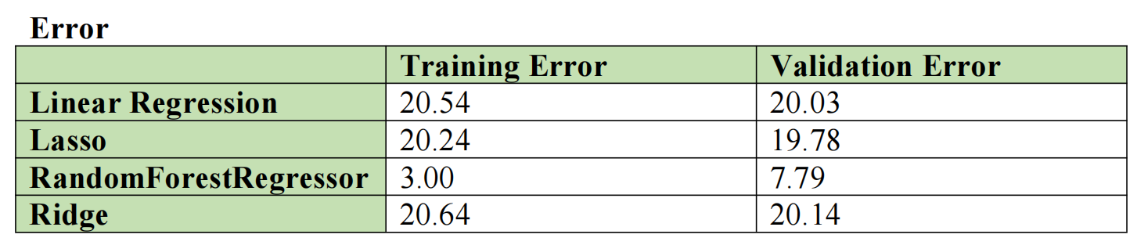
RESULT
We can see that Random Forest Regressor is giving the least Validation and Training Error

Slide 9
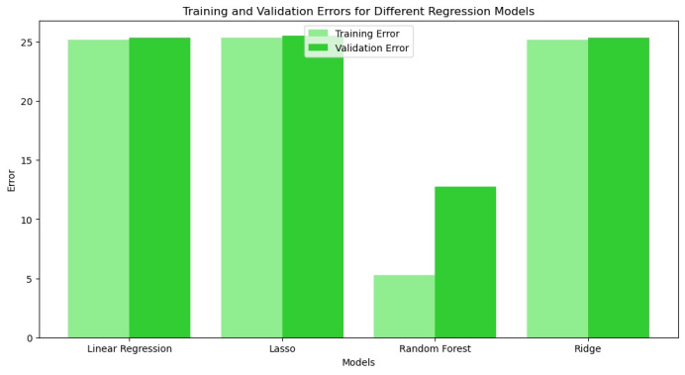

Slide 10
CONCLUSION
RandomForestRegressor has the lowest Training Error (3.00) among all the models, indicating that it has the best performance on the training data. This suggests that RandomForestRegressor is able to capture the underlying patterns in the training data more effectively than the other models.
RandomForestRegressor is particularly strong in terms of its ability to generalize to unseen data, making it a promising model for this dataset.
Additionally, the insights gained from our study can serve as a valuable reference for researchers and practitioners selecting machine learning algorithms for similar datasets. Our findings guide choosing algorithms for classification tasks, especially when dealing with datasets that share characteristics similar to ours.

Slide 11
THANK YOU
for your attention

