Slide 1
GPU/PCI Passthrough in Linux KVM for Building On-Demand GPU Clusters
Andre Bernardes Soares Guedes
Dogival Ferreira Da Silva Junior
Jessica De Paula Figueira Ribeiro
Priscila Da Costa Vieira

Slide 2
Virtual Machine
App
App
App
VFIO - Virtual Function I/O
MMIO – Memory Mapped I/O
DMA – Direct Memory Access
MMU – Memory Management Unit
IOMMU – Input–Output Memory Management Unit
KVM – Kernel Virtual Machine
QEMU – Quick Emulator
IRQ – Interrupt Request
Guest OS
IRQ
MMIO
DMA
QEMU
Host
KVM
VFIO
Hardware
MMU
IOMMU
I/O Device

Slide 3
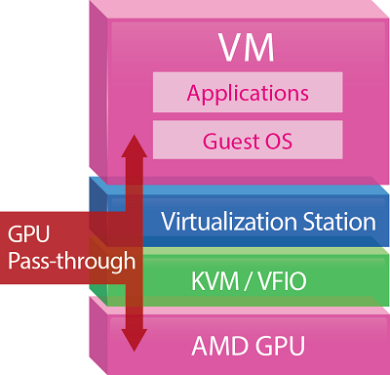
https://download.qnap.com/Origin/images/products/Application/notes/GPU-pass-through_en01.jpg
https://upload.wikimedia.org/wikipedia/en/e/e9/GPU_Passthrough_technology.jpg
http://www.fp7-save.eu/papers/EUC2014B.pdf

