Slide 1
Project Factor
Speech to Text – innovating and integrating WITH Data

Slide 2
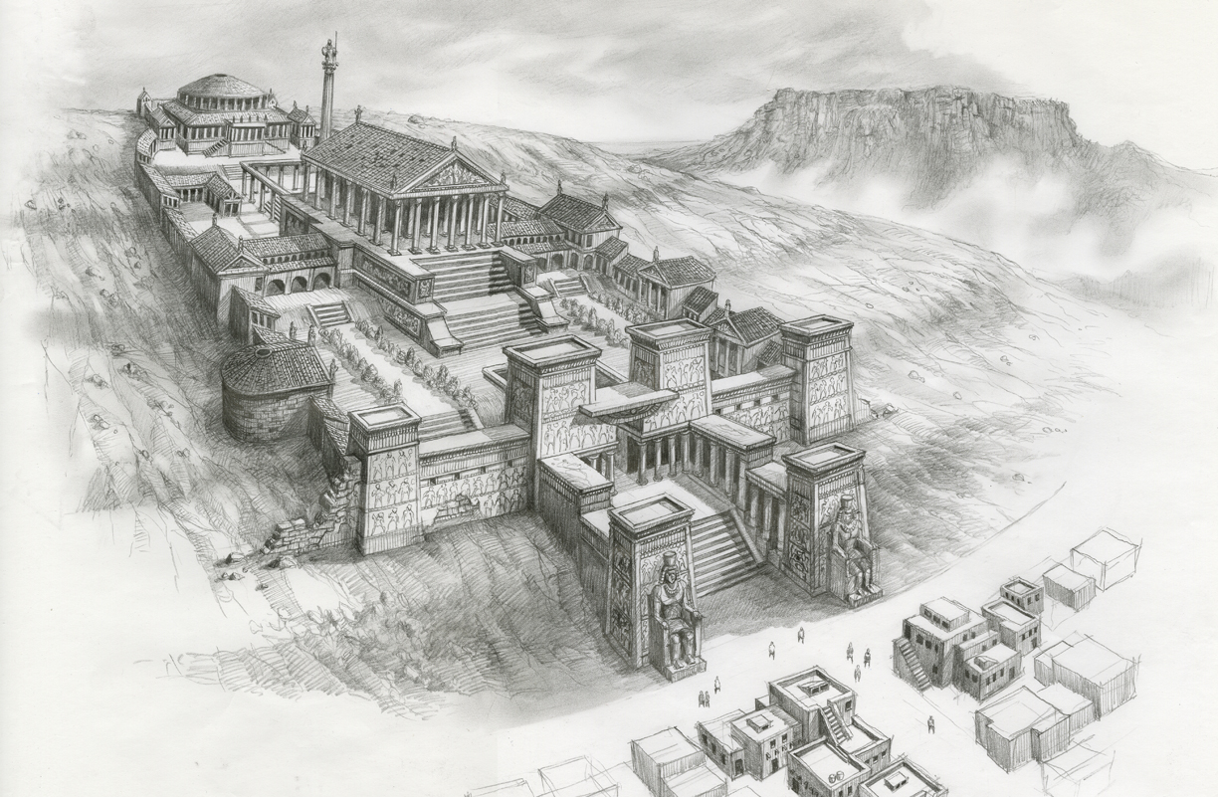
Library of Alexandria

Slide 3
Why?
Libraries were the controlled center of knowledge for the entire history of mankind!
Until the digital age…
Currently the online services groups in universities have become the defacto center for knowledge
But to them – the data they control or that knowledge is a burden to store and archive
They throw it away every 1 to 1.5 years on average!
Wouldn’t it be great if we have a place and a group that were experts in categorizing, searching, retrieving, and presenting this data to those who are looking for it?

Slide 4
We do…
It is called the library…

Slide 5
Project Factor Proposal
Factor is a software framework
The main goal is to take text from speech (video or audio) and convert it to raw text that users can manage and mark up
Why bother?
Users can correct the failures of machine translation
Users can then provide full English transcripts for subtitles and ADA use
Users can mark up unstructured text and share it with others in a library
Users can search the gathered text and make custom books from content scattered across departments and even years of lectures.
Users can also search via keywords to find video as well as text

Slide 6
What are the components?
Speech to text engine – using an opensource library called Sphinx from Carnegie Mellon University
Project Convert
Note… they are already using this library for a transcript purpose for some of their own courses
Transcript also provides timestamp which is used in the next project
Project Window-Pane
This is the interface that allows the user to view video (similar to blackboard) and simultaneously edit the text transcript
Project Marker
This portion allows a user to enter a drag and drop application and mark unstructured text via a simple GUI interface.
Code is rendered into a DocBook or HTMLBook format which allows for export to PDF, HTML, Docbook, and even ePub
PDF and HTML formats can be printed too – making real-time books

Slide 7
Factor components
Project SH-3
This is a meta portion of the project that deals with raw data storage and preparing data for archiving and retrieval.
Project Promised-Land
This is the search engine portion
Aggregates all the searchable text transcripts
Uses Lucene (an opensource indexing tool that prepares data for searching)
Uses Solr (an opensource webcrawler that a user would search from)
Uses Hadoop (just for data storage)

Slide 8
What is the current state?
We have a working prototype of each part
Main UI parts have been integrated
Two student groups have worked on separate prototypes and produced research into the Sphinx module and its inner workings
I am looking for support from any interested parties.
IPRO is not an option as they are looking for Full-time research professors
My department would not sponsor me to do an IPRO
So this idea is out unless someone else can pick up the torch

Slide 9
What is the library’s role?
Help with licenses
Can all the content be placed under creative commons?
If so which one?
Will the university have an issue?
Are there intellectual property issues?
Funding
Are there research grants for a product like this? IMLS? Mellon foundation? ADA?
Currently the NAD is suing MIT and Harvard for not providing captioning on their online course videos.
How would one apply? Where would one look?
Way down the road
Management and shepherding of the project?

Slide 10
Questions?
Questions and comments?
Resources and prototypes publically available here

