Slide 1




$σ$, stress
Ultimate
Fracture
Yield
$$E=\frac{σ_{linear}}{ε_{linⅇar}}$$
$ε$, strain
$$0.002$$

Slide 2





$σ$, stress
$$σ_{x}$$
$$U$$
$ε$, strain
$$ε_{x}$$

Slide 3



$τ$, shear stress
Ultimate
Fracture
Plastic
$$G=\frac{τ_{linear}}{γ_{linⅇar}}$$
$γ$, shear strain

Slide 4
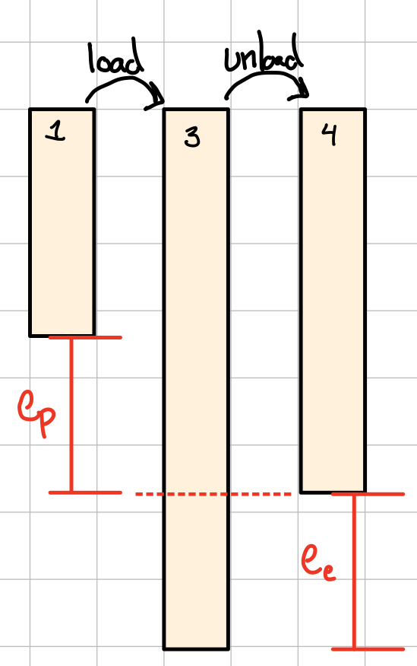










$σ$, stress
$$3$$
>
$$σ_{y}$$
>
$$2$$
$$σ_{0}$$
>
>
$$1$$
$$4$$
$ε$, strain
$$ε_{p}$$
$$ε_{e}$$

Slide 5
500
1045 steel
400
300
Fatigue limit
Stress amplitude (MN/m²)
200
2014-T6 aluminum
100
0
10³
10⁴
10⁵
10⁶
10⁷
10⁸
10⁹
10¹⁰
Number of cycles, N_{f}

