Slide 1
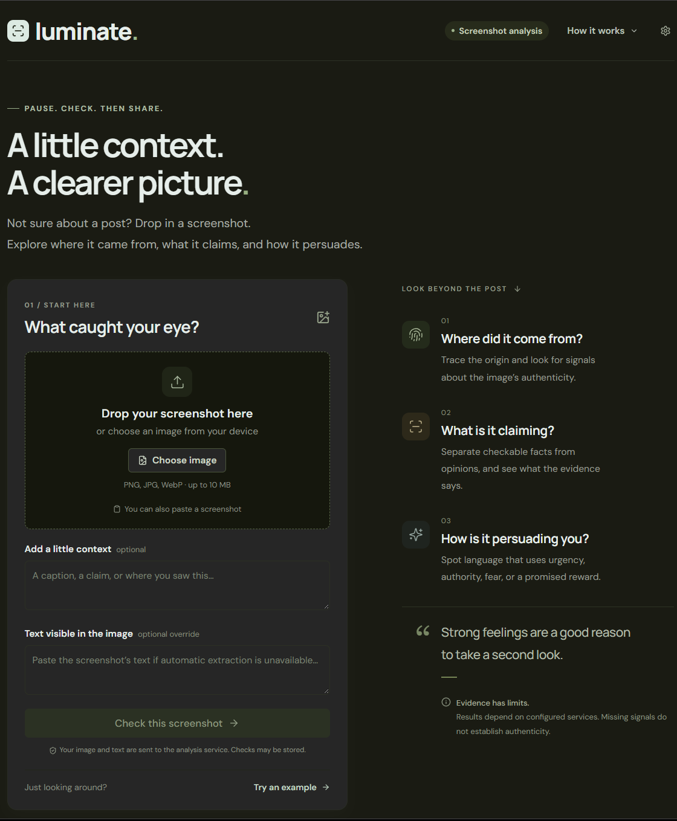
luminate.
Context before you share.
Notes:
Luminate is an AI-powered fact checker and AI-generated content detector. Mission: help people inspect a post before sharing it. The web app accepts screenshots and the Chrome extension checks posts in the feed. Detection provides signals, not proof of authorship. Built for the Innovation Intelligence Hackathon.
Sources: README.md and src/factcheck/pipeline.py at https://github.com/Illuminare-AI/IlluminarePipeline. Product screenshots supplied by the team. Layout, fonts and artwork retained from the user-provided reference deck.

Slide 2
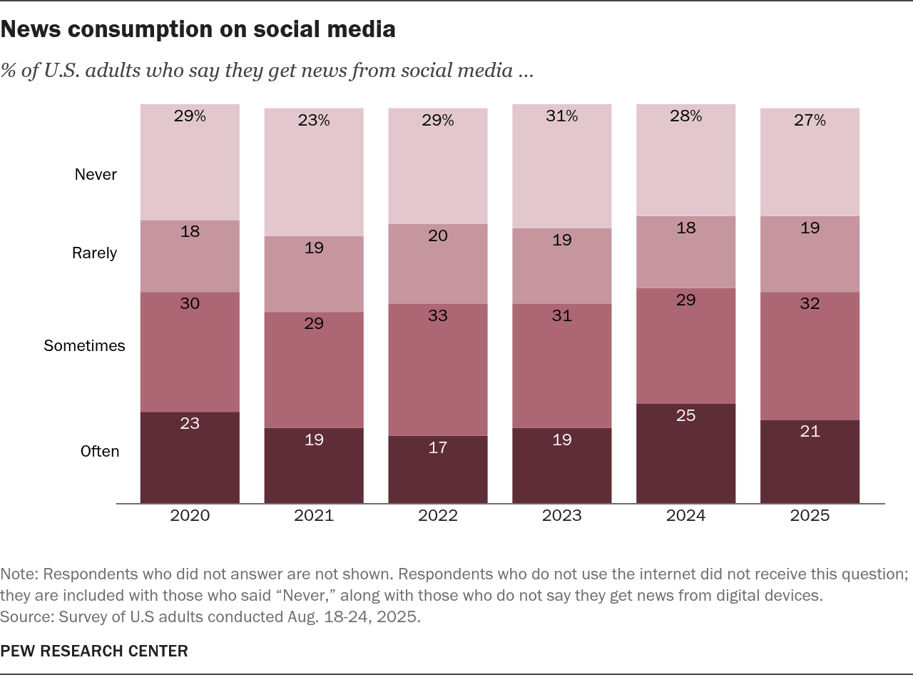
The Verification Gap
Misleading posts spread without context.
AI suspicion undermines human content, too.
Corrections arrive after users scroll past.
Luminate: Check a post when you see it.
Notes:
The Pew chart establishes audience size, not misinformation prevalence or adoption. In 2025, 53% of U.S. adults get news on social media at least sometimes: 21% often + 32% sometimes. Survey Aug. 18–24, 2025. Luminate allows on-demand checking rather than waiting for later corrections. No universal response-time claim is made. Pew Research Center: https://www.pewresearch.org/journalism/fact-sheet/social-media-and-news-fact-sheet/.
Sources: README.md and src/factcheck/pipeline.py at https://github.com/Illuminare-AI/IlluminarePipeline. Product screenshots supplied by the team. Layout, fonts and artwork retained from the user-provided reference deck.

Slide 3


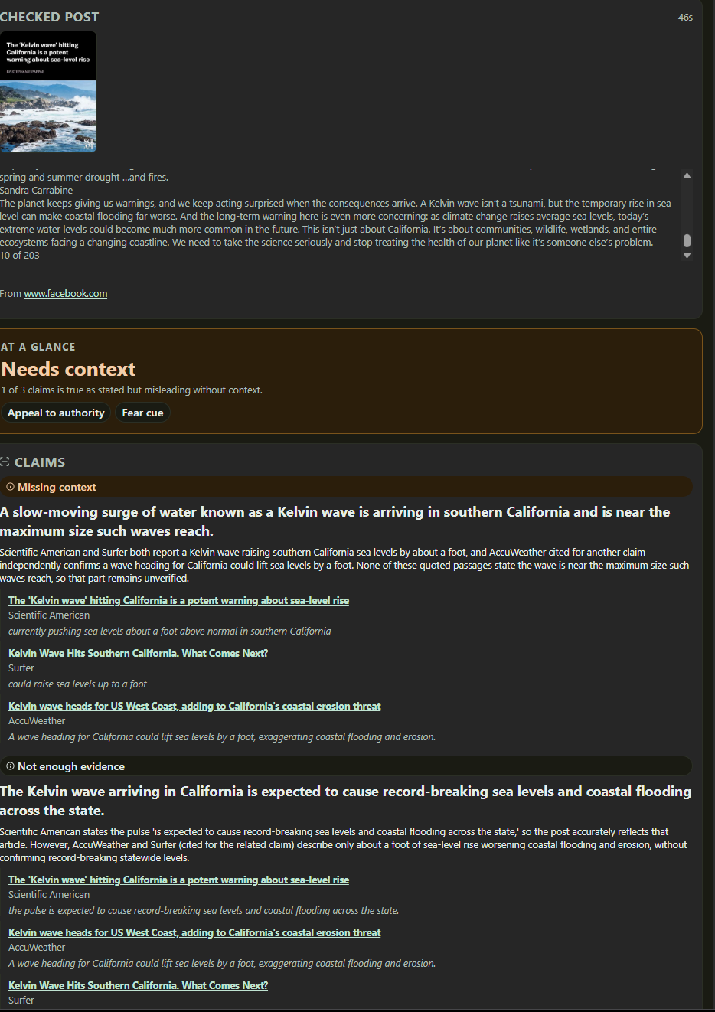
How Luminate Works
1
Read & Recall
Read the post. Reuse matching checks.
2
Extract Claims
Identify claims and persuasion cues.
3
Research & Detect
Fact-checks, web evidence and origin signals.
4
Review & Explain
Show verdicts, sources and uncertainty.
Notes:
Read and recall: text/DOM or screenshot OCR, image fingerprinting and matching media/claim memory. Extract checkable claims and persuasion phrases. Research: published fact-check lookup and speculative web research overlap, while origin checks run alongside claims. Review source support and reconcile claims. Assemble sources, verdicts, persuasion cues and uncertainty. Memory uses the default in-memory store or optional Postgres/pgvector. Matching stored verdicts provides a fast path. Origin checks include Content Credentials, detector and optional reverse image search. Missing signals do not establish authenticity. Live services require configuration.
Sources: README.md and src/factcheck/pipeline.py at https://github.com/Illuminare-AI/IlluminarePipeline. Product screenshots supplied by the team. Layout, fonts and artwork retained from the user-provided reference deck.

Slide 4



What's Next
Checking beyond the browser.
Mobile App
Public Bots
Model Testing
Save or share posts for checking.
Add context to viral posts on X and Reddit.
Compare accuracy, speed and cost.
Notes:
These are future plans: a standalone mobile app receiving shared posts or screenshots; automated public-service X/Twitter and Reddit bots; broader model evaluation for accuracy, latency and cost. The repository has a Reddit scaffold, not proof of a public launch. Test false AI accusations on authentic human content as well as claim accuracy.
Sources: README.md and src/factcheck/pipeline.py at https://github.com/Illuminare-AI/IlluminarePipeline. Product screenshots supplied by the team. Layout, fonts and artwork retained from the user-provided reference deck.

