Slide 1
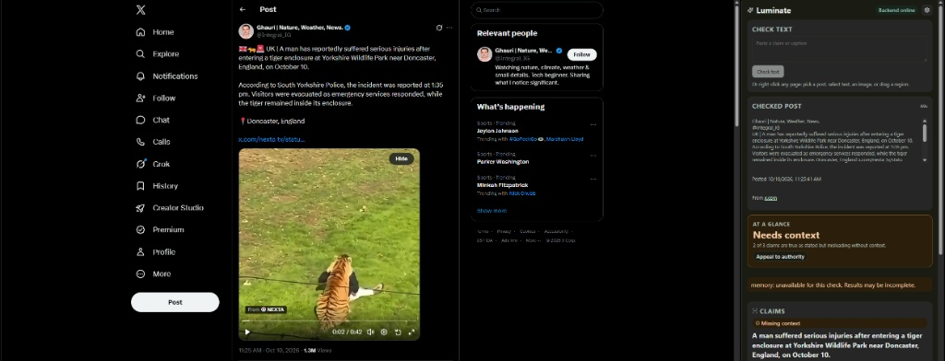
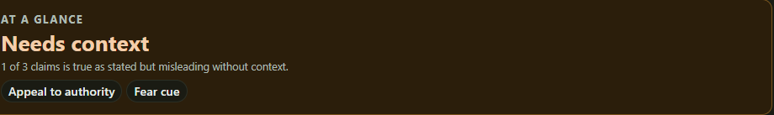
LUMINATE
01
Luminate
Context before
you share
AI-powered fact checking
and AI-content detection
for the posts in your feed.
Browser extension in action
Check a post on demand.
See the evidence behind it.
Claim context and persuasion cues
Notes:
Mission: help people assess a post before sharing it by making evidence and uncertainty visible. Walk through the browser extension and screenshot evidence card. Needs context is not a blanket false label. Origin detection is a signal rather than proof of AI authorship. Built for the Innovation Intelligence Hackathon. The supplied year (20256) was ambiguous and is omitted.
Sources: README.md and src/factcheck/pipeline.py in https://github.com/Illuminare-AI/IlluminarePipeline. Product screenshots and hackathon context supplied by the team. Live services require configuration. Fake mode is the default local backend.

Slide 2
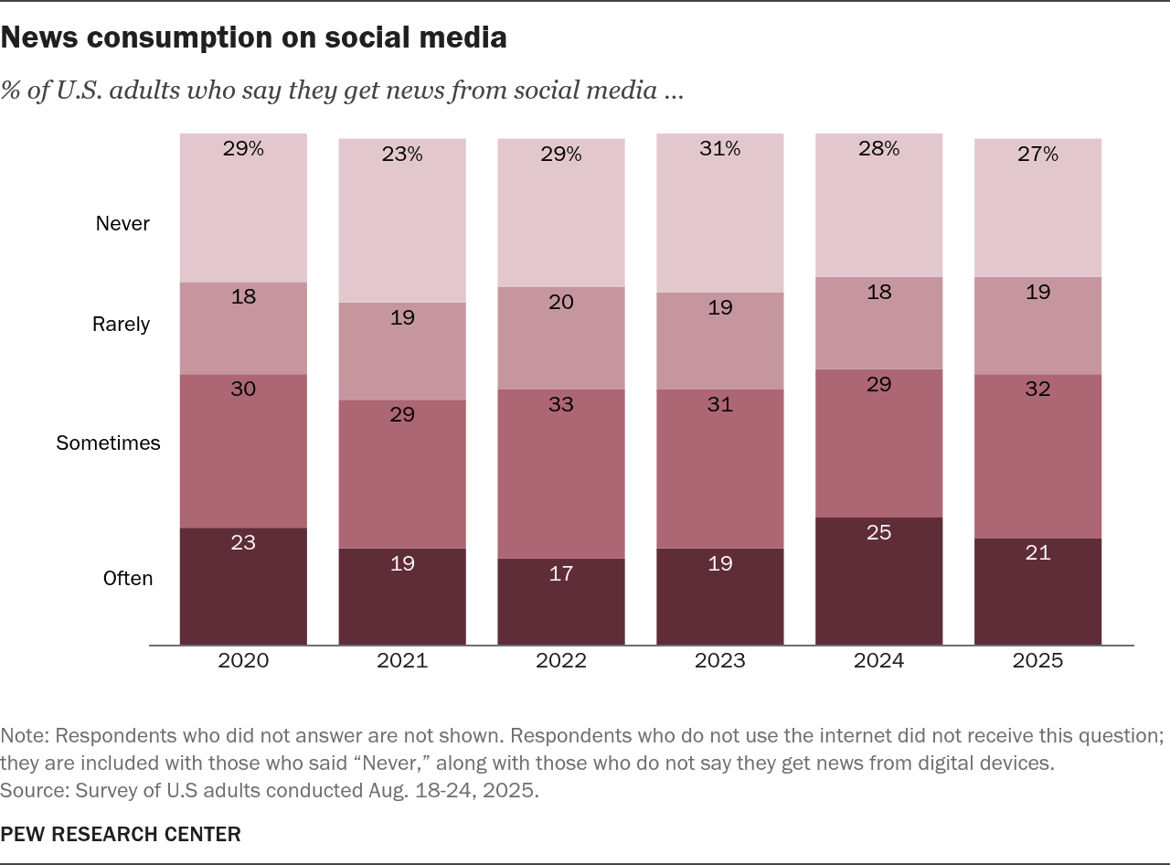
LUMINATE
02
A news feed with a trust problem
53%
of U.S. adults get news
from social media at
least sometimes
Misleading posts lose context.
AI suspicion puts human
content under doubt, too.
On-demand checks, before
the next correction arrives.
Notes:
The Pew figure describes a potential audience, not an adoption forecast. 53% equals 21% often + 32% sometimes in 2025. The chart does not measure misinformation prevalence or distrust of AI. Luminate allows user-initiated checking without waiting for a community note or later correction. No response-time benchmark is claimed. Pew Research Center, Social Media and News Fact Sheet, survey Aug. 18–24, 2025: https://www.pewresearch.org/journalism/fact-sheet/social-media-and-news-fact-sheet/. The supplied chart is preserved with its source and caveats.
Sources: README.md and src/factcheck/pipeline.py in https://github.com/Illuminare-AI/IlluminarePipeline. Product screenshots and hackathon context supplied by the team. Live services require configuration. Fake mode is the default local backend.

Slide 3
LUMINATE
03
How a post becomes an evidence card
One /check endpoint. Claims and origin checks run concurrently.
Read
Recall
Research
Review
Explain
OCR + hash
Extract claims
Image + claim
memory lookup
Fact-check API
Web search
Check sources
+ consistency
Verdicts
Sources + cues
Memory matches reuse prior verdicts
Fast paths
Origin signals
Evidence
card
Content Credentials
AI detector + reverse image search
Reuse known checks.
Research claims in parallel.
Save results for the next post.
Runs alongside claim research
Origin signals express uncertainty. “Not enough evidence” is a valid result.
Notes:
Simplified implemented pipeline: OCR/local image context and fingerprinting precede claim extraction. A media match can return a stored card early. Claims check memory, then published fact-checks and speculative web research overlap, with web work cancelled when a fact-check settles the claim. Origin checks run concurrently. Web answers receive a self-check and multiple claims undergo reconciliation. Results are saved. Storage defaults to in-memory, with an optional Postgres/pgvector adapter storing hashes, claims and verdicts rather than images. Fact Check Tools API, Content Credentials, Walter Writes detector and Cloud Vision reverse image search depend on configuration. Missing signals do not establish authenticity. The diagram uses editable native objects.
Sources: README.md and src/factcheck/pipeline.py in https://github.com/Illuminare-AI/IlluminarePipeline. Product screenshots and hackathon context supplied by the team. Live services require configuration. Fake mode is the default local backend.

Slide 4
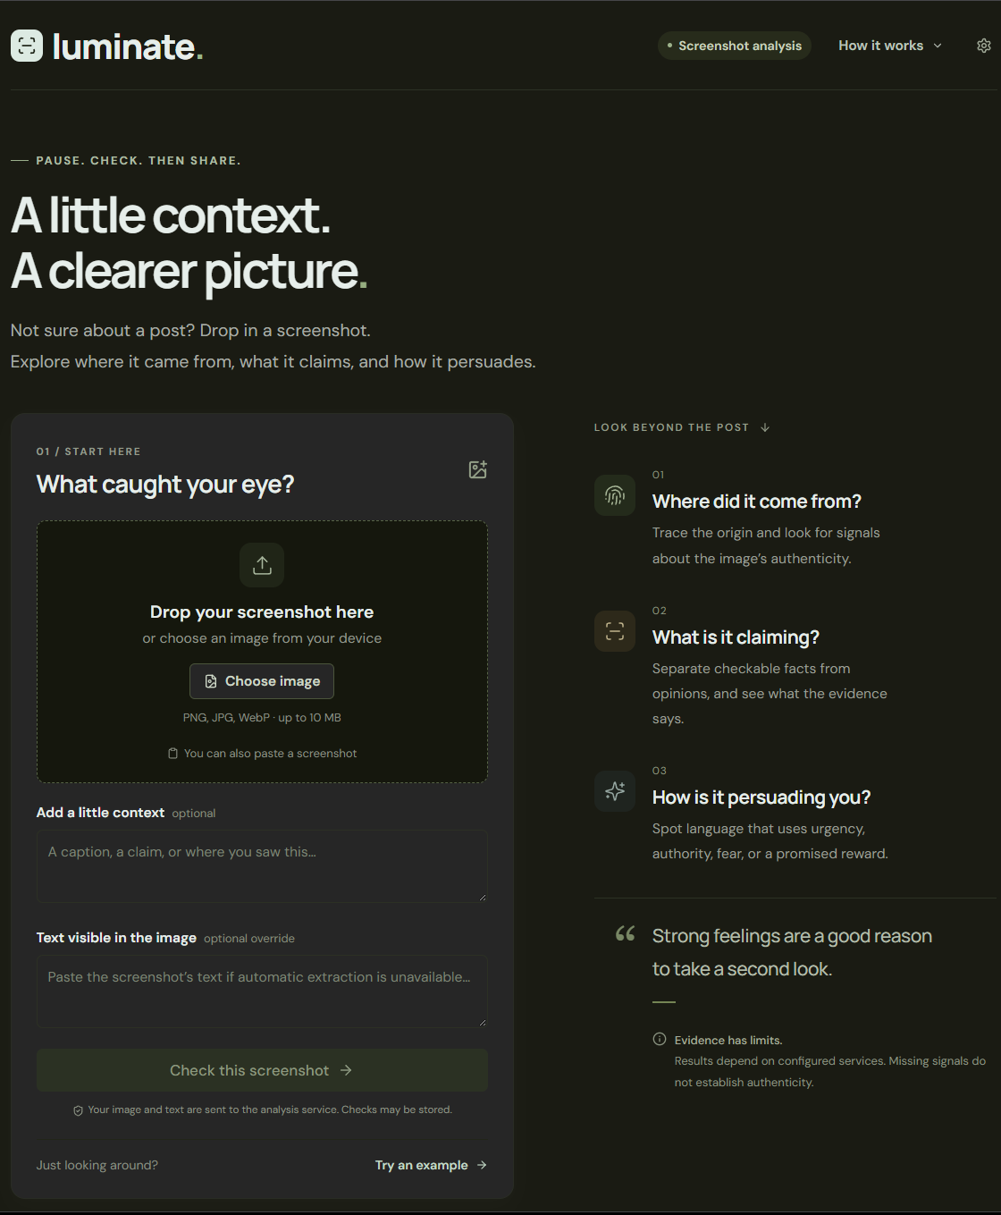
LUMINATE
04
Next: Luminate wherever posts travel
01
Mobile checking
Save or share a post to a standalone app.
02
Public-service bots
Bring evidence to high-attention posts on X and Reddit.
03
Better model choices
Test accuracy and speed across a wider model set.
Today’s screenshot workflow
is the foundation for mobile.
Notes:
Future plans, not launched functionality: standalone mobile checking using saved posts, screenshots or sharing into the app. Public-service X/Twitter and Reddit bots providing evidence on attention-grabbing posts. The repo contains a Reddit scaffold, not proof of a launched public service. Compare models on claim accuracy, false AI accusations on human content, context detection, citation quality, latency and cost. The screenshot shows the existing web product, not a finished native app.
Sources: README.md and src/factcheck/pipeline.py in https://github.com/Illuminare-AI/IlluminarePipeline. Product screenshots and hackathon context supplied by the team. Live services require configuration. Fake mode is the default local backend.

