Slide 1

Detection of mild depression based on multimodal data of electroencephalogram and eye movement tracking
基于脑电图与眼动追踪多模态数据检测轻度抑郁症
汇报人：舒XX、Illusionna
小组成员：赵XX、吴XX、舒XX、Illusionna
汇报时间：2026 年 4 月

Slide 2
Content
目录
01
Research background
02
Literature review
03
Classification
04
Issues, Gaps, Goals, logic, Significance
05
References

Slide 3
01
Research background

Slide 4

01
Research background
A Silent Struggle: How Do We See the Unseen?
(一场无声的挣扎：我们如何看见看不见的痛苦？)
Depression affects hundreds of millions, yet it often remains invisible.
Why is it so hard to detect accurately?
1

Slide 5




01
Research background
A Widespread Mental Health Crisis
According to the WHO, depression is a leading cause of disability worldwide, affecting an estimated 280 million people globally (as of 2023).
Mild Depression: A Hidden Epidemic
Often undiagnosed, mild symptoms significantly impair daily functioning and productivity, acting as a precursor to more severe depressive episodes.
Limitations of Traditional Diagnostic
Such as scale assessments and clinical interviews, rely heavily on subjective judgment and are prone to misdiagnosis and underdiagnosis.
2

Slide 6
01
Research background
Core Concepts:
Eye-Tracking Technology 眼动追踪：Non-invasive technology, reflects human cognitive and emotional processing, its features can reflect attentional biases in depressed patients. (Focuses on external cognitive behavior)
EEG (Electroencephalogram) 脑电图：Non-invasive technology, records brain electrical activity, serves as a reliable neural biomarker for depression detection, with higher sampling frequency. (Focuses on internal brain neural activity)
Multimodal Data Fusion (EEG + Eye-Tracking) 多模态数据融合：Combines the two non-invasive signals, complements their advantages, makes up for the one-sidedness of single-modal data, and provides more comprehensive information for depression detection.
3

Slide 7
02
Literature review

Slide 8
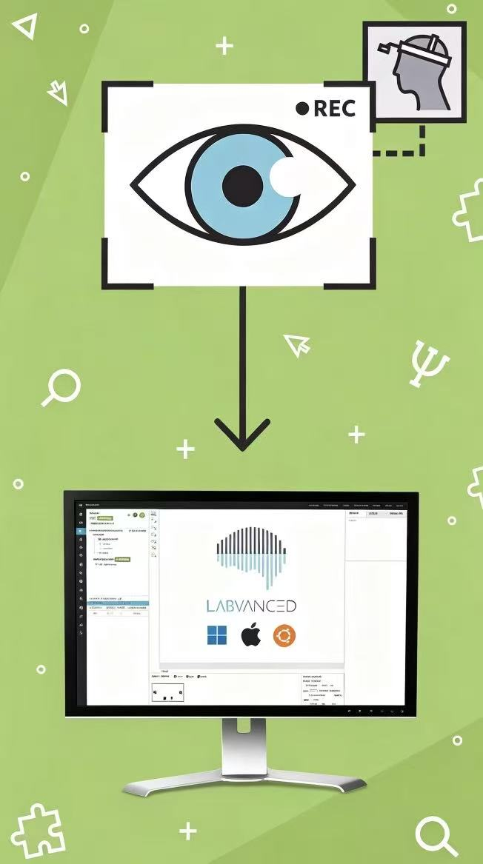
02
Literature review
Part 1：Eye tracking in Depression Detection
Source | Methods | Results and conclusions | Limitations
Alghowinem et al. (2013) | Analyzed eye movement features | Eye metrics reflect depressive attentional biases, laid foundation for eye-tracking in depression diagnosis | Qualitative analysis only, no deep learning
Stolicyn et al. (2022) | Developed a depression assessment system | Extracted facial/eye-tracking features, 79% accuracy via SVM | No mild depression classification, limited generalization
Yang et al. (2022) | Proposed spatiotemporal clustering algorithm | Identified ROIs via eye-tracking, 76.25% accuracy (89 participants) | Small sample, low sensitivity to mild depression
4

Slide 9
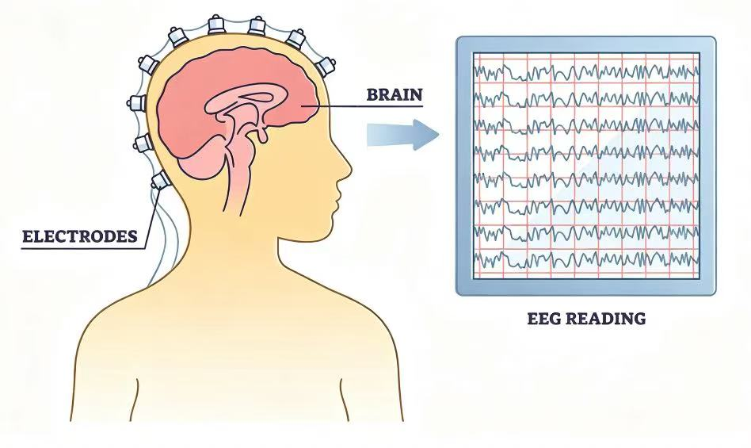
02
Literature review
Part 2：EEG in Depression Detection
Mahato & Paul (2020) classified depression and healthy subjects using EEG band features and SVM, achieving 88.33% accuracy.
Limitation: traditional machine learning, manual feature extraction
Deep Learning
Deep learning extracts features automatically and effectively.
Yin et al. (2023) proposed a Transformer-CNN hybrid model that outperforms existing methods.
Tigga & Garg (2023) introduced an attention-based Transformer model, achieving 98.67% accuracy in depression detection.
5

Slide 10

02
Literature review
➡ ️With the rise of multimodal biomedical data, Data fusion is increasingly applied.
Ding et al. (2019) classified major depression using EEG, eye tracking and GSR data, achieving an accuracy of 79.63%.
Zhu et al. (2019) proposed a content-based ensemble method to fuse EEG and eye tracking data, validating its effectiveness in identifying depressed patients. The fused information is more complex and comprehensive than original single-modal data.
Limitations: While existing methods perform well, most rely on single-modal data and cannot fully capture the complex pathology of depression.Multimodal fusion remains preliminary, lacking effective strategies for EEG and eye tracking.
6

Slide 11
03
Classification

Slide 12
03
Research Topic Classification
Primary discipline
Biomedical Engineering
Biomedical Signal Processing
Secondary discipline
Biomedical Engineering
Multimodal Data Fusion
Affective Computing
Brain-Computer Interface
Multimodal Data Fusion
Tertiary research direction
Intelligent Depression Detection
Deep Learning
Transformer Model
Joint Analysis of EEG and Eye Tracking
Intelligent Depression Detection
Objective auxiliary diagnosis of mild depression in adolescents
7

Slide 13
04
Issues, Gaps, Goals, logic, Significance

Slide 14


04
Research issues
Primary Question
How can we objectively and accurately detect mild depression in adolescents using non-invasive biological signals?
Technical Question
What is the most effective deep learning architecture and fusion stage (early, intermediate, or late) to integrate heterogeneous multimodal data (EEG and Eye Tracking) for depression detection?
8

Slide 15



04
Research gaps
overcome the limitations of single-mode data in capturing physiological signal characteristics.
the difference between attention maps generated by deep learning models (e.g., Transformers) and actual human visual attention mechanisms has not been thoroughly investigated in the context of depression detection
there is a lack of systematic comparison and optimization of fusion strategies (feature-based vs. deep learning fusion) and fusion stages (early, intermediate, late) specifically for depression detection.
9

Slide 16
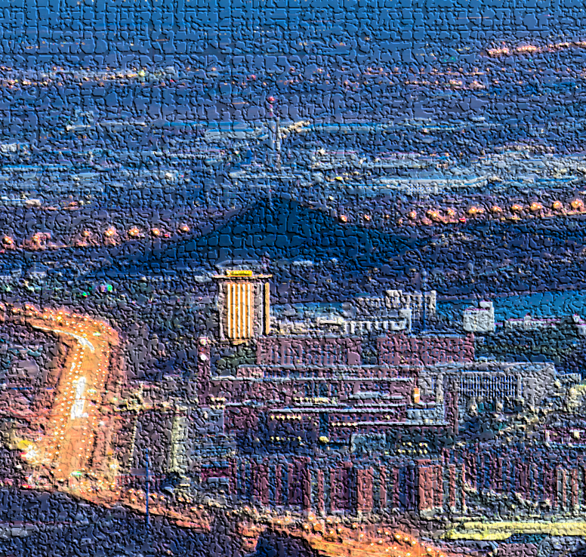
04
Research goals
Platform Development
To develop a multimodal signal acquisition platform to investigate visual attention and cognitive brain activities.
Model Innovation
To propose a novel Multimodal Transformer Network (MTNet) to capture local and global spatio-temporal characteristics of EEG and eye-tracking data.
Strategy Evaluation
To evaluate and compare the impact of different fusion stages (early, intermediate, and late) on depression classification performance.
10

Slide 17
04
Research Logical Structure
Problem-driven → Method design → Experiment verification
Ⅰ. Problem-driven
The diagnosis of depression is highly subjective.
It is necessary to search for objective and non-invasive biological signal indicators
Ⅱ. Method design
Multimodal fusion (EEG + eye tracking)
Limitations of single modality
Data acquisition & preprocessing (49 adolescents)
Traditional ML (handcrafted features + SVM etc.)
Deep learning MTNet (Transformer + multimodal)
Method design:
Ⅲ. Experiment verification
49 teenagers (21 with mild depression + 28 healthy controls) participated in the driving attention paradigm (with sudden driver/vehicle collision).
Deep learning model (MTNet):
EEG branch
Eye tracking branch
Fusion
11

Slide 18




04
Research significance
Clinical Value
Provides an objective, comprehensive, and accurate biological indicator for the prompt detection of adolescent mild depression.
Methodological Breakthrough
Demonstrates that the proposed MTNet achieves a state-of-the-art accuracy of 91.79%.
Fusion Stage Insight
Proves that intermediate fusion in DP is superior for processing heterogeneous multimodal data, effectively capturing interactions between modal features.
12

Slide 19
05
References

Slide 20
05
References
Das, Abhishek, et al. "Human attention in visual question answering: Do humans and deep networks look at the same regions?." Computer Vision and Image Understanding 163 (2017): 90-100.
Chlasta, Karol, et al. "AI-Based Screening for Depression and Social Anxiety Through Eye Tracking: An Exploratory Study." arXiv preprint arXiv:2503.17625 (2025).
Zhu, Jing, et al. "An improved classification model for depression detection using EEG and eye tracking data." IEEE transactions on nanobioscience 19.3 (2020): 527-537.
Zheng, Zhiguo, et al. "Diagnosing and tracking depression based on eye movement in response to virtual reality." Frontiers in Psychiatry 15 (2024): 1280935.
Lee, S., S. Kim, and K. M. Lee. "Depression detection using virtual avatar communication and eye tracking." Frontiers in Psychiatry 13 (2022): 10699095.
Zhu, Jing, et al. "Multimodal mild depression recognition based on EEG-EM synchronization acquisition network." IEEE Access 7 (2019): 28196-28210.
Zhu, Jing, et al. "Transformer-based fusion model for mild depression recognition with EEG and pupil area signals." Medical & Biological Engineering & Computing 63.7 (2025): 2011-2027.
Stolicyn, A., J. D. Steele, and P. Seriès. "Prediction of depression symptoms in individual subjects with face and eye movement tracking." Psychological Medicine 52.9 (2022): 1784-1792.
Yang, M., et al. "Clustering based on eye tracking data for depression recognition." IEEE Transactions on Cognitive and Developmental Systems (2022).
Mahato, S., and S. Paul. "Classification of depression patients and normal subjects based on electroencephalogram (EEG) signal using alpha power and theta asymmetry." Journal of Medical Systems 44 (2020): 1-8.
11. Yin, F., et al. "Depression detection in speech using transformer and parallel convolutional neural networks." Electronics 12.2 (2023): 328.
Tigga, N. P., and S. Garg. "Efficacy of novel attention-based gated recurrent units transformer for depression detection using electroencephalogram signals." Health Information Science and Systems 11.1 (2023): 1-17.
Ding, X., et al. "Classifying major depression patients and healthy controls using EEG, eye tracking and galvanic skin response data." Journal of Affective Disorders 251 (2019): 156-161.
Zhu, J., et al. "Toward depression recognition using EEG and eye tracking: an ensemble classification model CBEM." 2019 IEEE International Conference on Bioinformatics and Biomedicine (BIBM). IEEE, 2019.

Slide 21
Thank you for listening!

