Slide 1
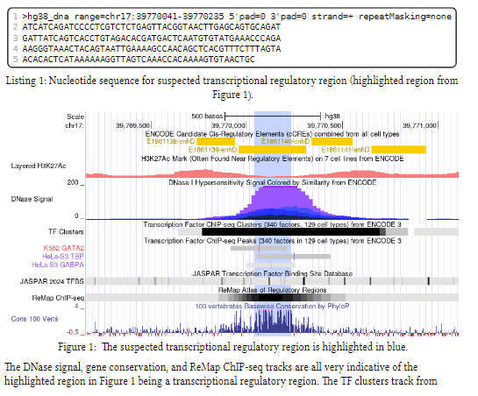
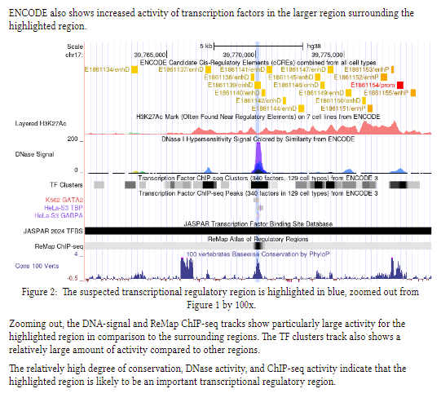

Slide 2
2 (2 points). True or False: TF binding site de novo motif enrichment analysis can be used to predict individual binding sites within a single promoter sequence. A. True B. False
3 (3 points). Which of the following lists describes types of widely used computational models that have been developed for measuring and predicting TF binding to DNA? A. PPIs, logos, and MPRAs B. MWMs, AUROCs, and inverted matrices C. PFMs/PWMs, k-mers, and dinucleotide matrices D. None of the above

