Slide 1
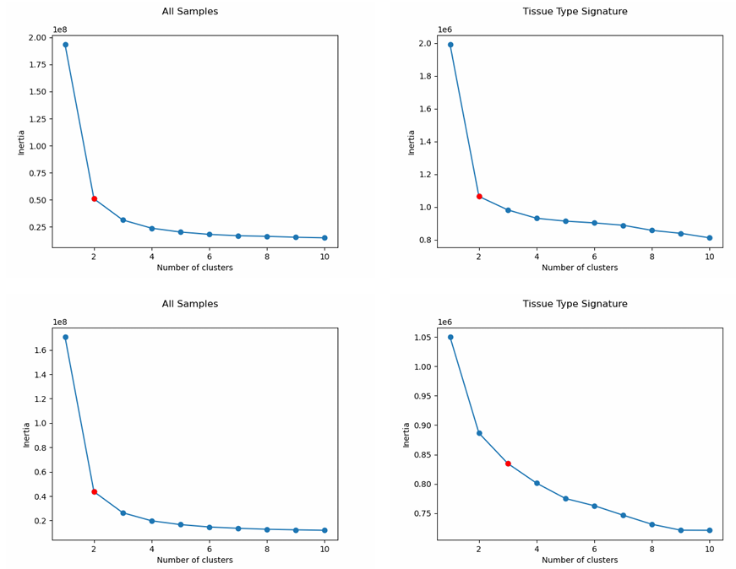
K-Means
Top Row: Cancer + non-cancer samples
Bottom Row: Only Cancer samples
Tissue type signature:
Tumor vs Non-tumor
Unstable clustering depending on random state
Notes:
Identifying the ideal number of clusters is important as it directly relates to molecular subtype, and therefore, potential treatments. Both k-means and the method used in the paper are linear unsupervised clustering techniques, meaning that they cannot identify non-linear relationships in data (can’t cut it with a line or hyperplane). Here we see that the clustering for the signature for differentially expressed genes is unstable, likely meaning that the separation between different clustering does not fit the assumptions of k-means, one of which is linear separation. Conversely, the bottom-right plot does agree with other literature.

Slide 2
