Slide 1
Unblind Your Apps: Predicting Natural-Language Labels for Mobile GUI Components by Deep Learning
Jieshan Chen, Chunyang Chen, Zhenchang Xing, Xiwei Xu, Liming Zhu, Guoqiang Li, Jinshui Wang
Research School of Computer Science
College of Engineering & Computer Science
The Australian National University
Canberra, Australia

Slide 2
MOTIVATION
Mobile application
Access a wide variety of services, such as Shopping, Reading, Chatting
Many apps remain difficult or impossible for people with disabilities
World Health Organization
Approximately 1.3 billion people live with some form of vision impairment globally, of whom 36 million are blind.
More eager to use the mobile apps to enrich their lives, as they need those apps to represent their eyes.

Slide 3
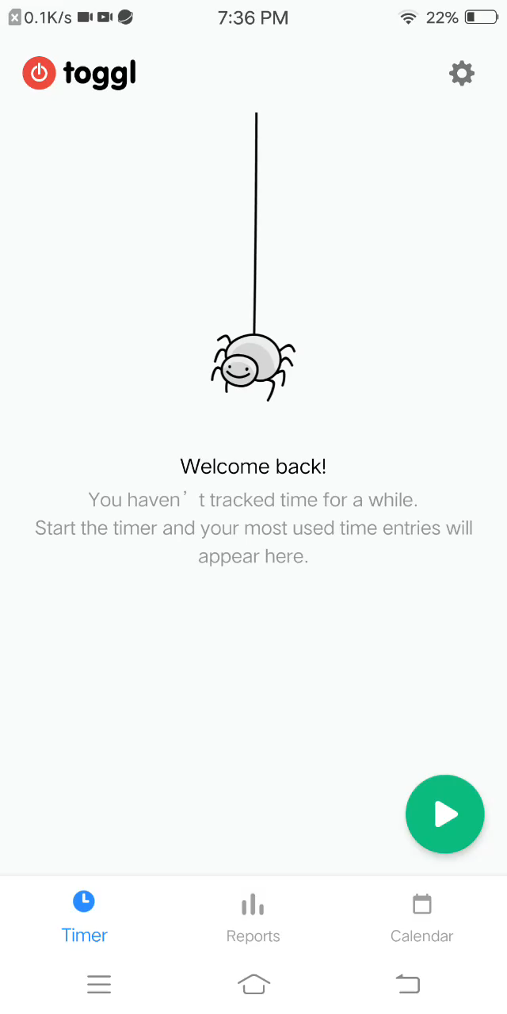
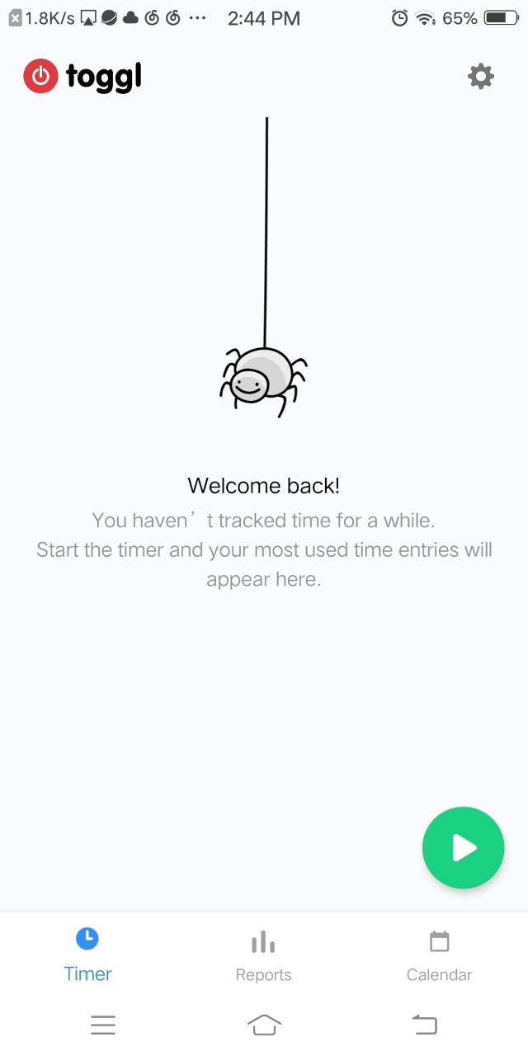
MOTIVATION
Setting, double tab to activate
Screen Reader (e.g. TalkBack, VoiceOver)
- Allow users to explore the views
- Read out the text/content-description
Image-based buttons: important Proxies for interactions
Without labels for image-based buttons
- Try and guess
- Stop using this app
Unlabeled, Button, double tab to activate

Slide 4
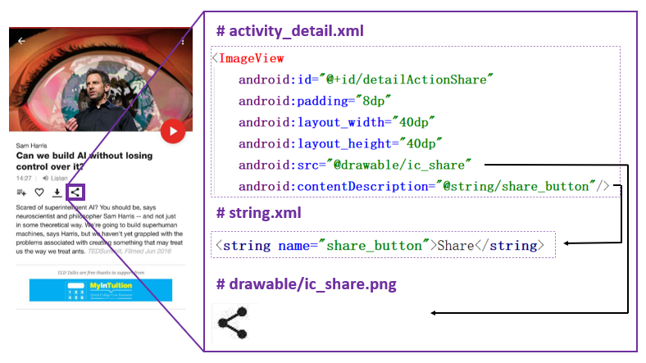
MOTIVATION

Slide 5
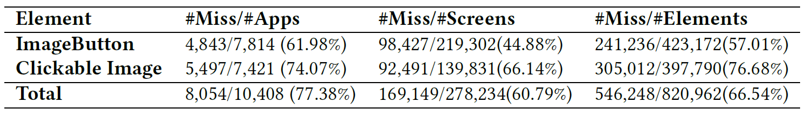
MOTIVATIONAL MINING STUDY
10,408 Android apps from Google Play Store
Screenshots and corresponding xml runtime code
Xml file contains bounds, type and content description.
More than 77% apps have issues of missing labels
Developers may not care about the content descriptions

Slide 6
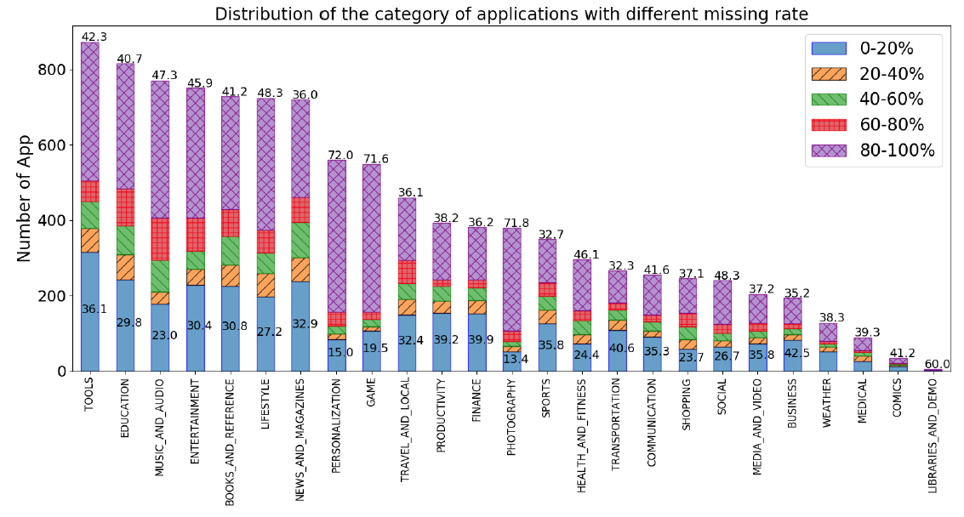
MOTIVATION

Slide 7
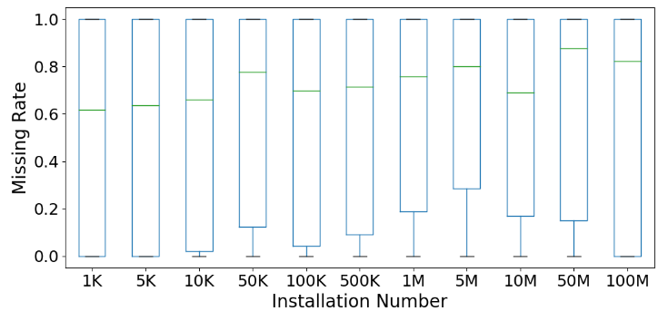
MOTIVATION
Spearman rank-order correlation: 0.046

Slide 8
MOTIVATION
Current accessibility issues are severe, and it is common among all categories and all apps with different popularity
Developers may not care about the accessibility issue

Slide 9
MOTIVATION – LabelDroid
Complete labels of image-based buttons for current applications with minor efforts
Assist developers in efficiently filling in the content descriptions of image-based buttons

Slide 10
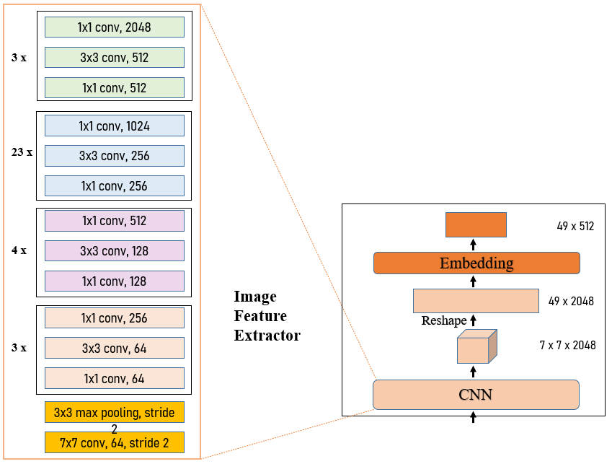
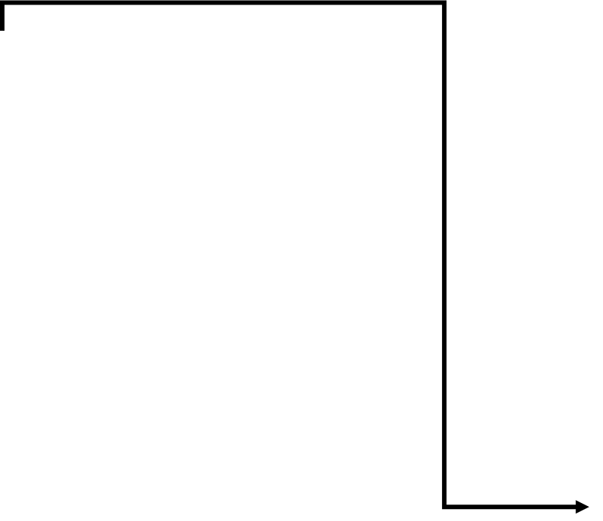
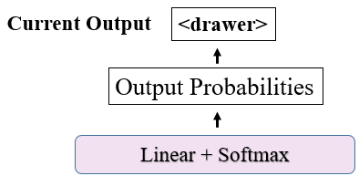
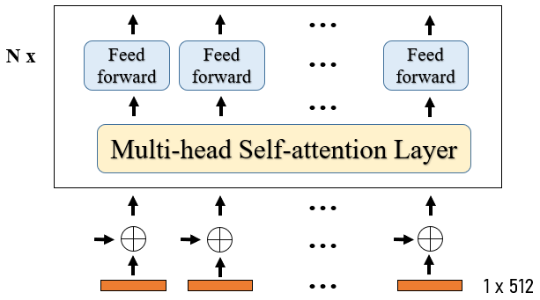
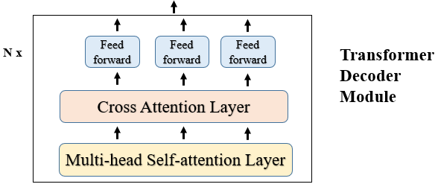
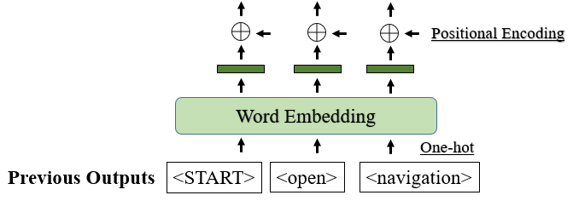
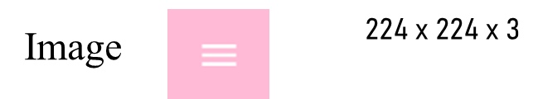
OUR APPROACH
Transformer
Encoder
Module
Positional Encoding
Row 0
Row 1
Row 48

Slide 11
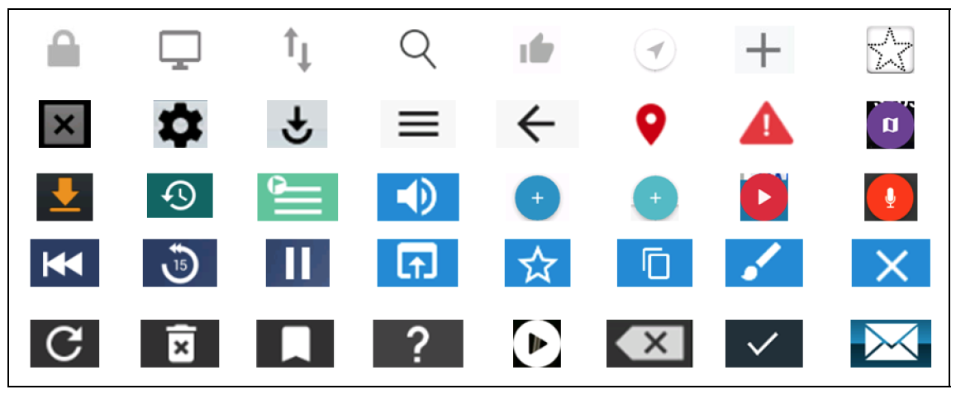
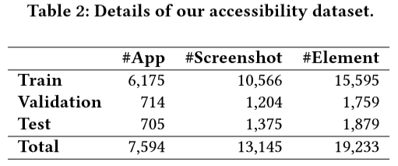
DATASET
Like the tweet
Refresh
Backspace

Slide 12
RESEARCH QUESTIONS
Accuracy
How accurate is our model compared with existing methods?
Generalization & Usefulness
How well does our model perform compared with the junior developers? Does it really useful?

Slide 13
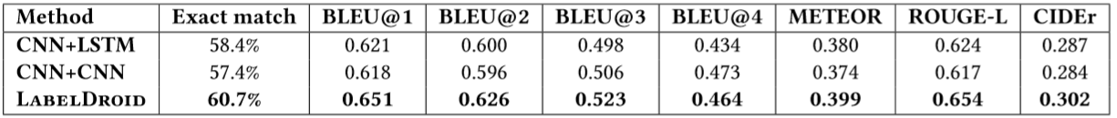
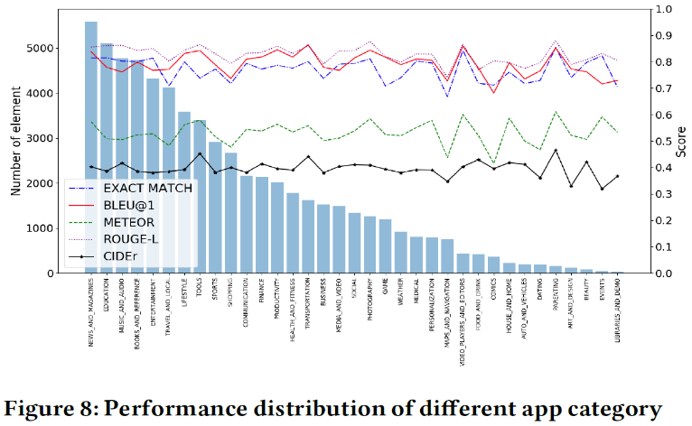
ACCURACY
Our method outperforms in all metrics
Gains about 2% to 11.3% increase
Our model is robust to apps from different categories
Performance among different categories

Slide 14
GENERALIZATION & USEFULNESS
Randomly select 12 apps with 100% missing rate → 156 image-based buttons
at least 1M installations
at least 15 screenshots
Participates
Three Annotators (A1, A2, A3) & Our model (M): to create labels
One Evaluator: to rate the labels
Metric
Acceptability score (AS) : 5-point Likert scale

Slide 15
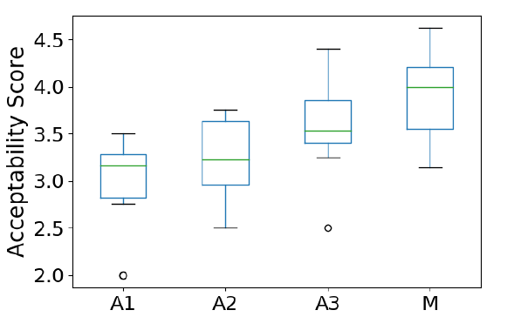
GENERALIZATION & USEFULNESS
The quality of content description from our model is higher than that from junior Android app developers.

Slide 16
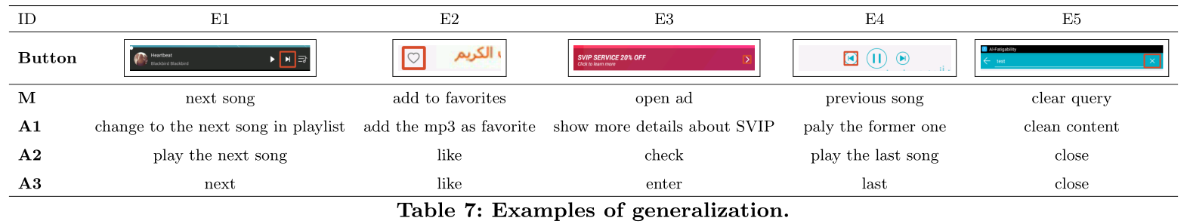
Generalization & Usefulness
Long label – too verbose (E1-A1,E2-A1)
Too short – without enough information (E2-A2/A3)
Ambiguous Label (E4 – A2/3)
Mistakes (E5 – A2/A3)
Not be aware of how to add concise, easy-to-understand descriptions

Slide 17
FUTURE WORKS
Take the app metadata into the consideration
Improve the quality
One image-based button may have different labels in different contexts
Test the quality of existing labels by checking if the description is concise and informative

Slide 18
Thank you
Jieshan Chen
Email: Jieshan.Chen@anu.edu.au
GitHub: https://github.com/chenjshnn/LabelDroid

