Slide 1

Digital Government
Attributes and Visions
Kimberly Stoltzfus, Department of Communication

Slide 2

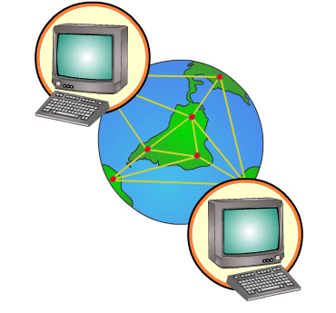
digital government overview
The use of Internet Communication Technology (ICT) by governmental institutions (local, state, national) to improve information sharing, dialogue, service and transactional processes with its stakeholders

Slide 3

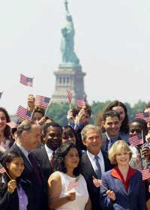


digital government overview (cont.)
There are four levels:
  G2C (Gov’t to Citizen)
GTB (Gov’t to Business)
  GTG (Gov’t to Gov’t)

Slide 4
digital government overview (cont.)
There are four levels (cont):
  IEE (Internal Efficiency and Effectiveness)

Slide 5
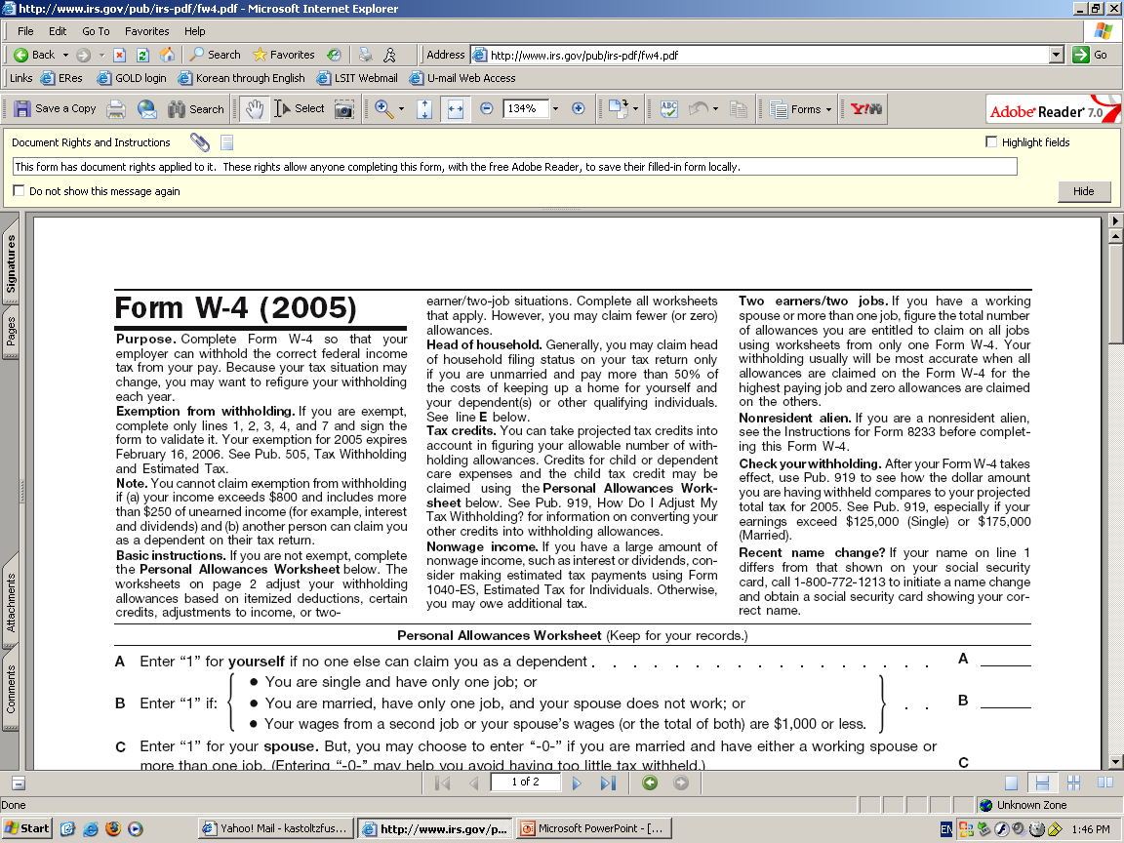
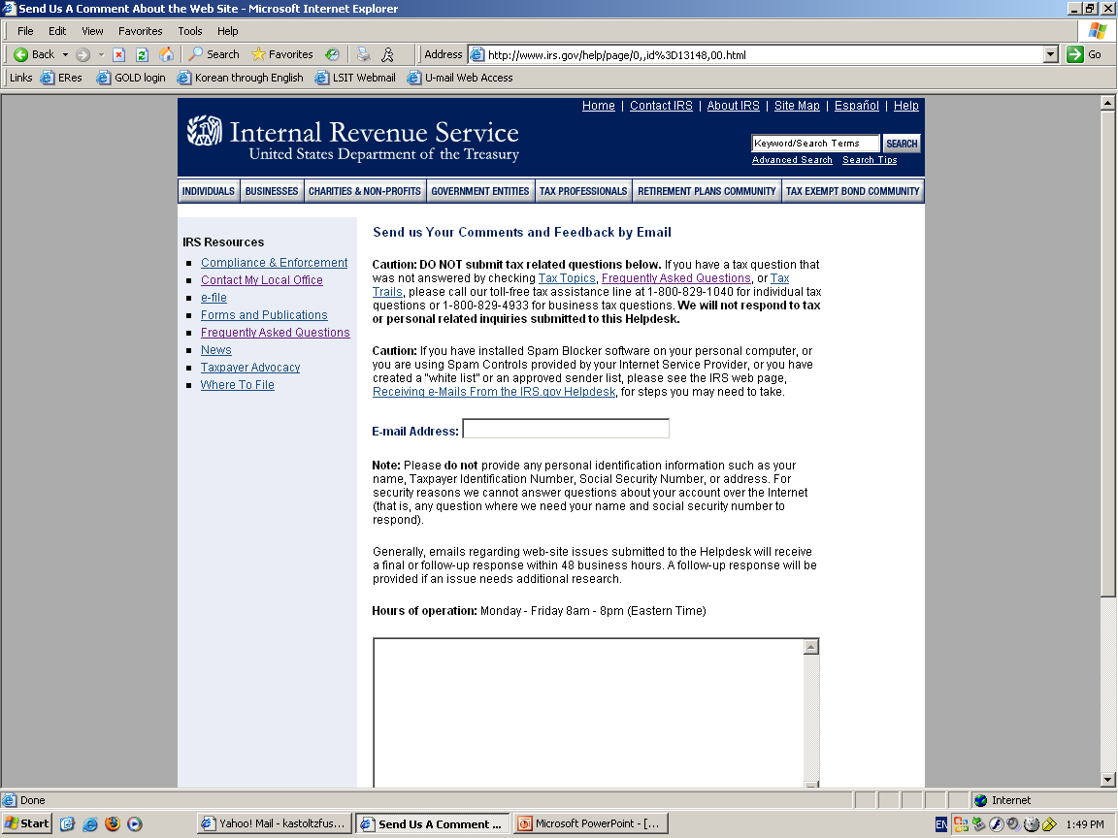
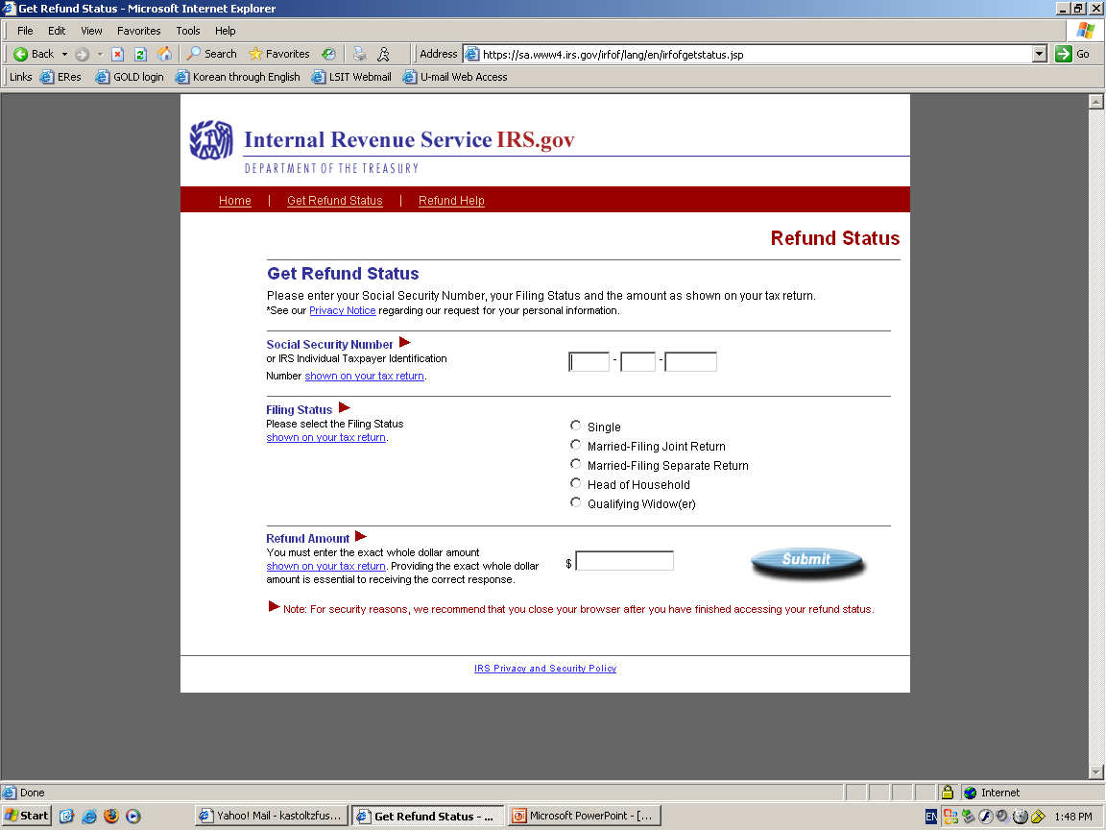
digital government overview (cont.)
There are three basic phases:
  Publish (e.g., info – one way)
  Interact (e.g., comment form, online forums)
  Transact (e.g., online services)

Slide 6

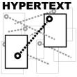



digital government overview (cont.) – U.S. timeline
1970s/80s
PC boom
Research by Kraemer, King and Dutton note that gov’t is unable to keep up with technology
1991
www released by Lee
Gopher created
Internet use by individuals
Mid 1993-1995
National Partnership for Reinventing Government
Web is commercialized
Whitehouse goes online (1993)
USNIIA Act (1993)
1996 - 2000
Clinger-Cohen Act – changed acquisition laws and IT management (1996)
E-gov as “capital investment”
First.gov launched (2000)
2002 - 2004
E-government Act of 2002
Development of Federal Enterprise Architecture Plan
E-Authentication (2004)

Slide 7
digital government overview (cont.)
Just some examples:
  e-filing
  community collaboration
  crisis management
  e-voting
  customer relationship management
  eco-informatics
  e-rulemaking

Slide 8
U.S. federal digital government
A good case study (GTC, GTB, GTG, and also transact level):
Internal Revenue Service’s Business Systems Modernization
http://www.irs.gov/newsroom/article/0,,id=98159,00.html
  1999 to present
  Antiquated technology from Kennedy Admin
  Two prior failed modernization efforts
  New effort emphasizes partnerships
  Multi-billion, multi-year program affecting everyone!
  Info Tech and Improvement Account (ITIA) created

Slide 9


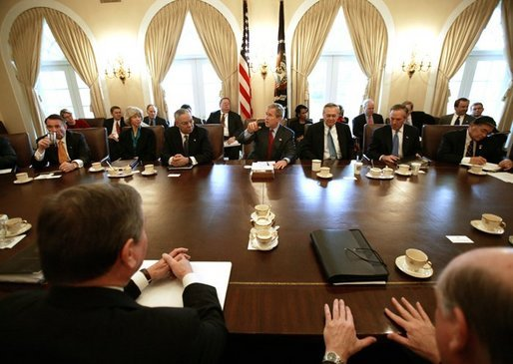






major federal gov’t players
Congress
GAO – General Accountability Office
OMB – Office of Management and Budget
Agency leadership: CIO is tech lead; Secretary/Commissioner is business lead
Consulting firms: CSC, IBM, BearingPoint, Accenture, SAIC, Lockheed Martin

Slide 10
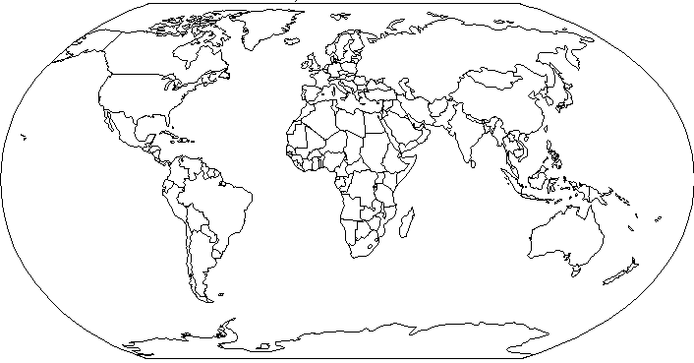
global examples
Canada: Numerous services
http://www.canada.gc.ca/
Italy: Encouraging citizen discussion
  http://www.comune.bologna.it
Pakistan: Report a crime
http://www.punjab.gov.pk
INDIA: Posts court records, case info
  http://indiancourts.nic.in/itinjud.htm

Slide 11
cited benefits
For citizens:
One stop shop
More government transparency
Easier access to information
Convenience
For government organizations:
Cost savings
Instant access to information
More challenging/interesting work
Congress is happy

Slide 12

“successful” digital government
National rankings (Brown University, 2005): http://www.brown.edu/Administration/News_Bureau/2005-06/05-023.html
International rankings: http://www.brown.edu/Administration/News_Bureau/2005-06/05-024.html
Accenture 2004 rankings: Canada’s #1
No standard benchmarking for “success”
Gartner – 60% will fail this year

Slide 13
some problems with U.S. federal digital gov’t
Not knowing the difference between project and endeavor – Gartner
Not getting enough middle managers involved in decision-making – GAO
Not having enough staff who understands the technology – Gov’t CIOs
Bad partnering - Everyone
Not focusing on internal communication efforts - Kim

Slide 14

the future of digital gov’t
M-government: Mobile Government
System: Combination of portable mobile devices and wireless Internet access
Devices: PDAs*, cellphones, BlackBerry, Tablet PC
Wireless: Cellular, Wi-Fi, Bluetooth, Satellite, Infrared (IR)

Slide 15
the future of digital gov’t
U.S. (G2C):
    Commonwealth of VA: Tracking election returns via PDA
    Iowa: Parking day SMS
    Seattle: GPS system Mobile Traffic Map
  (G2G):
    San Francisco: Wi-Fi Police Networks
    U.S. Navy: Field Inspections (PDA)
    Texas: Tax information (Tablet PC)

Slide 16
the technology and society perspective – some questions
GLOBAL:
What are the decision-making criteria for pursuing e-government?
Does Internet transform gov’t (i.e., democracy) or just re-create what already exists?
LOCAL/COMMUNITY/NATIONAL:
So, what happens to all those emails and comments that are sent?
Will control of dialogue change?
Will we be more trusting of government?

