Slide 1
I. Glavatskyi @ Ironhack Mid BootCamp Project „Credit card customers classification“
Extracting criteria for acceptance of the credit card offer to better target the banks politics and identify potential customers
Uses: Python.Pandas, SQL, Matplotlib, Seaborn, Numpy, Getpass, SQLAlchemy

Slide 2
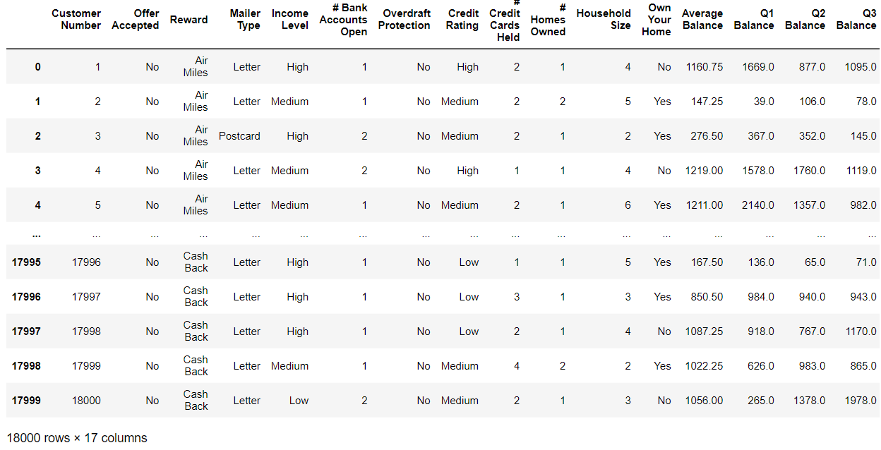
Data overview:

Slide 3
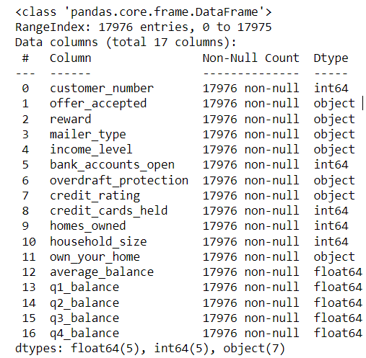
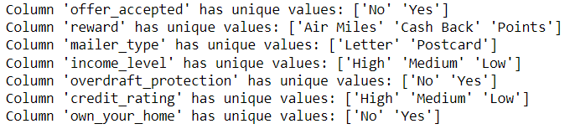
Initial preparation
nan_percentage = (df.isna().sum() / len(df)) * 100 -> average_balance 0.13% - Dropped.
Checked column types and adjusted to proper ->
Created the DB with a table and dropped irrelevant data (Q4 balance)
Checked the values of ordinal columns to ensure if standardization is necessary: unique_values_per_column = {column: df[column].unique() for column in df.select_dtypes(include=['object']).columns}

Slide 4

Investigating the data
#10.1 Average Balance of All Customers by Income: [('High', 942.6), ('Medium', 940.9), ('Low', 937.7)] – difference neglectable
#10.2 Average balance of customers grouped by Income Level: Average Balance of All Customers by # Bank Accs: [(1, 941.5), (2, 936.5), (3, 948.3)] - insignificant
#10.3 Average balance of customers grouped by Income Level: Average Balance of All Customers by # Bank Accs: [(1, 941.5), (2, 936.5), (3, 948.3)] – insignificant
Selected a view of customers with the following properties: (4949 rows × 17 columns)
- Credit rating medium or high &
- Credit cards held 2 or less &
- Owns their own home &
- Household size 3 or more
And selected customers whose average balance is less than that of all the customers in the database:
query = f"""SELECT * FROM {table_name}
WHERE (credit_rating = 'Medium' OR credit_rating = 'High') AND
credit_cards_held <= 2 AND
own_your_home = 'Yes' AND
household_size >= 3 AND
average_balance < (SELECT AVG(average_balance)
FROM {table_name});"""

Slide 5
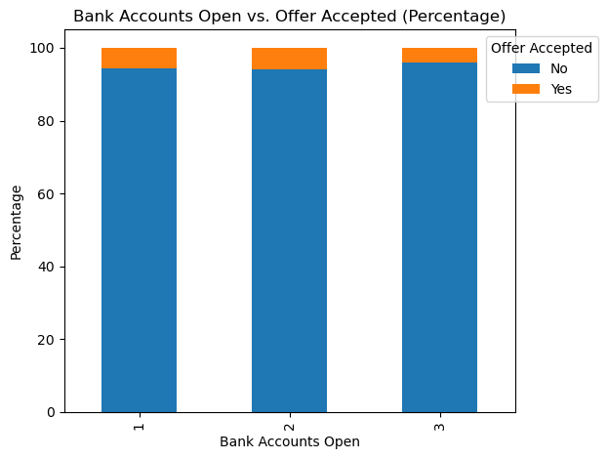
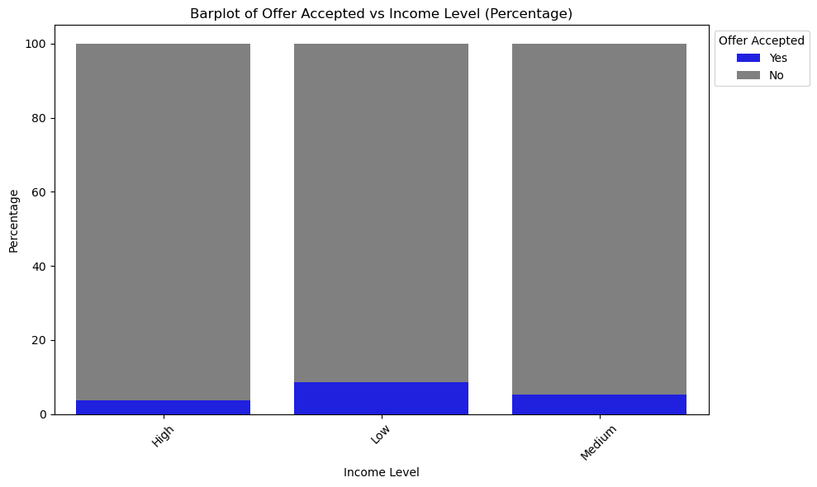
Find out credit card acceptance criteria
Filter only those accepted: df_accepted = df[df["offer_accepted"]=="Yes"] # 1021 entries
Customers with medium-high ratings have clearly more money on the balance, as expected
Communication is important: among the customers who accepted the offer, 721 were addressed by Postcards, while 300 by Letter.

