Slide 1

Urban Foods
Fresh. Local. Everyday Essentials

Slide 2
Table of contents
01
02
03
04
05
Introduction
Front-End and Back-End
Technologies Used
06
ER-Diagram
RDBMS Vs
NoSQL
Conclusion

Slide 3
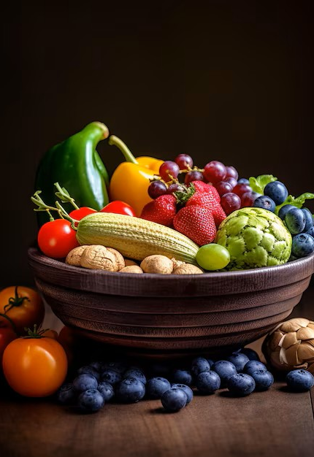
Introduction
An online grocery store which allows customers to order items and provide delivery services.
Admin can manage customers, suppliers, products, delivery, payments to make sure everything works smoothly.

Slide 4






Technologies used
Front-End
HTML5
CSS
PHP
JavaScript
Back-End
Oracle
MongoDB

Slide 5
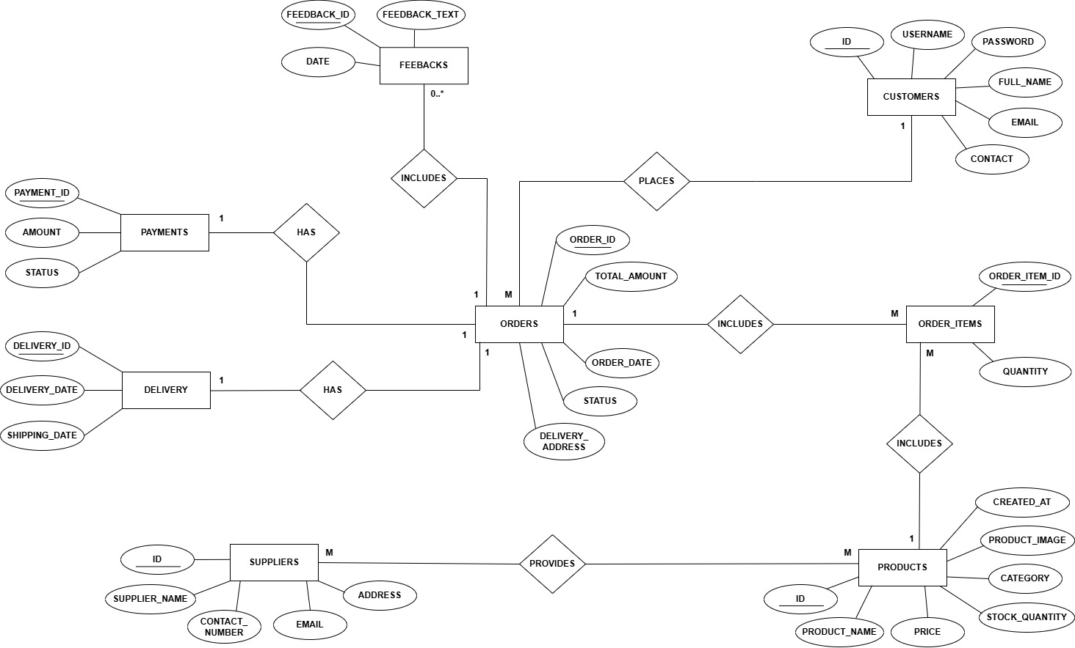
ER-Diagram

Slide 6
Strengths and weaknesses of RDBMS and NoSQL
 | Strengths | Weaknesses
RDBMS | Supports advnaced SQL queries Best for structured data | Not suitable for fast changing data Less flexible when changing requirements
NoSQL | Schema-less therefore easy to modify Works well with fast changing data | Not ideal for complex transactions Does not use standard SQL

Slide 7
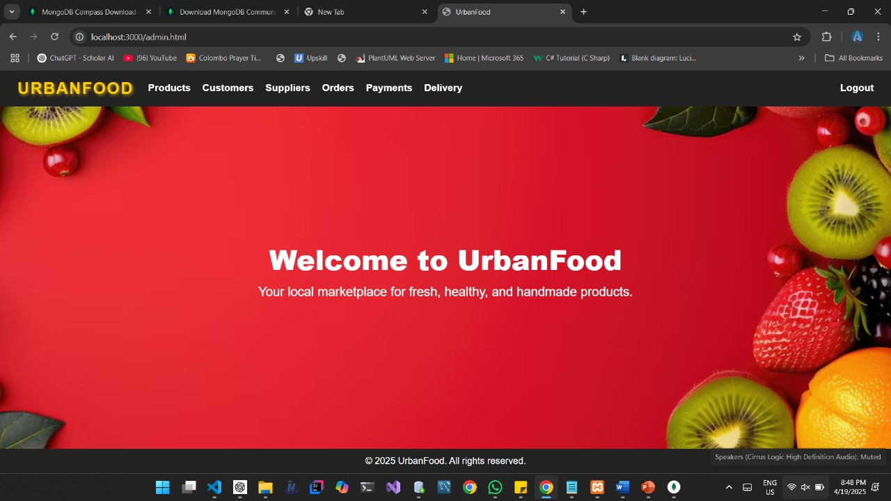
Front-End and Back-End
Front-End
Implemented using HTML, JS, PHP
Back-End
Implemented using Oracle, MongoDB

Slide 8

Conclusion
Our e-commerce website offers a smooth, secure, and user-friendly shopping experience.
It combines modern design, efficient functionality, and responsive features to meet customer needs.

Slide 9
Thanks!
A Project by Group-11

