Slide 1
LMS Usage at NIBM
A Statistical Analysis

Slide 2
Group Members
ILMA M H F COHNDSE242F-041
AZWARD M A COHNDSE242F-042
ISHINI B G U COHNDSE242F-092
JAYAMANNE S D COHNDSE242F-104
CHATHAMA M A L COHNDSE242F-114

Slide 3
Introduction
Why are we using LMS?
Why analyze LMS usage patterns
among students?
We are using a Learning Management System (LMS) to make learning more accessible, organized, and efficient.
It allows students to access course content, submit assignments, and communicate with instructors—all in one place.
Identify engagement trends – Analyzing LMS usage helps track how actively students participate, enabling early support for those falling behind.
Improve course content – Usage patterns reveal which materials are most engaging, guiding educators to refine and enhance course design.

Slide 4
Conceptual Framewrok
Independent Variables:
Demographics Information
Usage Trends
Technical Issues and Challenges
Security & Privacy
Dependent Variables:
User Adoption, Satisfaction and Improvement
Demographic Information
Usage Trends
User Adoption, Satisfaction & Improvements
Technical Issues & Challenges
Security &
Privacy

Slide 5
Methodology
Sampling & Data Collection
Target Population
Undergraduate students currently enrolled at the National Institute of Business Management (NIBM) who are actively using the Learning Management System (LMS) as part of their academic routine.
Sampling Technique
Stratified sampling method is used to collect data from students at the National Institute of Business Management (NIBM). This technique was chosen to ensure that the sample accurately represents different segments of the student population.

Slide 6
Methodology
Sampling & Data Collection
Sample Size
40 NIBM Students
Data Collection
Questionnaire survey administered manually to undergraduate students at
NIBM

Slide 7
Methodology
Statistical Methods
Descriptive Statistics
Correlation Analysis
Regression Analysis
T-test

Slide 8
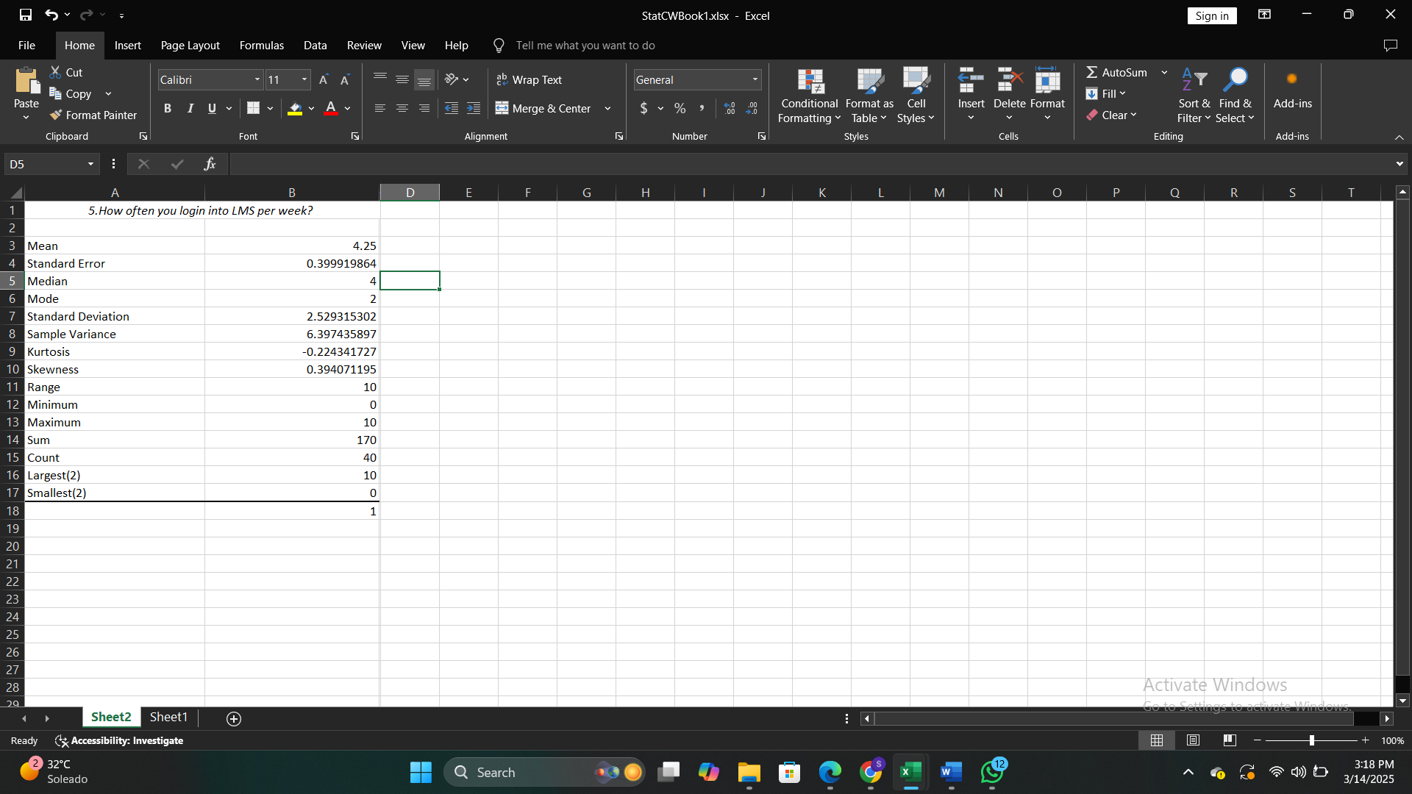
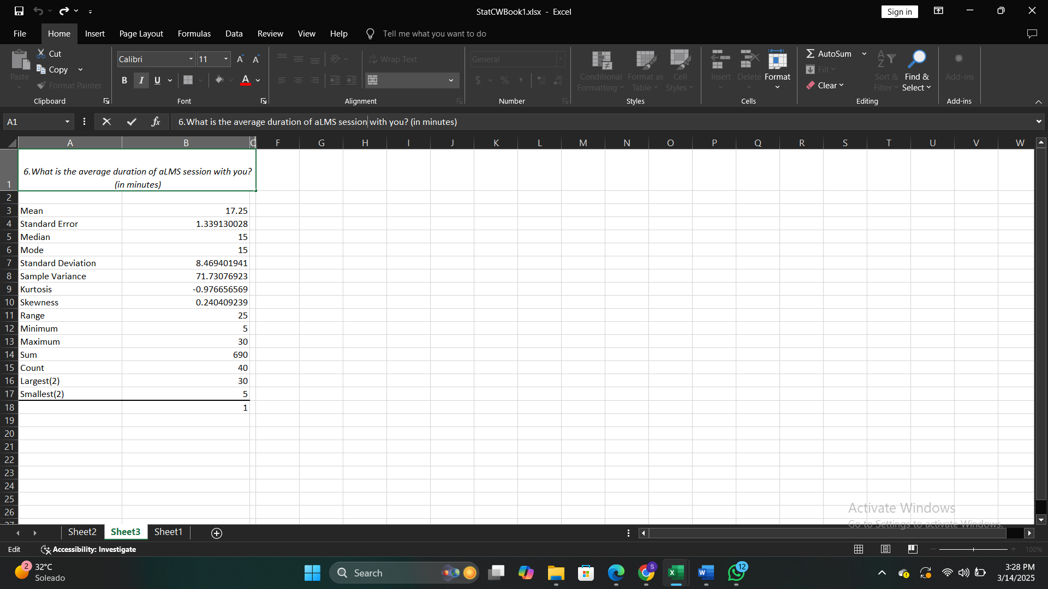
Descriptive Statistics
How often you login to LMS per week?
What is the average duration of LMS
session with you?

Slide 9
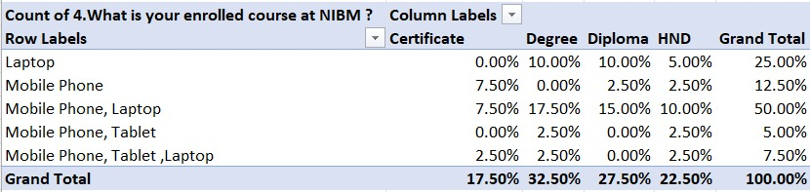
Correlation Analysis
Relationship between enrolled course at NIBM and which devices used to access LMS.

Slide 10
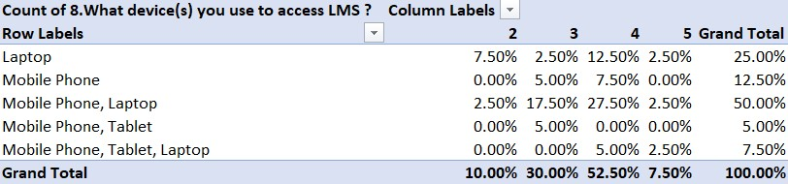
Correlation Analysis
Relationship between devices used to access LMS and ease of navigation on LMS.

Slide 11
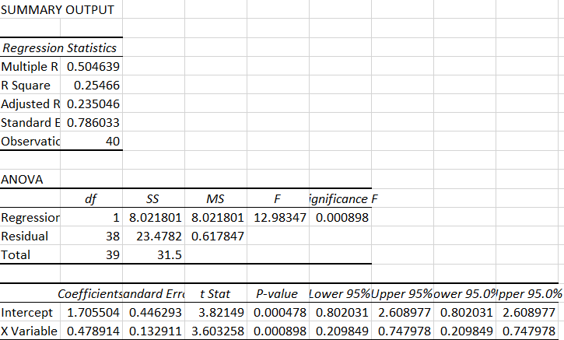
Regression Analysis
Average LMS session duration Vs Loading speed rating
Y-Satisfaction with LMS interface(Q11)
X-How would you rank the LMS when it comes to loading speeds(Q10)

Slide 12
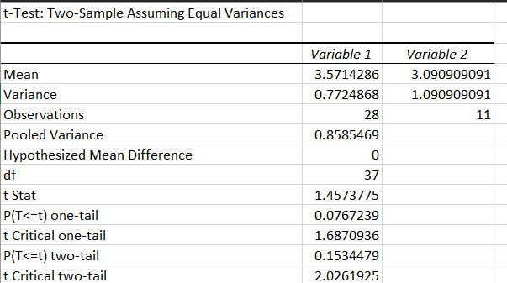
T-test
Check whether easy navigation score have relationship with prior experience.
H0: There is no association between easy navigation and prior experience.
H1: There is an association between easy navigation and prior experience.

Slide 13
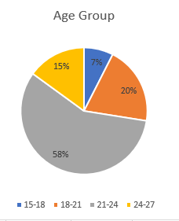
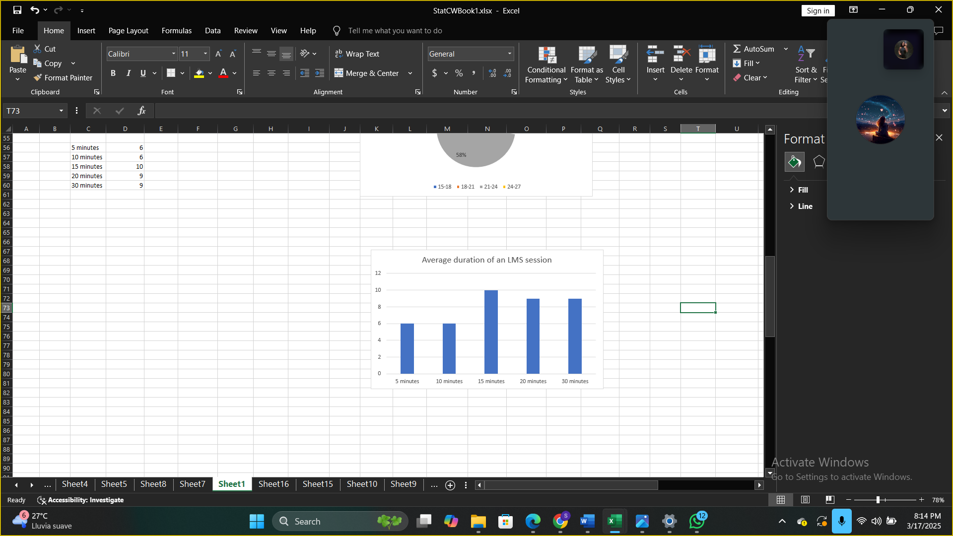
Descriptive Statistics Graphs
A Pie Chart
A Simple Bar Graph

Slide 14
Recommendations and Challenges
Recommendations | Challenges
Improve server performance and loading speed | Complicated User Interface and Navigation
Redesign UI add features like dark mode | Security of Data
AI chat bot for support | Login Issues
Notifications, offline access & multi language support | Lack of AI support

Slide 15
Conclusion
This study identified key factors that influence the adoption and effective use of the LMS at NIBM, including accessibility, technical performance, and user experience while students actively use the system. The findings highlight the need for continuous improvements in LMS to meet student needs and enhance the overall learning experience.

Slide 16
Thanks!

