Slide 1
The Pet Robot
"Next-Gen Pets, Powered by Robotics."

Slide 2
Table of Contents
1
3
2
4
Introduction
Components
Why we decided to implement?
What was required to build the robot?
Functions
3D Model ( Design )
What our robot does?
How our robot looks like?
Circuit Diagram
5
How are the components are connected technically?

Slide 3
Introduction
An automated Bluetooth controlled robotic pet
designed to replicate traditional pets.
Provides companionship, entertainment, and convenience.
Reduces maintenance costs and time compared to real pets.

Slide 4
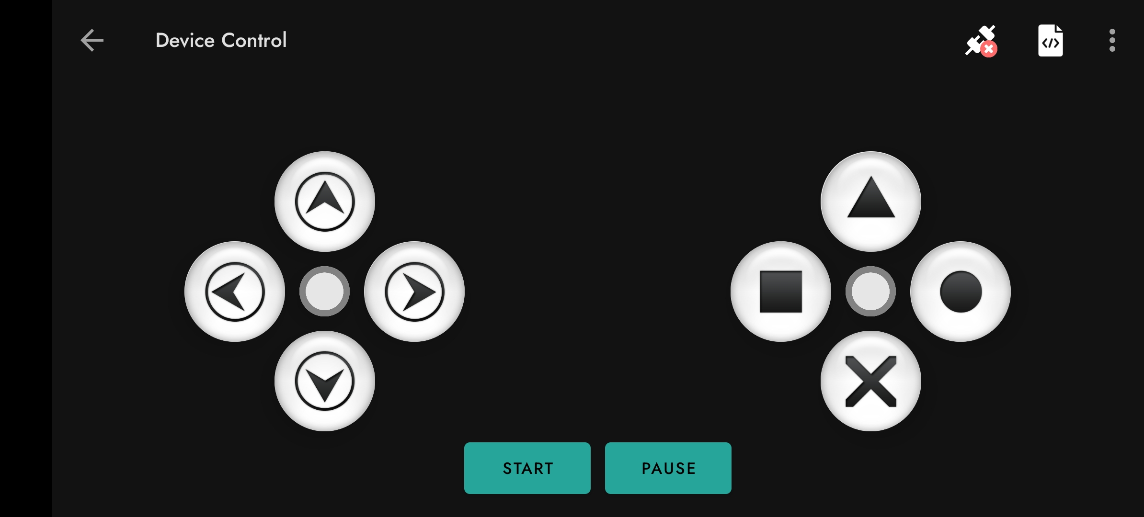
How does our robot work?
Default mode
Bluetooth controlled robot
When powered on it plays the default mode, Default mode has ability to move the robot front, back, left, right and to stop the robot
Control panel allows to toggle the 03 modes
Default mode
User following mode
Obstacle avoiding mode
Hand break
User
Following mode
Obstacle avoiding mode
Manual control in
Default mode

Slide 5
How does our robot work?
Main Components and their features,
Touch Sensor - Wags the tail when touched
Gas Sensor – Detects smoke leakage
Buzzer – Detects sound when smoke detected
Ultrasonic Sensor – Used to measure the distance of an object and avoid the obstacle
IR Sensor – Used to follow the user
LDR Module – Used to measure the temperature and using LED bulbs to light up during dark times
Servo Motors – Used to Wag tail and Tilt head

Slide 6
How does our robot work?

Slide 7
Bill of Materials(BOM)
Summary of the robot components with cost
Category | Components | Cost(Rs)
Main Components | Chassis, Arduino Uno, Motor Driver, Servo Motors, LDR Module, Sensors(IR, Ultrasonic, Gas, Touch) | 8,950
Power Supply | Lithium-ion batteries(2X3700mAh), 9v battery, Battery Charger, Buck convertor | 3,760
Connectivity | Jumper Cables (Male-Male, Male-Female, Female-Female), Breadboard, Bluetooth module | 2,850
Tools | Soldering Iron, Soldering Wire, Glue gun and Sticks, Plier, Paper Cutter, Double Tape, Scissors | 5,180
Additional Items | Buzzer, LED bulbs, Charging Case, Super Glue, Resistors, Others small Components | 1,110
Total |  | 21,850

Slide 8
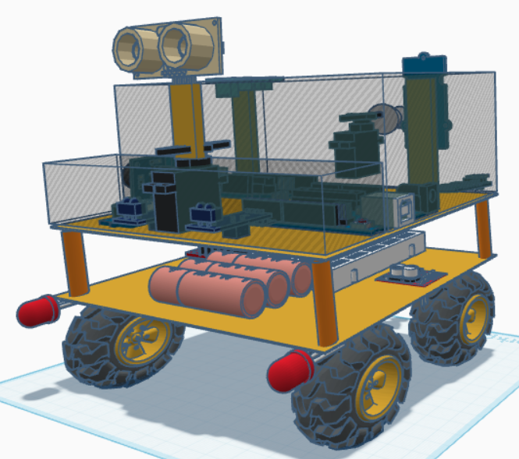
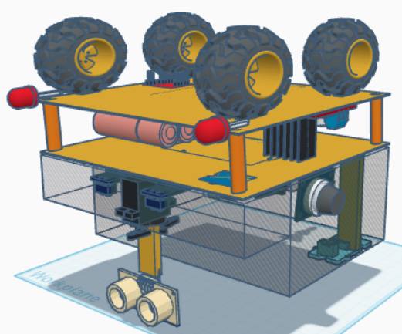
3D design of the Pet Robot
Top View
Bottom View

Slide 9
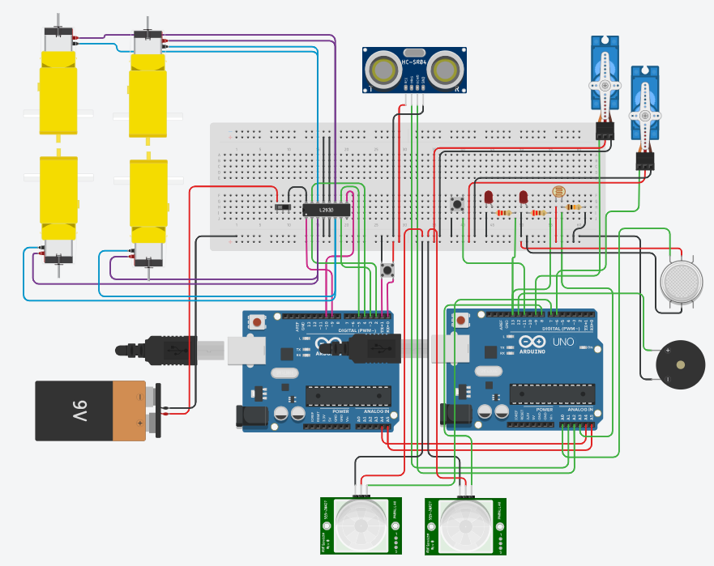
Circuit Diagram

Slide 10
Thank You

