Slide 1

Performance Evaluation of
Containerized Systems
before and after using Kubernetes
for Smart Farm Visualization Platform
based on LoRaWAN
TEAM 5 IIEEE
Notes:
Hello everyone! We are team IIEEE. I’m Dayeon Won as a presenter, Minji Kim and Sungjin Park will present after me. Our research topic is ‘performance evaluation of containerized systems before and after using Kubernetes for smart farm visualization platform based on LoRaWAN.’

Slide 2
Contents
1
2
3
4
5
Motivation
Objectives
Methodology
Experiment
Conclusion
Network
Web
Kubernetes
Result
Future Plan
Notes:
In this presentation, I will talk about the motivation and research objectives first. Then, Minji will provide methodology of network and web service. Sungjin will explain methodology of Kubernetes, experiment, and conclusion. Finally, Gayoung and Haegyoung will answer the questions.

Slide 3


Motivation
The growth of world population
[1]
Notes:
According to the United Nations, the world population is growing continuously.
UN에 따르면 계속적으로 인구가 증가

Slide 4

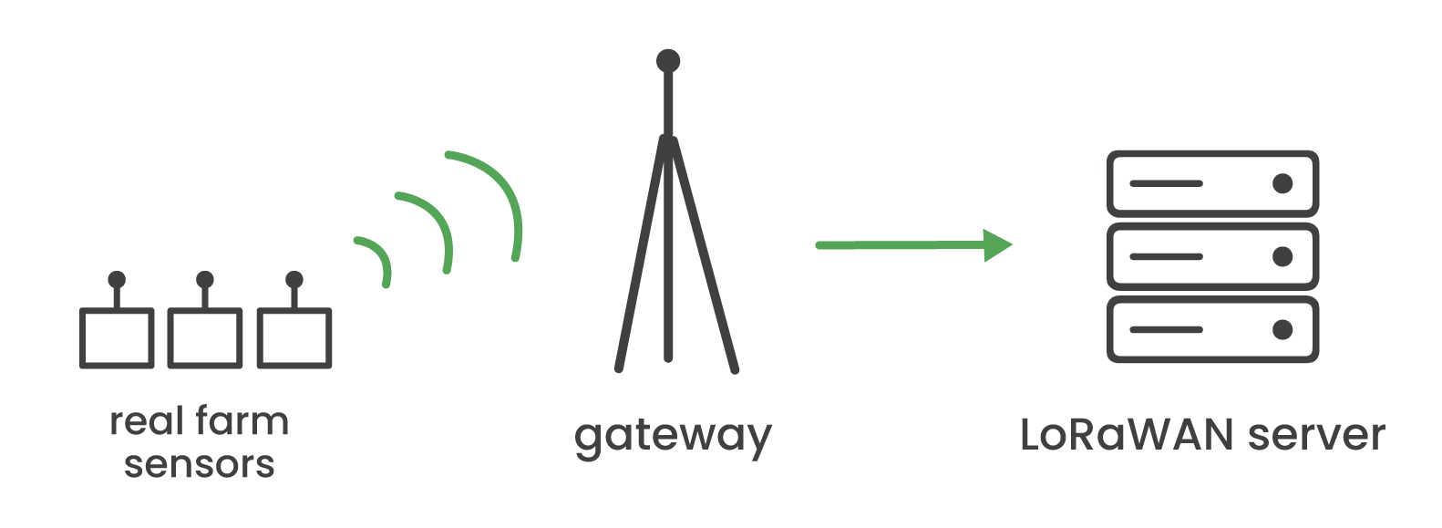
Motivation
It requires an increase in food production
Notes:
This population growth requires an increase in food production.
인구가 증가함에 따라 식량 생산량도 증가해야함

Slide 5
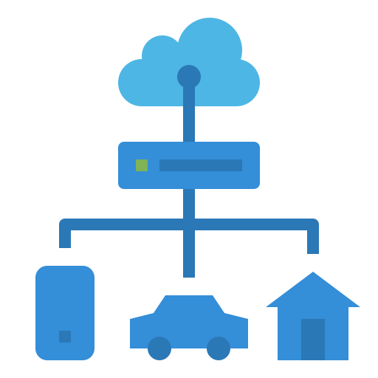

Motivation
farm
IoT
Presented smart farm based on IoT
[2]
Notes:
To meet the growing demand for food, smart agriculture systems based on IoT have been presented. IoT technology can reduce labor costs and improve crop yields.
증가하는 식량 수요를 충족시키기 위해 스마트 농업이 도입됨. IoT 기술은 노동 비용을 줄이고 작물 수확량을 개선시킴

Slide 6

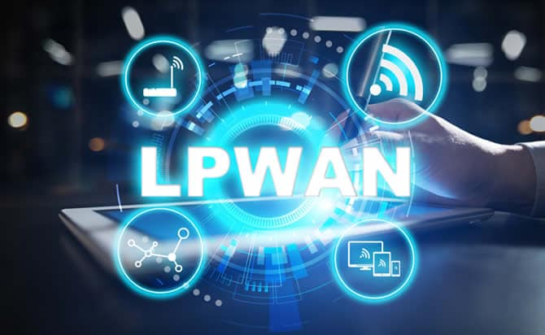
Motivation
wide areas
In order to communicate stably, LPWAN protocols are needed.
IoT of agriculture collects data of wide areas.
[3]
Notes:
IoT of agriculture collects data of wide areas. In order to have stable communication, Low Power Wide Area Network(LPWAN) protocols are needed.
농업에서의 IoT는 넓은 지역의 데이터를 수집하는데 여기서 안정적인 통신을 하기 위해서는 LPWAN(Low Power Wide Area Network) 프로토콜이 필요

Slide 7
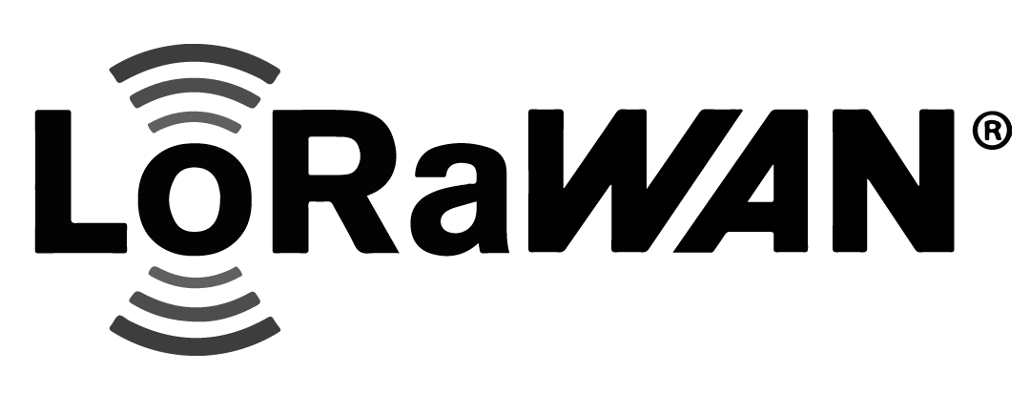
Motivation
[4]
Network protocol that functions on LoRa
Notes:
LoRaWAN is the most suitable communication network for LPWAN of smart agricultural IoT. It is network protocol that functions on LoRa.
농업 IoT를 위한 LPWAN (네트워크)에 가장 적합한 통신 네트워크는 LoRaWAN

Slide 8
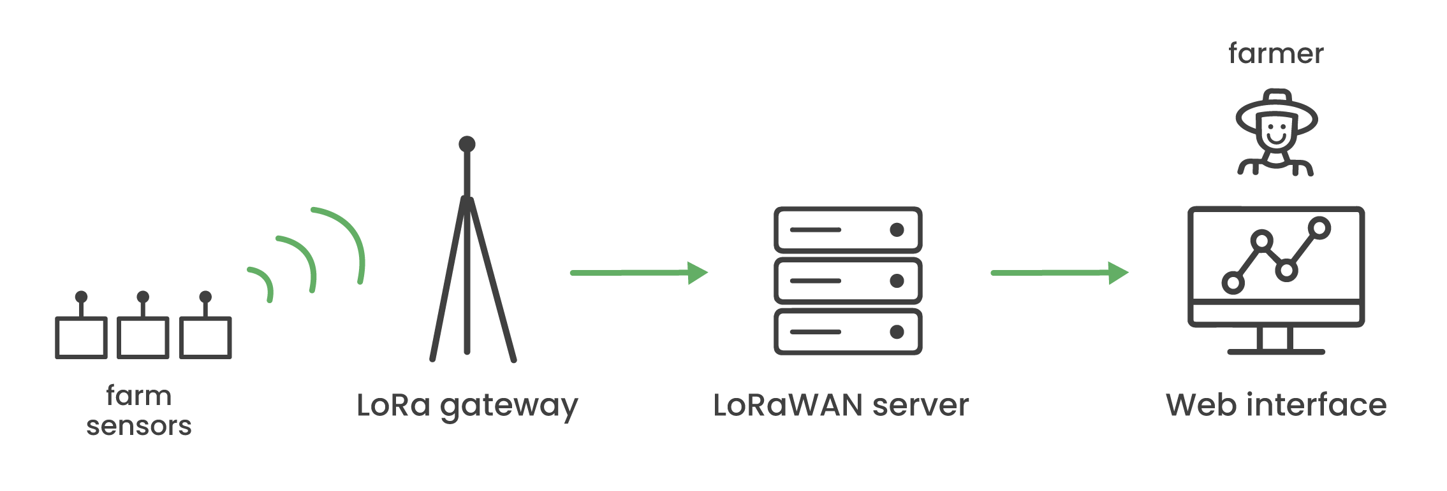
Motivation
Making a visualization platform
for farmers based on LoRaWAN
Notes:
So, we decided to make a data visualization platform for farmers who have smart farms based on LoRaWAN.
그래서 우리는 LoRaWAN 기반 스마트 팜을 가진 농부들을 위한 시각화 웹 서비스를 만들기로 결정했다.

Slide 9
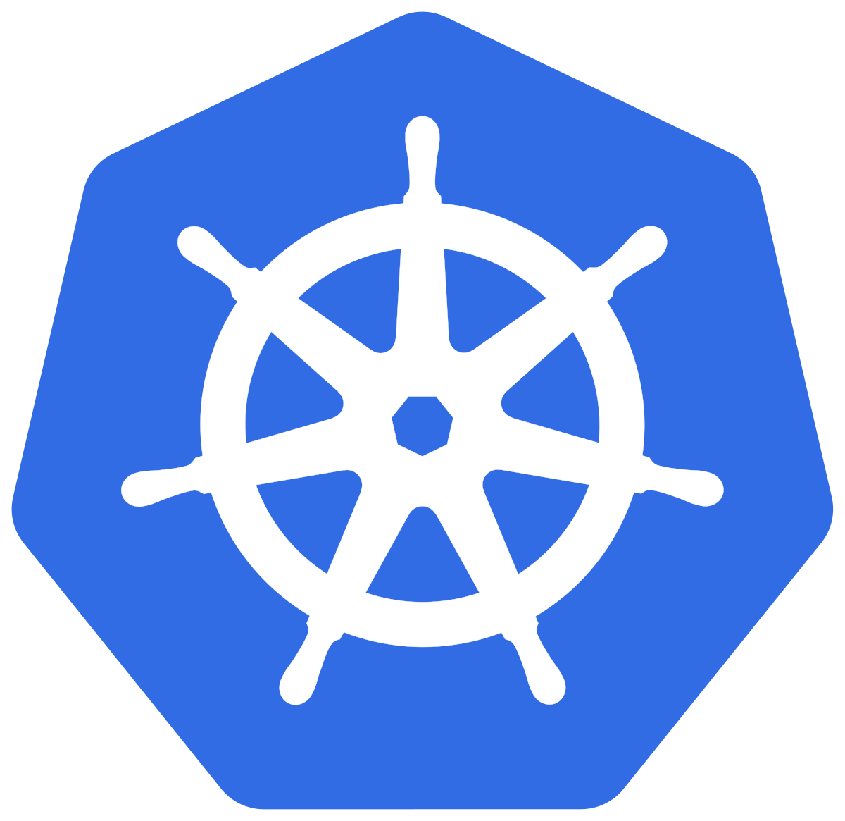

Objectives
[5]
Applying Kubernetes in this platform
Notes:
Moreover, we applied Kubernetes in this platform to improve efficiency.
우리는 이 플랫폼에 효율성 향상을 위해 쿠버네티스를 도입했다.

Slide 10

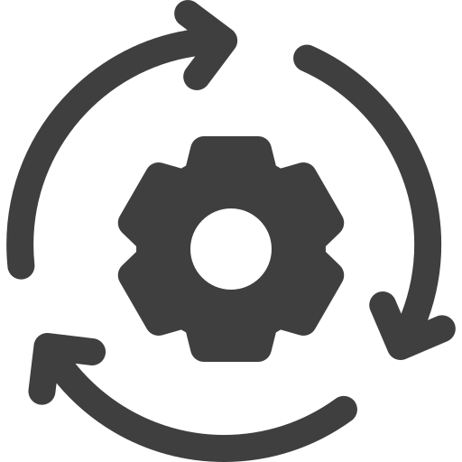

Objectives
Advantages of
Self healing
Monitoring
Auto scaling
Notes:
Kubernetes is an orchestration tool that has some advantages such as self-healing, monitoring, and auto-scaling.
쿠버네티스는 모니터링, 자동 확장, 셀프 힐링 등 몇 가지 장점이 있는 오픈 소스 플랫폼이다.

Slide 11

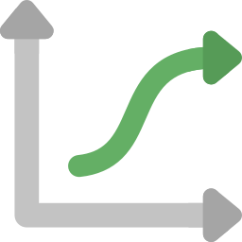
Objectives
It can cause
Learning curve
opportunity cost
Notes:
Introducing Kubernetes into the service can have a high learning curve and opportunity cost. However, it can be very effective in terms of performance and resources.
쿠버네티스를 서비스에 도입하는 것은 높은 러닝커브와 기회비용이 들 수 있지만, 성능과 자원 측면에서 매우 효과적일 수 있다.

Slide 12
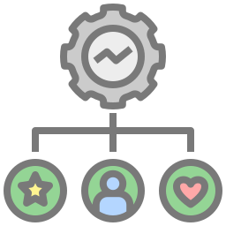
Objectives
It can be effective
performance and resources
Notes:
Introducing Kubernetes into the service can have a high learning curve and opportunity cost. However, it can be very effective in terms of performance and resources.
쿠버네티스를 서비스에 도입하는 것은 높은 러닝커브와 기회비용이 들 수 있지만, 성능과 자원 측면에서 매우 효과적일 수 있다.

Slide 13
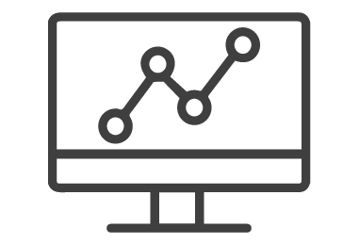
Objectives
Web interface
Web interface
Before and after using Kubernetes to find out the efficiency
Notes:
Therefore, we will compare before and after using Kubernetes to find out the efficiency of transaction performance.
따라서 우리는 쿠버 사용 전후를 비교하여 transcation 성능의 효율성을 알아보고자 한다.

Slide 14
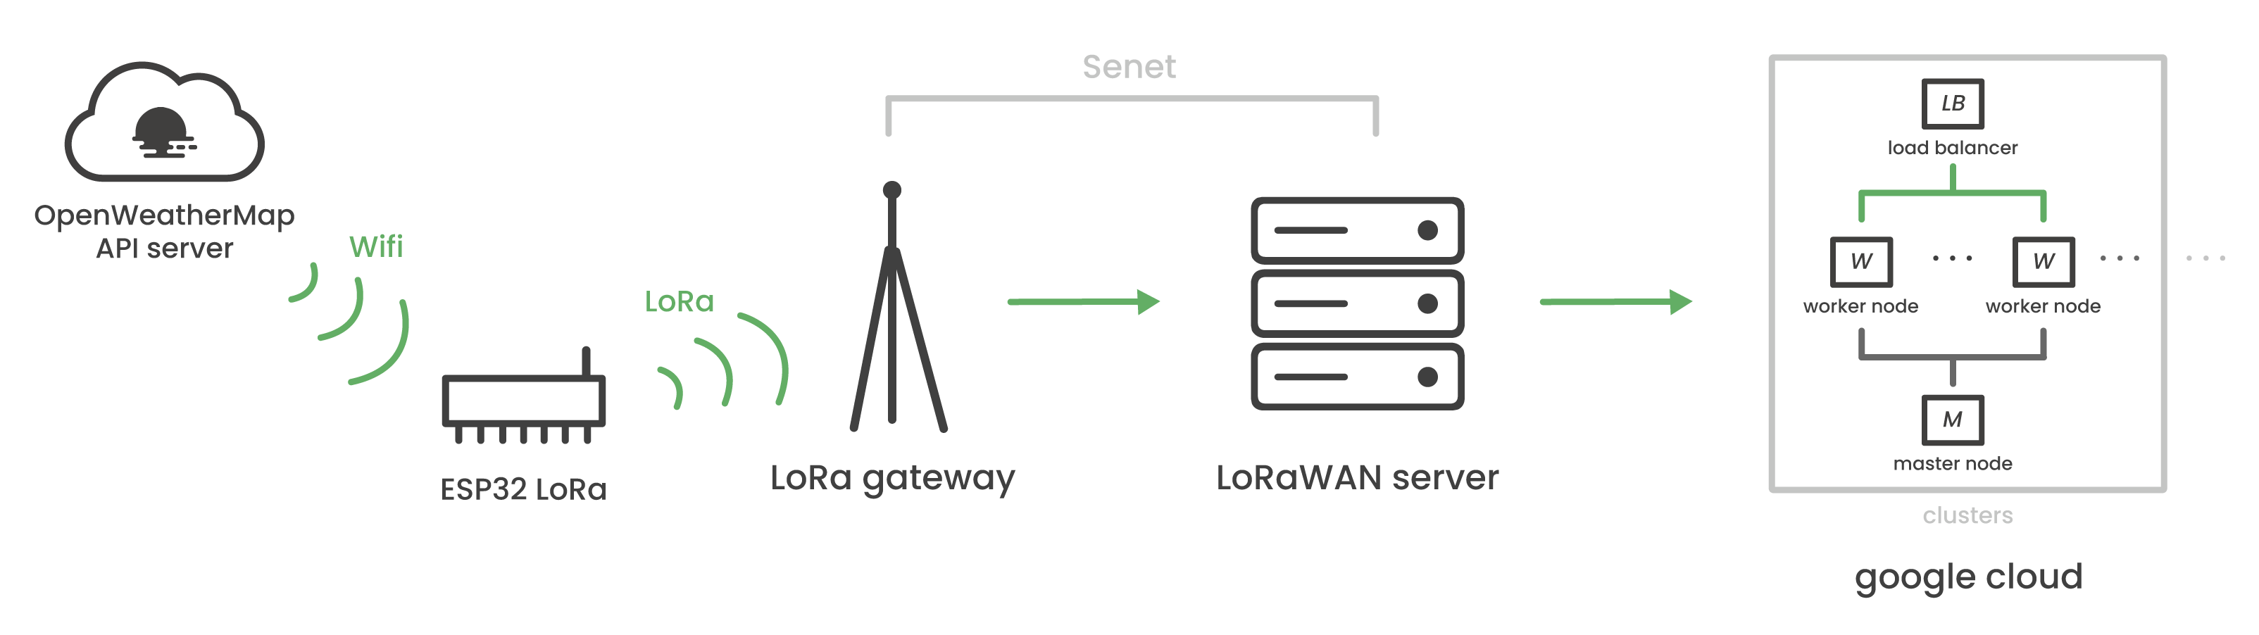
Objectives
Architecture
Notes:
This is our overall system architecture.
이것이 우리의 전반적인 시스템 아키텍처이다.

Slide 15
Objectives
Architecture
Process of gathering data
Notes:
This part is the process of gathering data as a network part,
이 파트는 네트워크 파트로, 데이터를 모으는 과정을 나타내고,

Slide 16
Objectives
Architecture
Applying Kubernetes
Notes:
and the other part is the core of our project and the process of applying Kubernetes to the application server.
Now, Minji will explain the process of collecting data from the network side and our web platform that visualizes the collected data.
이 파트는 우리 프로젝트의 핵심이자 application server에 쿠버네티스를 적용하는 과정을 보여준다.
자세한 내용은 methodology에서 이어지며, 먼저 민지가 network side에서 팜 데이터를 수집하는 과정과 받아온 데이터를 나타내는 우리의 web platform에 대해 설명해줄 것이다.

Slide 17
Objectives
Architecture
Notes:
Thank you Dayeon. This is Minji.
Then let’s look at our system architecture and processing in detail.

Slide 18
Methodology
Network
Notes:
The first part is Network.
I’ll let you know how to collect our data.

Slide 19
Methodology
Network
To get weather data
Notes:
농부들을 위한 날씨 데이터를 받기 위해서 실시간 날씨 데이터 API 플랫폼인 Open weather을 사용하였어.
To get weather data for farmers, we used Open Weather, a real-time weather data API platform.

Slide 20
Methodology
Network
Data type
Temperature
Humidity
Air pressure
Wind speed
4 data / 40 stations
Notes:
여기에서 40개 스테이션의 기온, 습도, 기압, 풍속 총 4가지의 데이터를 와이파이를 사용하여 esp32를 받아왔어
From here, we received temperature, humidity, air pressure, and wind speed total 4 data of 40 stations to ESP32 using WiFi.

Slide 21
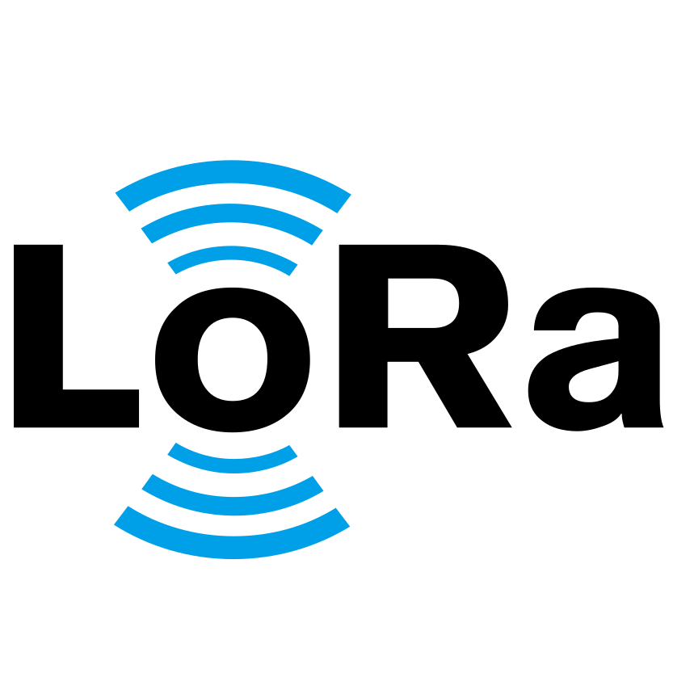
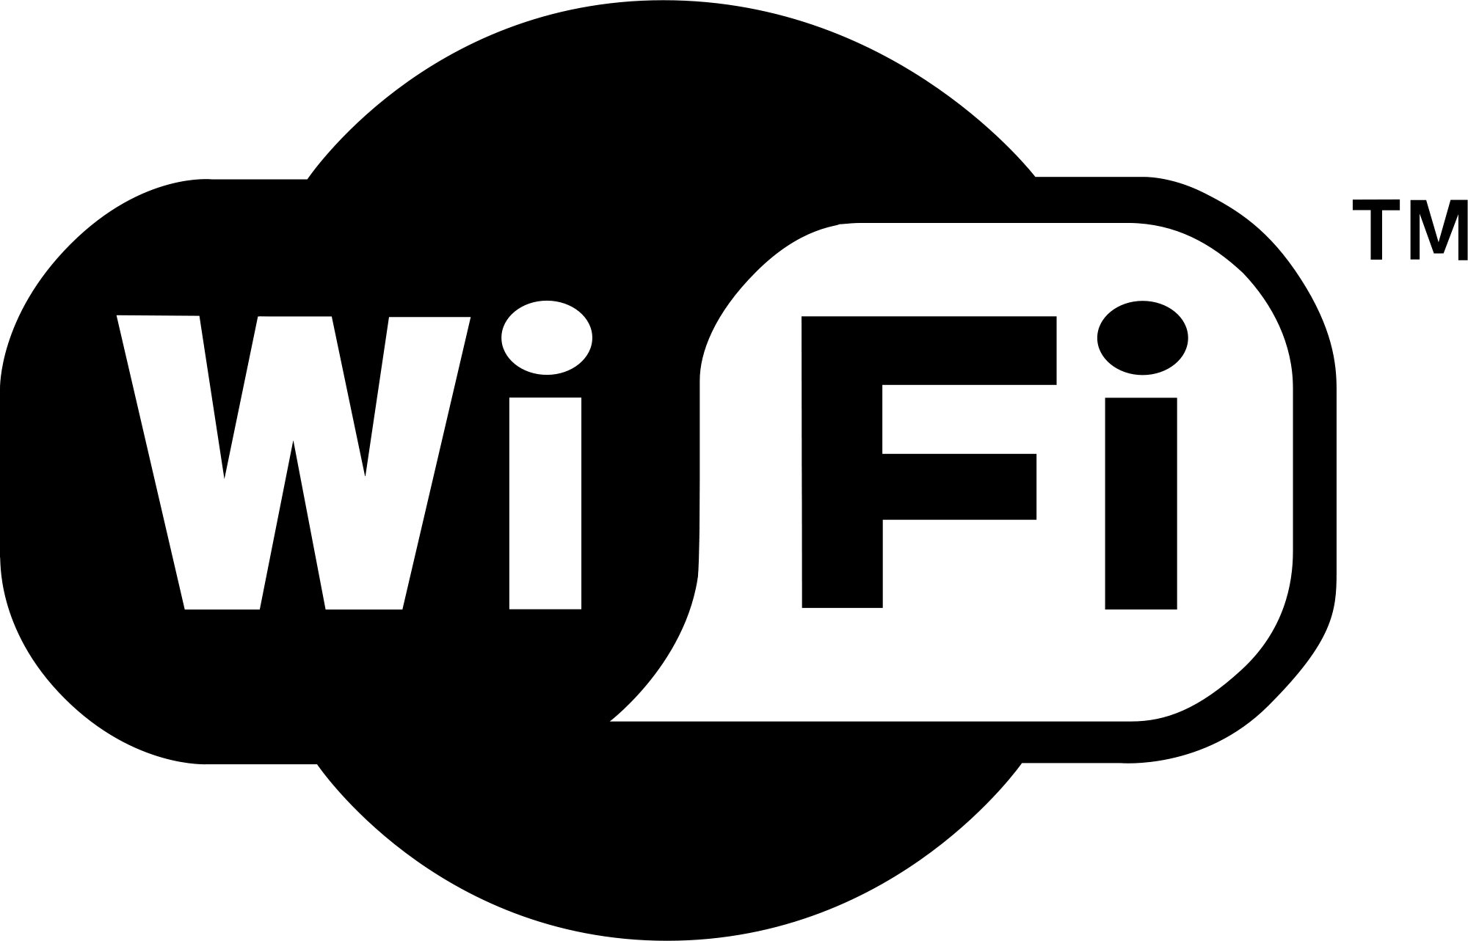
Methodology
Network
Low cost / Low power
Micro Controller Unit Board
Notes:
본 실험에서 사용한 ESP32는 ESP LoRa 32로, 로라 모듈이 내장되어 있는 MCU보드야.
여기서 잠깐 ESP32에 대한 아주 짧은 설명 하고 넘어갈게
이 디바이스가 와이파이로 받아온 데이터를 담아두었다가 로라를 사용하여 로라 게이트웨이에 전달하는 역할을 해.
I think you guys can be curious about what ESP32 is, So, let me give you a short explanation about it.
ESP32 is one of the MCU(Micro Controllers Unit), and exactly what we use is esp LoRa 32 which has a LoRa module.
It holds the data which is received through Wi-Fi and delivers it to Gateway using LoRa protocol.
There's something I need to know for a while here.

Slide 22
Methodology
Network
[6]
Long
Range
Long Range Low Power
Notes:
여기서 잠시 알아야 할 것이 있어.
그것은 바로 로라!
로라란 무엇일까
로라는 Low Range의 준말로서 커뮤니케이션 네트워크 프로토콜의 종류 중 하나야!
특히나 LPWAN 즉. low- power, wide area network에 속하지.
이름에서 알 수 있듯이 로라는 광범위한 영역을 저전력으로도 커버할 수 있다는 장점이 있어.
That is LoRa.
Then, what is LoRa?
LoRa is an abbreviation for Low Range and is one of the types of communication network protocols!
As the name shows, LoRa can cover a wide range of areas with low power
This can be a big advantage in IoT networks

Slide 23
Methodology
Network
ESP32 allow us to build LoRaWAN
Notes:
로라를 사용한 시스템인 로라완을 구축할 수 있게 해준 것이 바로 ESP32이지.
Anyway, It was the ESP32 that allowed us to build LoRaWAN

Slide 24
Methodology
Network
Notes:
다시 돌아와서 다음 과정을 봐 보자.
ESP32에 수집된 데이터는 LoRa 모듈의 로라를 통하여 Senet의 LoRa Gateway에 들어가게 돼.
이미 설치되어 있는 senet의 게이트 웨이를 사용하였다.
well, let’s get back and see the next step.
The data from ESP32 is entered into already set Senet's LoRa Gateway through the LoRa.

Slide 25
Methodology
Network
JSON
ASCII
JSON
Notes:
At this time, the data of Open weather was received in JSON format.
However, LoRa Gateway can not get that format, So we had to parse Json to ASCII to get data to the gateway
일련의 과정을 거친 데이터는 다시 Senet 클라우드에 있는 LoRaWAN server로 들어가게 되고, 어플리케이션 서버로 다시 들어가게 돼.
After this processes, the data goes back to the Lora WAN server in the Senet cloud and go into the application server.

Slide 26
Methodology
Network
Showing data to users
Notes:
이렇게 받은 데이터는 유저들에게 어떤 방식으로 보여질까?
이 부분에 대한 설명을 위해 다음 파트인 Web part로 넘어가자!
Then, now it's time to show this data to Users I mean, farmers.

Slide 27

Methodology
Web
Developed web service
Notes:
우리는 해피파머라는 서비스 플랫폼을 개발했어.

Slide 28
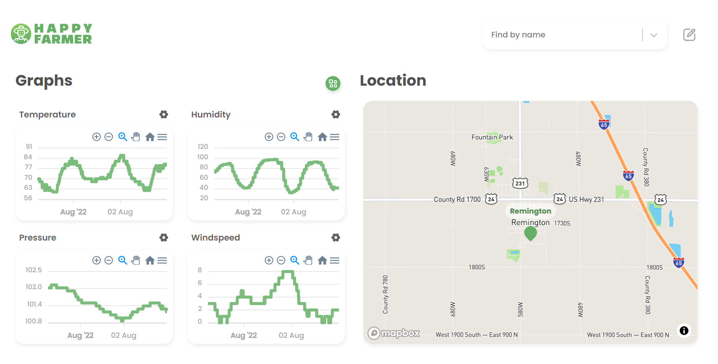
Methodology
Web
Notes:
메인 페이지에 처음 들어가면 현재 위치와 가장 가까운 팜의 데이터로 렌더링이 돼.

Slide 29
Methodology
Web
Notes:
왼쪽 부분은 센서 데이터를 그래프로 보여주고 있어. 여기서 각 그래프마다 설정 버튼이 있는데 이 버튼을 누르면 사용자가 직접 센서 값에 대한 range를 설정할 수 있어.

Slide 30
Methodology
Web
Notes:
왼쪽 부분은 센서 데이터를 그래프로 보여주고 있어. 여기서 각 그래프마다 설정 버튼이 있는데 이 버튼을 누르면 사용자가 직접 센서 값에 대한 range를 설정할 수 있어.

Slide 31
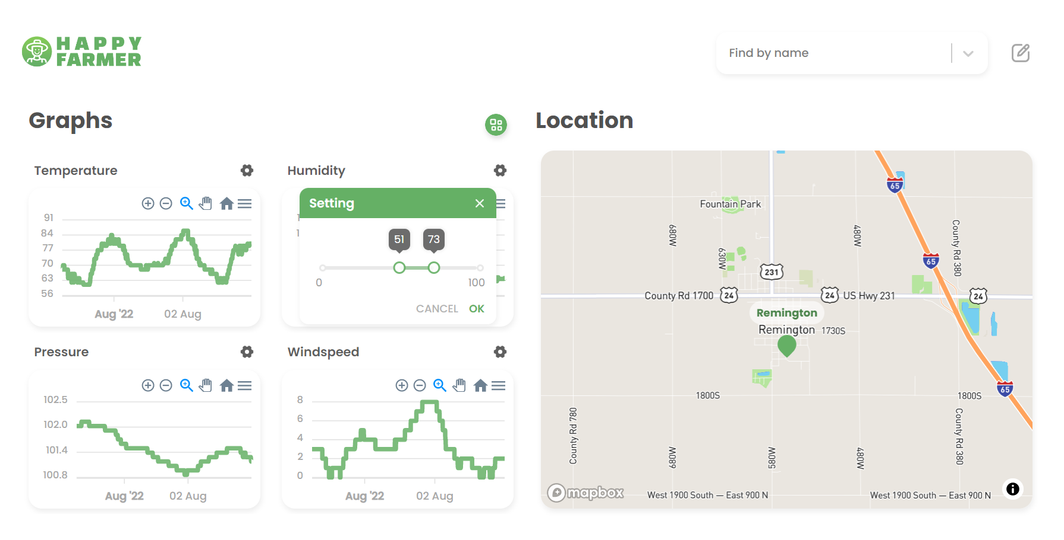
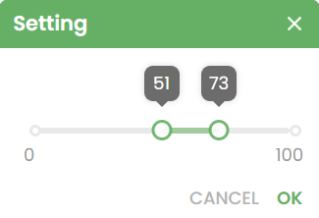
Methodology
Web
Notes:
왼쪽 부분은 센서 데이터를 그래프로 보여주고 있어. 여기서 각 그래프마다 설정 버튼이 있는데 이 버튼을 누르면 사용자가 직접 센서 값에 대한 range를 설정할 수 있어.

Slide 32
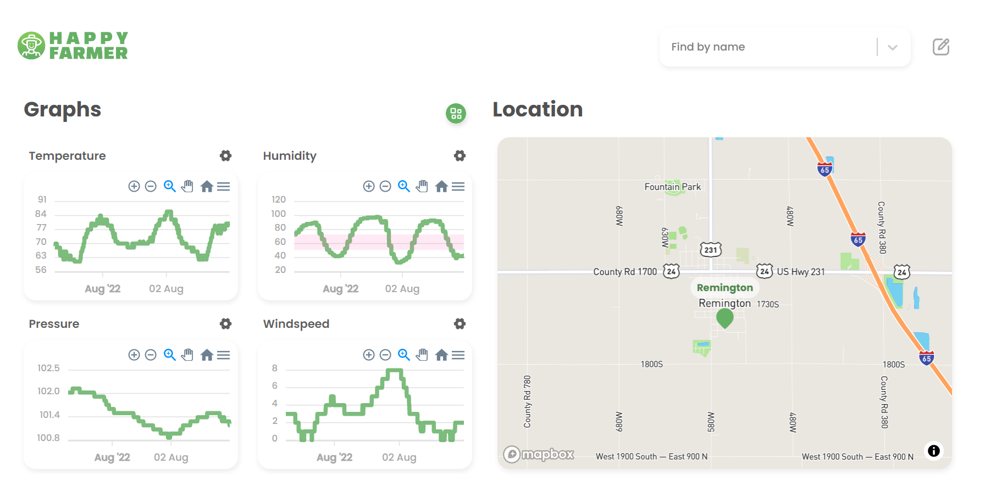
Methodology
Web
Notes:
설정하고 나면 그래프에 화면과 같이 (슬라이드에서 보이듯이 이렇게) 나타나는데, 이를 통해 사용자는 자신에게 필요한 정보에 집중할 수 있어.

Slide 33
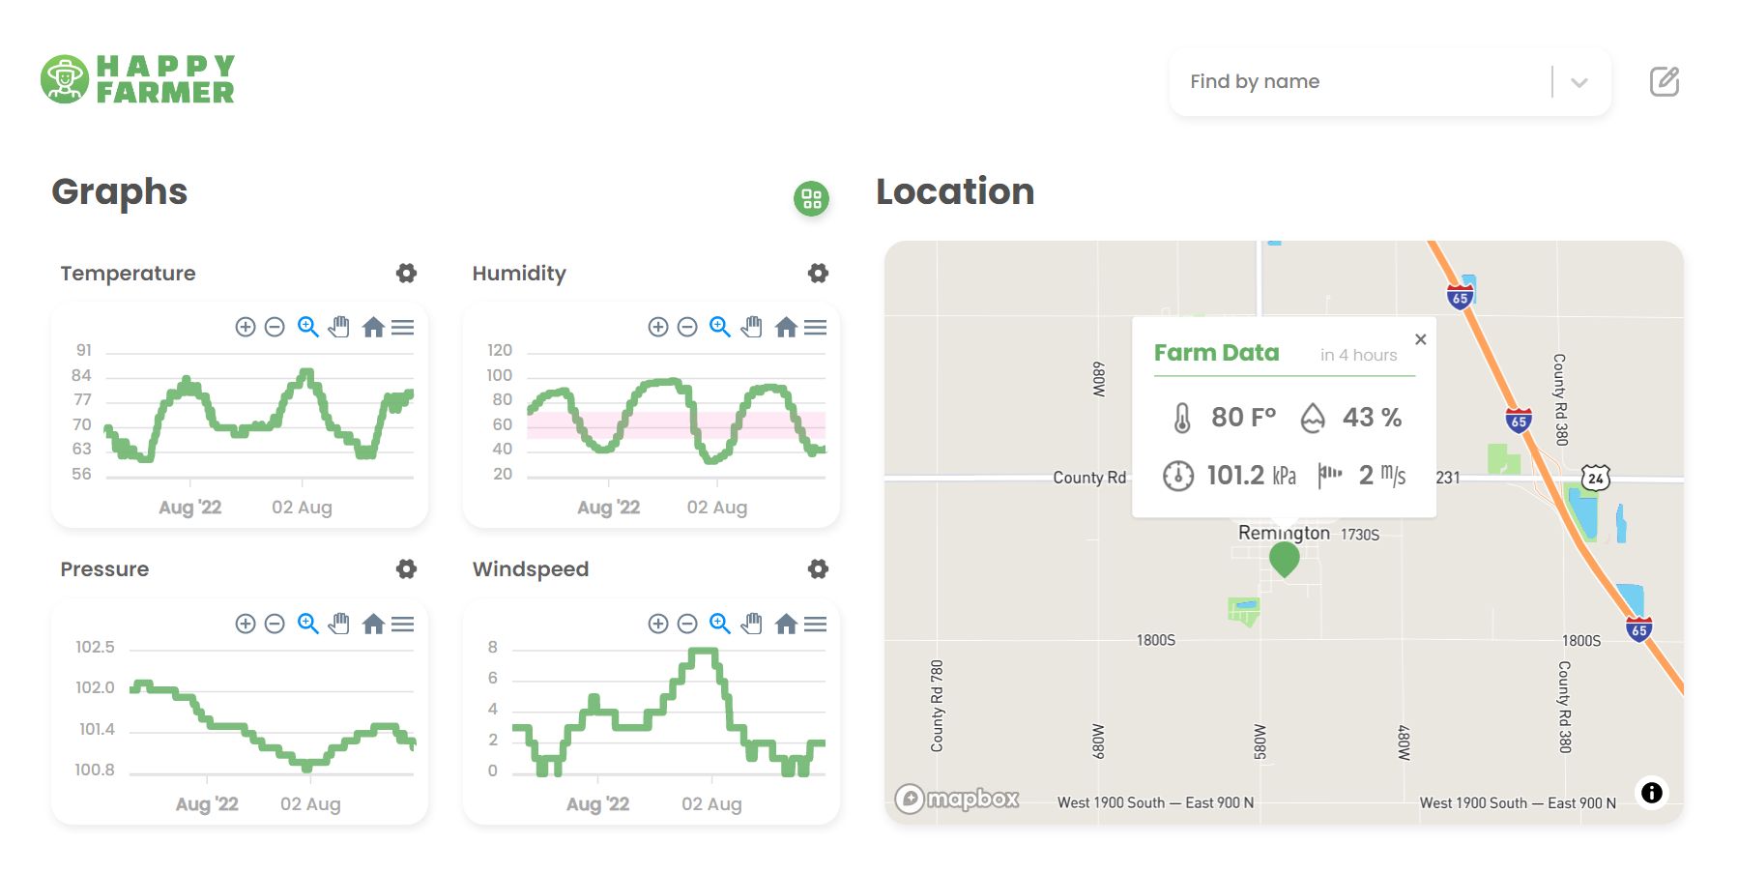
Methodology
Web
Notes:
오른쪽 부분은 맵 안의 마커를 통해 여러 지역의 현재 데이터를 수치로 확인할 수 있어.

Slide 34
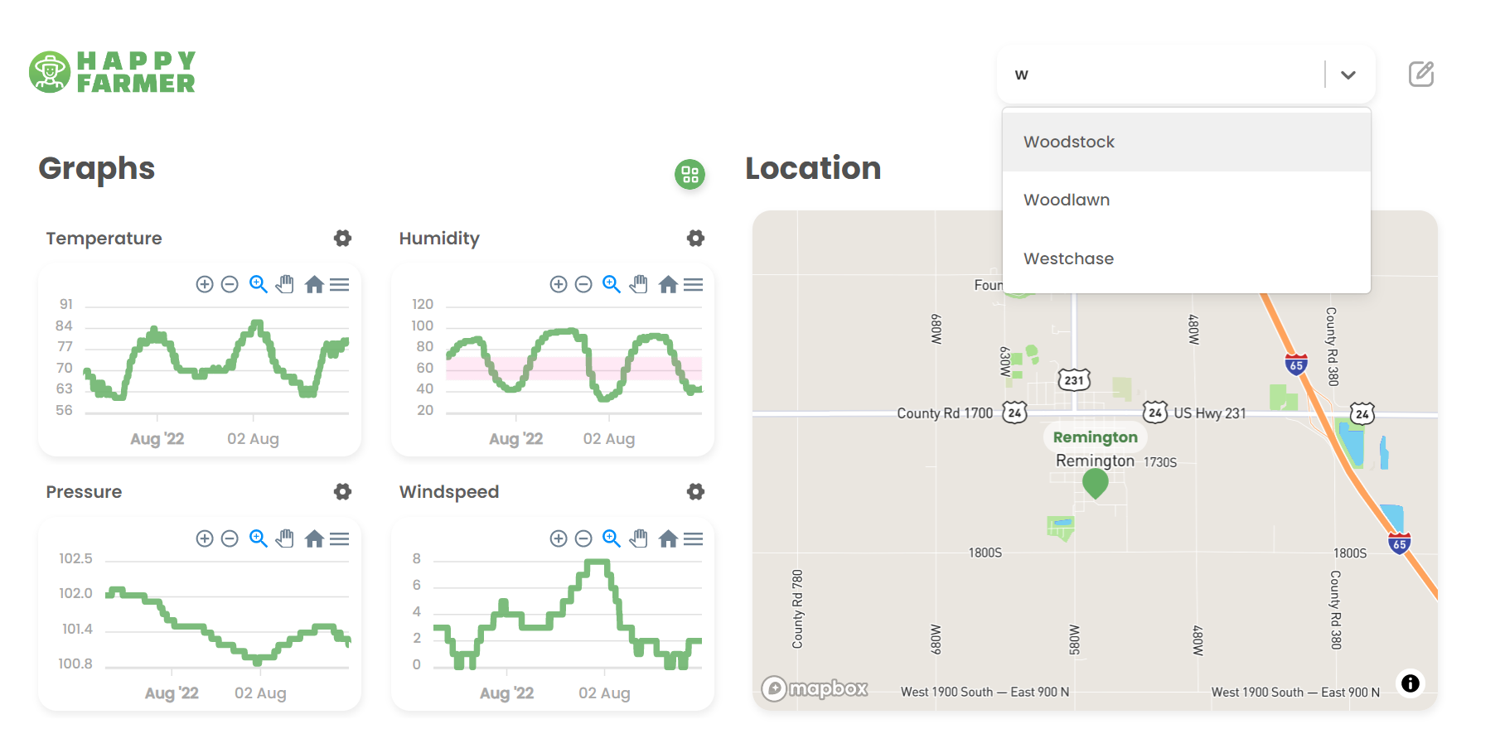
Methodology
Web
Notes:
그리고 위의 검색 기능으로 팜을 선택하면 해당 팜의 데이터를 확인할 수 있어.

Slide 35
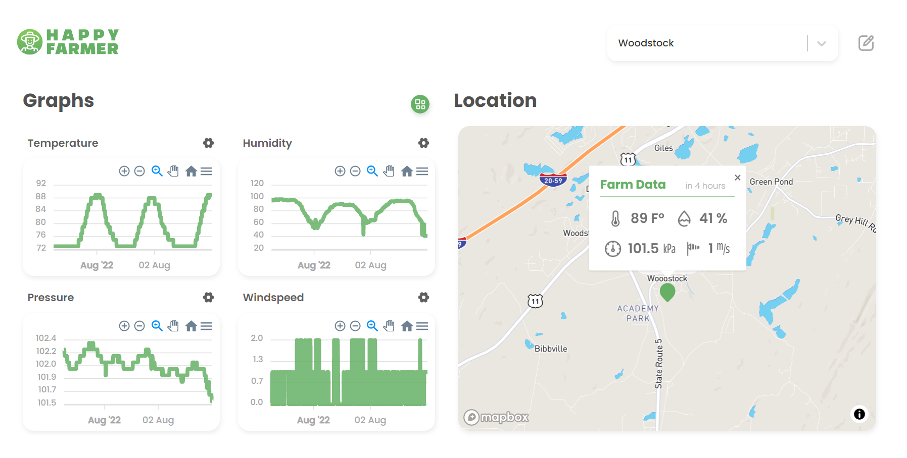
Methodology
Web
Notes:
그리고 위의 검색 기능으로 팜을 선택하면 해당 팜의 데이터를 확인할 수 있어.

Slide 36
Methodology
Kubernetes
Notes:
Thank you, Minji!
Hello, I am Sungjin who took over the presentation. What I’m going to talk about is Kubernetes.
Earlier, Minji showed a surprising service. We applied Kubernetes to this service.

Slide 37
Methodology
Kubernetes
Notes:
This architecture shows how we applied Kubernetes to our platform. In the platform, We have two servers, a front-end web server and a back-end application server which were dockerized. These dockerized containers run in pods, the minimum execution unit of Kubernetes.
The worker node is controlled by the master node. Each worker node's Kublet monitors its state and delivers it to the master node.
And the master node monitors this state and adjusts the number of nodes and pods. This makes the state of the cluster optimal.

Slide 38
Methodology
Kubernetes
Notes:
This architecture shows how we applied Kubernetes to our platform. In the platform, We have two servers, a front-end web server and a back-end application server which were dockerized. These dockerized containers run in pods, the minimum execution unit of Kubernetes.
The worker node is controlled by the master node. Each worker node's Kublet monitors its state and delivers it to the master node.
And the master node monitors this state and adjusts the number of nodes and pods. This makes the state of the cluster optimal.

Slide 39

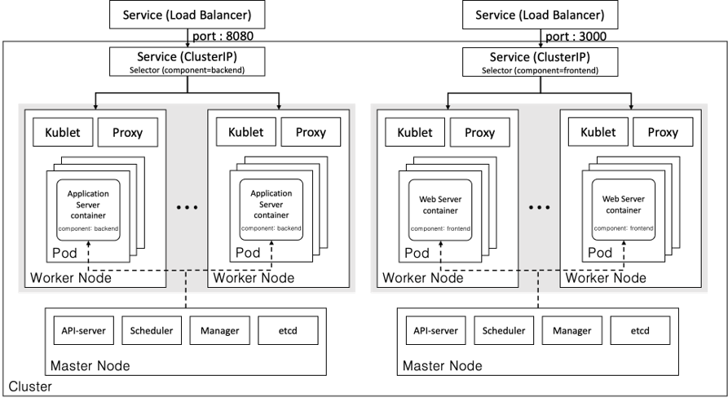
Methodology
Kubernetes
Notes:
This architecture shows how we applied Kubernetes to our platform. In the platform, We have two servers, a front-end web server and a back-end application server which were dockerized. These dockerized containers run in pods, the minimum execution unit of Kubernetes.
The worker node is controlled by the master node. Each worker node's Kublet monitors its state and delivers it to the master node.
And the master node monitors this state and adjusts the number of nodes and pods. This makes the state of the cluster optimal.

Slide 40
Experiment
Advantages of
Self healing
Monitoring
Auto scaling
Notes:
As we heard from Dayeon, we already know about the three benefits of Kubernetes. Does anyone remember?
That's right! Self healing, Monitoring, Auto scaling.
Through these advantages, we can expect an effect in terms of stability and availability. Therefore we compared before and after using Kubernetes in the LoRaWAN-based smart farm platform to find out the pros and cons.

Slide 41
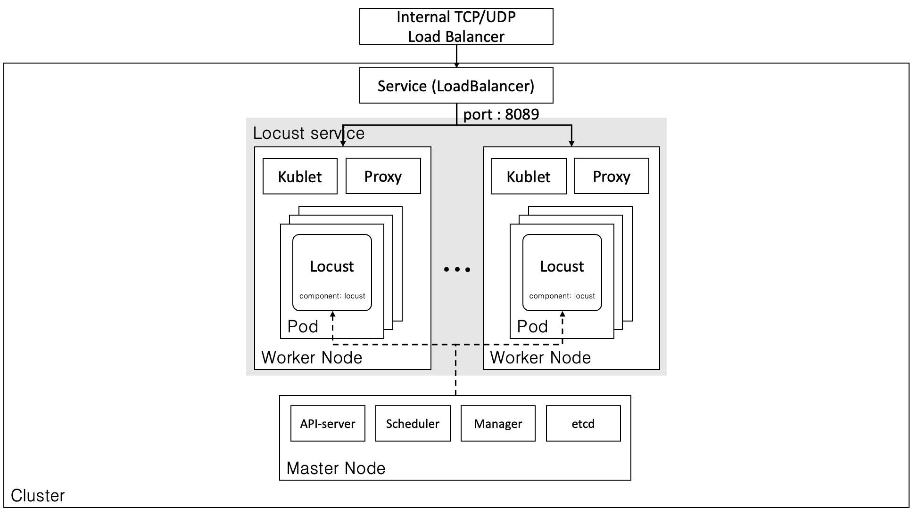
Experiment
Notes:
We configured a distributed load testing cluster for accurate experiments. In fact, I had used several terminals on a single computer to conduct the test, but the test PC was overloaded.
That's why we organized the testing tools into clusters. The structure is almost the same as the cluster of the services we saw before.

Slide 42

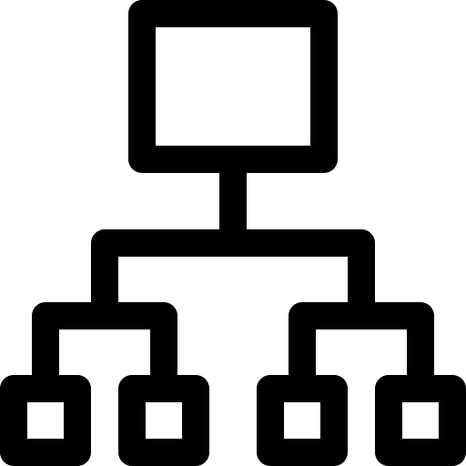
Experiment
Single
K8s
vs
4 virtual core CPU
8GiB memory
1 virtual core CPU
2GiB memory
Per pod
Notes:
For the correct comparison, the hardware spec was set the same.
One is a Single instance with 4 virtual core CPU and 8GiB memory. And the other is the Kubernetes cluster with 1 virtual core and 2 GiB memory per pod. The cluster can auto-scaling between one to four pods.

Slide 43
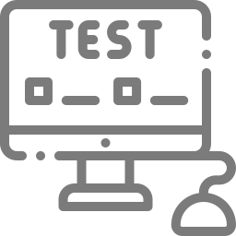
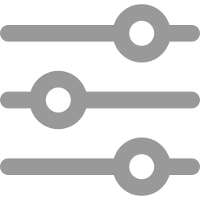
Experiment
1st TEST
Set Values
2nd TEST
Users: 250
Spawn rate: 10
Time: 4 Min.
Time: 30 Sec.
Users: 500
Spawn rate: 20
Time: 6 Min.
Notes:
In the 1st trial, the user is 250, the spawn rate is 10, and the 2nd trial was double.
Spawn rate means an increasing number of users per second.
By increasing the load, we tried to see Kubernetes' auto-scaling

Slide 44
Conclusion
Result
Evaluation Index
1. CPU
2. Request Per Second
3. Response Times
Notes:
The results of the experiment were very surprising. 평가 지표 3가지 (cpu, rps, response time)

Slide 45
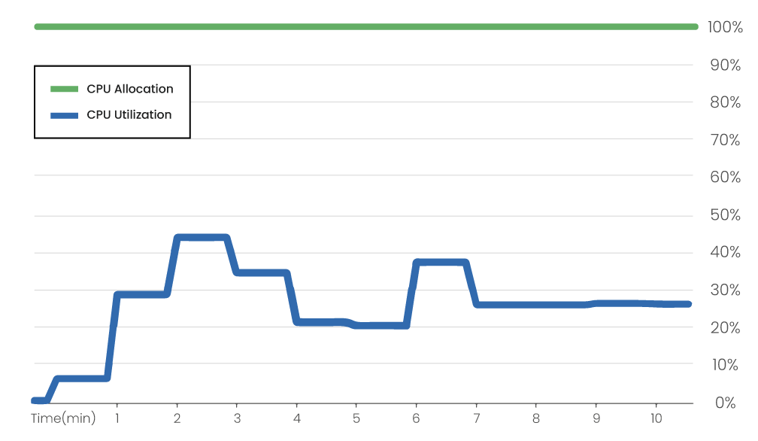
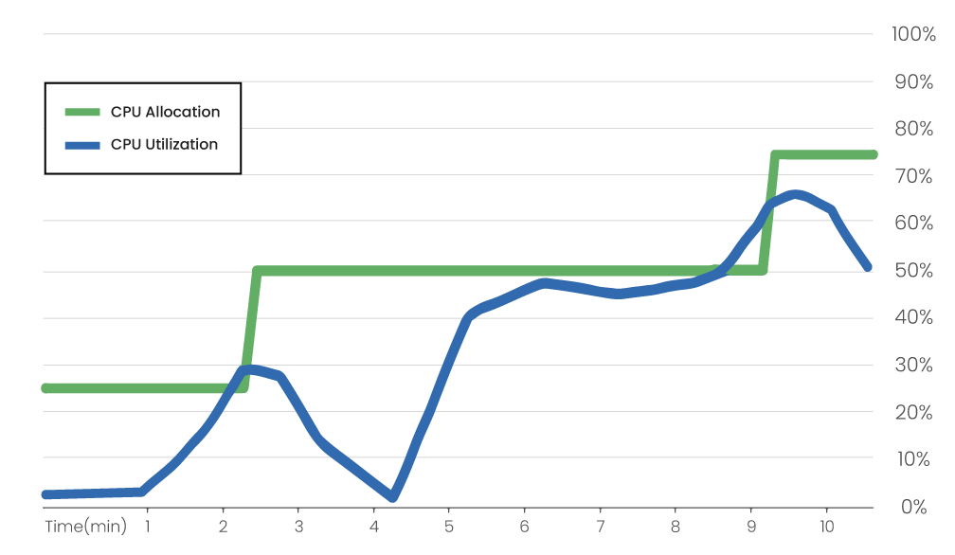
Conclusion
Result
1. CPU
Pod 2 → 3
Pod 1 → 2
K8s not applied
K8s applied
Notes:
The first is the CPU Result.
Kubernetes flexibly allocates resources according to utilization. By comparison, a single instance allocates 100% of its resources. Thus Kubernetes is much better at resource efficiency.

Slide 46
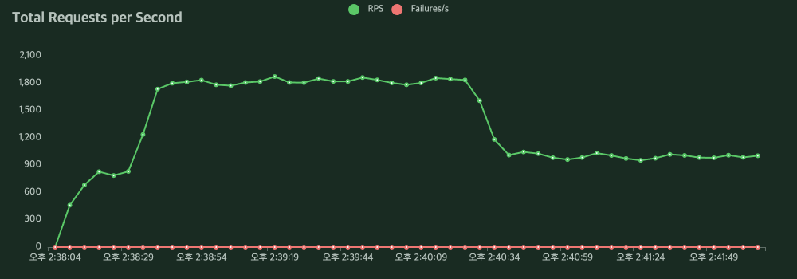
Conclusion
Result
2. RPS
K8s not applied
1st TEST
2nd TEST
Notes:
The second is RPS Result.
When Kubernetes was not applied, the RPS and performance decreased further as the load increased.
However, When kubernetes was applied, the performance rather increased because the number of pods increased according to the load.

Slide 47
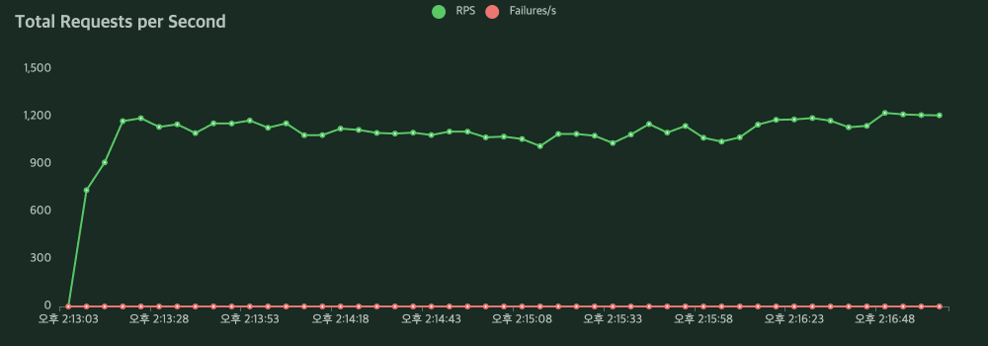
Conclusion
Result
2. RPS
K8s applied
1st TEST
2nd TEST
Notes:
The second is RPS Result.
When Kubernetes was not applied, the RPS and performance decreased further as the load increased.
However, When kubernetes was applied, the performance rather increased because the number of pods increased according to the load.

Slide 48
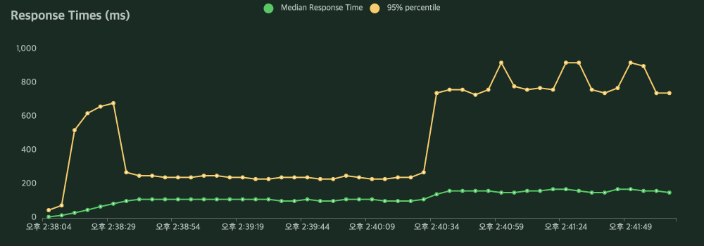
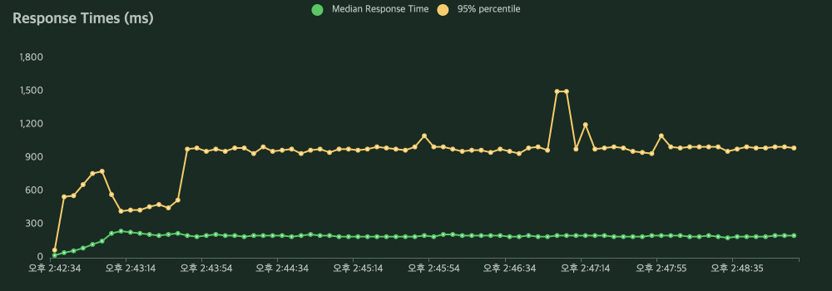
Conclusion
Result
3. Response Times
K8s not applied
1st TEST
2nd TEST
Notes:
The last is response times result.
When Kubernetes was not applied, the response times increased further as the load increased. And There is a large deviation between the response time of the top 50% and the response time of the top 95%. So it's less stable.
On the contrary when kubernetes was applied, the response time and deviation decreased as the pods increased.

Slide 49
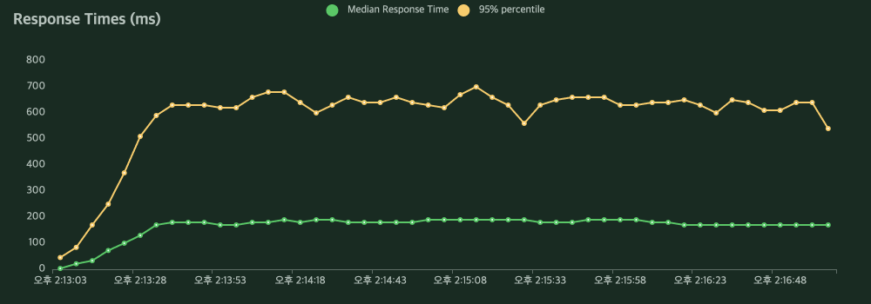
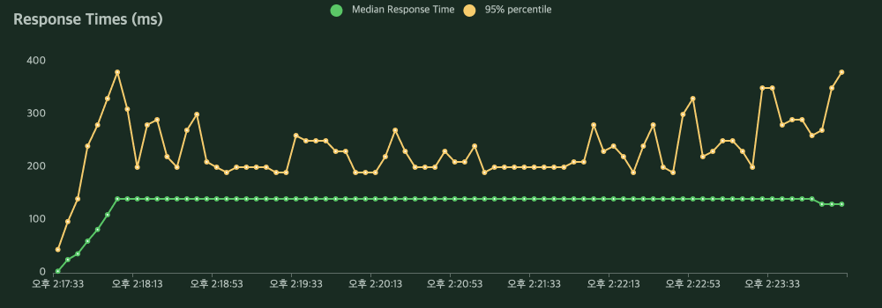
Conclusion
Result
3. Response Times
K8s applied
1st TEST
2nd TEST
Notes:
The last is response times result.
When Kubernetes was not applied, the response times increased further as the load increased. And There is a large deviation between the response time of the top 50% and the response time of the top 95%. So it's less stable.
On the contrary when kubernetes was applied, the response time and deviation decreased as the pods increased.

Slide 50

Conclusion
Future Plan
Study the structure that can maximize
the performance of Kubernetes
Notes:
Lastly, I'd like to talk about our future plan.
I think the performance and effectiveness of Kubernetes have been fully proven through this experiment. However, Kubernetes has various structures and models. In the future, we will study the structure that can further maximize the performance of Kubernetes.

Slide 51
References
[1] Gupta, M., et al., "Security and privacy in smart farming: Challenges and opportunities," IEEE Access vol. 8, 2020, pp. 34564-34584.
[2] Bu, F., and X. Wang, "A smart agriculture IoT system based on deep reinforcement learning," Future Generation Computer Syst. vol. 99, 2019, pp. 500-507.
[3] Gutiérrez, S., et al., “Smart mobile LoRa agriculture system based on internet of things,” 2019 IEEE 39th Central America and Panama Conv. (CONCAPAN XXXIX), pp. 1-6.
[4] Miles, B., et al., “A study of LoRaWAN protocol performance for IoT applications in smart agriculture,” Computer Commun. vol. 164, 2020, pp. 148-157.
[5] “What is Kubernetes?” Kubernetes. https://kubernetes.io/docs/concepts/overview/what-is-kubernetes/ (accessed July. 19, 2022).
[6] “What is LoRaWAN® Specification.” LoRa Alliance. https://lora-alliance.org/about-lorawan/(accessed Aug. 1, 2022).
Notes:
As I said before, this project will be deployed on a large scale. However, the physical scale of our project in K-SW is a bit small, because there is no time to build LoRaWAN all over the world. So, we will expand the scale and fill the dataset with real data after this program.

Slide 52

Q & A

