Slide 1
Employee Data Analysis using Excel
STUDENT NAME:Ilmun Nisha.K
REGISTER NO:312207798
DEPARTMENT:B.COM (General)
COLLEGE:The Quaide Milleth College For Men

Slide 2
PROJECT TITLE
Employee Performance Analysis using Excel

Slide 3


AGENDA
Problem Statement
Project Overview
End Users
Our Solution and Proposition
Dataset Description
Modelling Approach
Results and Discussion
Conclusion
3/21/2024 Annual Review

Slide 4

PROBLEM STATEMENT
An organization wants to analyze the performance of its employees to identify top performers, areas for improvement, and overall workforce efficiency. The performance data includes metrics such as productivity scores, number of tasks completed, attendance records, sales figures, and customer feedback ratings. The goal is to use Excel to organize, visualize, and analyze this data, enabling HR managers to make informed decisions on promotions, training needs, and performance incentives. Key requirements include generating pivot tables, charts, and applying data analysis tools like conditional formatting, trend analysis, and VLOOKUP to track and compare employee performance over time and across departments. The insights derived will guide strategic HR initiatives aimed at improving overall productivity and employee satisfaction.

Slide 5

PROJECT OVERVIEW
This project aims to analyze employee performance data using Excel to enhance decision-making related to promotions, training, and incentives. The data will include productivity scores, tasks completed, attendance, sales figures, and customer feedback. Excel will be utilized to create structured data tables, pivot tables, and charts to summarize and visualize key performance metrics. Tools such as VLOOKUP, conditional formatting, and trend analysis will be applied to identify high-performing employees, improvement areas, and overall workforce trends. The outcome will be a dynamic Excel dashboard to help HR managers and team leaders make data-driven decisions, improving overall employee productivity and satisfaction.
.

Slide 6

WHO ARE THE END USERS?
HR managers, team leaders, and senior management will use the Excel tool to analyze employee performance, make informed decisions on promotions and training, and enhance workforce productivity. Employees will use it for feedback and personal development, while training teams will identify skill gaps and plan relevant programs.

Slide 7

OUR SOLUTION AND ITS VALUE PROPOSITION
Our Excel-based solution provides a comprehensive tool for analyzing employee performance data, offering a clear and intuitive dashboard to visualize key metrics like productivity, attendance, and customer feedback. The value proposition lies in enabling HR managers and team leaders to make data-driven decisions quickly, improving employee engagement, optimizing resource allocation, and enhancing overall organizational productivity. By providing real-time insights and easy-to-use analytics, the solution promotes transparency, motivates employees through clear performance feedback, and supports strategic initiatives to boost workforce efficiency.

Slide 8
Dataset Description
1. **Employee Details**: Includes Employee ID, Name, Department, Position, and Date of Hire.
2. **Performance Metrics**: Contains Productivity Scores, Sales Figures, and Customer Feedback Ratings.
3. **Attendance and Training**: Tracks attendance records and total training hours.
4. **Evaluation Scores**: Includes Performance Review Scores, Bonuses/Incentives Earned, and Feedback.
5. **Review History**: Provides the Last Performance Review Date to maintain current evaluations.
This dataset helps in analyzing employee performance comprehensively and identifying key trends.

Slide 9

THE "WOW" IN OUR SOLUTION
Our solution transforms complex employee performance data into a user-friendly, dynamic Excel dashboard that offers real-time insights at a glance. The "Wow" factor lies in its simplicity, accessibility, and powerful analytics capabilities, enabling HR managers and team leaders to effortlessly identify top performers, pinpoint improvement areas, and make strategic decisions. It combines advanced Excel features like pivot tables, conditional formatting, and automated trend analysis into one tool, making performance management intuitive and actionable. Additionally, employees benefit from transparent feedback and personalized growth paths, fostering a culture of continuous improvement and engagement.
3/21/2024 Annual Review
9

Slide 10
MODELLING
1. **Data Structuring**: Organize raw performance data into structured tables for easy manipulation and analysis.
2. **Pivot Tables**: Create pivot tables to summarize and filter key metrics, such as productivity and attendance.
3. **Charts and Graphs**: Utilize visual tools to represent performance trends and comparisons, enhancing data interpretation.
4. **Formulas and Functions**: Apply Excel functions like VLOOKUP, IF statements, and conditional formatting to automate calculations and highlight critical insights.
5. **Dashboard Integration**: Combine all elements into an interactive dashboard that provides a comprehensive view of performance metrics and trends.
10

Slide 11
RESULTS
1. **Enhanced Decision-Making**: HR managers and team leaders gain actionable insights to make informed decisions on promotions, training, and resource allocation.
2. **Improved Performance Visibility**: Clear visualization of performance trends and metrics helps identify top performers and areas needing improvement.
3. **Increased Employee Engagement**: Transparent feedback and performance tracking foster motivation and personal development.
4. **Streamlined Reporting**: Automated dashboards and reports simplify data analysis and reporting processes.
5. **Optimized Workforce Management**: Data-driven insights enable more effective management of employee performance and productivity.
11

Slide 12
conclusion
Our Excel-based solution effectively streamlines employee performance analysis, providing clear, actionable insights through dynamic dashboards and advanced analytics. This empowers HR managers and team leaders to make data-driven decisions, enhances employee engagement, and optimizes overall workforce management. The result is a more informed, motivated, and productive workforce.

Slide 13
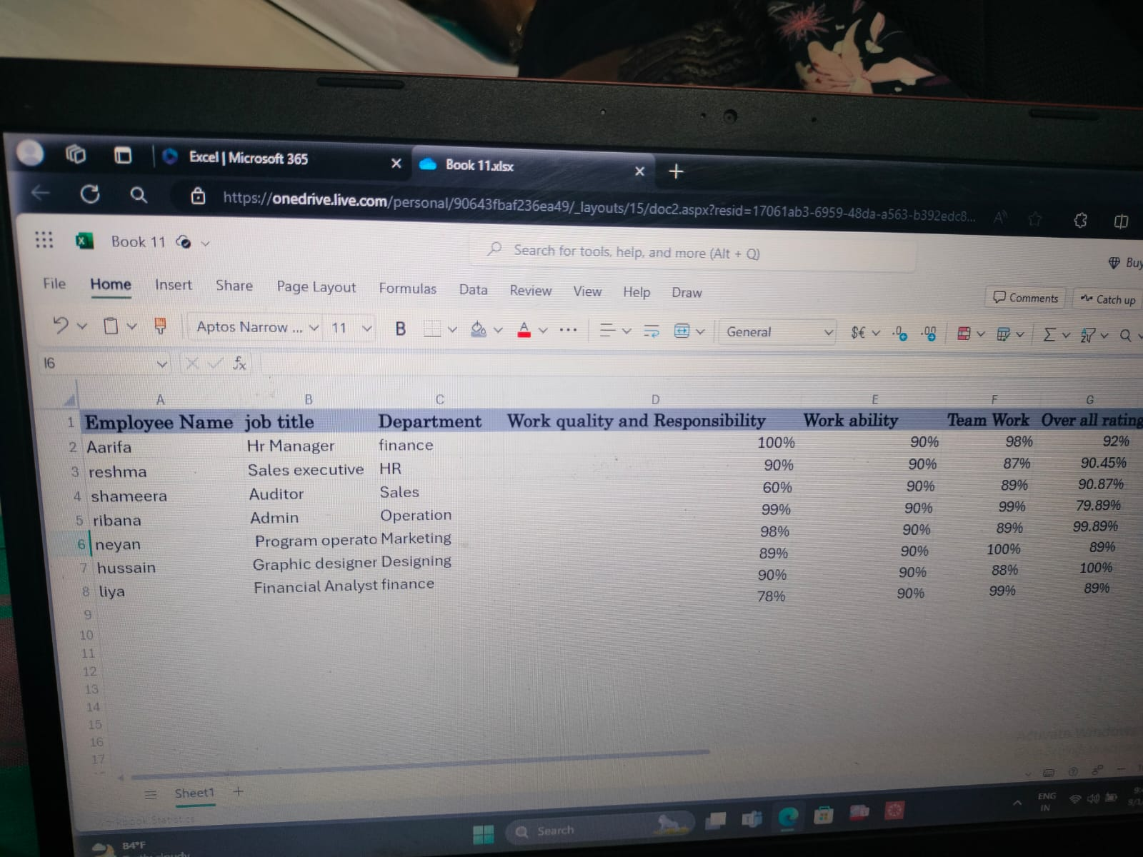

Slide 14
