Slide 1
Developing SQL Databases
RowStore Index

Slide 2
Storage
Files
Pages/Extents
Partitions
Allocation Units
Reads

Slide 3
Files
At a minimum, every SQL Server database has two operating system files: a data file and a log file. Data files contain data and objects such as tables, indexes, stored procedures, and views. Log files contain the information that is required to recover all transactions in the database. Data files can be grouped together in filegroups for allocation and administration purposes.
Primary
The primary data file contains the startup information for the database and points to the other files in the database. User data and objects can be stored in this file or in secondary data files. Every database has one primary data file. The recommended file name extension for primary data files is .mdf.
Secondary
Secondary data files are optional, are user-defined, and store user data. Secondary files can be used to spread data across multiple disks by putting each file on a different disk drive. Additionally, if a database exceeds the maximum size for a single Windows file, you can use secondary data files so the database can continue to grow.
Transaction Log
The transaction log files hold the log information that is used to recover the database. There must be at least one log file for each database. The recommended file name extension for transaction logs is .ldf.

Slide 4
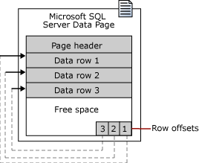
The fundamental unit of data storage in SQL Server is the page. The disk space allocated to a data file (.mdf or . ndf) in a database is logically divided into pages numbered contiguously from 0 to n. Disk I/O operations are performed at the page level. That is, SQL Server reads or writes whole data pages.
Extents are a collection of eight physically contiguous pages and are used to efficiently manage the pages. All pages are stored in extents.
Page
In SQL Server, the page size is 8 KB. This means SQL Server databases have 128 pages per megabyte. Each page begins with a 96-byte header that is used to store system information about the page. This information includes the page number, page type, the amount of free space on the page, and the allocation unit ID of the object that owns the page.

Slide 5
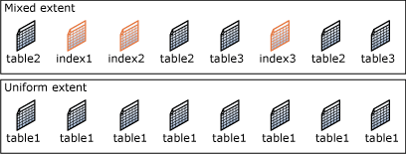
Extent
Extents are the basic unit in which space is managed. An extent is eight physically contiguous pages, or 64 KB. This means SQL Server databases have 16 extents per megabyte.
SQL Server has two types of extents:
Uniform extents are owned by a single object; all eight pages in the extent can only be used by the owning object.
Mixed extents are shared by up to eight objects. Each of the eight pages in the extent can be owned by a different object. allocations.

Slide 6
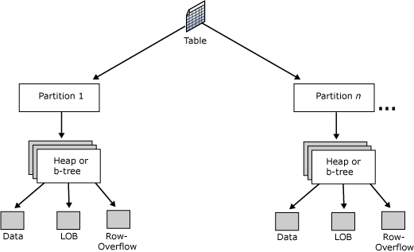
Tables and indexes are stored as a collection of 8-KB pages.
A table is contained in one or more partitions and each partition contains data rows in either a heap or a clustered index structure. The pages of the heap or clustered index are managed in one or more allocation units, depending on the column types in the data rows.
Partition
Table and index pages are contained in one or more partitions. A partition is a user-defined unit of data organization. By default, a table or index has only one partition that contains all the table or index pages.
To view the partitions used by a table or index, use the sys.partitions catalog view.

Slide 7
Allocation Units
An allocation unit is a collection of pages within a heap or B-tree used to manage data based on their page type. The following table lists the types of allocation units used to manage data in tables and indexes.
IN_ROW_DATA: Data or index rows that contain all data, except large object (LOB) data. Pages are of type Data or Index.
LOB_DATA: Large object data stored in one or more of these data types: text, ntext, image, xml, varchar(max), nvarchar(max), varbinary(max), or CLR user-defined types (CLR UDT). Pages are of type Text/Image.
ROW_OVERFLOW_DATA: Variable length data stored in varchar, nvarchar, varbinary, or sql_variant columns that exceed the 8,060 byte row size limit. Pages are of type Text/Image.
A heap or B-tree can have only one allocation unit of each type in a specific partition.
https://pl.seequality.net/jednostki-alokacji-w-sql-server-czyli-in_row_data-row_overflow_data-i-lob_data/

Slide 8
Reads
logical reads Number of pages read from the data cache.
physical reads Number of pages read from disk.
read-ahead reads Number of pages placed into the cache for the query.
„Hard disks are slow; memory is fast. This is a fact of nature for anyone that works with computers. Even SSDs are slow when compared to high-performance memory. The way in which software deals with this problem is to write data from slow storage into fast memory. Once loaded, your favorite apps can perform very fast and only need to go back to disk when new data is needed. This fact of life in computing is also an important part of SQL Server architecture.
Whenever data is written to or read from a SQL Server database, it will be copied into memory by the buffer manager. The buffer cache (also known as the buffer pool) will use as much memory as is allocated to it in order to hold as many pages of data as possible. When the buffer cache fills up, older and less used data will be purged in order to make room for newer data.”

Slide 9
Implementing Indexes
Heaps and Balanced Trees

Slide 10
Heap
A heap is a table without a clustered index. One or more nonclustered indexes can be created on tables stored as a heap. Data is stored in the heap without specifying an order. Usually data is initially stored in the order in which is the rows are inserted into the table, but the Database Engine can move data around in the heap to store the rows efficiently; so the data order cannot be predicted.
To guarantee the order of rows returned from a heap, you must use the ORDER BY clause. To specify the order for storage of the rows, create a clustered index on the table, so that the table is not a heap.
If a table is a heap and does not have any nonclustered indexes, then the entire table must be examined (a table scan) to find any row. This can be acceptable when the table is tiny, such as a list of the 12 regional offices of a company.

Slide 11
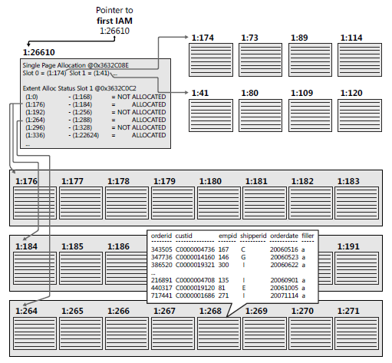
Heap

Slide 12
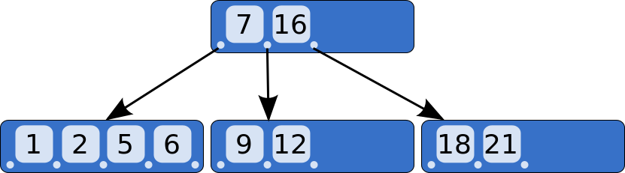
B-Tree
In computer science, a B-tree is a self-balancing tree data structure that keeps data sorted and allows searches, sequential access, insertions, and deletions in logarithmic time.
The B-tree is a generalization of a binary search tree in that a node can have more than two children.
Unlike self-balancing binary search trees, the B-tree is optimized for systems that read and write large blocks of data. B-trees are a good example of a data structure for external memory. It is commonly used in databases and filesystems.

Slide 13
Index
A database index is a data structure that improves the speed of data retrieval operations on a database table at the cost of additional writes and storage space to maintain the index data structure.
Indexes are used to quickly locate data without having to search every row in a database table every time a database table is accessed. Indexes can be created using one or more columns of a database table, providing the basis for both rapid random lookups and efficient access of ordered records.
Indexes are automatically created when PRIMARY KEY and UNIQUE constraints are defined on table columns. For example, when you create a table and identify a particular column to be the primary key, the Database Engine automatically creates a PRIMARY KEY constraint and index on that column.

Slide 14
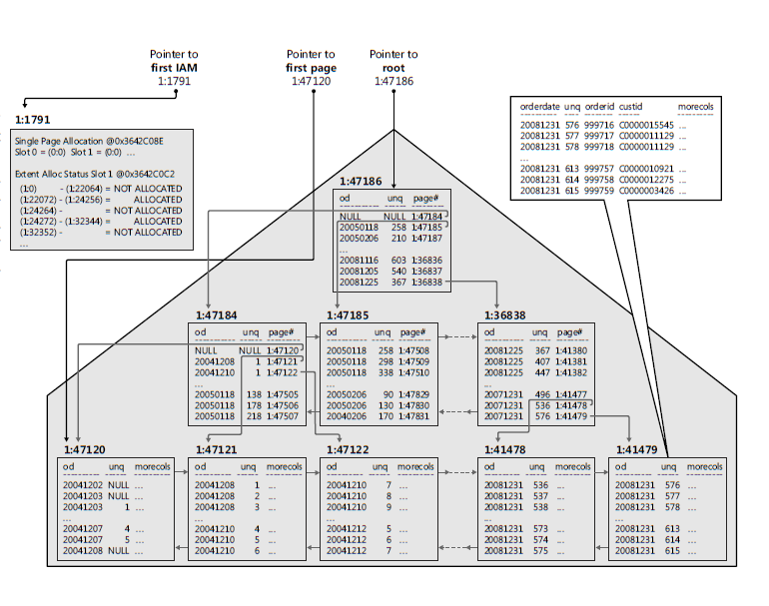
Index

Slide 15
Index
Well-designed indexes can reduce disk I/O operations and consume fewer system resources therefore improving query performance. Indexes can be helpful for a variety of queries that contain SELECT, UPDATE, DELETE, or MERGE statements.
When performing a table scan, the query optimizer reads all the rows in the table, and extracts the rows that meet the criteria of the query. A table scan generates many disk I/O operations and can be resource intensive. However, a table scan could be the most efficient method if, for example, the result set of the query is a high percentage of rows from the table.
When the query optimizer uses an index, it searches the index key columns, finds the storage location of the rows needed by the query and extracts the matching rows from that location.
Generally, searching the index is much faster than searching the table because unlike a table, an index frequently contains very few columns per row and the rows are in sorted order.
The query optimizer typically selects the most efficient method when executing queries. However, if no indexes are available, the query optimizer must use a table scan. Your task is to design and create indexes that are best suited to your environment so that the query optimizer has a selection of efficient indexes from which to select.

Slide 16
Clustered Index
Clustered indexes sort and store the data rows in the table or view based on their key values. These are the columns included in the index definition. There can be only one clustered index per table, because the data rows themselves can be sorted in only one order.
The only time the data rows in a table are stored in sorted order is when the table contains a clustered index. When a table has a clustered index, the table is called a clustered table. If a table has no clustered index, its data rows are stored in an unordered structure called a heap.

Slide 17
Non-Clustered Index
Nonclustered indexes have a structure separate from the data rows. A nonclustered index contains the nonclustered index key values and each key value entry has a pointer to the data row that contains the key value.
The pointer from an index row in a nonclustered index to a data row is called a row locator. The structure of the row locator depends on whether the data pages are stored in a heap or a clustered table. For a heap, a row locator is a pointer to the row. For a clustered table, the row locator is the clustered index key.
You can add nonkey columns to the leaf level of the nonclustered index to by-pass existing index key limits, 900 bytes and 16 key columns, and execute fully covered, indexed, queries.

