Slide 1
Developing SQL Databases
Columnstore

Slide 2
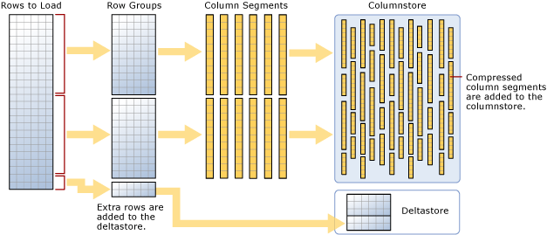
Columnstore Index
A columnstore index is a technology for storing, retrieving and managing data by using a columnar data format, called a columnstore. SQL Server supports both clustered and nonclustered columnstore indexes. Both use the same in-memory columnstore technology, but they do have differences in purpose and in features they support.
Benefits
Columnstore indexes work well for mostly read-only queries that perform analysis on large data sets. Often, these are queries for data warehousing workloads.
Columnstore indexes give high performance gains for queries that use full table scans, and are not well-suited for queries that seek into the data, searching for a particular value.

Slide 3
Columnstore indexes are purpose built for reporting scenarios, particularly when dealing with large quantities of data. Columnstore indexes are based on the concept of a columnar database, of which the concept is not a new one.
The base idea is that instead of storing all of the data for a row together, you store all of the data for a column together. Each column is stored independently, but the rows of the table are kept in the same order in each segment.
Column-oriented indexes, because they are not ordered, are not useful for picking only a few rows out of a table.

Slide 4
There are several data types that are not supported:
varchar(max) and nvarchar(max)
rowversion (also known as timestamp)
sql_variant
CLR based types (hierarchyid and spatial types)
xml
ntext, text, and image (though rightfully so as these data types have been deprecated for some time)

Slide 5
Each row group contains up to 1,048,576 rows each, broken down into segments that are all ordered physically the same, though in no logical order.
In each row group, there is a set of column segments, that store the data for one single column.
The deltastore structure comes into play when you are modifying the data in a table with a columnstore index. New rows are placed into the deltastore in a heap structure until the rows in the deltastore are compressed, and moved into a compressed row group in column segments.

Slide 6
DELETE operations simply mark the row as removed from the column segment, telling the query processor to ignore the row. UPDATE operations in the columnstore index are a delete from the columnstore index, and then the row is added to the deltastore like a normal INSERT operation.
The process that moves rows from the deltastore to compressed rowgroups is called the tuple mover. It is a background process that runs periodically and does most of the management of your columnstore index maintenance.

Slide 7
At a high level, columnstore indexes support two scenarios, one of which works with each type of index:
Dimensional formatted data warehouses (Clustered Columnstore Indexes)
Different than relational databases we have covered so far, we look at the pattern of how dimensional databases are structured, and how these indexes work well with them
Analytics on OLTP tables (Nonclustered Columnstore Indexes)
Due to how these indexes are maintained, it can be that when operational reporting is needed, a columnstore index performs better overall than a B-Tree index, particularly if multiple complex B-Tree indexes are needed, as the query processor only needs to synchronously maintain one analytical index.
These indexes are not used to improve performance of small row by row operations, but rather when one needs to work through large sets of data, touching most of the rows. In this section, we review how this need applies to the two identified scenarios, and how they differ calling for the different type of index.

Slide 8
DELAYING ADDING ROWS TO COMPRESSED ROWGROUPS
Columnstore indexes have to be maintained in the same transaction with the modification statement, just like normal indexes. However, modifications are done in a multi-step process that is optimized for the loading of the data. As described earlier, all modifications are done as an insert into the delta store, a delete from a column segment or the delta store, or both for an update to a row. The data is organized into compressed segments over time, which is a burden in a very busy system. Note that many rows in an OLTP system can be updated multiple times soon after rows are created, but in many systems are relatively static as time passes.
Hence there is a setting that lets you control the amount of time the data stays in the
deltastore. The setting is: COMPRESSION_DELAY, and the units are minutes. This says that
the data stays in the delta rowgroup for at least a certain number of minutes.

Slide 9
USING FILTERED NON-CLUSTERED COLUMNSTORE INDEXES TO TARGET COLDER DATA
Similar to filtered rowstore indexes, non-clustered columnstore indexes have filter clauses that allow you to target only data that is of a certain status. For example, Listing 1-17 is the structure of the Sales.Orders table. Say that there is a business rule that once the items have been picked by a person, it is going to be shipped. Up until then, the order could change in several ways. The user needs to be able to write some reports on the orders that have been picked.

