Slide 1
Developing SQL Databases
SQL Server Data Tools

Slide 2
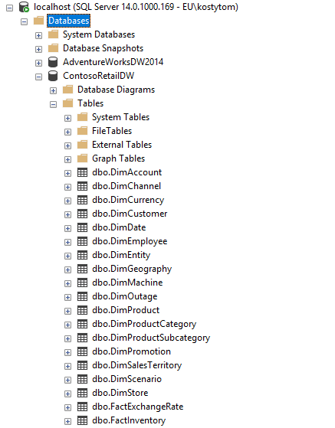
Contoso
Task:
Script database

Slide 3
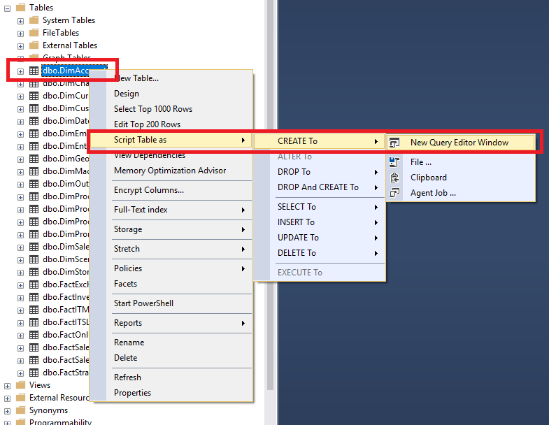
Script each Database Object separately:

Slide 4
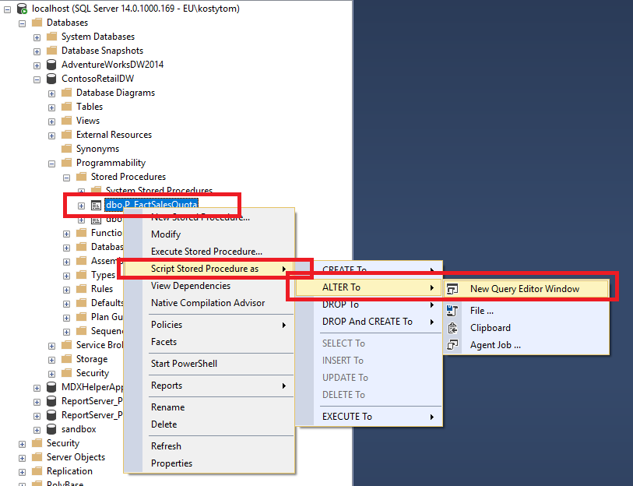
Script each Database Object separately:

Slide 5
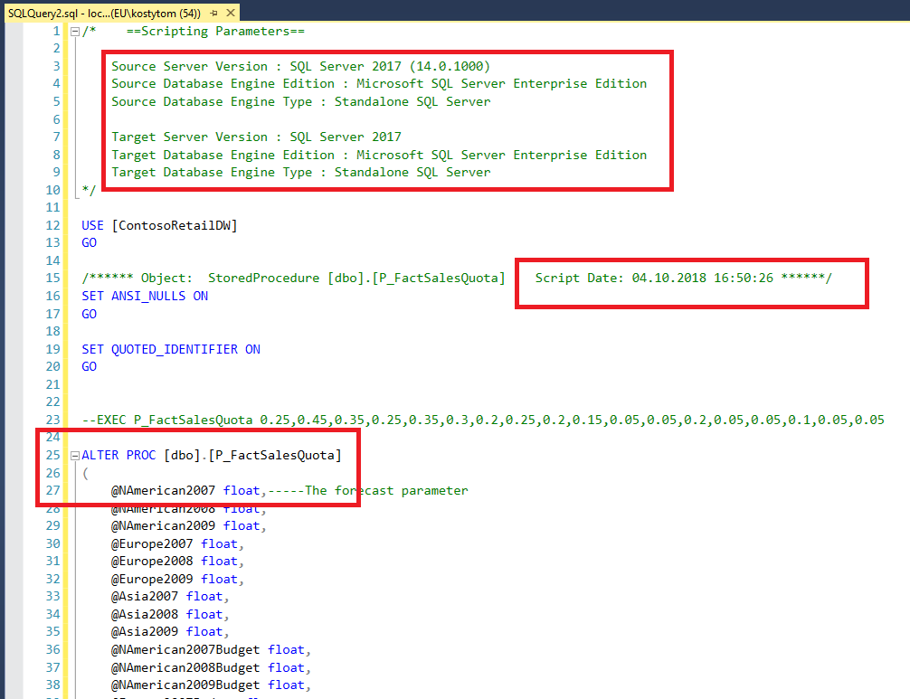
Script each Database Object separately:

Slide 6
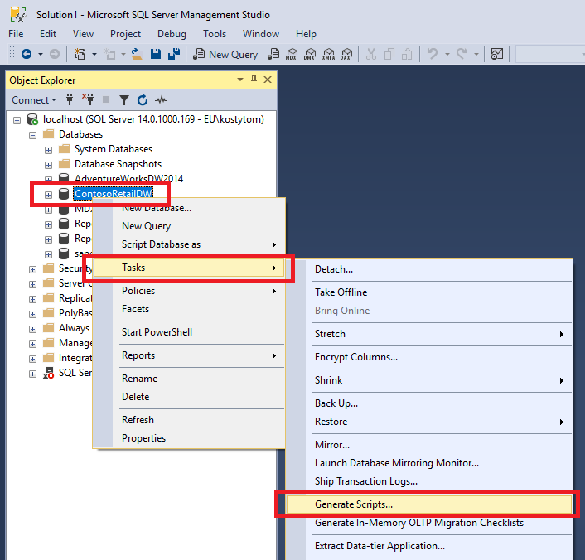
Generate Scripts …

Slide 7
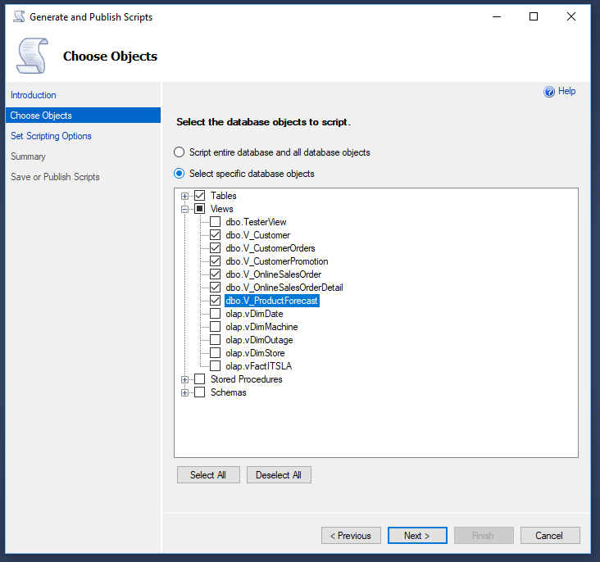
Generate Scripts …

Slide 8
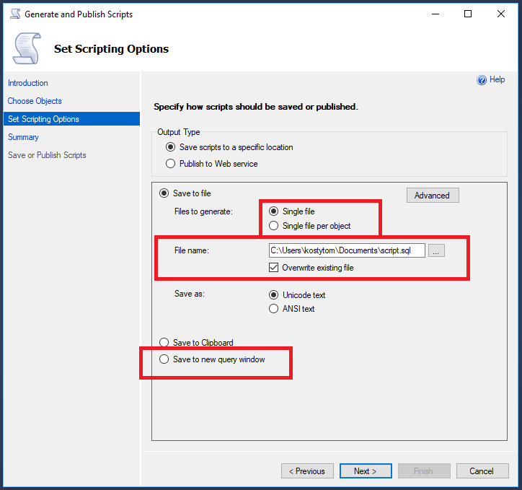
Generate Scripts …

Slide 9
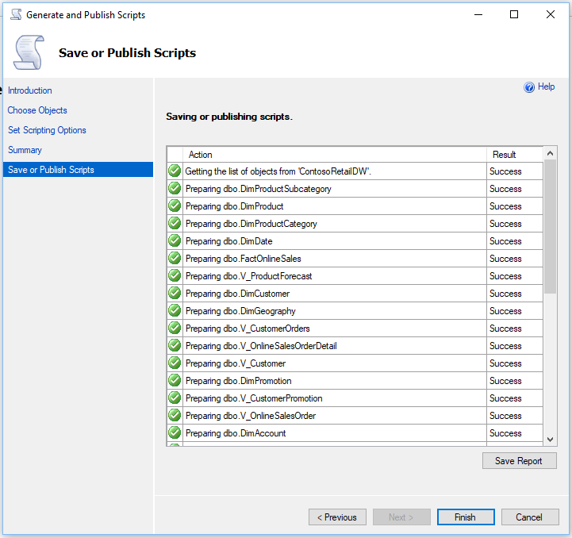
Generate Scripts …

Slide 10
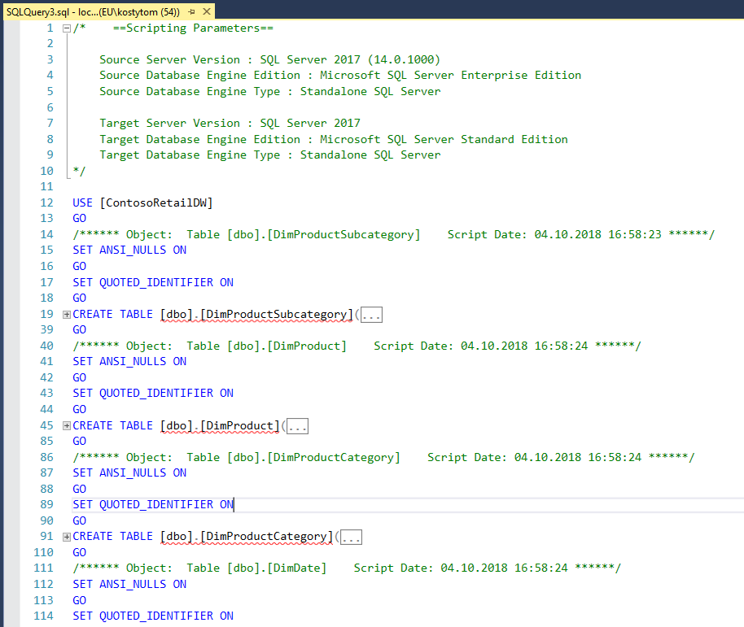
Generate Scripts …

Slide 11
SQL Server Data Tools

Slide 12
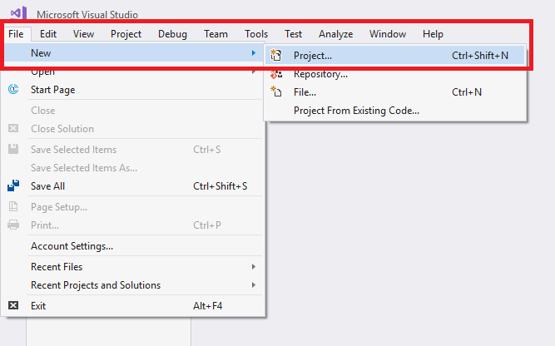
Create project:

Slide 13
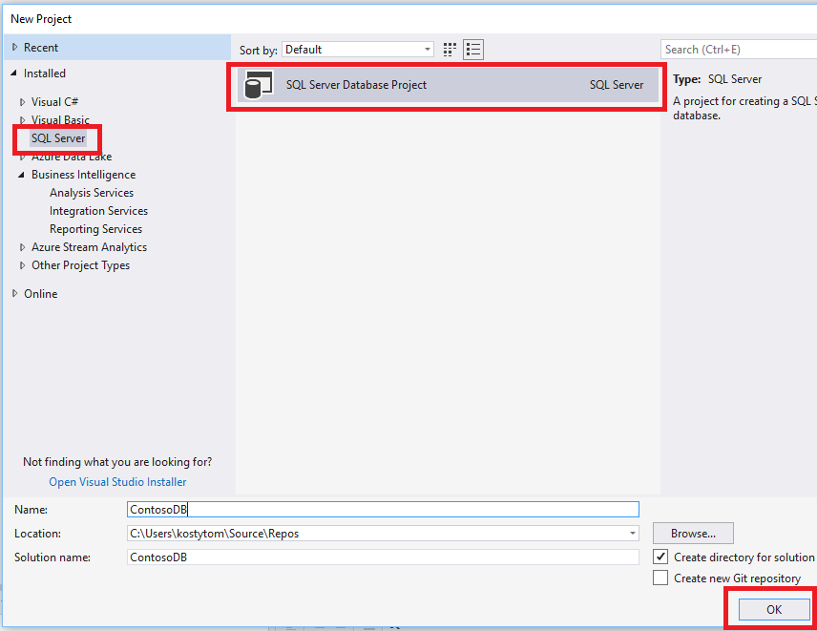
SQL/S DB Project:

Slide 14
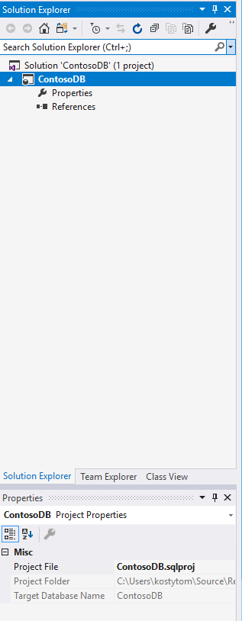
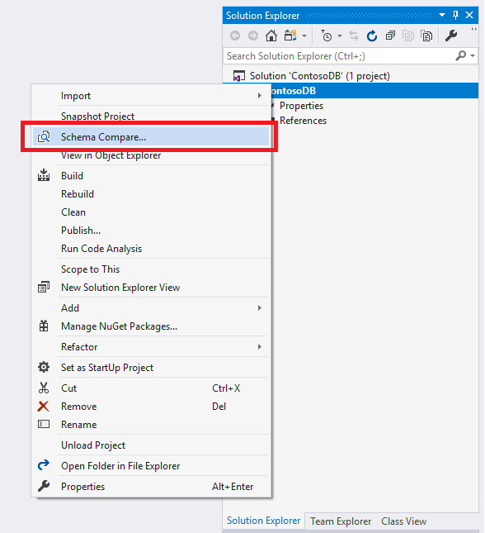
Schema Compare:

Slide 15
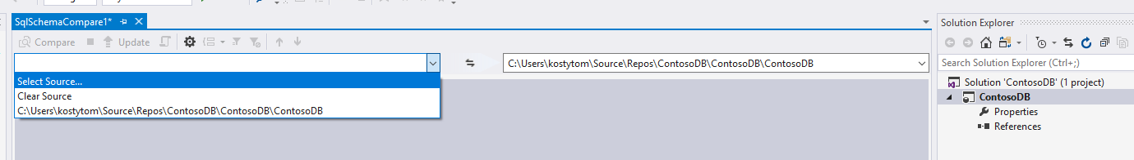
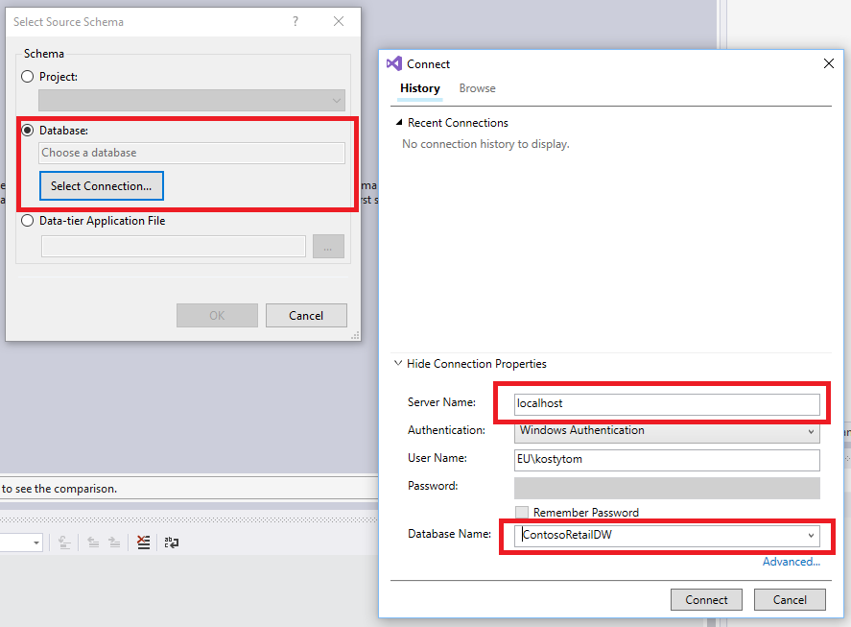
Schema Compare:

Slide 16
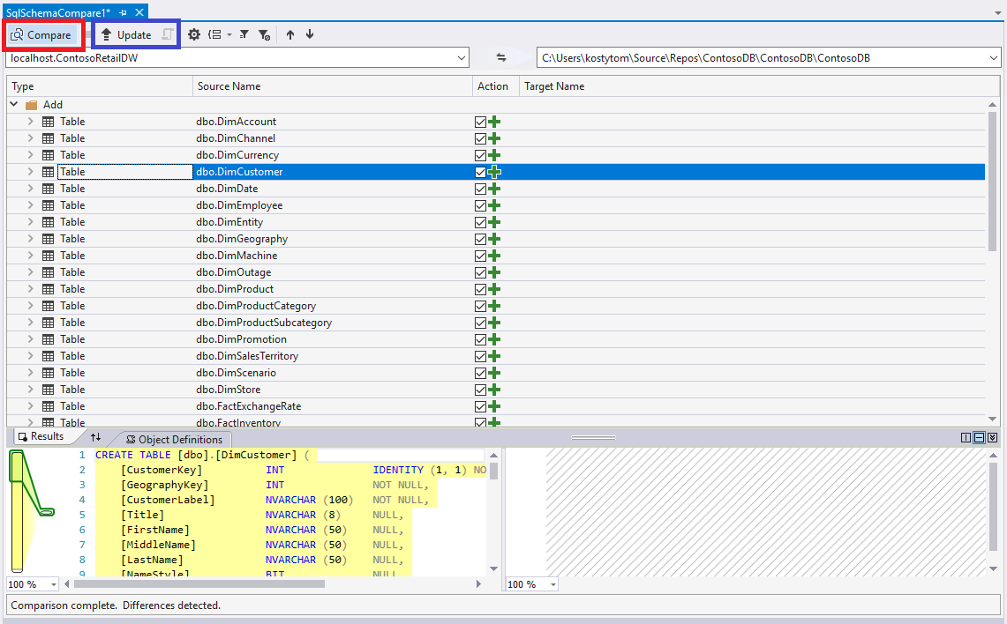
Compare & Update:

Slide 17
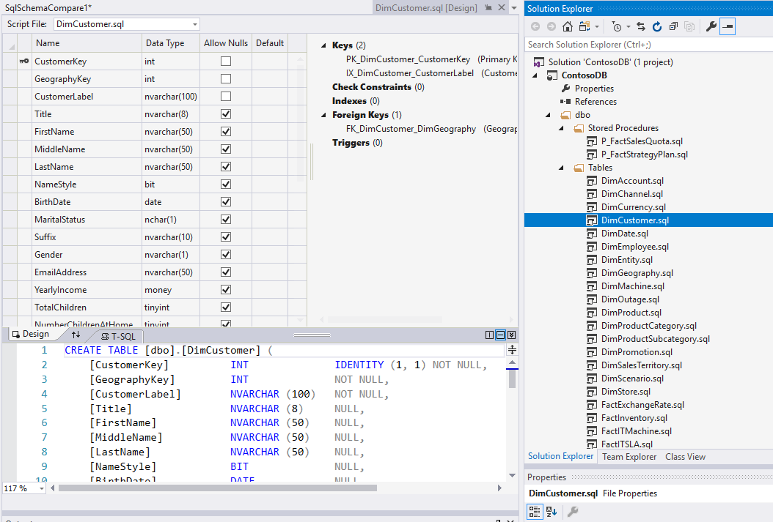
Check Objects in the project:

Slide 18
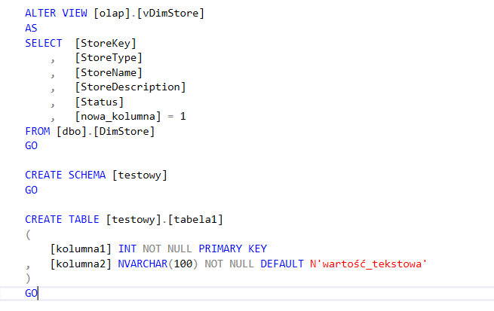
Alter objects in the DB, add new Schema/Table:

Slide 19
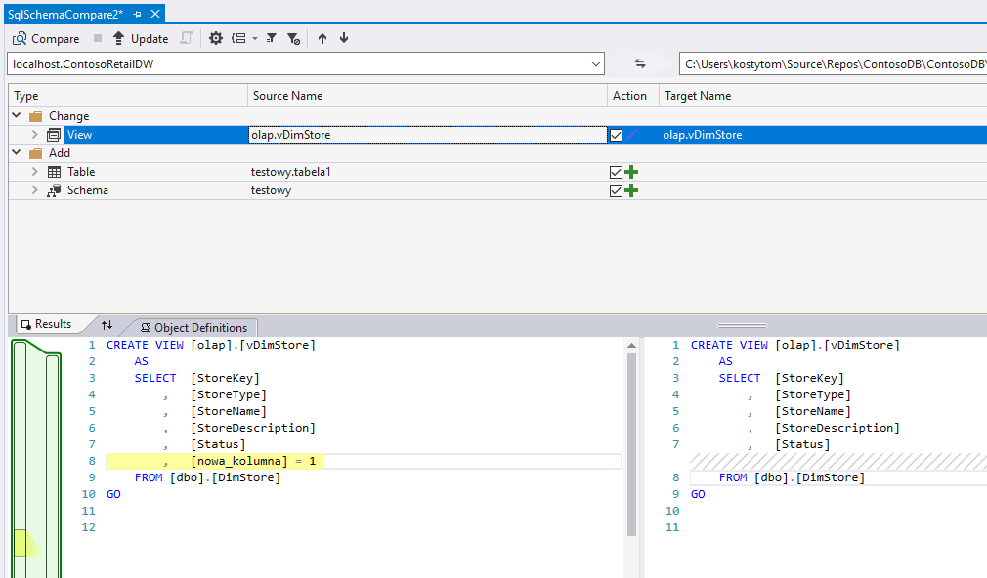
Compare & Update:

