Slide 1
Developing SQL Databases
Normalization

Slide 2
Normalization
First Normal Form (1NF)
Second Normal Form (2NF)
Third Normal Form (3NF)
Fourth Normal Form (4NF)
Fifth Normal Form (5NF)

Slide 3
Normalization
Normalization is the process of efficiently organizing data in a database. There are two goals of the normalization process: eliminating redundant data (for example, storing the same data in more than one table) and ensuring data dependencies make sense (only storing related data in a table).
Normalization has these three advantages:
Development costs: Although it may take longer to design a normalized database, such databases are easier to work with and reduce development costs.
Usability: Placing columns in the correct table makes it easier to understand a database and write correct queries. This helps reduce design time and cost.
Extensibility: A non-normalized database is often more complex and therefore more difficult to modify.

Slide 4
Normalization
First normalization form (1NF): Eliminate repeating groups
Second normalization form (2NF): Eliminate redundant data
Third normalization form (3NF): Eliminate columns not dependent on key
Fourth normalization form (4NF): Isolate independent multiple relationships
Fifth normalization form (5NF): Isolate semantically related multiple relationships
Normalization forms represent a progressive level of compliance. You can’t be in 2NF until you have met 1NF.

Slide 5
First Normal Form (1NF)
The table is in 1NF if he following three conditions are met:
The table must have no duplicate records. Once you have defined a primary key for the table, you have met the first normalized form criterion.
The table must not have multivalued attributes, meaning that you can’t combine in a single column multiple values that are considered valid for a column (eg. names of certifications an employee achieved).
The entries in the column or attribute must be of the same data type.
product_id | color | price
1 | red | 753,79
1 | green | 753,79
2 | green | 44,73
3 | blue | 327,27
3 | red | 327,27
4 | blue | 245,78
5 | red | 947,74
6 | red | 290,32
product_id | color | price
1 | red, green | 753,79
2 | green | 44,73
3 | blue, red | 327,27
4 | blue | 245,78
5 | red | 947,74
6 | red | 290,32

Slide 6
Second Normal Form (2NF)
The 2NF ensures that each attribute does in fact describe the entity.
This form is entirely based on dependency: attribute must be functionally dependent upon the entire primary key.
Combined (composite) primary keys run into trouble with the second normal form if the attributes aren’t dependent on every attribute in the primary key.
If an attribute depends on one of the primary key attributes but not the others, then it becomes a partial dependency, which violates the second normal form.
product_id | color
1 | red
1 | green
2 | green
3 | blue
3 | red
4 | blue
5 | red
6 | red
product_id | color | price
1 | red | 753,79
1 | green | 753,79
2 | green | 44,73
3 | blue | 327,27
3 | red | 327,27
4 | blue | 245,78
5 | red | 947,74
6 | red | 290,32
product_id | price
1 | 753,79
2 | 44,73
3 | 327,27
4 | 245,78
5 | 947,74
6 | 290,32

Slide 7
Third Normal Form (3NF)
3NF checks transitive dependencies.
A transitive dependency is similar to a partial dependency in that both refer to attributes that are not fully dependent on a primary key.
A dependency is considered transient when attribute1 is dependent on attribute2, which is then dependent on the primary key.
The second normal form is violated when an attribute depends on only part of the key, and the third normal form is violated when the attribute depends on the key but also on another non-key attribute.
The central phrase to remember in describing the third normal form is that
every attribute must “provide a fact about the key, the whole key, and nothing but the key.”
There are two basic requirements for a database to be in third normal form:
The database must already meet the requirements of both 1NF and 2NF.
The database must not contain any columns that aren’t fully dependent upon the primary key.

Slide 8
Third Normal Form (3NF)
product_id | product_price
1 | 753,79
2 | 44,73
3 | 327,27
4 | 245,78
5 | 947,74
6 | 290,32
product_id | product_code | product_price
1 | AA1 | 753,79
2 | AB4 | 44,73
3 | CF3 | 327,27
4 | KD9 | 245,78
5 | XE2 | 947,74
6 | CP0 | 290,32
product_id | product_code
1 | AA1
2 | AB4
3 | CF3
4 | KD9
5 | XE2
6 | CP0
OrderNumber (PK)
CustomerNumber
UnitPrice
Quantity
Total
OrderNumber (PK)
CustomerNumber
UnitPrice
Quantity

Slide 9
Fourth Normal Form (4NF)
The fourth normal form (4NF) involves two independent attributes brought together to form a primary key along with a third attribute.
Under fourth normal form, a record type should not contain two or more independent multi-valued facts about an entity. In addition, the record must satisfy third normal form.
EMPLOYEE | LANGUAGE
Smith | French
Smith | German
Smith | Greek
EMPLOYEE | SKILL | LANGUAGE
Smith | type | French
Smith | type | German
Smith | type | Greek
Smith | cook | French
Smith | cook | German
Smith | cook | Greek
EMPLOYEE | SKILL
Smith | type
Smith | cook

Slide 10
Fifth Normal Form (5NF)
The fifth normal form (5NF) provides a method for designing complex relationships involving multiple (usually three or more) entities.
Fifth normal form deals with cases where information can be reconstructed from smaller pieces of information that can be maintained with less redundancy. Second, third, and fourth normal forms also serve this purpose, but fifth normal form generalizes to cases not covered by the others.
If we can decompose table further to eliminate redundancy and anomaly, and when we re-join the decomposed tables by means of candidate keys, we should not be losing the original data or any new record set should not arise. In simple words, joining two or more decomposed table should not lose records nor create new records.

Slide 11
Fifth Normal Form (5NF)
AGENT | COMPANY
Smith | Ford
Smith | GM
Jones | Ford
Brown | Ford
Brown | GM
Brown | Toyota
AGENT | COMPANY | PRODUCT
Smith | Ford | car
Smith | Ford | truck
Smith | GM | car
Smith | GM | truck
Jones | Ford | car
Jones | Ford | truck
Brown | Ford | car
Brown | GM | car
Brown | Totota | car
Brown | Totota | bus
COMPANY | PRODUCT
Ford | car
Ford | truck
GM | car
GM | truck
Toyota | car
Toyota | bus
AGENT | PRODUCT
Smith | car
Smith | truck
Jones | car
Jones | truck
Brown | car
Brown | bus

Slide 12
Denormalization
Star
Snowflake

Slide 13
OLTP vs. OLAP
 | OLTP System | OLAP System
 | Online Transaction Processing | Online Analytical Processing
 | (Operational System) | (Data Warehouse)
źródło danych | dane operacyjne | dane skonsolidowane, pobierane z systemów OLTP, dane zewnętrzne (np. GUS), pliki xlsx/csv (korekty, analizy, wyliczenia)
cel | obsługa procesów biznesowych | analiza, planowanie, wspomaganie podejmowania decyzji
Co jest w danych | stan bieżący | stan bieżący oraz historia
Operacje Insert i Update | krótkie, szybkie, inicjowane przez użytkowników (dużo małych) | cykliczne ładowania o dużej obiętości, UPDATE sporadycznie
Zapytania | relatywnie proste, punktowe | złożone, na dużym wolumenie danych
Czas procesowania | bardzo szybki | w zależności od zapytania, może być bardzo długi
Potrzebne miejsce | relatywnie mało | dużo
Struktura bazy danych | mocna normalizacja | denormalizacja - schemat gwiazdy/płatka śniegu
Kopia i odzyskiwanie danych | obowiązkowy backup, utrada danych bardzo kosztowna (często niedopuszczalna), mirroring (np. Backup Full + Diff, Recovery Full, backup logów) | relatywnie rzadko, bardziej w celu przyśpiszenia odtwarzania niż z obawy przed utratą danych. Odzyskać można poprzez ponowne przeliczenie prosto z systemów źródłowych.

Slide 14
DENORMALIZACJA (Hurtownie Danych)
Korzyści płynące z normalizacji:
Storage Space – w przypadku wymiarów nieistotne
Spójność danych po operacjach DML – nieistotne, DWH się ładuje i nie modyfikuje, porządek z OLTP zostaje przeniesiony
Łatwość modyfikacji struktur – nieistotne
Koszty normalizacji:
Wolniejsze zapytania wykorzystujące łączenie tabel (JOIN) – bardzo ważne!

Slide 15
Star Schema (GWIAZDA)
Dim Territory
FACT
SALES
Dim Customer
Dim Product
Dim Store

Slide 16
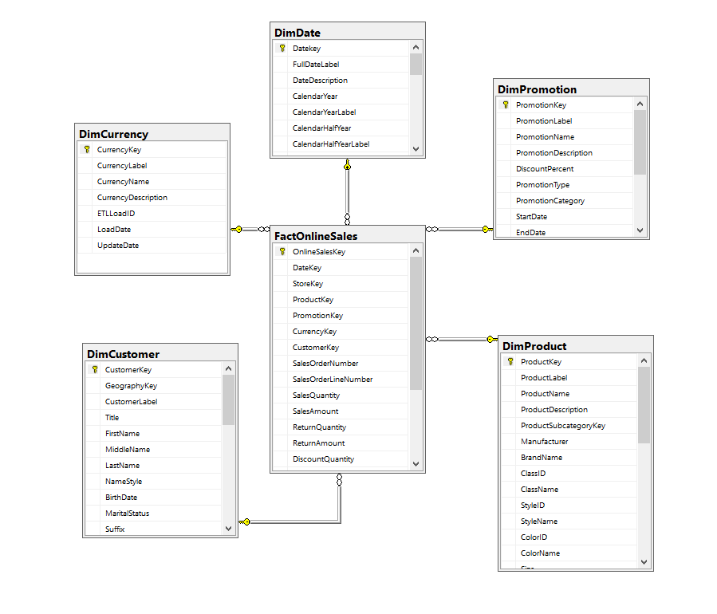
Contoso

Slide 17
Snowflake Schema (PŁATEK ŚNIEGU)
Dim Region
Dim Territory
FACT
SALES
Dim Customer
Dim Product
Dim Store
Dim Product
Category
Dim Organization Structure

Slide 18
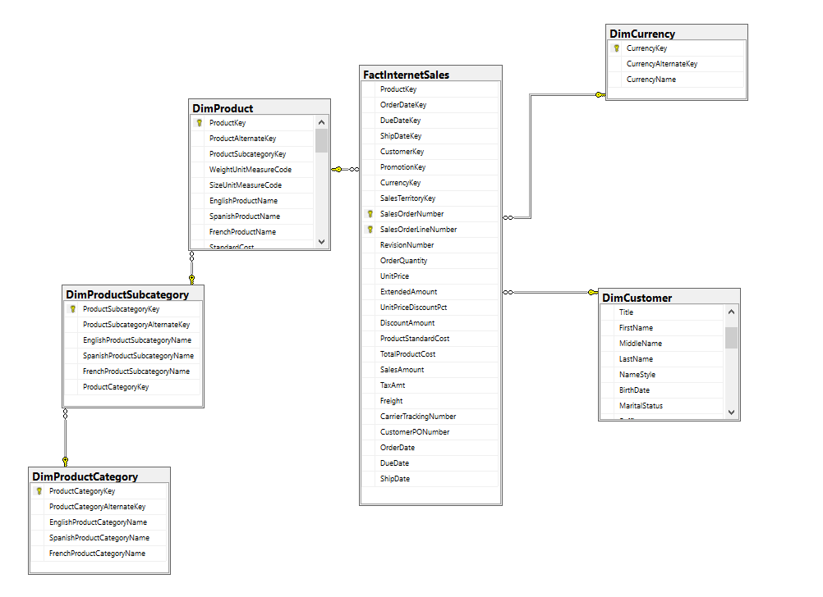
AW DW

