Slide 1
Developing SQL Databases
Rebuild/Reorganize

Slide 2
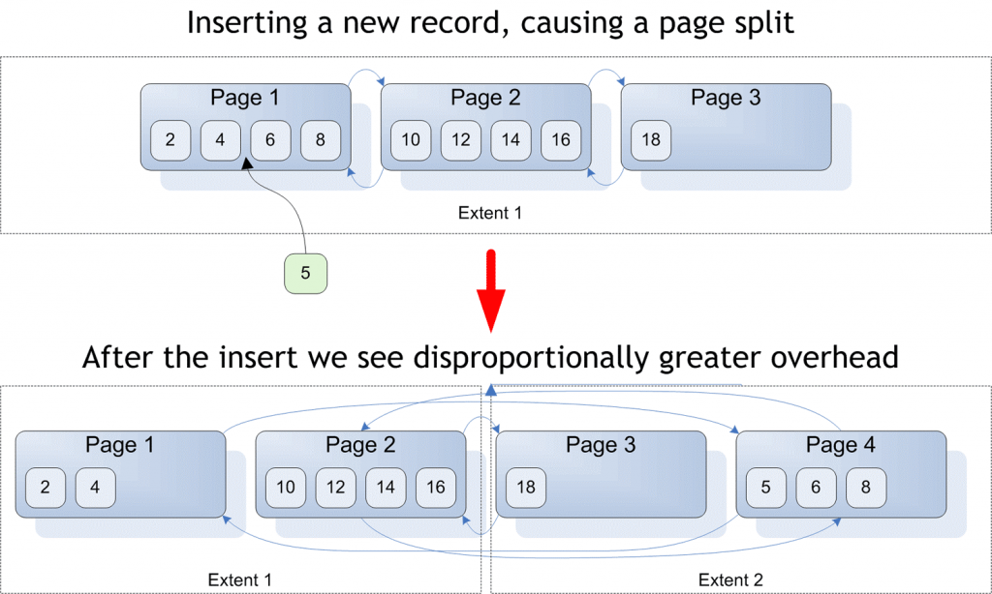
Fragmentation
A fragmented table is a table where some of its data pages point to pages that are not immediately following pages in the extent, and if all its pages are contiguous in both the allocation plan and the extents, then the table is not fragmented.
https://social.technet.microsoft.com/wiki/contents/articles/40339.what-is-fragmentation-in-sql-server.aspx
https://docs.microsoft.com/en-us/sql/relational-databases/indexes/reorganize-and-rebuild-indexes?view=sql-server-2017

Slide 3
Fragmentation
A fragmented table is a table where some of its data pages point to pages that are not immediately following pages in the extent, and if all its pages are contiguous in both the allocation plan and the extents, then the table is not fragmented.
sys.dm_db_index_physical_stats
Returns size and fragmentation information for the data and indexes of the specified table or view in SQL Server. For an index, one row is returned for each level of the B-tree in each partition. For a heap, one row is returned for the IN_ROW_DATA allocation unit of each partition. For large object (LOB) data, one row is returned for the LOB_DATA allocation unit of each partition. If row-overflow data exists in the table, one row is returned for the ROW_OVERFLOW_DATA allocation unit in each partition.
https://docs.microsoft.com/en-us/sql/relational-databases/system-dynamic-management-views/sys-dm-db-index-physical-stats-transact-sql?view=sql-server-2017

Slide 4
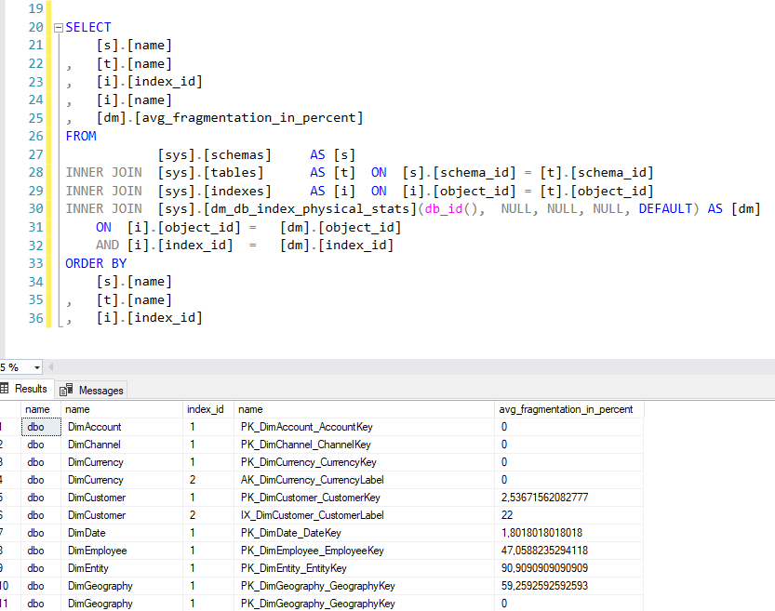

Slide 5
REBUILD vs. REORGANIZE
The first step in deciding which defragmentation method to use is to analyze the index to determine the degree of fragmentation.
Column Description
avg_fragmentation_in_percent The percent of logical fragmentation (out-of-order pages in the index).
fragment_count The number of fragments (physically consecutive leaf pages) in the index.
avg_fragment_size_in_pages Average number of pages in one fragment in an index.
After the degree of fragmentation is known, use the following table to determine the best method to correct the fragmentation.
> 5% and < = 30% ALTER INDEX REORGANIZE
> 30% ALTER INDEX REBUILD WITH (ONLINE = ON)

Slide 6
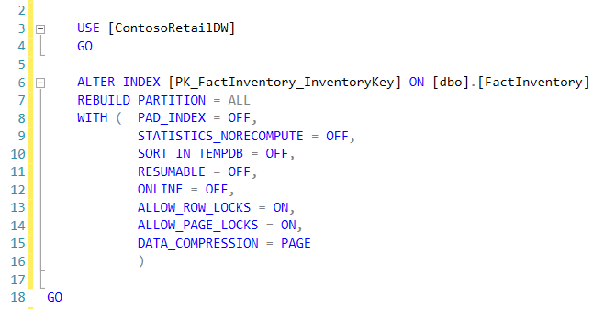
REBUILD
An index ‘rebuild’ creates a fresh, sparkling new structure for the index. If the index is disabled, rebuilding brings it back to life.
You can apply a new fillfactor when you rebuild an index. If you cancel a rebuild operation midway,
it must roll back (and if it’s being done offline, that can take a while).

Slide 7
REBUILD OPTIONS
FILLFACTOR
Specifies a percentage that indicates how full the Database Engine should make the leaf level of each index page during index creation or alteration. fillfactor must be an integer value from 1 to 100. The default is 0. Fill factor values 0 and 100 are the same in all respects.
An explicit FILLFACTOR setting applies only when the index is first created or rebuilt. The Database Engine does not dynamically keep the specified percentage of empty space in the pages.
DATA_COMPRESSION
Specifies the data compression option for the specified index, partition number, or range of partitions. The options are as follows:
NONE: Index or specified partitions are not compressed. This does not apply to columnstore indexes.
ROW: Index or specified partitions are compressed by using row compression. This does not apply to columnstore indexes.
PAGE: Index or specified partitions are compressed by using page compression. This does not apply to columnstore indexes.

Slide 8
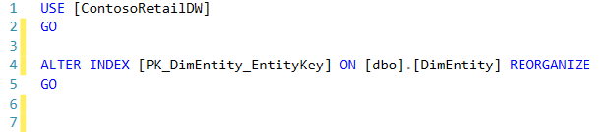
REORGANIZE
This option is more lightweight. It runs through the leaf level of the index,
and as it goes it fixes physical ordering of pages and also compacts pages to apply any previously set fillfactor settings.
This operation is always online, and if you cancel it then it’s able to just stop where it is (it doesn’t have a giant operation to rollback).

