Slide 1
Developing SQL Databases
Transactions And Locks

Slide 2
Transactions

Slide 3
TRANSACTIONS
A transaction is a logical unit of work. Either all the work completes as a whole unit, or none of it does.

Slide 4
ACID
Atomicity
Every transaction is an atomic unit of work, meaning that all database changes in the transaction succeed or none of them succeed.
Consistency
Every transaction, whether successful or not, leaves the database in a consistent state as defined by all object and database constraints. If an inconsistent state results, SQL Server will roll back the transaction to maintain a consistent state.
Isolation
Every transaction looks as though it occurs in isolation from other transactions in regard to database changes. The degree of isolation can vary based on isolation level.
Durability
Every transaction endures through an interruption of service. When service is restored, all committed transactions are rolled forward (committed changes to the database are completed) and all uncommitted transactions are rolled back (uncommitted changes are removed).

Slide 5
TYPES OF TRANSACTIONS
SQL Server has two basic types of transactions:
System transactions
SQL Server maintains all its internal persistent system tables by using transactions that it classifies as system transactions. These transactions are not under user control.
User transactions
These are transactions created by users in the process of changing and even reading data, whether automatically, implicitly, or explicitly.

Slide 6
TRANSACTION MODE
There are three modes for user transactions in SQL Server—that is, three ways of working with transactions:
AUTOCOMMIT
In the autocommit mode, single data modification and DDL T-SQL statements are executed in the context of a transaction that will be automatically committed when the statement succeeds, or automatically rolled back if the statement fails.
IMPLICIT TRANSACTION
In the implicit transaction mode, when you issue one or more DML or DDL statements, or a SELECT statement, SQL Server starts a transaction, increments @@TRANCOUNT, but does not automatically commit or roll back the statement. You must issue a COMMIT or ROLLBACK interactively to finish the transaction, even if all you issued was a SELECT statement.
EXPLICIT TRANSACTION
An explicit transaction occurs when you explicitly issue the BEGIN TRANSACTION or BEGIN TRAN command to start a transaction.

Slide 7
TRANSACTION STATE
You can detect the transaction level or state by using two system functions:
@@TRANCOUNT
can be queried to find the level of transaction.
A level of 0 indicates that at this point, the code is not within a transaction.
A level > 0 indicates that there is an active transaction, and a number > 1 indicates the nesting level of nested transactions.
XACT_STATE()
can be queried to find the state of the transaction.
A state of 0 indicates that there is no active transaction.
A state of 1 indicates that there is an uncommitted transaction, and it can be committed, but the nesting level is not reported.
A state of -1 indicates that there is an uncommitted transaction, but it cannot be committed due to a prior fatal error.

Slide 8
ADDITIONAL TRANSACTION OPTIONS
Numerous additional remaining options for transactions are available that are somewhat
more specialized.
SAVEPOINTS
These are locations within transactions that you can use to roll back a selective subset of work.
CROSS-DB TRANSACTIONS
A transaction may span two or more databases on a single SQL Server instance without any additional work on the user’s part.
DISTRIBUTED TRANSACTIONS
It is possible to make a transaction span more than one server, by using a linked server. In that case, the transaction is known as a distributed (as opposed to local) transaction.

Slide 9
Locks

Slide 10
BASICS
Locking is the activity that occurs when a SQL Server session takes "ownership" of a resource prior to performing a particular action on that resource, such as reading or updating it.
Keep in mind that locking is just a logical concept, designed to help support the ACID properties of our transactions, so that our data stays consistent.
If SQL Server acquired no locks, it could still perform all the actions specified by commands in the SQL language. However, for anyone who cares about data consistency, locks are a good and necessary database mechanism.
fundamental aspects of this locking mechanism:
The unit of data locked (lock resource) – such as row, page, or table
The type of locks acquired (lock mode) – shared, exclusive, update, and so on

Slide 11
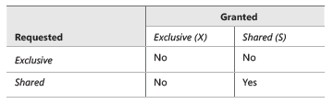
BASICS
To preserve the isolation of transactions, SQL Server implements a set of locking protocols. At the basic level, there are two general modes of locking:
Shared locks
Used for sessions that read data—that is, for readers
Exclusive locks
Used for changes to data—that is, writers
When a session is just reading data, by default SQL Server will issue very brief shared locks on the resource, such as a row or table. Two or more sessions can read the same objects because shared locks are compatible with other shared locks.
However, when a session has a resource locked exclusively, no other session can read the resource, in addition to not being able to write to the resource.

Slide 12
BLOCKING
If two sessions request an exclusive lock on the same resource, and one is granted the request, then the other session must wait until the first releases its exclusive lock. In a transaction, exclusive locks are held to the end of the transaction, so if the first session is performing a transaction, the second session will have to wait until the first session either commits or rolls back the transaction. No two sessions can write to the same resource (such as a table or row) at the same time, so writers can block writers.
DEADLOCKING
A deadlock results from mutual blocking between two or more sessions. Sometimes locking sequences between sessions cannot be resolved simply by waiting for one transaction to finish. This occurs due to a cyclical relationship between two or more commands. SQL Server detects this cycle as a deadlock between two sessions, aborts one of the transactions, and returns error message 1205 to the client.

Slide 13
SHARED LOCKS
By default, SQL Server acquires shared (S) locks automatically when it reads data.
A table, page, or individual row of a table or index can hold an S-lock. In addition, to support SERIALIZABLE transaction isolation, SQL Server can place S-locks on a range of index rows.
As the name implies, many processes can hold S-locks on the same data, but no process can acquire an exclusive lock on data that has an S-lock on it (unless the process requesting the exclusive lock is the same process holding the S lock, and no other process has an S lock on the data).

Slide 14
EXCLUSIVE LOCK
SQL Server automatically acquires exclusive (X) locks on data in order to modify that data, during an INSERT, UPDATE, or DELETE operation.
Only one transaction at a time can hold an X lock on a particular data resource, and X locks remain until the end of the transaction.
The changed data is usually unavailable to any other process until the transaction holding the lock either commits or rolls back.
However, if a transaction uses the READ UNCOMMITTED transaction isolation level, it can read data exclusively locked by another transaction.

Slide 15
RESOURCES
SQL Server can acquire a lock on any of the following resources to ensure that the user
of that resource has a consistent view of the data throughout a transaction:
RID
A row identifier for the single row to lock within a heap and is acquired when possible to provide the highest possible concurrency.
KEY
A key or range of keys in an index for a serializable transaction can be locked in one of two ways depending on the isolation level. If a transaction runs in the READ COMMITTED or REPEATABLE READ isolation level, the index keys of the accessed rows are locked.
PAGE
An 8-kilobyte (KB) data or index page gets locked when a transaction reads all rows on a page or when page-level maintenance, such as updating page pointers after a page-split, is performed.
EXTENT
A contiguous block of eight data or index pages gets a shared (S) or exclusive (X) locks typically during space allocation and de-allocation.

Slide 16
RESOURCES
HoBT
A heap or B-Tree lock can be an entire index or all data pages of a heap. Table An entire table, including both data and indexes, can be locked for SELECT, UPDATE, or DELETE operations.
File
A database file can be locked individually.
Application
A resource defined by your application can be locked by using sp_getapplock so that you can lock any resource you want with a specified lock mode.
Metadata
Any system metadata can be locked to protect system catalog information.
Allocation unit
An database allocation unit used for storage of data can be locked.
Database
An entire database gets a shared (S) lock to indicate it is currently in use so that another process cannot drop it, take it offline, or restore it.or restore it.

Slide 17
DMVs

Slide 18
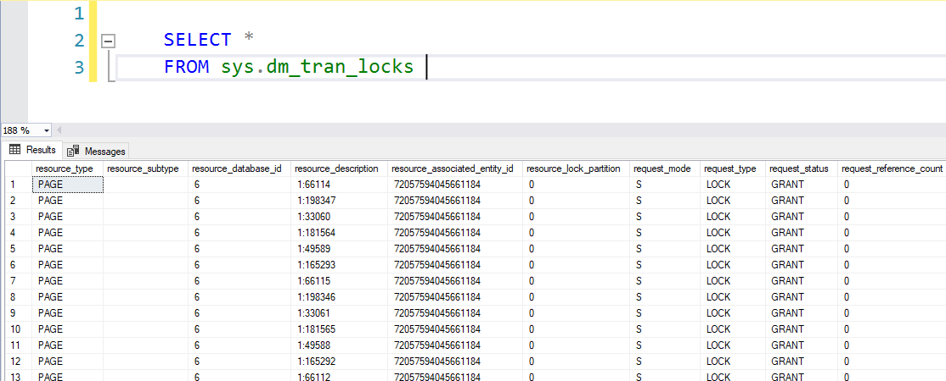
DMVs
sys.dm_tran_locks
Use this DMV to view all current locks, the lock resources, lock mode, and other related information.
The sys.dm_tran_locks DMV provides you with information about existing locks and locks that have been requested but not yet granted in addition to details about the resource for which the lock is requested. You can use this DMV only to view information at the current point in time. It does not provide access to historical information about locks. Table 3-2 describes each column in sys.dm_tran_locks.

Slide 19
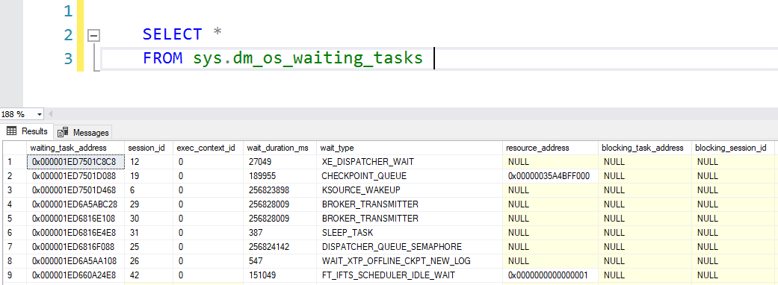
DMVs
sys.dm_os_waiting_tasks
Use this DMV to see which tasks are waiting for a resource.
Another useful DMV is sys.dm_os_waiting_tasks. Whenever a user asks you why a query is taking longer to run than usual, a review of this DMV should be one of your standard troubleshooting steps.

Slide 20
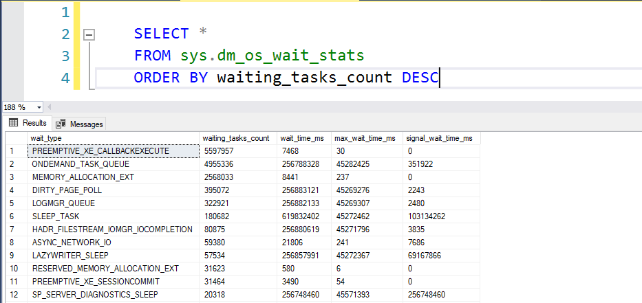
DMVs
sys.dm_os_wait_stats
Use this DMV to see how often processes are waiting while locks are taken.
The sys.dm_os_wait_stats DMV is an aggregate view of all waits that occur when a requested resource is not available, a worker thread is idle typically due to background tasks, or an external event must complete first.

Slide 21
HINTS

Slide 22
HINTS
HOLDLOCK
Is equivalent to SERIALIZABLE. For more information, see SERIALIZABLE later in this topic. HOLDLOCK applies only to the table or view for which it is specified and only for the duration of the transaction defined by the statement that it is used in.
NOLOCK
Is equivalent to READUNCOMMITTED. For more information, see READUNCOMMITTED later in this topic.
PAGLOCK
Takes page locks either where individual locks are ordinarily taken on rows or keys, or where a single table lock is ordinarily taken.
ROWLOCK
Specifies that row locks are taken when page or table locks are ordinarily taken.

Slide 23
HINTS
TABLOCK
Specifies that the acquired lock is applied at the table level. The type of lock that is acquired depends on the statement being executed. For example, a SELECT statement may acquire a shared lock. By specifying TABLOCK, the shared lock is applied to the entire table instead of at the row or page level. If HOLDLOCK is also specified, the table lock is held until the end of the transaction.
TABLOCKX
Specifies that an exclusive lock is taken on the table.
XLOCK
Specifies that exclusive locks are to be taken and held until the transaction completes.

