Slide 1
Developing SQL Databases
Triggers

Slide 2
TRIGGERs
DML triggers
operation such as an INSERT, UPDATE or DELETE statement execution
DDL triggers
triggers that fire when someone changes something in SQL Server, a setting or object on the server
LOGON triggers
someone logging into a server

Slide 3
DML TRIGGER

Slide 4
TRIGGER
A DML trigger is a special kind of stored procedure that is associated with selected data manipulation language (DML) events on a table or view. A trigger cannot be explicitly executed.
Rather, a trigger is fired when a DML event occurs that the trigger is associated with, such as INSERT, UPDATE, or DELETE. Whenever the event takes place, the trigger fires and the trigger’s code runs.

Slide 5
DML TRIGGER
A DML trigger is a T-SQL batch associated with a table that is defined to respond to a particular DML event such as an INSERT, UPDATE, or DELETE, or a combination of those events. SQL Server supports two kinds of DML triggers:
AFTER
this trigger fires after the event it is associated with finishes and can only be defined on permanent tables
INSTEAD OF
This trigger fires instead of the event it is associated with and can be defined on permanent tables and views.
A trigger executes only once for each DML statement, no matter how may rows may be affected. The schema of the trigger must be the same as the schema of the table or view the trigger is associated with.
You can use DML triggers for auditing, enforcing complex integrity rules, and more.

Slide 6
Usage Cases
Complex data integrity CHECK
constraints can only see data in the same row. IF you need to check data across multiple rows, only triggers can do this automatically.
Running code in response to some action
For example, if an order comes in past a threshold (like a $3,000,000 order for lattes from Fourth Coffee), you could write a ROW to a table to have the row checked for validity.
Ensuring columnar data is modified
IF you want to make sure that data is modified, like a column that tells you when a row was last modified, triggers can ensure that the user does not put in invalid data.
Making a view editable
IF a VIEW references more than one table, it becomes complicated to modify it using simple DML operations.

Slide 7
ROLLBACK TRAN in Trigger
Issuing a ROLLBACK TRAN command within the trigger’s code causes a rollback of all changes that took place in the trigger, in addition to rolling back the original DML statement to which the trigger is attached.
However, using a ROLLBACK TRAN in a trigger can have some unwanted side effects. Instead, you can issue THROW or RAISERROR and control the failure by using your standard error handling routines.

Slide 8
inserted/deleted TABLES
In the T-SQL code for both types of DML triggers, you can access tables that are named inserted and deleted. These tables contain the rows that were affected by the modification that caused the trigger to fire.
The inserted table
holds the new image of the affected rows in the case of INSERT and UPDATE statements
The deleted table
holds the old image of the affected rows in the case of DELETE and UPDATE statements
In the case of INSTEAD OF triggers, the inserted and deleted tables contain the rows that would be affected by the DML statement.

Slide 9
AFTER Triggers
AFTER triggers can only be defined for tables. In an AFTER trigger, the trigger code executes
after the DML statement has passed all constraints, such as a primary or foreign key constraint,
a unique constraint, or a check constraint. If the constraint is violated, the statement
fails and the trigger is not executed.

Slide 10
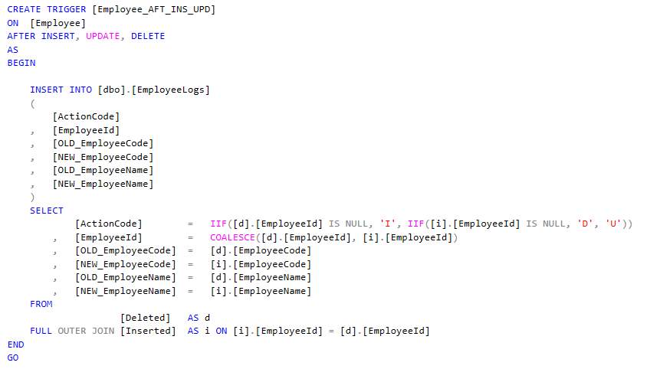
AFTER Triggers

Slide 11
Nested AFTER Triggers
AFTER triggers can be nested—that is, you can have a trigger on Table A that updates Table B. Then Table B may have a trigger that is executed as well. The maximum depth of nested trigger executions is 32. If the nesting is circular (Table A's trigger fires Table B's trigger, which fires Table C's trigger, which fires Table A's trigger, and so on), the maximum level of 32 will be reached and the trigger execution will stop.

Slide 12
INSTEAD OF Triggers
The INSTEAD OF trigger executes a batch of T-SQL code instead of the INSERT, UPDATE, or DELETE statement. You can reissue the statement later in the code.
Although INSTEAD OF triggers can be created against both tables and views, they are commonly used with views.
The reason is that when you send an UPDATE statement against a view, only one base table can be updated at a time. In addition, the view may have aggregations or functions on columns that prevent a direct update.
An INSTEAD OF trigger can take that UPDATE statement against the view and instead of executing it, replace it with two or more UPDATE statements against the base tables of the view.

Slide 13
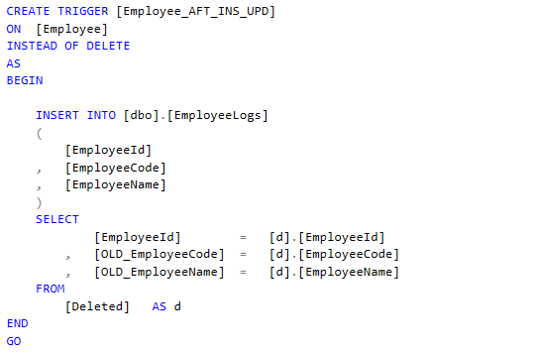
INSTEAD OF Triggers

Slide 14
DML TRIGGER Functions
You can use two functions in your trigger code to get information about what is going on:
UPDATE()
You can use this function to determine whether a particular column has been referenced by an INSERT or UPDATE statement.
COLUMNS_UPDATED()
You can use this function if you know the sequence number of the column in the table. It requires you to use the bitwise AND operation (&) to see whether a column was updated.

Slide 15
DDL & LOGON TRIGGERS

Slide 16
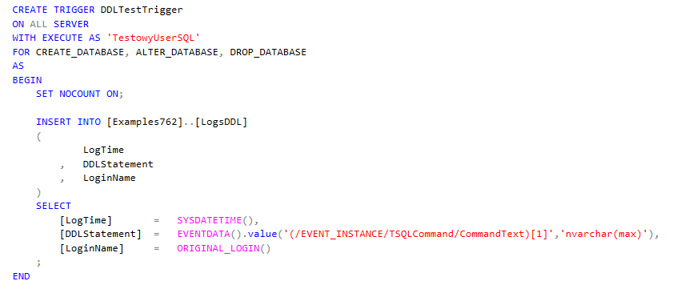
DDL TRIGGER
Used to react to DDL operations at the server or database level.

Slide 17
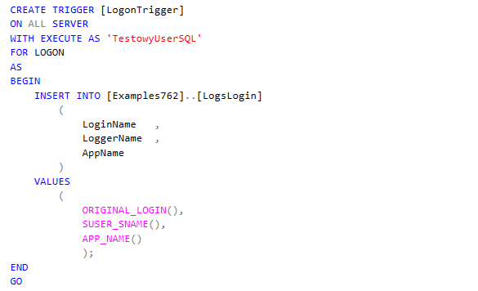
LOGON TRIGGER
Used to react to someone logging into the server.

