Slide 1
Developing SQL Databases
UDFs

Slide 2
FUNCTION (1)
Like functions in programming languages, SQL Server user-defined functions are routines that accept parameters, perform an action, such as a complex calculation, and return the result of that action as a value. The return value can either be a single scalar value or a result set.
The benefits of using user-defined functions in SQL Server are:
They allow modular programming.
You can create the function once, store it in the database, and call it any number of times in your program. User-defined functions can be modified independently of the program source code.
They allow faster execution.
Transact-SQL user-defined functions reduce the compilation cost of Transact-SQL code by caching the plans and reusing them for repeated executions. This means the user-defined function does not need to be reparsed and reoptimized with each use resulting in much faster execution Times.
They can reduce network traffic.
An operation that filters data based on some complex constraint that cannot be expressed in a single scalar expression can be expressed as a function. The function can then invoked in the WHERE clause to reduce the number or rows sent to the client.

Slide 3
FUNCTION (2)
Scalar Function
User-defined scalar functions return a single data value of the type defined in the RETURNS clause.
For a multistatement scalar function, the function body, defined in a BEGIN...END block, contains a series of Transact-SQL statements that return the single value.
The return type can be any data type except text, ntext, image, cursor, and timestamp.
Table-Valued Functions
User-defined table-valued functions return a table data type.
For an inline table-valued function, there is no function body; the table is the result set of a single SELECT statement.

Slide 4
FUNCTION (3)
Limitations and Restrictions
User-defined functions cannot be used to perform actions that modify the database state.
User-defined functions cannot return multiple result sets.
User-defined functions cannot call a stored procedure.
User-defined functions cannot make use of dynamic SQL or temp tables. Table variables are allowed.
SET statements are not allowed in a user-defined function.
The FOR XML clause is not allowed
User-defined functions can be nested; that is, one user-defined function can call another. The nesting level is incremented when the called function starts execution, and decremented when the called function finishes execution. User-defined functions can be nested up to 32 levels.

Slide 5
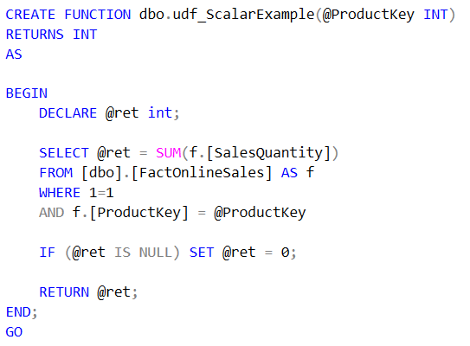
SCALAR FUNCTION (1)
Scalar UDFs allow you to encapsulate small amounts of code into a module that can be called inside of other statements.

Slide 6
INLINE TVF (1)
An inline table-valued function returns a rowset based on a SELECT statement you coded
into the function. In effect, you treat the table-valued function as a table and select from it by
using the SELECT FROM statement.
To create an inline table-valued function:
Specify parameters. Parameters are optional, but the parentheses that would enclose parameters are not optional.
Add the clause RETURNS TABLE to signal to SQL Server that this is a table-valued function.
Following the AS block, enter a single RETURN statement. This acts like an internal function to return the embedded SELECT statement.
Embed the SELECT statement that will define what you want the function to return as a rowset to the caller.

Slide 7
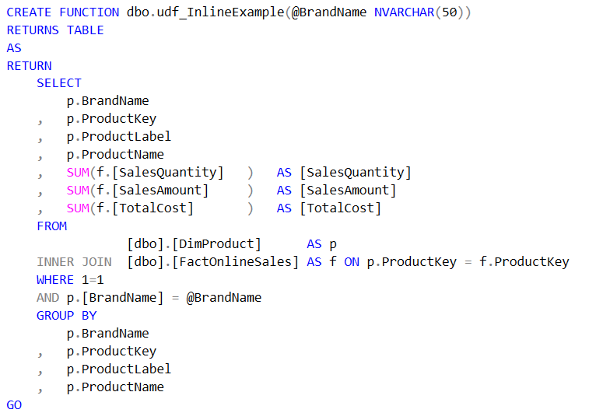
INLINE TVF (2)

Slide 8
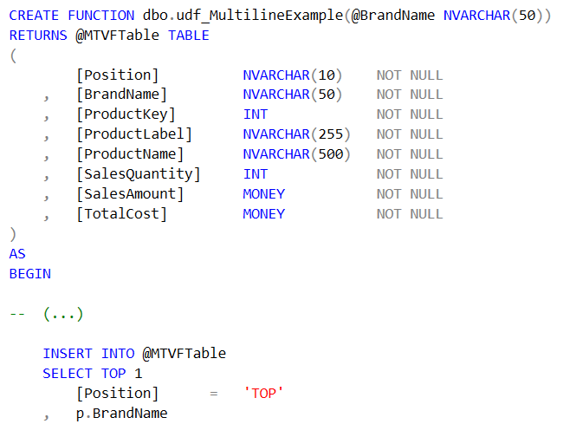
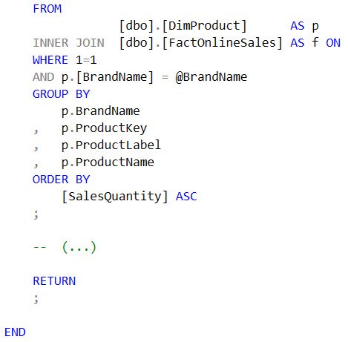
MULTISTATEMANT TVF (1)
Consists of as many statements as you need, allowing you to build a set of data using the same logic as you had in scalar UDFs, but returning a table instead of a scalar variable.

Slide 9
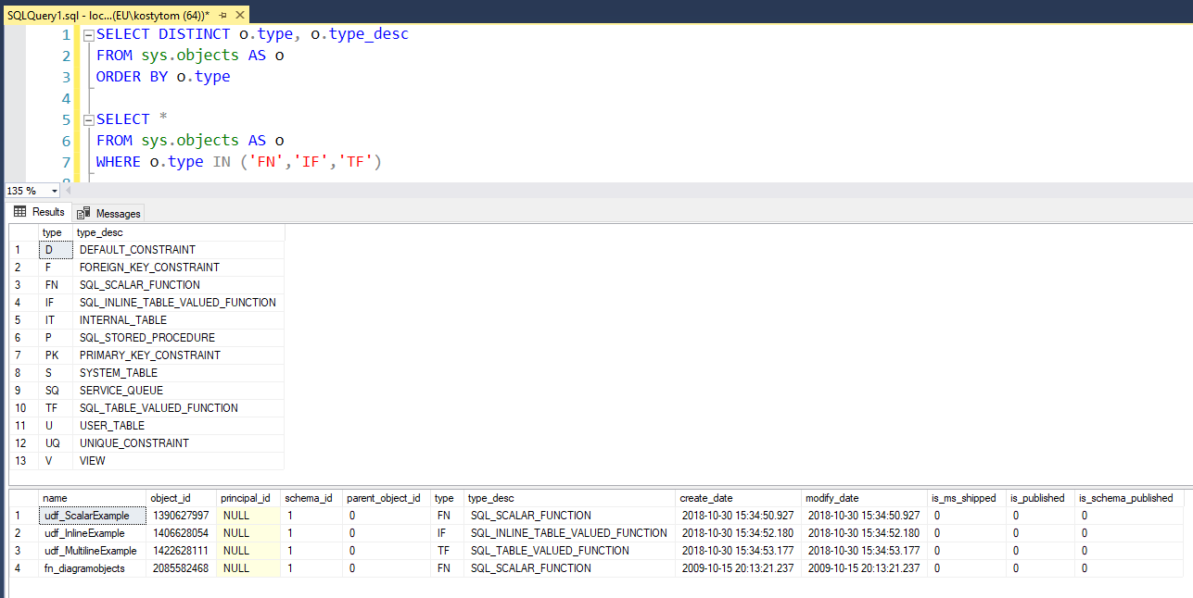

Slide 10
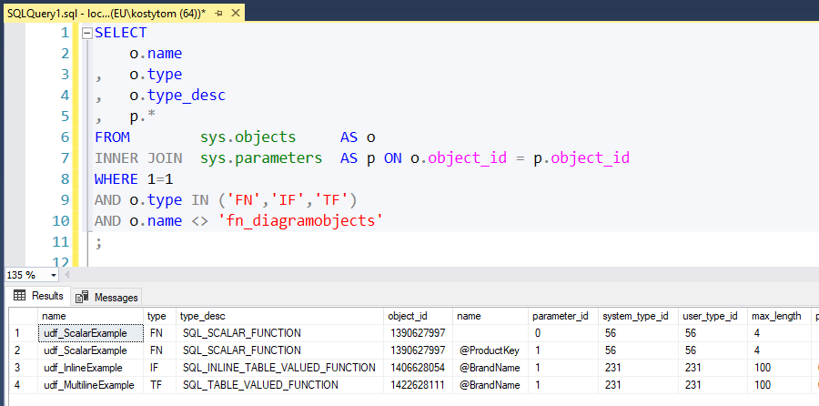

Slide 11
LINKS
https://docs.microsoft.com/en-us/sql/relational-databases/user-defined-functions/user-defined-functions?view=sql-server-2017
https://docs.microsoft.com/en-us/sql/relational-databases/user-defined-functions/create-user-defined-functions-database-engine?view=sql-server-2017

