Slide 1
Developing SQL Databases
Columnstore

Slide 2
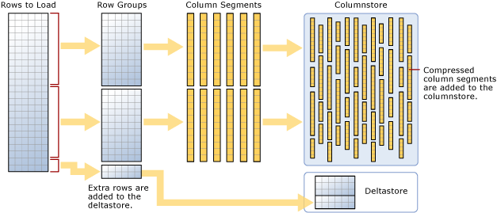
Columnstore Index
A columnstore index is a technology for storing, retrieving and managing data by using a columnar data format, called a columnstore. SQL Server supports both clustered and nonclustered columnstore indexes. Both use the same in-memory columnstore technology, but they do have differences in purpose and in features they support.
Benefits
Columnstore indexes work well for mostly read-only queries that perform analysis on large data sets. Often, these are queries for data warehousing workloads.
Columnstore indexes give high performance gains for queries that use full table scans, and are not well-suited for queries that seek into the data, searching for a particular value.

