Slide 1
Developing SQL Databases
SQL Server Data Tools

Slide 2
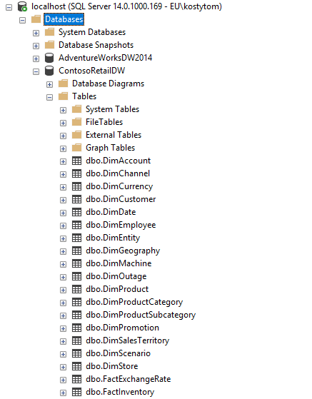
Contoso
Task:
Script database

Slide 3
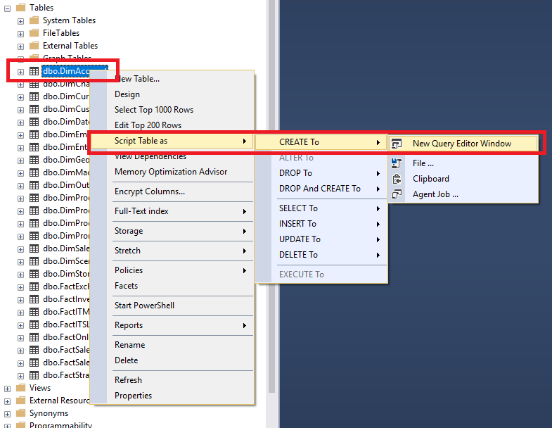
Script each Database Object separately:

Slide 4
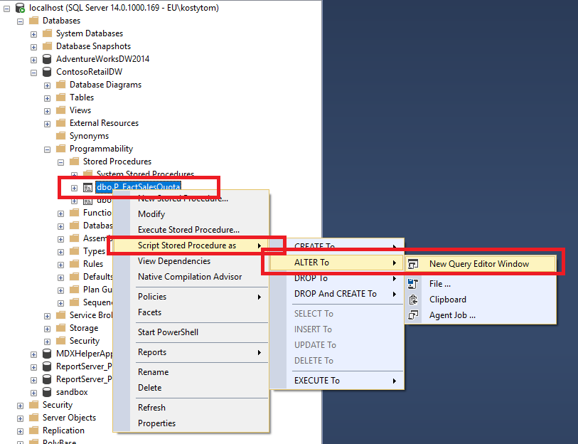
Script each Database Object separately:

Slide 5
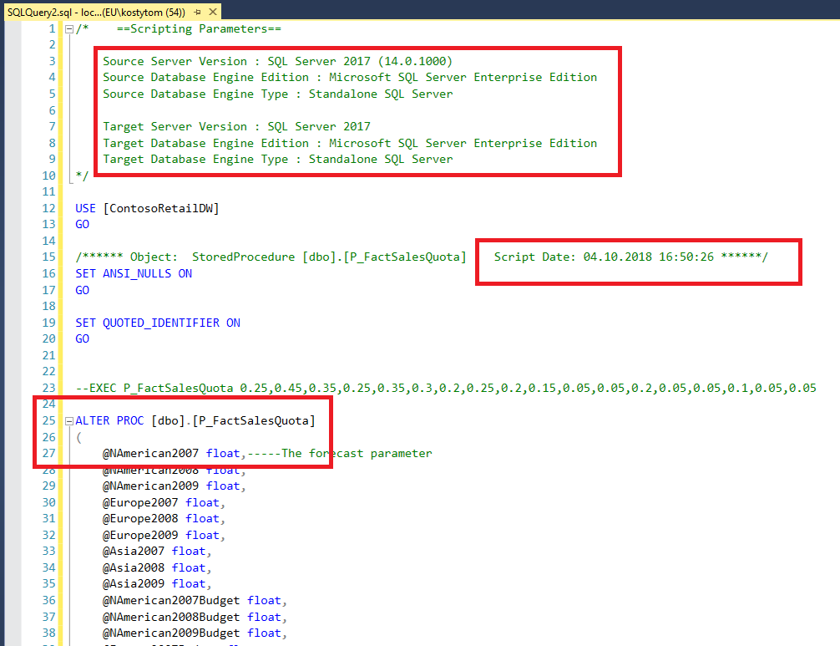
Script each Database Object separately:

Slide 6
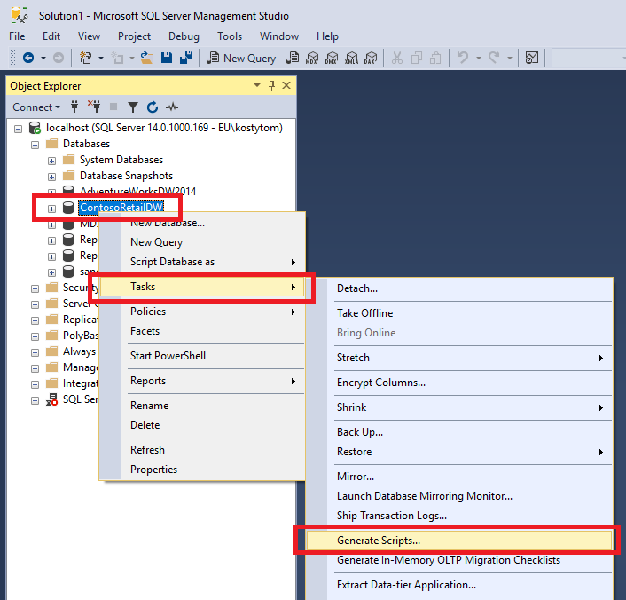
Generate Scripts …

Slide 7
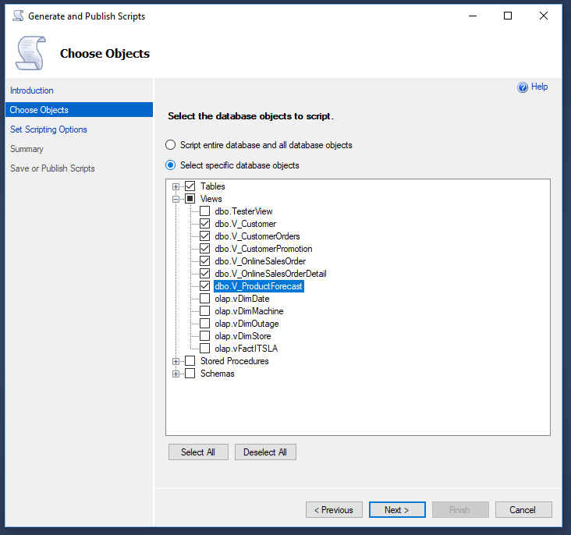
Generate Scripts …

Slide 8
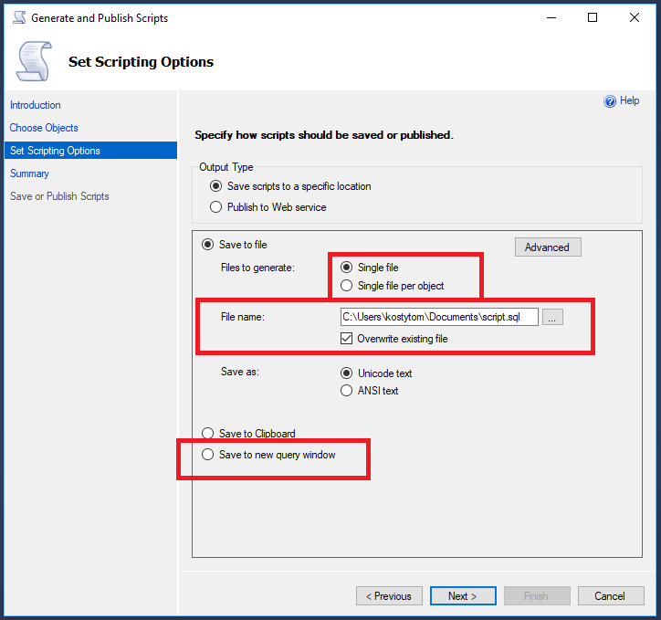
Generate Scripts …

Slide 9
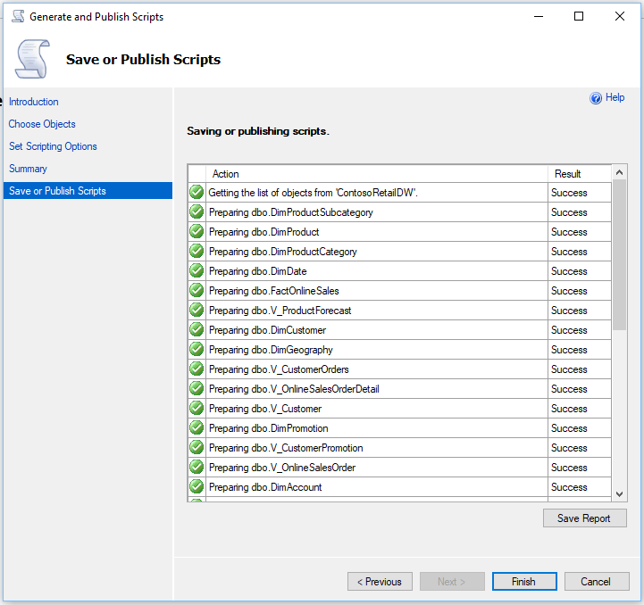
Generate Scripts …

Slide 10
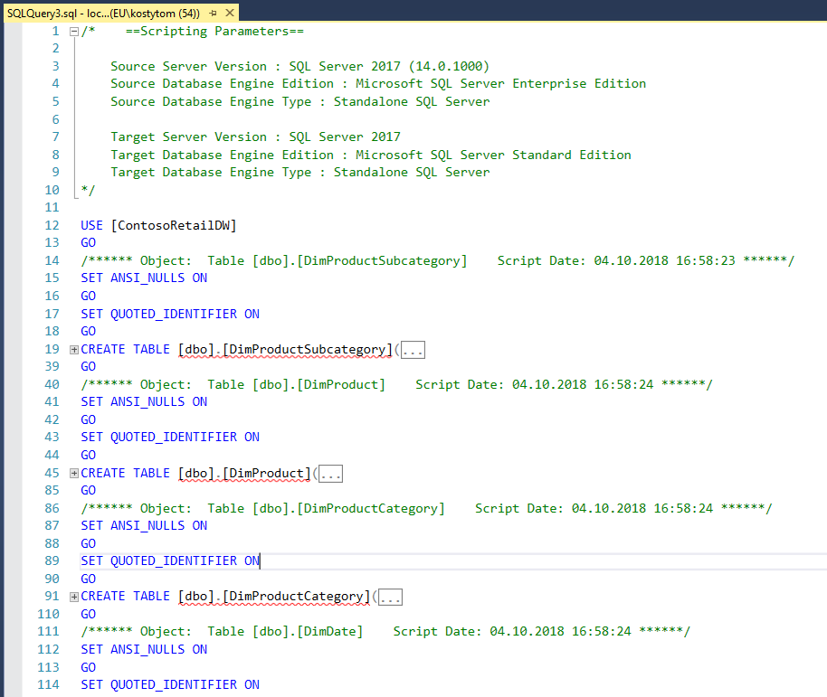
Generate Scripts …

Slide 11
SQL Server Data Tools

Slide 12
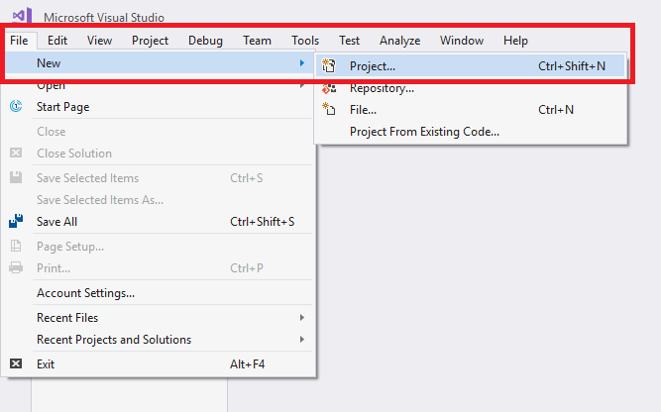

Slide 13
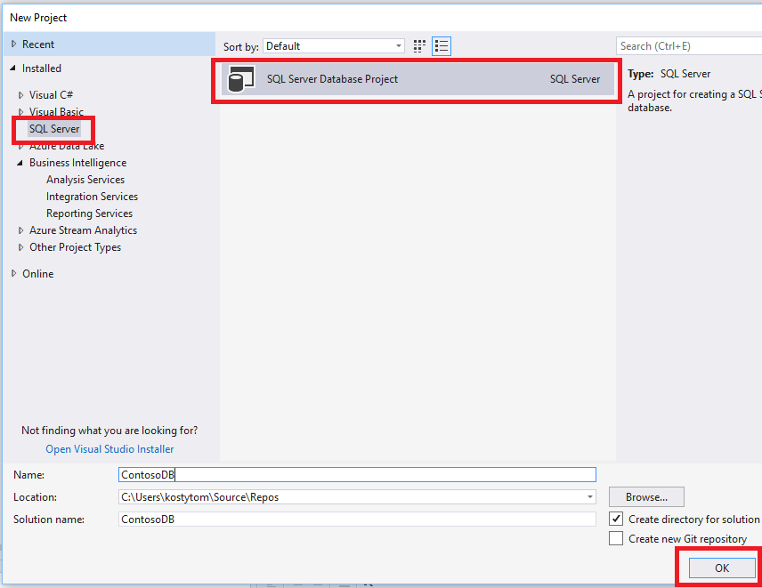

Slide 14
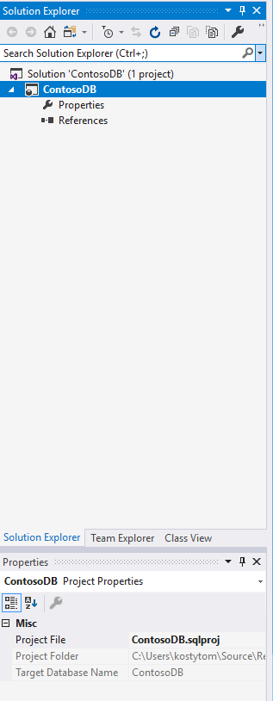
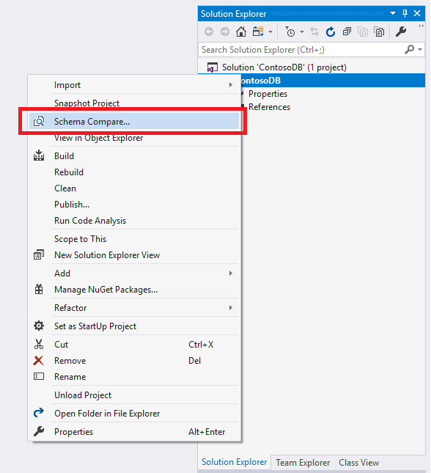

Slide 15

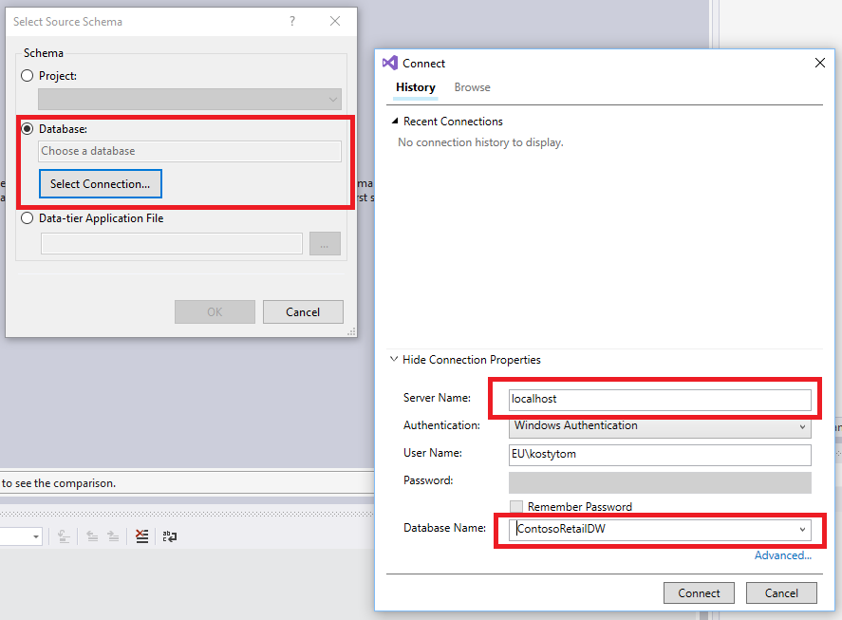

Slide 16
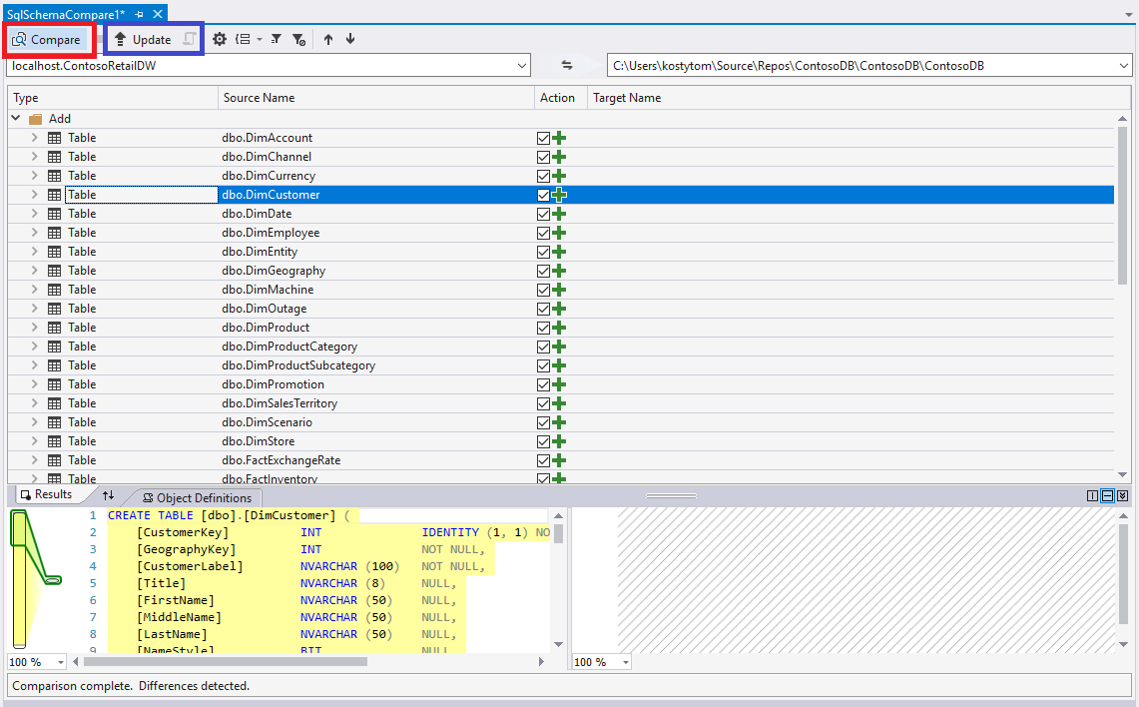

Slide 17
