Slide 1
Developing SQL Databases
Partitions

Slide 2
FILEGROUP, FILE
At a minimum, every SQL Server database has two operating system files: a data file and a log file.
Data files contain data and objects such as tables, indexes, stored procedures, and views.
Log files contain the information that is required to recover all transactions in the database. Data files can be grouped together in filegroups for allocation and administration purposes.
Every database has a primary filegroup. This filegroup contains the primary data file and any secondary files that are not put into other filegroups.
User-defined filegroups can be created to group data files together for administrative, data allocation, and placement purposes.
https://docs.microsoft.com/en-us/sql/relational-databases/databases/database-files-and-filegroups?view=sql-server-2017

Slide 3
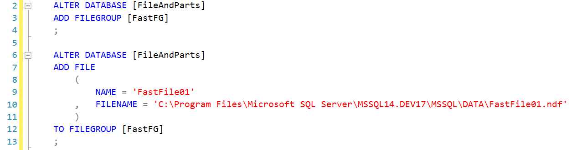

Slide 4
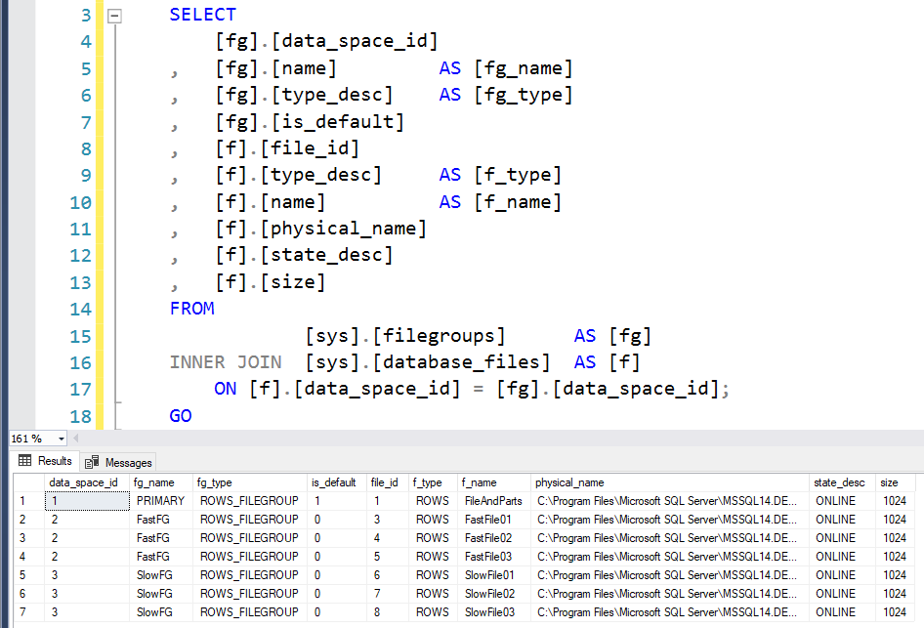

Slide 5
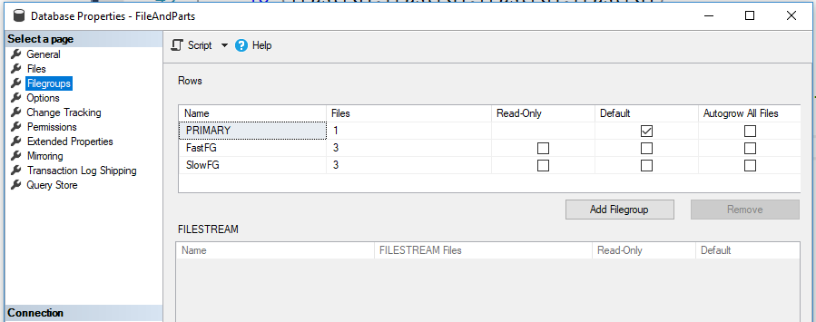

Slide 6
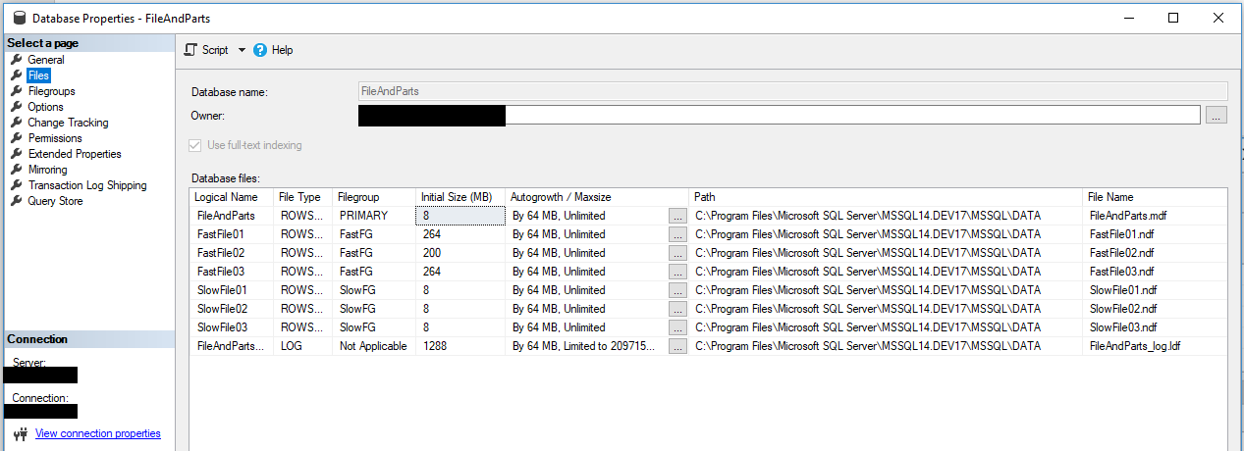

Slide 7
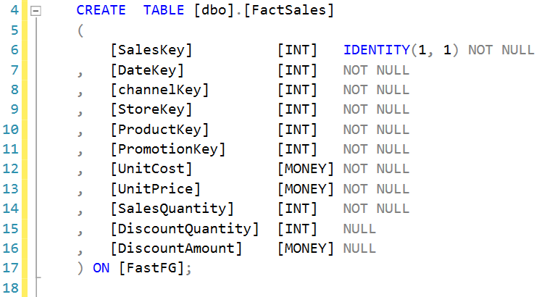

Slide 8
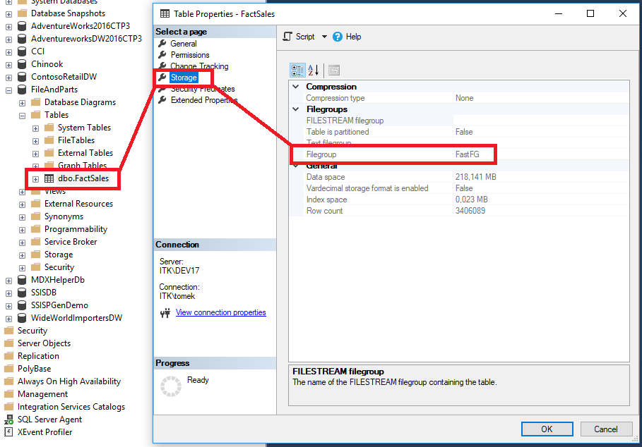

Slide 9
Fill Strategy
Filegroups use a proportional fill strategy across all the files within each filegroup. As data is written to the filegroup, the SQL Server Database Engine writes an amount proportional to the free space in the file to each file within the filegroup, instead of writing all the data to the first file until full. It then writes to the next file.
As soon as all the files in a filegroup are full, the SQL Server Database Engine automatically expands one file at a time in a round-robin manner to allow for more data, provided that the database is set to grow automatically.

Slide 10
Designing Files and Filegroups
A file or filegroup cannot be used by more than one database
A file can be a member of only one filegroup.
Recommendations:
Most databases will work well with a single data file and a single transaction log file.
If you use multiple data files, create a second filegroup for the additional file and make that filegroup the default filegroup. In this way, the primary file will contain only system tables and objects.
To maximize performance, create files or filegroups on different available disks as possible. Put objects that compete heavily for space in different filegroups.
Use filegroups to enable placement of objects on specific physical disks.
Put different tables used in the same join queries in different filegroups. This will improve performance, because of parallel disk I/O searching for joined data.
Put heavily accessed tables and the nonclustered indexes that belong to those tables on different filegroups. This will improve performance, because of parallel I/O if the files are located on different physical disks.
Do not put the transaction log file(s) on the same physical disk that has the other files and filegroups.

Slide 11
PARTITIONING
SQL Server supports table and index partitioning. The data of partitioned tables and indexes is divided into units that can be spread across more than one filegroup in a database. The data is partitioned horizontally, so that groups of rows are mapped into individual partitions. All partitions of a single index or table must reside in the same database.
Benefits of Partitioning
You can transfer or access subsets of data quickly and efficiently, while maintaining the integrity of a data collection. For example, an operation such as loading data from an OLTP to an OLAP system takes only seconds, instead of the minutes and hours the operation takes when the data is not partitioned.
You can perform maintenance operations on one or more partitions more quickly. The operations are more efficient because they target only these data subsets, instead of the whole table. For example, you can choose to compress data in one or more partitions or rebuild one or more partitions of an index.
You may improve query performance, based on the types of queries you frequently run and on your hardware configuration. For example, the query optimizer can process equi-join queries between two or more partitioned tables faster when the partitioning columns in the tables are the same, because the partitions themselves can be joined.
https://docs.microsoft.com/en-us/sql/relational-databases/partitions/partitioned-tables-and-indexes?view=sql-server-2017

Slide 12
Components
Partition function
A database object that defines how the rows of a table or index are mapped to a set of partitions based on the values of certain column, called a partitioning column. That is, the partition function defines the number of partitions that the table will have and how the boundaries of the partitions are defined. For example, given a table that contains sales order data, you may want to partition the table into twelve (monthly) partitions based on a datetime column such as a sales date.
Partition scheme
A database object that maps the partitions of a partition function to a set of filegroups. The primary reason for placing your partitions on separate filegroups is to make sure that you can independently perform backup operations on partitions. This is because you can perform backups on individual filegroups.
Partitioning column
The column of a table or index that a partition function uses to partition the table or index. Computed columns that participate in a partition function must be explicitly marked PERSISTED. All data types that are valid for use as index columns can be used as a partitioning column, except timestamp.

Slide 13
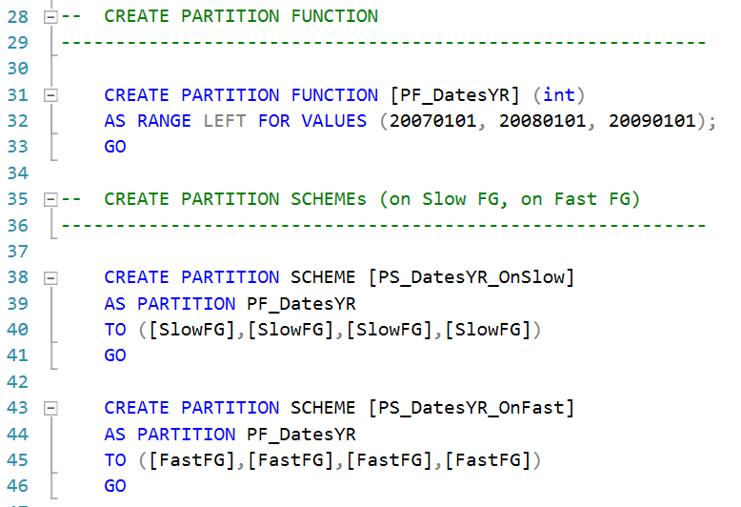

Slide 14
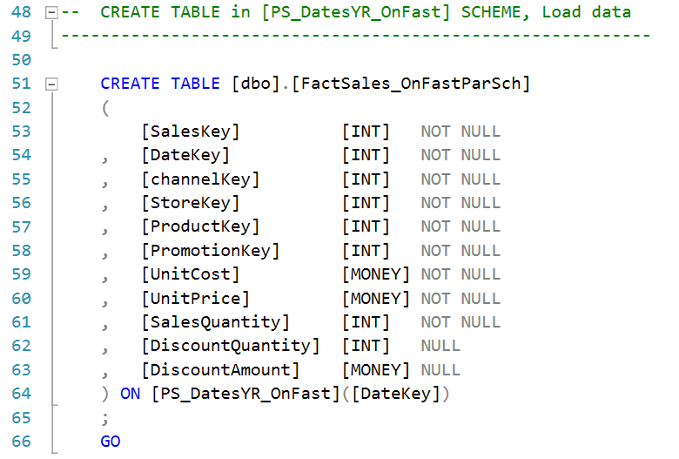

Slide 15
