Slide 1
Developing SQL Databases
In-Memory OLTP

Slide 2
In-Memory OLTP
The In-Memory OLTP feature built into SQL Server 2016 adds a new memory-optimized relational data management engine and a native stored procedure compiler to the platform that you can use to run transactional workloads with higher concurrency.
A memory-optimize table is a highly optimized data structure that SQL Server uses to store data completely in memory without paging to disk.
It uses hash and nonclustered ordered indexes to support faster data access from memory than traditional B-tree indexes. SQL Server maintains a copy of the data on disk to guarantee transaction durability and to reload tables during database recovery.

Slide 3
Usage Scenarios (Tables)
In general, OLTP workloads with the following characteristics benefit most from migration to memory-optimized tables:
short transactions with fast response times,
queries accessing a limited number of tables that contain small data sets,
high concurrency requirements.
This type of workload could also require high transaction throughput and low latency at scale. In the exam, you must be able to recognize the following use cases for which memory optimized tables are best suited:
High data ingestion rate
High volume, high performance data reads
Complex business logic in stored procedures
Real-time data access
Applications relying heavily on temporary tables, table variables, and table valued parameters
ETL operations

Slide 4
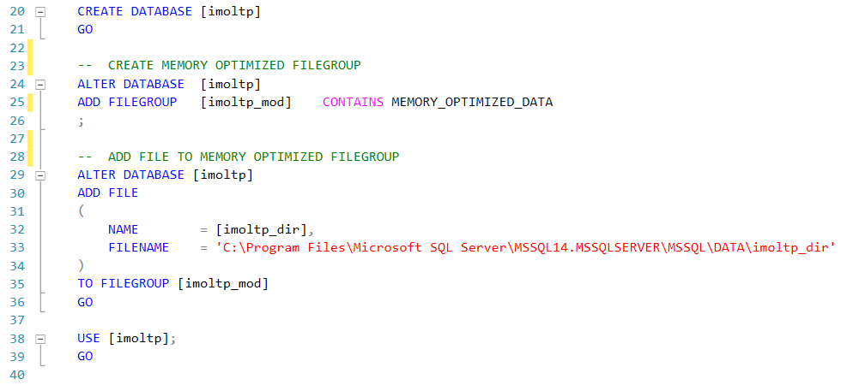

Slide 5
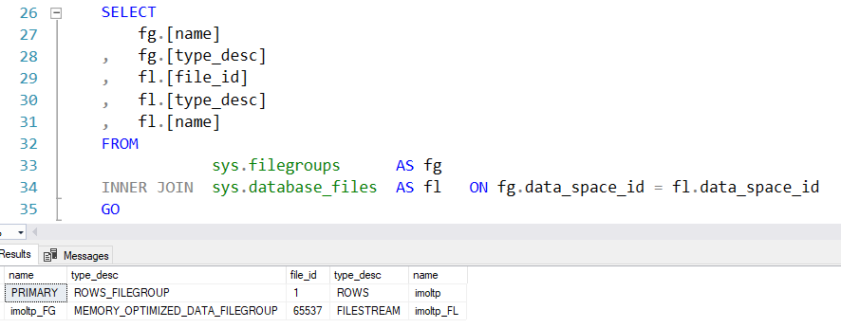

Slide 6
Memory Optimized Tables
Memory-optimized tables are fully durable by default, and, like transactions on (traditional) disk-based tables, transactions on memory-optimized tables are fully atomic, consistent, isolated, and durable (ACID).
The primary storage for memory-optimized tables is the main memory. Rows in the table are read from and written to memory. A second copy of the table data is maintained on disk, but only for durability purposes.
For even greater performance gains, In-Memory OLTP supports durable tables with transaction durability delayed. Delayed durable transactions are saved to disk soon after the transaction has committed and control was returned to the client. In exchange for the increased performance, committed transactions that have not saved to disk are lost in a server crash or fail over.
Besides the default durable memory-optimized tables, SQL Server also supports non-durable memory-optimized tables, which are not logged and their data is not persisted on disk.

Slide 7
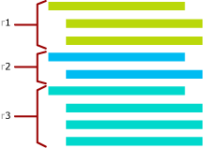
Memory Optimized Tables
Rows in memory-optimized tables are versioned. This means that each row in the table potentially has multiple versions. All row versions are maintained in the same table data structure. Row versioning is used to allow concurrent reads and writes on the same row.
The following figure illustrates multi-versioning. The figure shows a table with three rows and each row has different versions.
Data in memory-optimized tables is accessed in two ways:
Through natively compiled stored procedures.
Through interpreted Transact-SQL, outside of a natively-compiled stored procedure.
https://docs.microsoft.com/en-us/sql/relational-databases/in-memory-oltp/introduction-to-memory-optimized-tables?view=sql-server-2017

Slide 8
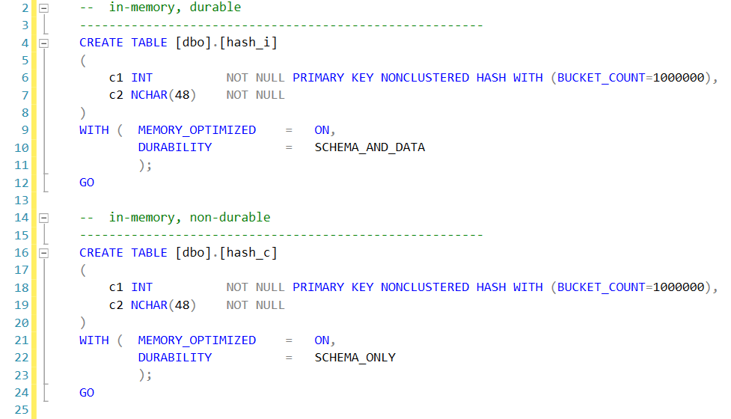

Slide 9
Natively compiled SPs
Natively compiled stored procedures are Transact-SQL stored procedures compiled to native code that access memory-optimized tables. Natively compiled stored procedures allow for efficient execution of the queries and business logic in the stored procedure.
Stored procedures that are marked with NATIVE_COMPILATION are natively compiled. This means the Transact-SQL statements in the procedure are all compiled to native code for efficient execution of performance-critical business logic.

Slide 10
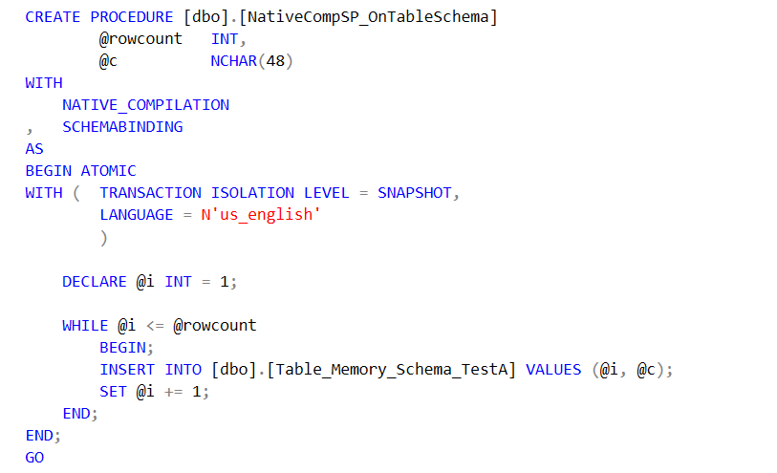

Slide 11
Natively compiled SPs – limitations #1
Many of the limitations that existed in SQL Server 2014 for natively compiled stored procedures
have been removed. However, the following limitations still remain in SQL Server 2016:
tempdb access
You cannot create or access temporary tables, table variables, or table-valued functions in tempdb.
CURSOR
As an alternative, you can use set-based logic or a WHILE loop.
CASE statement
MERGE statement
You cannot use a memory-optimized table as the target of a MERGE statement.
SELECT INTO clause
You cannot use an INTO clause with a SELECT statement.
FROM clause
You cannot use a FROM clause or subqueries in an UPDATE statement.

Slide 12
Natively compiled SPs – limitations #2
PERCENT or WITH TIES in TOP clause
DISTINCT with aggregate functions
INTERSECT, EXCEPT, APPLY, PIVOT, UNPIVOT, LIKE, CONTAINS
There are no alternatives for using these operators in a natively compiled stored procedure.
Common table expressions (CTEs)
You must rewrite your query to reproduce the functionality of a CTE in a natively compiled stored procedure.
Multi-row INSERT statements
You must instead use separate INSERT statements in a natively compiled stored procedure.
EXECUTE WITH RECOMPILE
There is no alternative for using this option in a natively compiled stored procedure.
VIEW
You cannot reference a view in a natively compiled stored procedure. You must define your desired SELECT statement explicitly in the procedure code.

Slide 13
Indexes
A memory-optimized table can have up to eight non-clustered indexes, all of which are covering indexes.
Unlike a traditional B-tree index for a disk-based table, an index for a memory-optimized table exists only in memory and does not contain data. Instead, an index points to a row in memory and is recreated during database recovery.
An index for a memory-optimized table can be one of the following three types:
Hash
Columnstore
Nonclustered B-tree

Slide 14
Indexes
Hash
You use a nonclustered hash index when you have many queries that perform point lookups, also known as equi-joins. When you specify the index type, as shown below, you must include a bucket count. The bucket count value should be between one to two times the expected number of distinct values in the indexed column.
Columnstore
A new feature in SQL Server 2016 is the ability to add a columnstore index to a memory-optimized table. This type of index is best when your queries perform large scans of a table. Rather than read data row by row, it can process chunks of data in batches and thereby reduce query execution time and CPU utilization. Consider this type of index for single-threaded queries, sort operations (such as ORDER BY), and T-SQL window functions.
Nonclustered B-tree
You use a memory-optimized non-clustered B-tree index when your queries have an ORDER BY clause on an indexed column, or when your queries return a few records by performing range selections against an index column using the greater than (>) or less than (<) operators, or testing an indexed column for inequality.

Slide 15
Usage Scenarios (Native SPs)
In SQL Server 2016, you can use natively compiled stored procedures to get better performance when operating on memory-optimized tables.
You use them for:
Applications for which obtaining the best possible performance is a requirement
Queries that execute frequently
Tasks that must perform as fast as possible
If you have a lot of rows to process and a lot of logic to apply, the natively compiled stored procedure performs faster than an interpreted stored procedure.
It is also good when you need to perform any of the following tasks:
Aggregation
Nested loop join
Multi-statement SELECT, INSERT, UPDATE, or DELETE operations
Complex expressions
Procedural logic, such as conditional statements and loops
It is not typically the best option when you need to process only a single row.

Slide 16
Statistics
Some statistics, such as worker_time and elapsed_time, do not get collected by DMVs such as sys.dm_exec_query_stats and sys.dm_exec_procedure_stats.
In fact, these DMVs include no information about natively compiled stored procedures. Instead, you need to specifically enable the collection of execution statistics by using one of the following system stored procedures
sys.sp_xtp_control_proc_exec_stats
Use this system stored procedure to enable statistics collection for your SQL Server instance at the procedure level.
sys.sp_xtp_control_query_exec_stats
Use this system stored procedure to enable statistics collection at the query level for selected natively compiled stored procedures.

Slide 17
LINKS
https://docs.microsoft.com/en-us/sql/relational-databases/in-memory-oltp/memory-optimized-tables?view=sql-server-2017
https://docs.microsoft.com/en-us/sql/relational-databases/in-memory-oltp/creating-and-managing-storage-for-memory-optimized-objects?view=sql-server-2017
https://docs.microsoft.com/en-us/sql/relational-databases/in-memory-oltp/in-memory-oltp-in-memory-optimization?view=sql-server-2017
https://blogs.msdn.microsoft.com/sqlserverstorageengine/2016/03/07/real-time-operational-analytics-memory-optimized-table-and-columnstore-index/
https://pl.seequality.net/in-memory-oltp-wstep-i-memory-optimized-tables/
https://pl.seequality.net/memory-optimized-tables-wykorzystanie-dziennika/

