Slide 1
Developing SQL Databases
Restore Database from BAK file

Slide 2
Links
ContosoRetailDW
https://www.microsoft.com/en-us/download/confirmation.aspx?id=18279
AdventureWorks2016
https://www.microsoft.com/en-us/download/details.aspx?id=49502

Slide 3
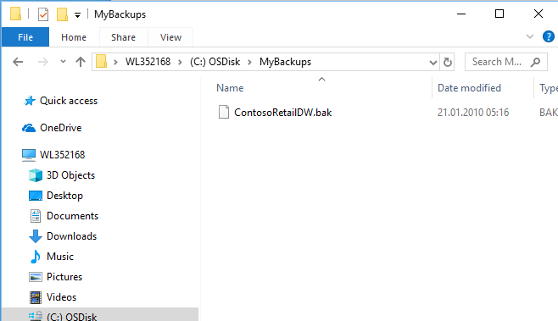
Save .bak files somewhere outside C:\Users…

Slide 4
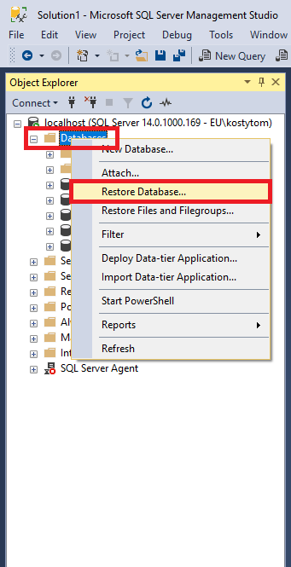
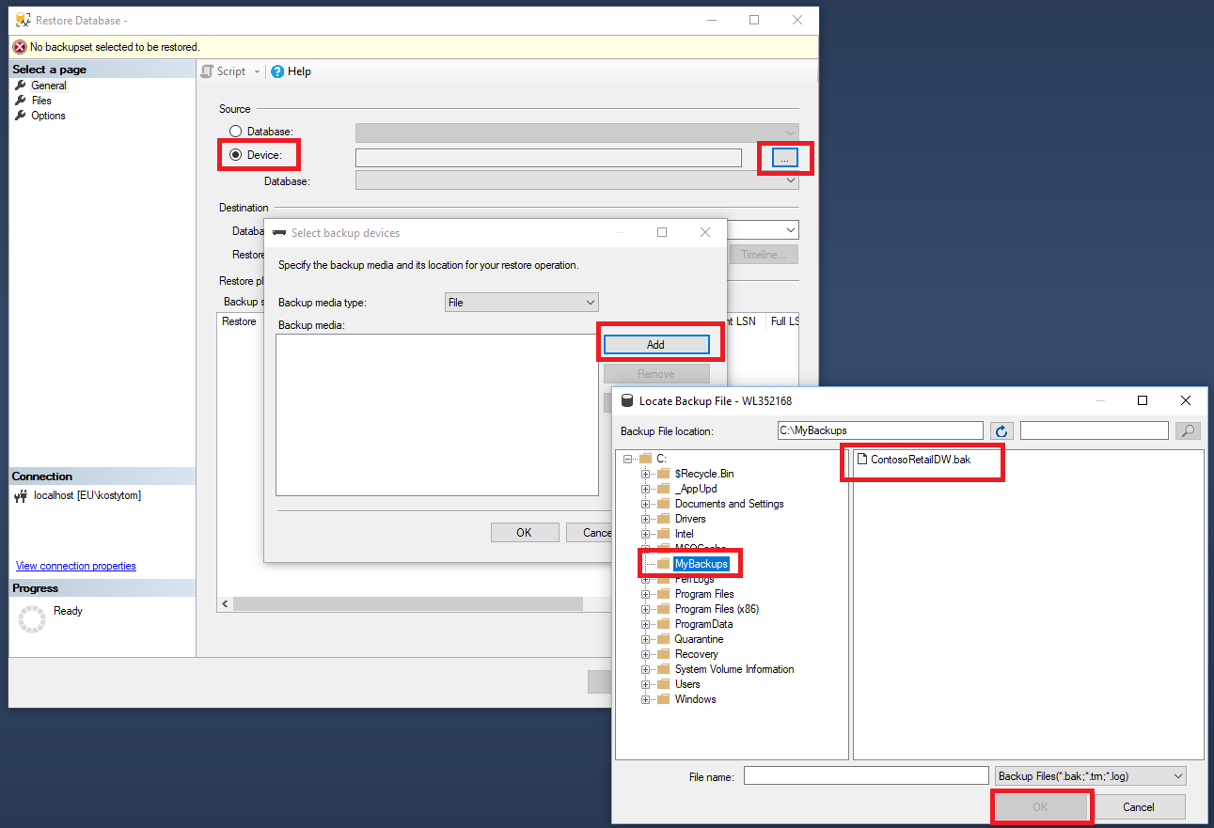
In Management Studio…

Slide 5
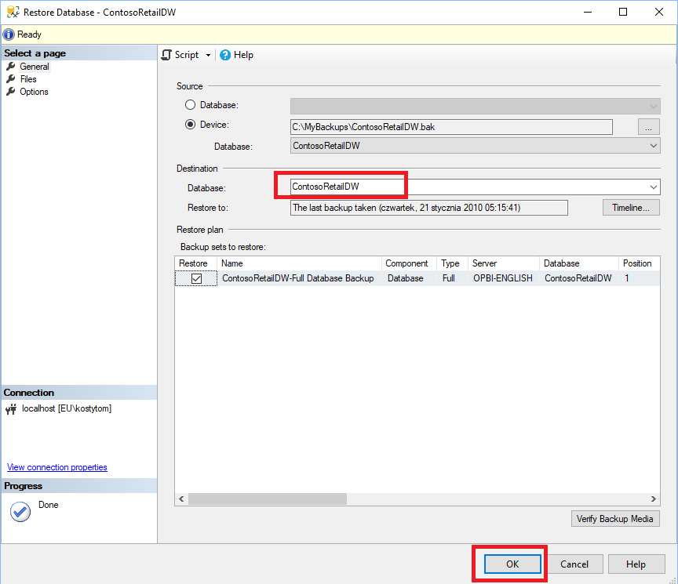
In Management Studio…

Slide 6
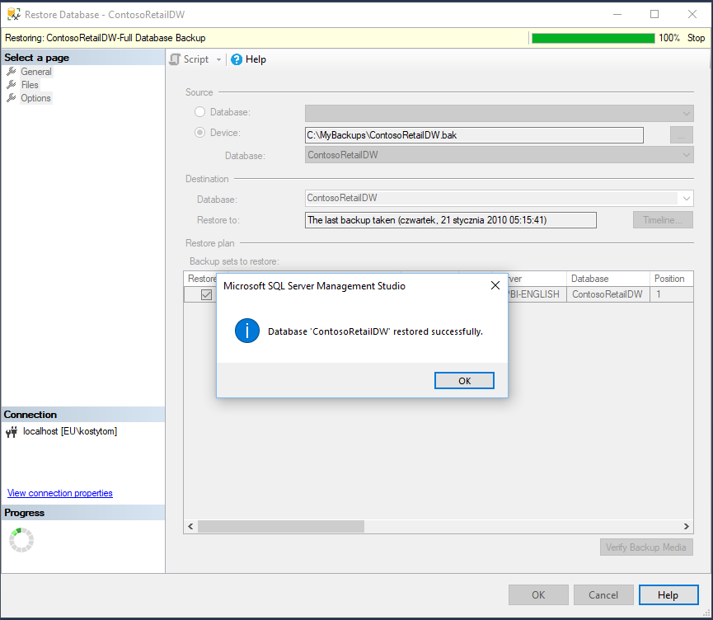
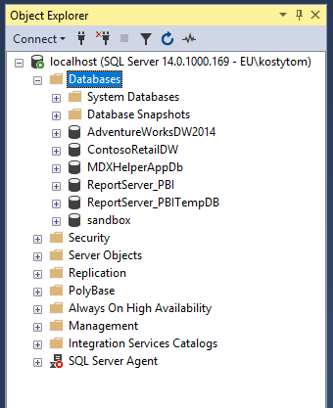
In Management Studio…

