Slide 1
Developing SQL Databases
Error Handling

Slide 2
Error Handling

Slide 3
ERROR MESSAGE
Error number The error number is an integer value.
SQL Server error messages are numbered from 1 through 49999.
Custom error messages are numbered 50001 and higher.
The error number 50000 is reserved for a custom message that does not have a custom error number.
Severity level SQL Server defines 26 severity levels numbered from 0 through 25.
As a general rule, errors with a severity level of 16 or higher are logged automatically to the SQL Server log and the Windows Application log.
Errors with a severity level from 19 through 25 can be specified only by members of the sysadmin fixed server role.
Errors with a severity level from 20 through 25 are considered fatal and cause the connection to be terminated and any open transactions to be rolled back.
Errors with severity level 0 through 10 are informational only.
State This is an integer with a maximum value of 127, used by Microsoft for internal purposes.
Error message The error message can be up to 255 Unicode characters long.
SQL Server error messages are listed in sys.messages.
You can add your own custom error messages by using sp_addmessage.

Slide 4
RAISERROR
Generates an error message and initiates error processing for the session. RAISERROR can either reference a user-defined message stored in the sys.messages catalog view or build a message dynamically.
The errors generated by RAISERROR operate the same as errors generated by the Database Engine code.
The values specified by RAISERROR are reported by the ERROR_LINE, ERROR_MESSAGE, ERROR_NUMBER, ERROR_PROCEDURE, ERROR_SEVERITY, ERROR_STATE, and @@ERROR system functions.
When RAISERROR is run with a severity of 11 or higher in a TRY block, it transfers control to the associated CATCH block.

Slide 5
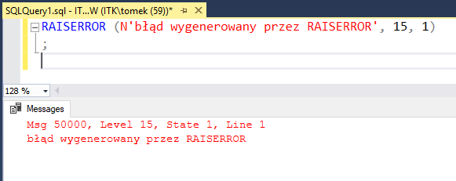
RAISERROR
Some more advanced features of RAISERROR include the following:
You can issue purely informational messages (similar to PRINT) by using a severity level of 0 through 9.
You can issue RAISERROR with a severity level > 20 if you use the WITH LOG option and if you have the SQL Server sysadmin role. SQL Server will then terminate the connection when the error is raised.
You can use RAISERROR with NOWAIT to send messages immediately to the client. The message does not wait in the output buffer before being sent.

Slide 6
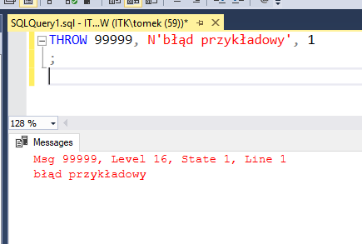
THROW
The THROW command behaves mostly like RAISERROR, with some important exceptions.
THROW does not use parentheses to delimit parameters.
THROW can be used without parameters, but only in the CATCH block of a TRY/CATCH construct.
When parameters are supplied, error_number, message, and state are all required.
The state parameter must be an integer that ranges from 0 to 255.
Any parameter can be a variable.
There is no severity parameter; the severity is always set to 16.
THROW always terminates the batch except when it is used in a TRY block.

Slide 7
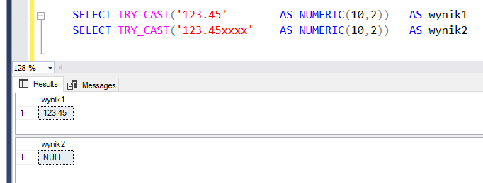
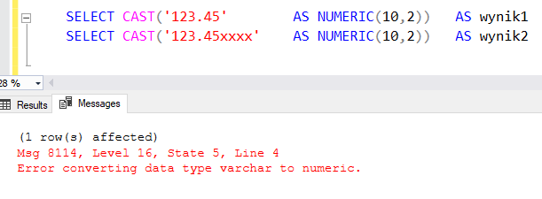
TRY_CAST, TRY_CONVERT, TRY_PARSE

Slide 8
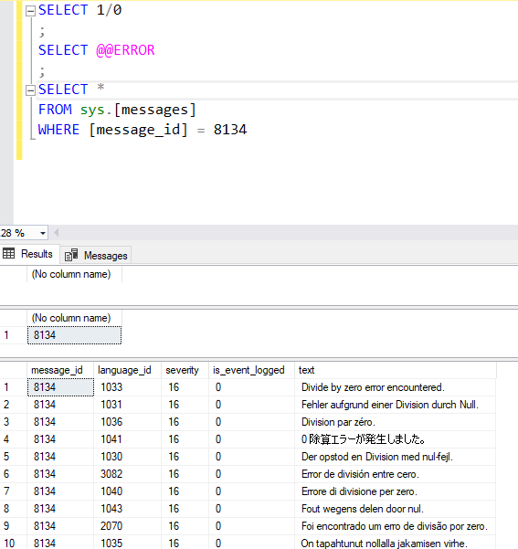
@@ERROR
Returns 0 if the previous Transact-SQL statement encountered no errors.
Returns an error number if the previous statement encountered an error.
If the error was one of the errors in the sys.messages catalog view, then @@ERROR contains the value from the sys.messages.message_id column for that error.
You can view the text associated with an @@ERROR error number in sys.messages.

Slide 9
XACT_ABORT
XACT_ABORT works with all types of code and affects the entire batch. You can make an entire batch fail if any error occurs by beginning it with SET XACT_ABORT ON. You set XACT_ABORT per session.
After it is set to ON, all remaining transactions in that setting are subject to it until it is set to OFF.
SET XACT_ABORT has some advantages. It causes a transaction to roll back based on any error with severity > 10.
However, XACT_ABORT has many limitations, such as the following:
You cannot trap for the error or capture the error number.
Any error with severity level > 10 causes the transaction to roll back.
None of the remaining code in the transaction is executed. Even the final PRINT statements of the transaction are not executed.
After the transaction is aborted, you can only infer what statements failed by inspecting the error message returned to the client by SQL Server.

Slide 10
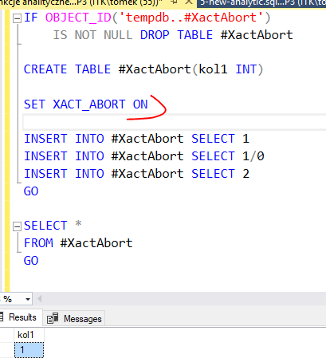
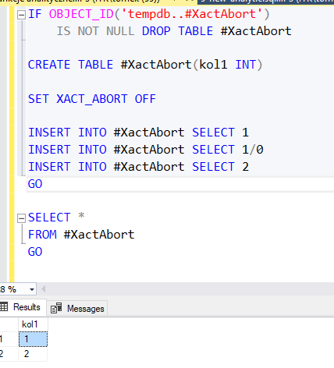
XACT_ABORT

Slide 11
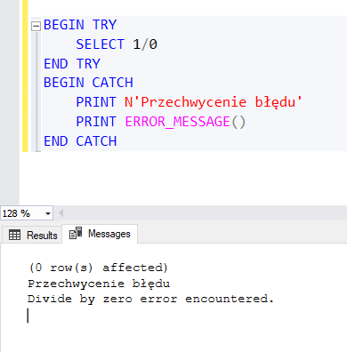
TRY - CATCH
A TRY…CATCH construct catches all execution errors that have a severity higher than 10 that do not close the database connection.

Slide 12
TRY - CATCH
A TRY block must be immediately followed by an associated CATCH block. Including any other statements between the END TRY and BEGIN CATCH statements generates a syntax error.
A TRY…CATCH construct cannot span multiple batches. A TRY…CATCH construct cannot span multiple blocks of Transact-SQL statements. For example, a TRY…CATCH construct cannot span two BEGIN…END blocks of Transact-SQL statements and cannot span an IF…ELSE construct.
If there are no errors in the code that is enclosed in a TRY block, when the last statement in the TRY block has finished running, control passes to the statement immediately after the associated END CATCH statement.
If there is an error in the code that is enclosed in a TRY block, control passes to the first statement in the associated CATCH block. If the END CATCH statement is the last statement in a stored procedure or trigger, control is passed back to the statement that called the stored procedure or fired the trigger.

Slide 13
TRY - CATCH
Errors with severity greater than 10 and less than 20 within the TRY block result in transferring control to the CATCH block.
Errors with a severity level of 20 and greater that do not close connections are also handled by the CATCH block.
Compile errors and some runtime errors involving statement level compilation abort the batch immediately and do not pass control to the CATCH block.
If an error is encountered in the CATCH block, the transaction is aborted and the error is returned to the calling application unless the CATCH block is nested within another TRY block.
A TRY/CATCH block does not trap errors that cause the connection to be terminated, such as a fatal error or a sysadmin executing the KILL command.
You also cannot trap errors that occur due to compilation errors, syntax errors, or nonexistent objects. Therefore, you cannot use TRY/CATCH to test for an object's existence.
You can nest TRY/CATCH blocks; in other words, you can place an inner TRY/CATCH block inside an outer TRY block. An error within the nested TRY block transfers execution to the corresponding nested CATCH block.

