Slide 1
Developing SQL Databases
JOINS

Slide 2
JOINS
SQL Server employs three types of join operations:
Nested loops joins
Merge joins
Hash joins
https://docs.microsoft.com/en-us/previous-versions/sql/sql-server-2008/ms191426(v=sql.100)

Slide 3
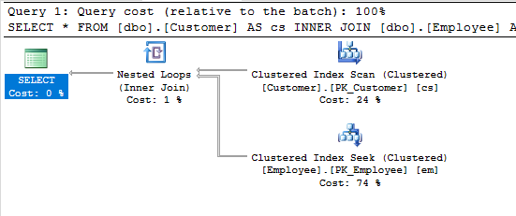
NESTED LOOP JOIN
If one join input is small and the other join input is fairly large and indexed on its join columns, an index nested loops join is the fastest join operation because they require the least I/O and the fewest comparisons.
The nested loops join is also called a nested iteration.
In the simplest case, the search scans an entire table or index; this is called a naive nested loops join. If the search exploits an index, it is called an index nested loops join. If the index is built as part of the query plan (and destroyed upon completion of the query), it is called a temporary index nested loops join.
A nested loops join is particularly effective if the outer input is small and the inner input is preindexed and large. In many small transactions, such as those affecting only a small set of rows, index nested loops joins are superior to both merge joins and hash joins.
In large queries, however, nested loops joins are often not the optimal choice.

Slide 4
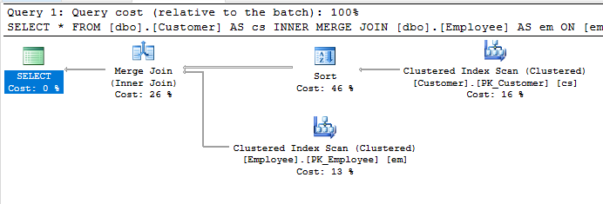
MERGE JOIN
If the two join inputs are not small but are sorted on their join column, a merge join is the fastest join operation. If both join inputs are large and the two inputs are of similar sizes, a merge join with prior sorting and a hash join offer similar performance.
However, hash join operations are often much faster if the two input sizes differ significantly from each other.

Slide 5
MERGE JOIN
The merge join requires both inputs to be sorted on the merge columns, which are defined by the equality (ON) clauses of the join predicate.
Because each input is sorted, the Merge Join operator gets a row from each input and compares them. For example, for inner join operations, the rows are returned if they are equal. If they are not equal, the lower-value row is discarded and another row is obtained from that input. This process repeats until all rows have been processed.
Merge join itself is very fast, but it can be an expensive choice if sort operations are required. However, if the data volume is large and the desired data can be obtained presorted from existing B-tree indexes, merge join is often the fastest available join algorithm.

Slide 6
HASH JOIN
Hashing is a programmatic technique where data is converted into a symbolic form that makes it easier to be searched for quickly. For example, a row of data in a table can be programmatically converted into a unique value that represents the contents of the row. In many ways it is like taking a row of data and encrypting it. Like encryption, a hashed value can be converted back to the original data.
Hashing is often used within SQL Server to convert data into a form that is more efficient to work with, or in this case, to make searching more efficient.
A hash table, on the other hand, is a data structure that divides all of the elements into equal-sized categories, or buckets, to allow quick access to the elements. The hashing function determines which bucket an element goes into. For example, you can take a row from a table, hash it into a hash value, then store the hash value into a hash table.

Slide 7
HASH JOIN
Hash Match join occurs when SQL Server joins two tables by hashing the rows from the smaller of the two tables to be joined, and then inserting them into a hash table, then processing the larger table one row at a time against the smaller hashed table, looking for matches where rows need to be joined.
Because the smaller of the tables provides the values in the hash table, the table size is kept at a minimum, and because hashed values instead of real values are used, comparisons can be made very quickly. As long as the table that is hashed is relatively small, this can be a quick process.
On the other hand, if both tables are very large, a Hash Match join can be very inefficient as compared to other types of joins.

Slide 8
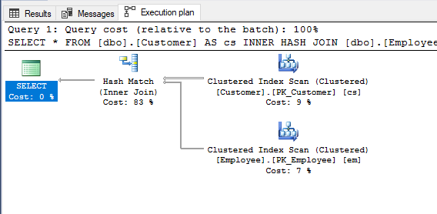
HASH JOIN
Hash Match joins are often very efficient with large data sets, especially if one of the tables is substantially smaller than the other.
Hash Match joins also work well for tables that are not sorted on join columns, and they can be efficient in cases where there are no useable indexes.
On the other hand, a Hash Match join might indicate that a more efficient join method (Nested Loops or Merge) could be used.
For example, seeing a Hash Match join in an execution plan sometimes indicates:
a missing or incorrect index
a missing WHERE clause
a WHERE clause with a calculation or conversion that makes it non-SARG.

Slide 9
 | Nested Loops Join | Merge Join | Hash Join
Best for … | Relatively small inputs with an index on the inner table on the join key. | Medium to large inputs with indexes to provide order on the equijoin keys and/or where we require order after the join. | DW queries with medium to large inputs. Parallel execution that scales linearly.
Concurrency | Supports large numbers of concurrent users. | Many-to-one join with indexes to provide order supports large numbers of concurrent users. | Best for small numbers of concurrent users with high throughput requirements.
Uses memory | No | No (may require sorts which use memory) | Yes
Uses tempdb | No | Yes (many-to-many join only) | Yes (if join runs out of memory and spills)
Requires order | No | Yes | No
https://blogs.msdn.microsoft.com/craigfr/2006/08/16/summary-of-join-properties/

Slide 10
LINKS:
https://pl.seequality.net/sql-server-nested-loops-jak-to-dziala/
https://pl.seequality.net/sql-server-merge-join-operator-jak-to-dziala/
https://pl.seequality.net/sql-server-hash-match-jak-dziala/

