Slide 1
Database Fundamentals
Subqueries

Slide 2
SUBQUERY
A subquery is a query that is nested inside a SELECT, INSERT, UPDATE, or DELETE statement, or inside another subquery. A subquery can be used anywhere an expression is allowed.
A subquery is also called an inner query or inner select, while the statement containing a subquery is also called an outer query or outer select.
Many Transact-SQL statements that include subqueries can be alternatively formulated as joins.
https://www.simple-talk.com/sql/sql-training/subqueries-in-sql-server/

Slide 3
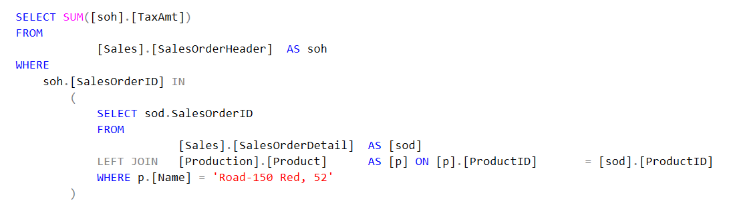
SUBQUERY

Slide 4
SUBQUERY
A DML statement that includes a subquery is referred to as the outer query. The following guidelines provide details about how to implement subqueries in your outer queries or in other subqueries:
You must enclose a subquery in parenthesis.
A subquery must include a SELECT clause and a FROM clause.
A subquery can include optional WHERE, GROUP BY, and HAVING clauses.
A subquery cannot include COMPUTE or FOR BROWSE clauses.
You can include an ORDER BY clause only when a TOP clause is included.
You can nest subqueries up to 32 levels.

Slide 5
CORRELATED SUBQUERY
A correlated subquery is a SELECT statement nested inside another T-SQL statement, which contains a reference to one or more columns in the outer query. Therefore, the correlated subquery can be said to be dependent on the outer query.
This is the main difference between a correlated subquery and just a plain subquery. A plain subquery is not dependent on the outer query, can be run independently of the outer query, and will return a result set. A correlated subquery, since it is dependent on the outer query will return a syntax errors if it is run by itself.

Slide 6
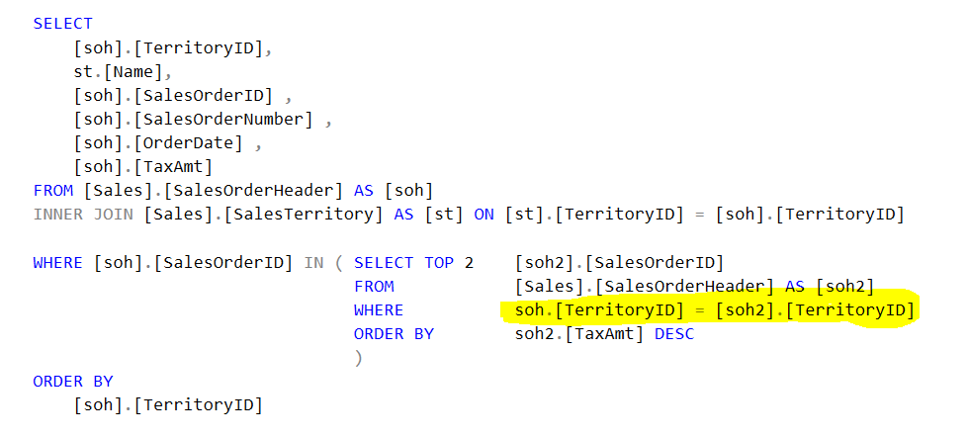
CORRELATED SUBQUERY

