Slide 1
Developing SQL Databases
QueryStore

Slide 2
QueryStore
By default, Query Store is not enabled. You can enable it at the database level in SQL Server Management Studio by using Object Explorer to navigate to the database for which you want to enable Query Store. Right-click the database name to open the Database Properties dialog ox and click the Query Store tab. In the Operation Mode (Requested) drop-down list, select Read Write.

Slide 3
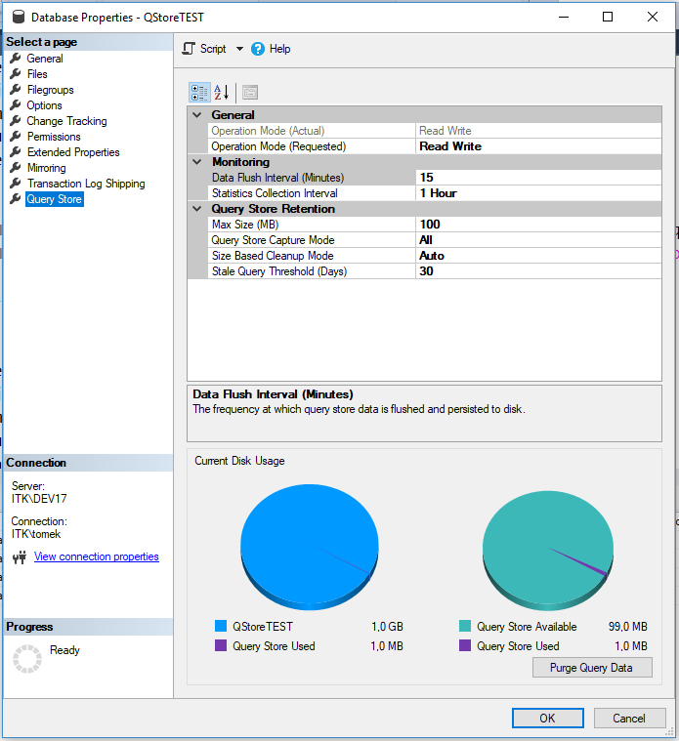

Slide 4
QueryStore Settings
Data Flush Interval (Minutes)
The frequency in minutes at which SQL Server writes data collected by the query store to disk.
Statistics Collection Interval
The granularity of time for which SQL Server aggregates runtime execution statistics for the query store. You can choose one of the following intervals: 1 minute, 5 minutes, 10 minutes, 15 minutes, 30 minutes, 1 hour, or 1 day. If you capture data at a high frequency, bear in mind that the query store requires more space to store more finely grained data.
Max Size (MB)
The maximum amount of space allocated to the query store. The default value is 100 MB per database. If your database is active, this value might not be large enough to store query plans and related information.

Slide 5
QueryStore Settings
Query Store Capture Mode
The specification of the types of queries for which SQL Server captures data for the query store. You can choose one of the following options:
None The query store stops collecting data for new queries, but continues capturing data for existing queries.
All The query store captures data for all queries.
Auto The query store captures data for relevant queries. It ignores infrequent queries and queries with insignificant compile and execution duration.
Size Based Cleanup Mode
The specification of whether the cleanup process activates when the query store data approaches its maximum size (Auto) or never runs (OFF).
Stale Query Threshold (Days)
The number of days that SQL Server keeps data in the query store.

Slide 6
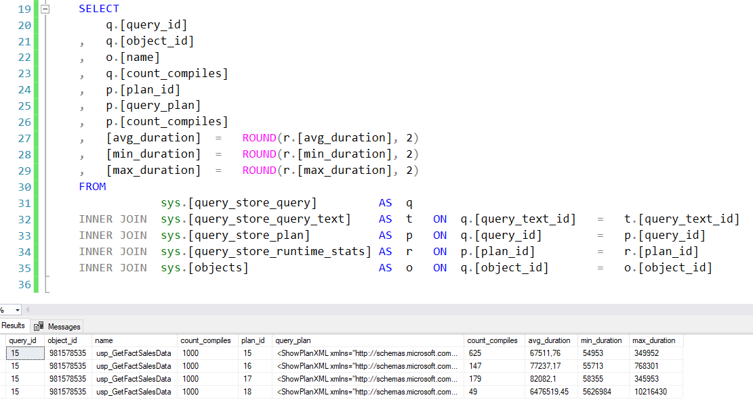

Slide 7
DMVs
The query store captures information about query plans and runtime execution statistics until the maximum space allocation is reached. You can review this data in the following DMVs:
sys.query_store_plan
Query plan information, such as Showplan XML, the number of compilations, the date and time of the initial and last compilations, the last execution date and time, and the average and most recent duration of compilation, among other details. The query plan available in this DMV is the estimated plan only.
sys.query_store_query
Aggregated runtime execution statistics for a query, including CPU binding, memory, optimization, and compilation statistics. This information is stored at the statement level and not at the batch level which is different from the behavior of sys.dm_exec_query_stats.
sys.query_store_query_text
The text of the executed query.
sys.query_store_runtime_stats
Runtime execution statistics for a query, such as first and last execution date and time, the number of executions, statistics (average, last, minimum, maximum, and standard deviation) for query duration, CPU time, logical IO reads and writes, physical IO reads and writes, CLR time, DOP, maximum used memory, and row counts.

Slide 8
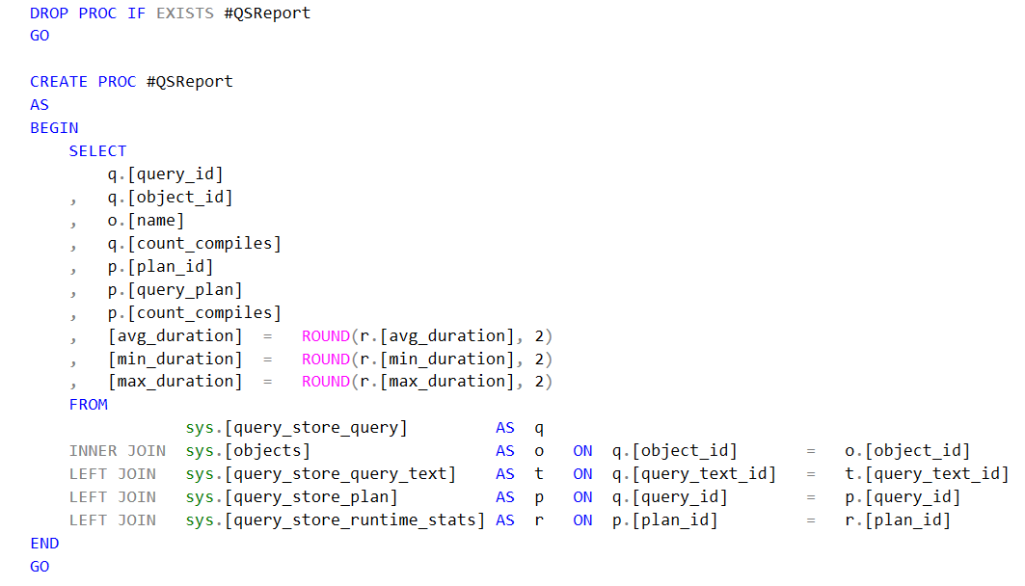

Slide 9
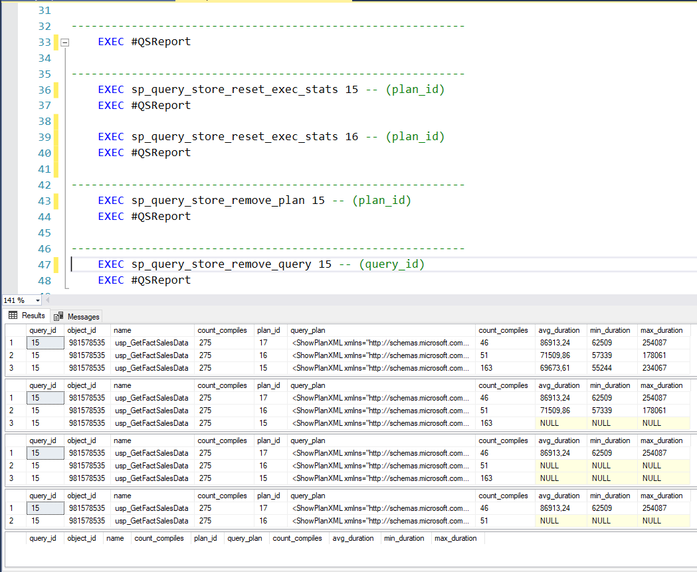

Slide 10
SPs
sp_query_store_flush_db
Flush the portion of the query store currently in memory to disk. This stored procedure takes no arguments.
sp_query_store_force_plan
Force SQL Server to use a specified query plan for a specified query. You provide identifiers for the query and plan as arguments for this stored procedure.
sp_query_store_unforce_plan
Keep a specified query plan in the query store, but no longer force SQL Server to use it for a specified query.
sp_query_store_remove_plan
Remove a specified query plan from the query store.
sp_query_store_remove_query
Remove a specified query from the query store, in addition to the query plans and runtime execution statistics related to it.
sp_query_store_reset_exec_stats
Reset the runtime execution statistics for a specified plan.

Slide 11
LINKS:
https://blogs.technet.microsoft.com/dataplatform/2017/01/31/query-store-how-it-works-how-to-use-it/
https://pl.seequality.net/sql-server-2016-query-store_1/
https://pl.seequality.net/sql-server-2016-query-store-2/
https://docs.microsoft.com/en-us/sql/relational-databases/performance/monitoring-performance-by-using-the-query-store?view=sql-server-2017

