Slide 1
Developing SQL Databases
Create Table, Constraints

Slide 2
Creating and Altering Tables
CREATE TABLE
ALTER TABLE

Slide 3
Table
In SQL Server, the table is the main method used for storing data. Every table belongs to
exactly one database.
Other variations on tables that are covered elsewhere in this Training Kit are as follows:
Temporary tables are base tables that exist in tempdb and last only as long as a session or scope referencing them endures.
Table variables are variables that can store data but only for the duration of a T-SQL batch.
Views, which are not base tables but are derived from queries against base tables, appear just like tables but do not store data.
Indexed views store data but are defined as views and are updated whenever the base tables are updated.
Derived tables and table expressions are subqueries that are referenced like tables in queries.

Slide 4
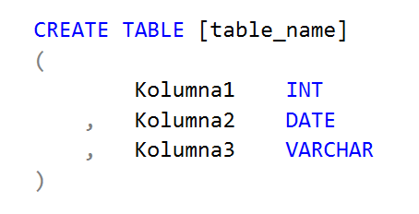
CREATE TABLE
You must specify:
The table name.
The table columns, including:
Column names.
Column data types.

Slide 5
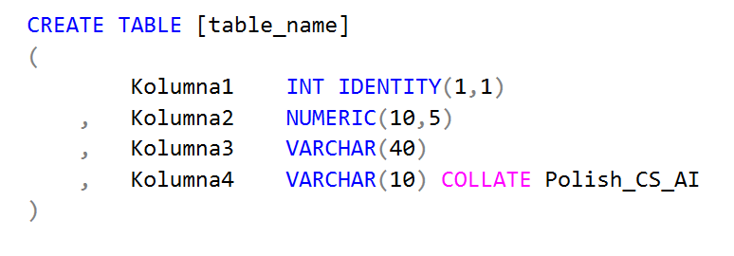
CREATE TABLE
You can also specify for columns:
The lengths of character data types, such as (15).
The precision of numeric and some date data types.
Optional special types of columns (computed, sparse, IDENTITY, ROWGUIDCOL), such as IDENTITY.
The collation of the column (normally used only if you need to specify a non-default collation).

Slide 6
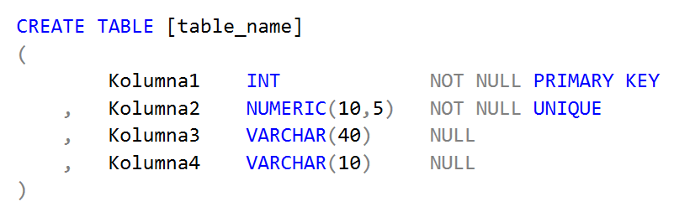
CREATE TABLE
You can also specify CONSTRAINTS , including:
Nullability
Default
Check
Primary key
Foreign key
Unique

Slide 7
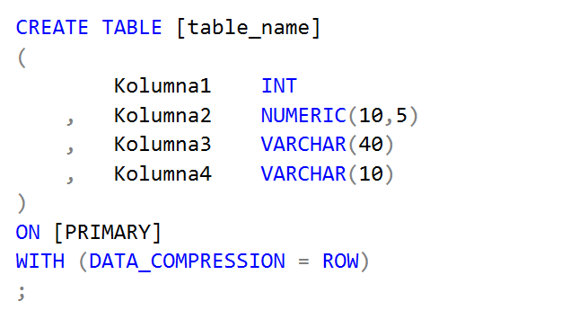
CREATE TABLE
You can also specify Possible table storage directions, including:
Filegroup
Partition schema
Table compression

Slide 8
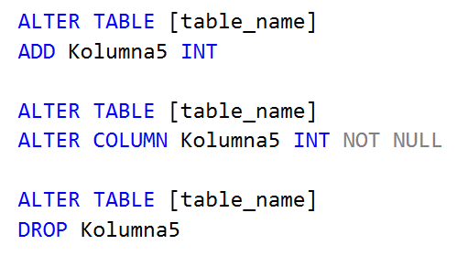
ALTER TABLE
After you have created a table, you can use the ALTER TABLE command to change the table's
structure and add or remove certain table properties, such as table constraints. You can use
ALTER TABLE to:
Add or remove a column, including a computed column.
Change the data type of a column.
Change a column's nullability (that is, from NULL to NOT NULL, or vice versa).
Add or remove a constraint, including the following:
Primary key constraint
Unique constraint
Foreign key constraint
Check constraint
Default constraint

Slide 9
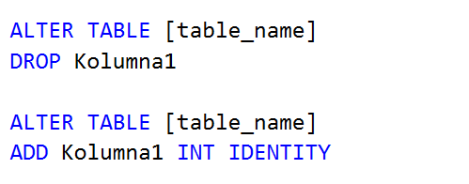
ALTER TABLE
You cannot use ALTER TABLE to:
Change a column name.
Add an identity property.
Remove an identity property.

