Slide 1
Developing SQL Databases
Constraints

Slide 2
CONSTRAINTS
NOT NULL
UNIQUE
CHECK
DEFAULT
PRIMARY KEY
FOREIGN KEY

Slide 3
CONSTRAINTS
SQL constraints are used to specify rules for the data in a table.
If there is any violation between the constraint and the data action, the action is aborted by the constraint. Constraints can be specified when the table is created (inside the CREATE TABLE statement) or after the table is created (inside the ALTER TABLE statement).
In SQL, we have the following constraints:
NOT NULL: Indicates that a column cannot store NULL value
UNIQUE: Ensures that each row for a column must have a unique value
CHECK: Ensures that the value in a column meets a specific condition
DEFAULT: Specifies a default value for a column
PRIMARY KEY: A combination of a NOT NULL and UNIQUE. Ensures that a column (or combination of two or more columns) have a unique identity which helps to find a particular record in a table more easily and quickly
FOREIGN KEY: Ensure the referential integrity of the data in one table to match values in another table

Slide 4
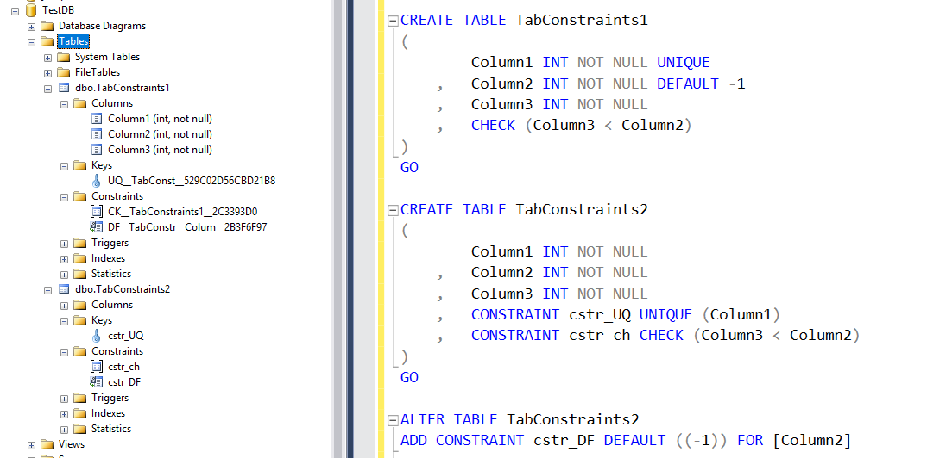
CONSTRAINTS

Slide 5
Primary Key
Perhaps the most important concept of designing any database table is ensuring that it has a primary key – an attribute or set of attributes that can be used to uniquely identify each row.
Every table must have a primary key; without a primary key, it’s not a valid table.
By definition, a primary key:
must be unique
must have a value that is not null
In some tables, there might be multiple possible primary keys to choose from, such as employee number, driver’s license number, or another government-issued number such as a Social Security Number (SSN).
In this case, all the potential primary keys are known as candidate keys.
Candidate keys that are not selected as the primary key are then known as alternate keys.

Slide 6
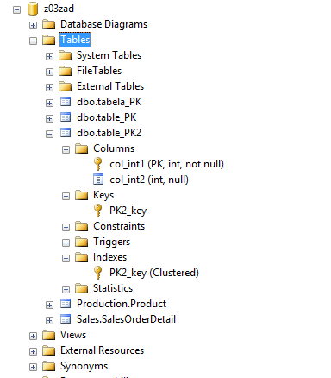
Primary Key
Creating a primary key constraint automatically creates a corresponding index.
CREATE TABLE table_PK
(
col_int1 INT NOT NULL PRIMARY KEY,
col_int2 INT NULL
)
CREATE TABLE table_PK2
(
col_int1 INT NOT NULL,
col_int2 INT NULL
)
ALTER TABLE table_PK2
ADD CONSTRAINT PK2_key
PRIMARY KEY (col_int1)

Slide 7
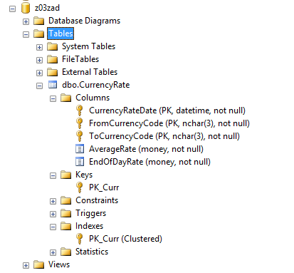
Composite Primary Key
A composite primary key occurs when you define more than one column as your primary key.
CREATE TABLE [CurrencyRate]
(
[CurrencyRateDate] [DATETIME] NOT NULL,
[FromCurrencyCode] [NCHAR](3) NOT NULL,
[ToCurrencyCode] [NCHAR](3) NOT NULL,
[AverageRate] [MONEY] NOT NULL,
[EndOfDayRate] [MONEY] NOT NULL,
CONSTRAINT PK_Curr
PRIMARY KEY ( [CurrencyRateDate],
[FromCurrencyCode],
[ToCurrencyCode])
);
GO

Slide 8
Foreign Key
A foreign key (FK) is a column or combination of columns that is used to establish and enforce a link between the data in two tables to control the data that can be stored in the foreign key table.
In a foreign key reference, a link is created between two tables when the column or columns that hold the primary key value for one table are referenced by the column or columns in another table. This column becomes a foreign key in the second table.
Unlike primary key constraints, creating a foreign key constraint does not automatically create a corresponding index.

Slide 9
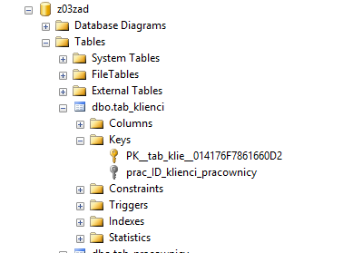
Foreign Key
CREATE TABLE tab_pracownicy
(
prac_ID VARCHAR(3) PRIMARY KEY NOT NULL,
prac_Imie VARCHAR(100)NULL,
prac_Nazwisko VARCHAR(100)NULL
)
CREATE TABLE tab_klienci
(
klient_ID VARCHAR(3)PRIMARY KEY NOT NULL,
klient_Imie VARCHAR(100)NULL,
klient_Nazwisko VARCHAR(100)NULL,
prac_ID VARCHAR(3)
)
ALTER TABLE tab_klienci
ADD CONSTRAINT prac_ID_klienci_pracownicy
FOREIGN KEY (prac_ID)
REFERENCES tab_pracownicy(prac_ID)

Slide 10
Foreign Key - Cascading Referential Integrity
By using cascading referential integrity constraints, you can define the actions that the SQL Server takes when a user tries to delete or update a key to which existing foreign keys point.
NO ACTION is the default if ON DELETE or ON UPDATE is not specified.
ON DELETE/UPDATE NO ACTION
ON DELETE/UPDATE SET NULL
ON DELETE/UPDATE DEFAULT
ON DELETE/UPDATE CASCADE

Slide 11
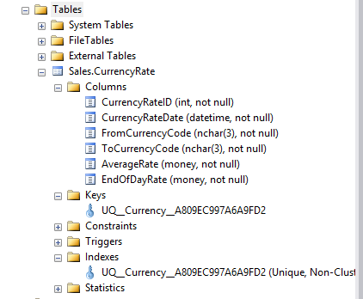
Unique Key
A unique key constraint will allow you to enforce the uniqueness property of columns, in addition to a primary key within a table.
A unique constraint acts similarly to a primary key but with two important differences:
Columns containing a unique key constraint may contain only one row with a NULL value. You cannot have two rows containing a NULL value in this column, as that would violate the unique constraint’s duplicate value error.
A table may have multiple unique key constraints.
CREATE TABLE [Sales].[CurrencyRate]
(
[CurrencyRateID] [INT] UNIQUE NOT NULL ,
[CurrencyRateDate] [DATETIME] NOT NULL ,
[FromCurrencyCode] [NCHAR](3) NOT NULL ,
[ToCurrencyCode] [NCHAR](3) NOT NULL ,
[AverageRate] [MONEY] NOT NULL ,
[EndOfDayRate] [MONEY] NOT NULL
);
GO

Slide 12
Bonus
IDENTITY
COMPUTED COLUMNS
ROW/PAGE COMPRESSION
SEQUENCE

Slide 13
IDENTITY
An Identity column is a column (also known as a field) in a database table that is made up of values generated by the database.
An identity column differs from a primary key in that its values are managed by the server and usually cannot be modified. In many cases an identity column is used as a primary key; however, this is not always the case.
It is a common misconception that an identity column will enforce uniqueness; however, this is not the case. If you want to enforce uniqueness on the column you must include the appropriate constraint too.
In Microsoft SQL Server you have options for both the seed (starting value) and the increment. By default the seed and increment are both 1.

Slide 14
COMPUTED COLUMNS
Unless otherwise specified, computed columns are virtual columns that are not physically stored in the table. Their values are recalculated every time they are referenced in a query. The Database Engine uses the PERSISTED keyword in the CREATE TABLE and ALTER TABLE statements to physically store computed columns in the table.
Computed columns used as CHECK, FOREIGN KEY, or NOT NULL constraints must be marked PERSISTED. A computed column can be used as a key column in an index or as part of any PRIMARY KEY or UNIQUE constraint if the computed column value is defined by a deterministic expression and the data type of the result is allowed in index columns.
A computed column cannot be the target of an INSERT or UPDATE statement.

Slide 15
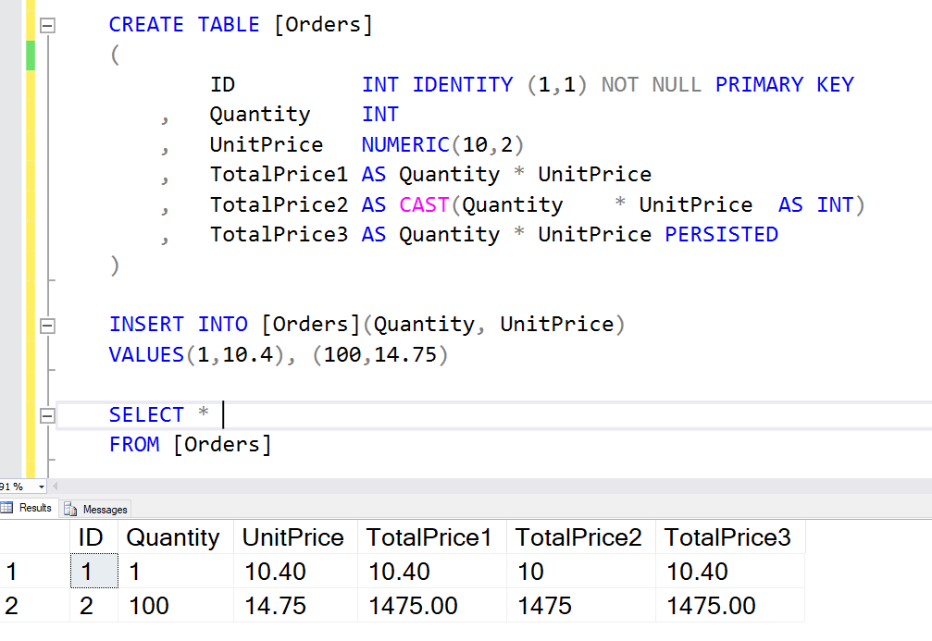
COMPUTED COLUMNS

Slide 16
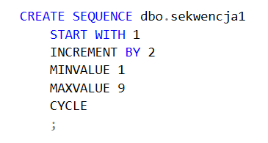
SEQUENCE
A sequence is a user-defined schema bound object that generates a sequence of numeric values according to the specification with which the sequence was created. The sequence of numeric values is generated in an ascending or descending order at a defined interval and can be configured to restart (cycle) when exhausted. Sequences, unlike identity columns, are not associated with specific tables. Applications refer to a sequence object to retrieve its next value. The relationship between sequences and tables is controlled by the application. User applications can reference a sequence object and coordinate the values across multiple rows and tables.

Slide 17
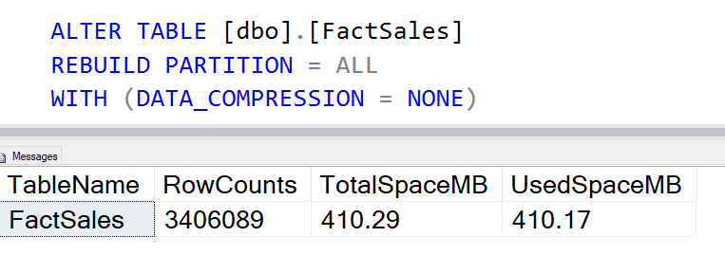
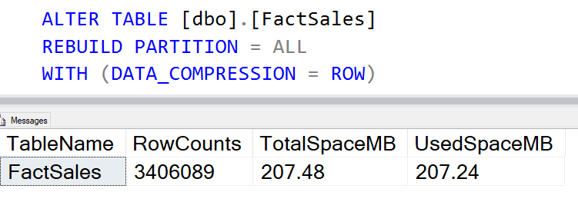
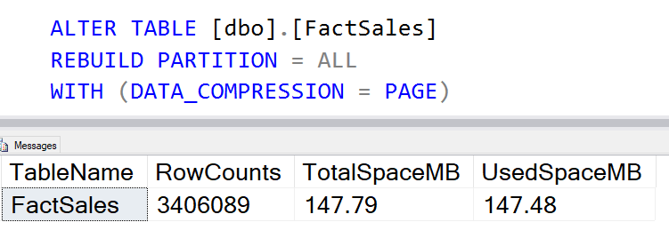
ROW/PAGE COMPRESSION
You can compress the data in a table, in addition to the indexes, to get more efficient storage. Table compression has two levels:
Row For row-level compression, SQL Server applies a more compact storage format to each row of a table.
Page Page-level compression includes row-level plus additional compression algorithms that can be performed at the page level.

