Slide 1
Developing SQL Databases
NamingConventions

Slide 2
Naming Convention
In computer programming, a naming convention is a set of rules for choosing the character sequence to be used for identifiers which denote variables, types, functions, and other entities in source code and documentation.
Reasons for using a naming convention (as opposed to allowing programmers to choose any character sequence) include the following:
To reduce the effort needed to read and understand source code;[1]
To enable code reviews to focus on more important issues than arguing over syntax and naming standards.
To enable code quality review tools to focus their reporting mainly on significant issues other than syntax and style preferences.
https://en.wikipedia.org/wiki/Naming_convention_(programming)

Slide 3
camelCase, PascalCase
Camel case (stylized as camelCase or CamelCase; also known as camel caps or more formally as medial capitals) is the practice of writing compound words or phrases such that each word or abbreviation in the middle of the phrase begins with a capital letter, with no intervening spaces or punctuation.
Common examples include "iPhone", "eBay", "FedEx", "DreamWorks", and "HarperCollins". It is also sometimes used in online usernames such as "JohnSmith", and to make multi-word domain names more legible, for example in advertisements.
For clarity:
upper camel case (initial uppercase letter, also known as Pascal case, PascalCase)
lower camel case (initial lowercase letter). Some people and organizations, notably Microsoft, use the term camel case only for lower camel case. Pascal case means only upper camel case.
https://en.wikipedia.org/wiki/Camel_case

Slide 4
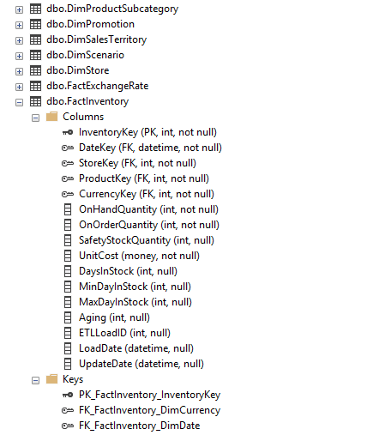
Naming Convention in SQL
https://launchbylunch.com/posts/2014/Feb/16/sql-naming-conventions/
https://www.codeproject.com/Articles/1065295/SQL-Server-Table-and-Column-Naming-Conventions

