Slide 1
Developing SQL Databases
RowStore Index

Slide 2
SEARCH ARGUMENTS
Including the WHERE clause in a query, even if the predicate is very selective and supported by an index, does not guarantee that SQL Server is going to use an index. You need to write an appropriate predicate to allow the Query Optimizer to take advantage of the indexes. The Query Optimizer is not omnipotent. It can decide to use an index only when the arguments in the predicate are searchable. You have to learn how to write appropriate search arguments (SARGs).
To write an appropriate SARG, you must ensure that a column that has an index on it appears in the predicate alone, not as a function parameter.

Slide 3
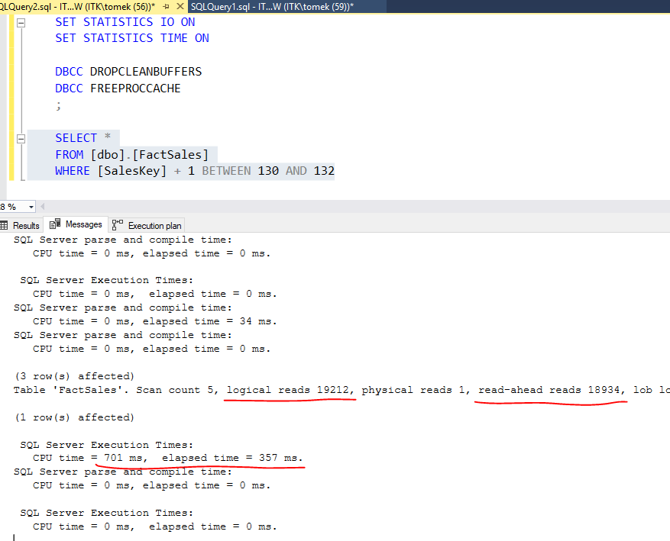
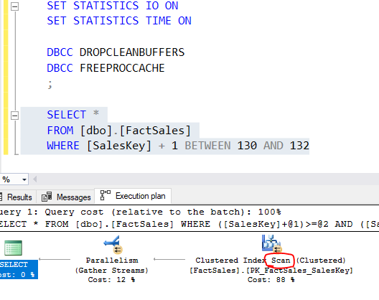
NON SARG

Slide 4
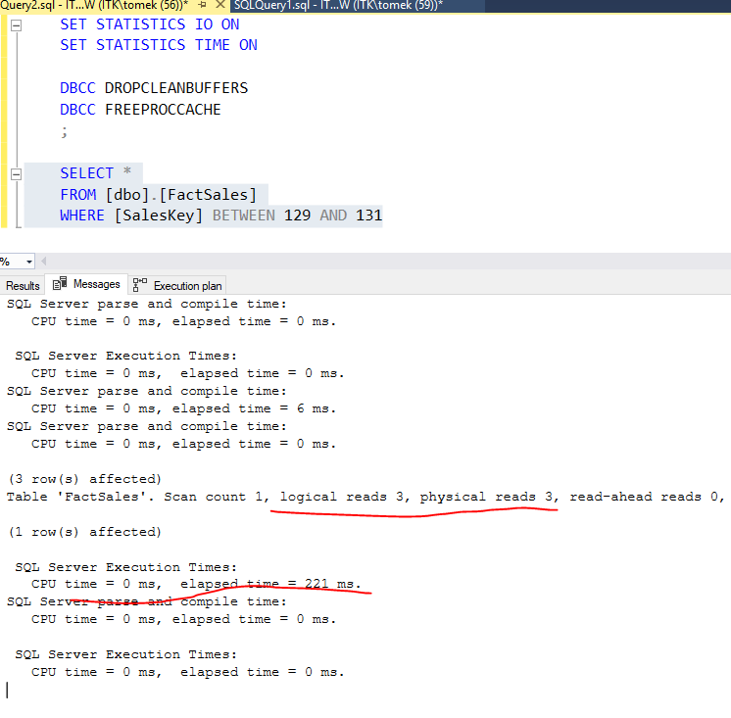
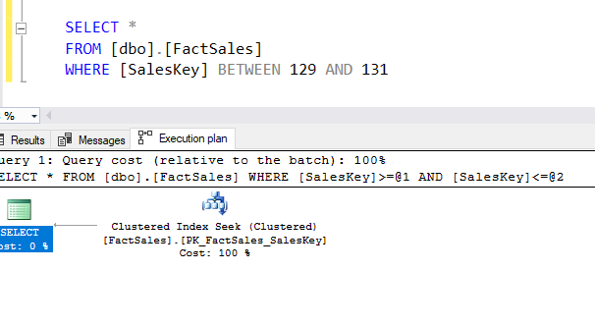
SARG

