Slide 1
Developing SQL Databases
Views

Slide 2
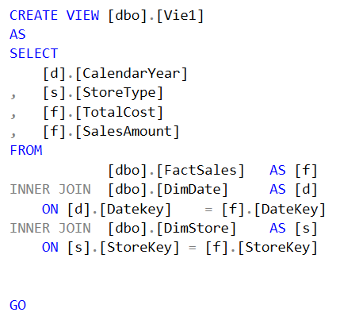
VIEW (1)
Creates a virtual table whose contents (columns and rows) are defined by a query. Use this statement to create a view of the data in one or more tables in the database.
A view can be used for the following purposes:
To focus, simplify, and customize the perception each user has of the database.
As a security mechanism by allowing users to access data through the view, without granting the users permissions to directly access the underlying base tables.
To provide a backward compatible interface to emulate a table whose schema has changed.

Slide 3
VIEW (2)
A view does not have to be a simple subset of the rows and columns of one particular table. A view can be created that uses more than one table or other views with a SELECT clause of any complexity.
The SELECT clauses in a view definition cannot include the following:
An ORDER BY clause, unless there is also a TOP clause in the select list of the SELECT statement (1)
The INTO keyword
The OPTION clause
A reference to a temporary table or a table variable.
(1) The ORDER BY clause is used only to determine the rows that are returned by the TOP or OFFSET clause in the view definition. The ORDER BY clause does not guarantee ordered results when the view is queried, unless ORDER BY is also specified in the query itself.

Slide 4
VIEW (3)
CHECK OPTION
Forces all data modification statements executed against the view to follow the criteria set within select_statement. When a row is modified through a view, the WITH CHECK OPTION makes sure the data remains visible through the view after the modification is committed.
ENCRYPTION
Encrypts the entries in sys.syscomments that contain the text of the CREATE VIEW statement. Using WITH ENCRYPTION prevents the view from being published as part of SQL Server replication.
SCHEMABINDING
Binds the view to the schema of the underlying table or tables. When SCHEMABINDING is specified, the base table or tables cannot be modified in a way that would affect the view definition. When you use SCHEMABINDING, the select_statement must include the two-part names (schema.object) of tables, views, or user-defined functions that are referenced. All referenced objects must be in the same database.

Slide 5
VIEW (4)
The CREATE VIEW must be the first statement in a query batch.
A view can have a maximum of 1,024 columns.
If a view depends on a table or view that was dropped, the Database Engine produces an error message when anyone tries to use the view. If a new table or view is created and the table structure does not change from the previous base table to replace the one dropped, the view again becomes usable.
When a view is created, information about the view is stored in the following catalog views:
sys.views
sys.columns
sys.sql_expression_dependencies
The text of the CREATE VIEW statement is stored in the:
sys.sql_modules

Slide 6
VIEW (5) – UPDATABLE VIEW
You can modify the data of an underlying base table through a view, as long as the following conditions are true:
Any modifications, including UPDATE, INSERT, and DELETE statements, must reference columns from only one base table.
The columns being modified in the view must directly reference the underlying data in the table columns. The columns cannot be derived in any other way, such as through the following:
An aggregate function: AVG, COUNT, SUM, MIN, MAX, GROUPING, STDEV, STDEVP, VAR, and VARP.
A computation. The column cannot be computed from an expression that uses other columns. Columns that are formed by using the set operators UNION, UNION ALL, CROSSJOIN, EXCEPT, and INTERSECT amount to a computation and are also not updatable.
The columns being modified are not affected by GROUP BY, HAVING, or DISTINCT clauses.
TOP is not used anywhere in the select_statement of the view together with the WITH CHECK OPTION clause.

Slide 7
VIEW (6) – INDEXED VIEW
For a standard view, the overhead of dynamically building the result set for each query that references a view can be significant for views that involve complex processing of large numbers of rows, such as aggregating lots of data, or joining many rows. If such views are frequently referenced in queries, you can improve performance by creating a unique clustered index on the view. When a unique clustered index is created on a view, the result set is stored in the database just like a table with a clustered index is stored.
Indexed views work best when the underlying data is infrequently updated. The maintenance of an indexed view can be greater than the cost of maintaining a table index. If the underlying data is updated frequently, the cost of maintaining the indexed view data may outweigh the performance benefits of using the indexed view. If the underlying data is updated periodically in batches but treated primarily as read-only between updates, consider dropping any indexed views before updating, and rebuilding them afterward. Doing this may improve performance of the updates.
Indexed views improve the performance of the following types of queries:
Joins and aggregations that process many rows.
Join and aggregation operations that are frequently performed by many queries.
Indexed views typically do not improve the performance of the following types of queries:
OLTP systems that have many writes.
Databases that have many updates.
Queries that do not involve aggregations or joins.

Slide 8
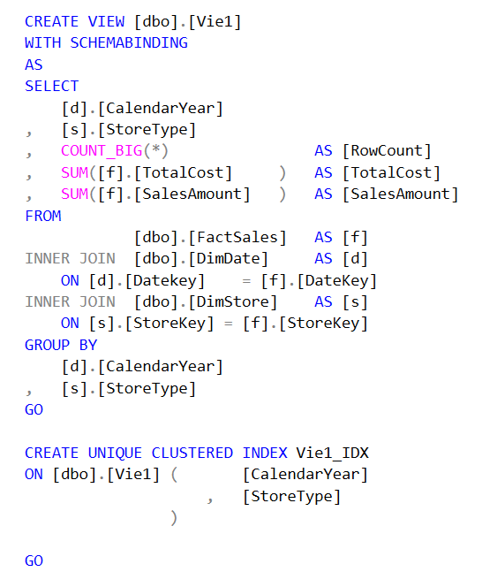
VIEW (7) – INDEXED VIEW
A view must meet the following requirements before you can create a clustered index on it:
The view must not reference any other views, only base tables.
All base tables referenced by the view must be in the same database as the view and have the same owner as the view.
The view must be created with the SCHEMABINDING option. Schema binding binds the view to the schema of the underlying base tables.
Tables and user-defined functions must be referenced by two-part names in the view. One-part, three-part, and four-part names are not allowed.
All functions referenced by expressions in the view must be deterministic.

