Slide 1
Developing SQL Databases
GitHub

Slide 2
Tools
Git
https://git-scm.com/
https://git-scm.com/book/pl/v1/Podstawy-Gita-Pierwsze-repozytorium-Gita
GitHub
https://github.com/
GitHub Extension for VisualStudio
https://visualstudio.github.com/
GitHub Desktop (nieobowiązkowe)
https://desktop.github.com/
Azure DevOps (nieobowiązkowe)
https://dev.azure.com

Slide 3
Setting GitHub account

Slide 4


Slide 5
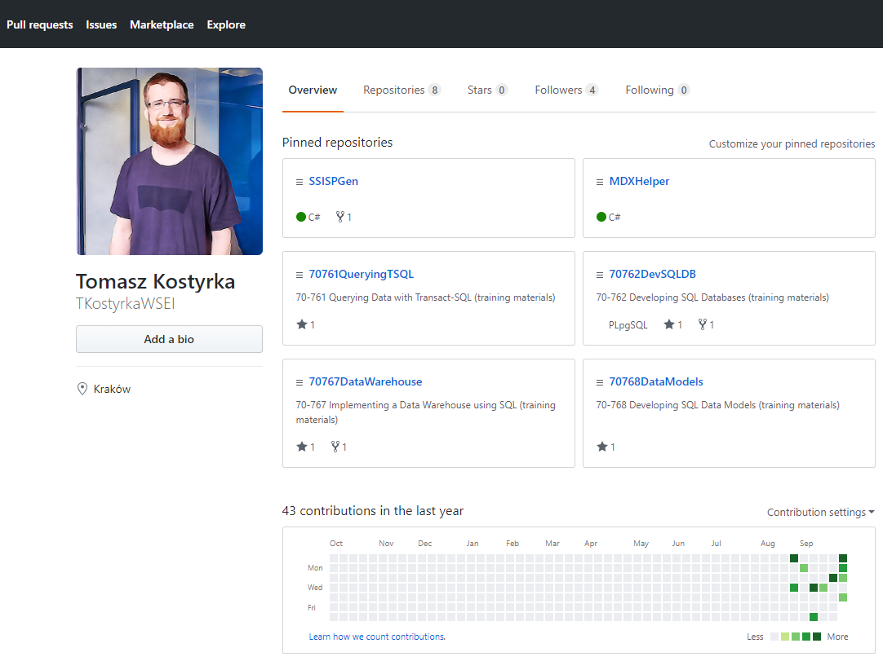

Slide 6
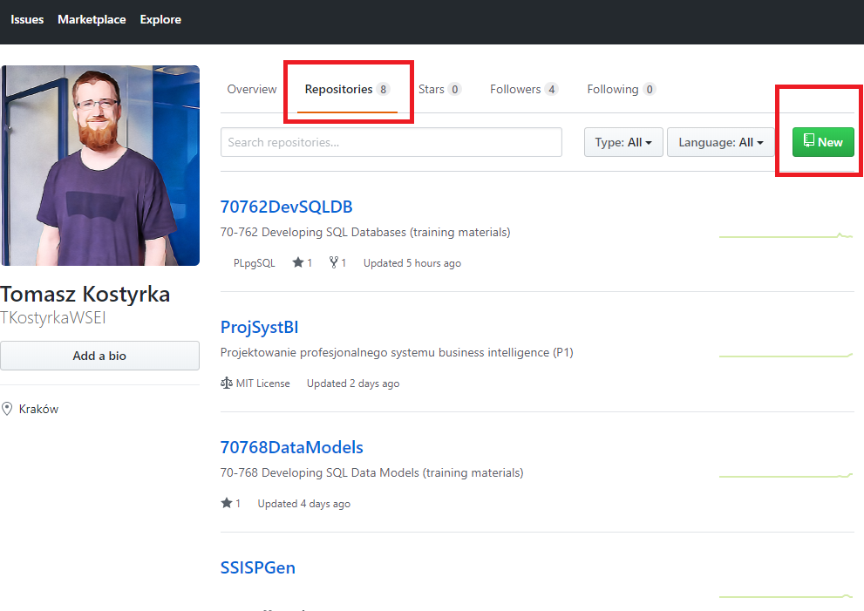

Slide 7
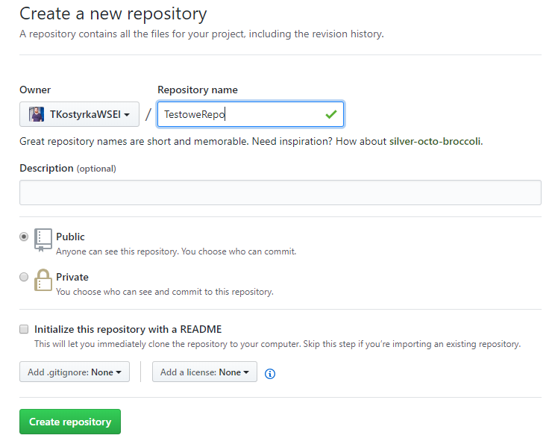

Slide 8
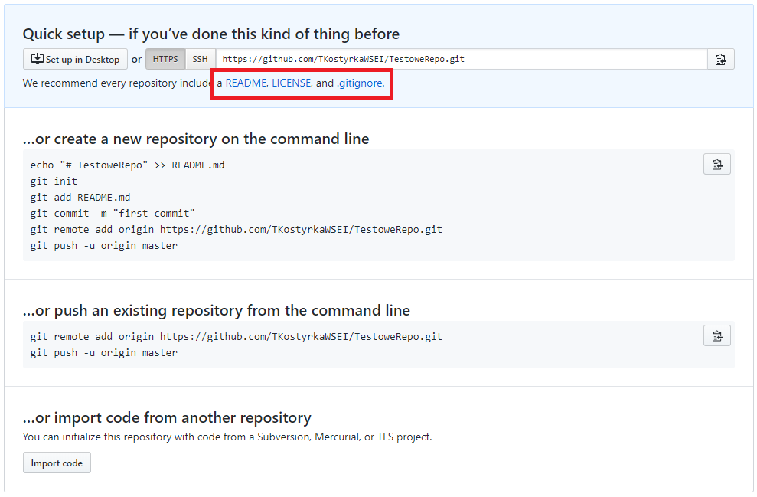

Slide 9
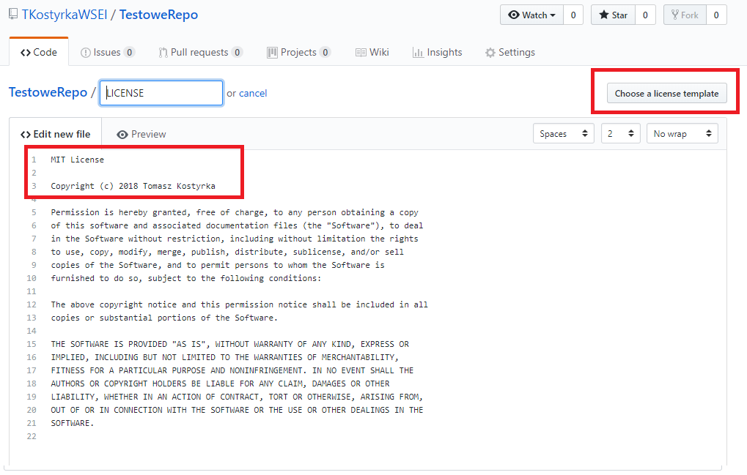

Slide 10
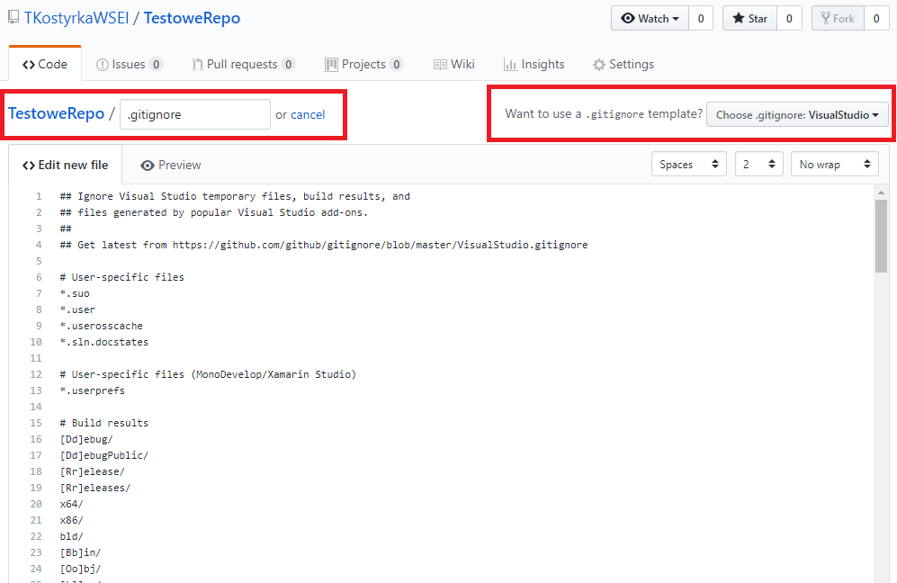

Slide 11
Initializing Solution from VisualStudio

Slide 12
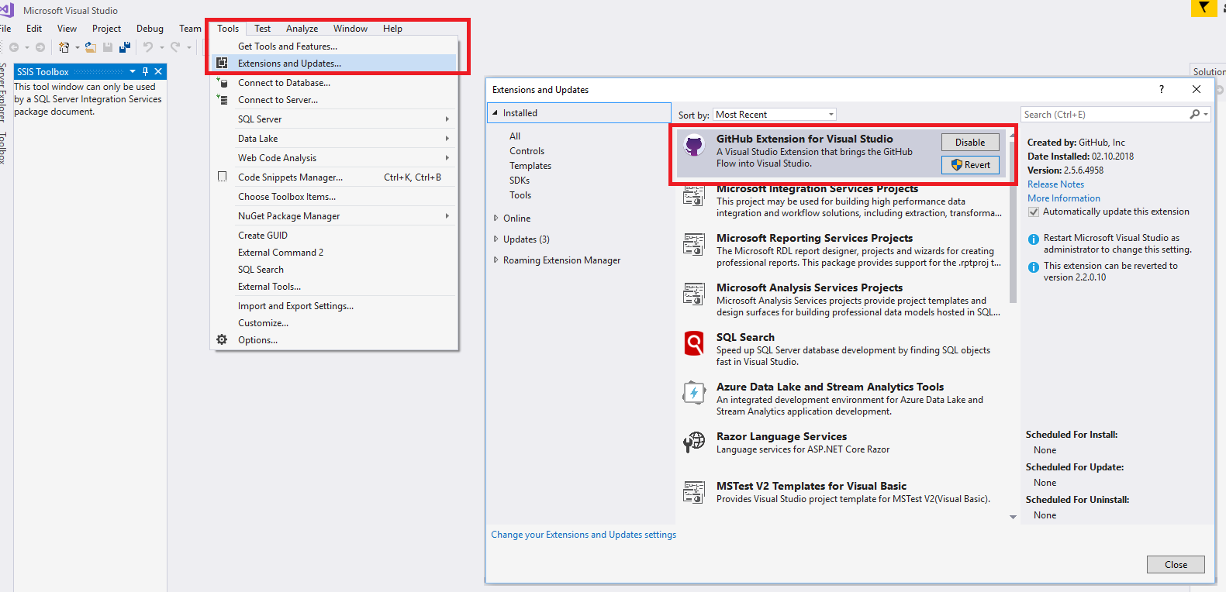

Slide 13
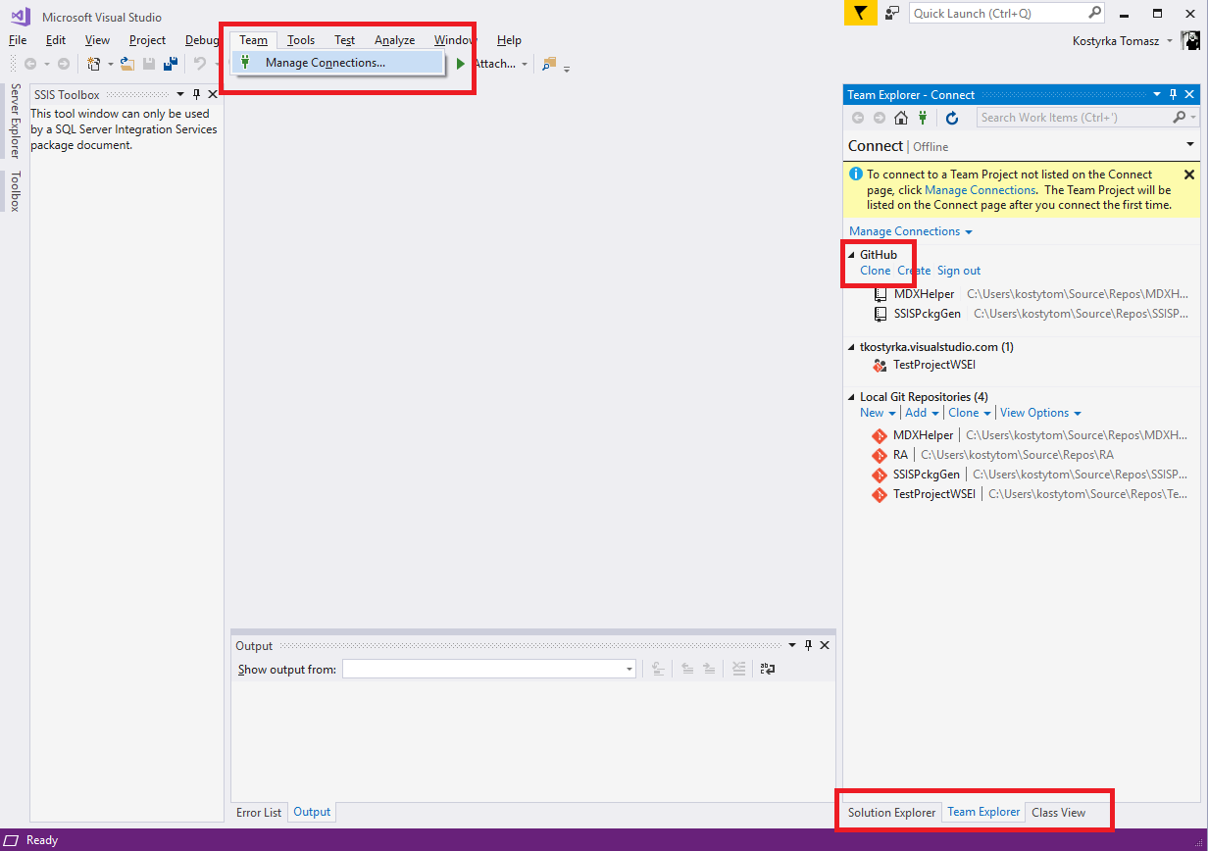

Slide 14
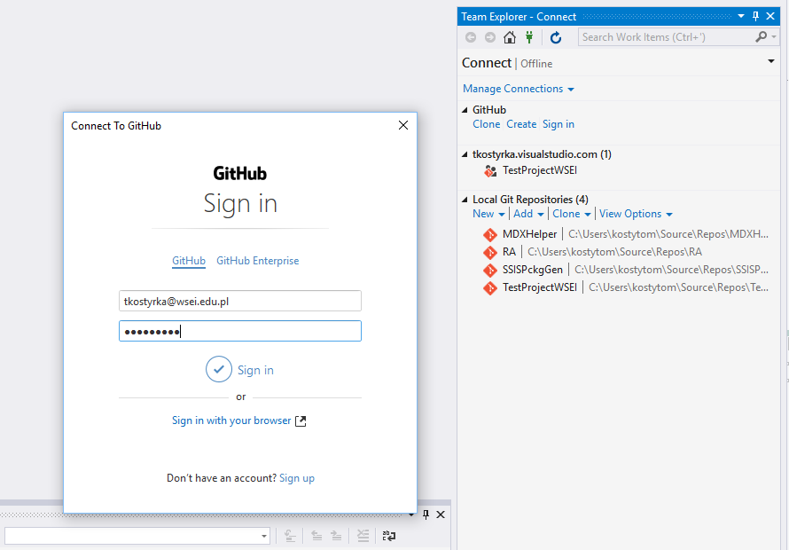

Slide 15
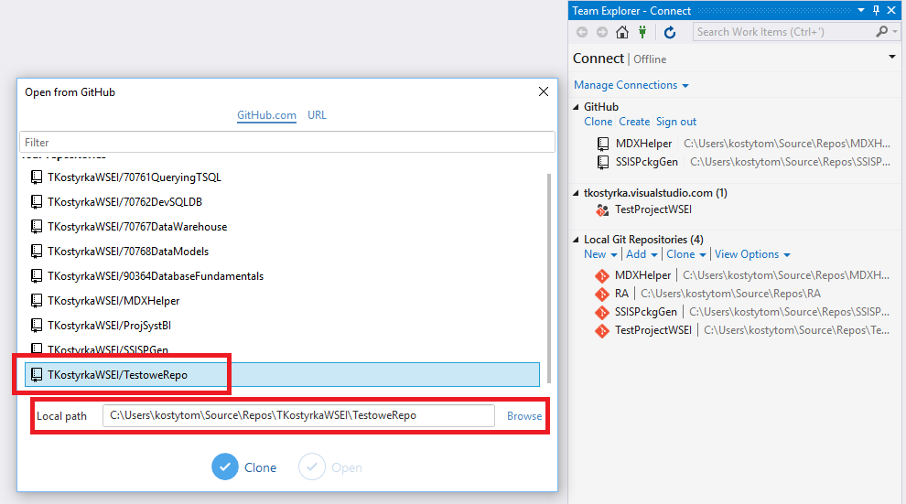

Slide 16
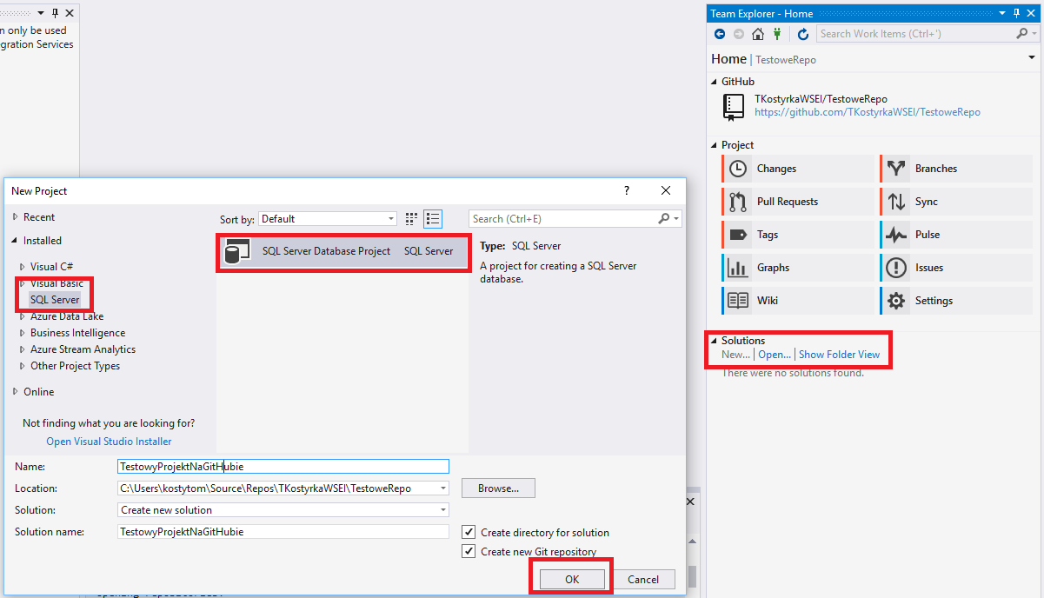

Slide 17
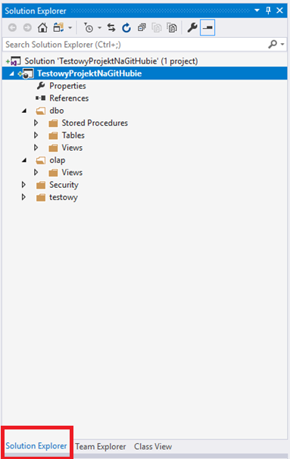
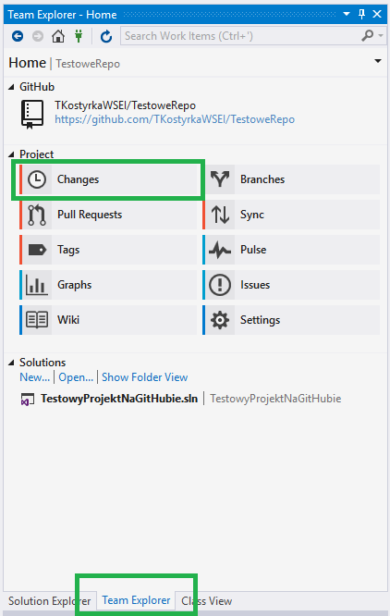
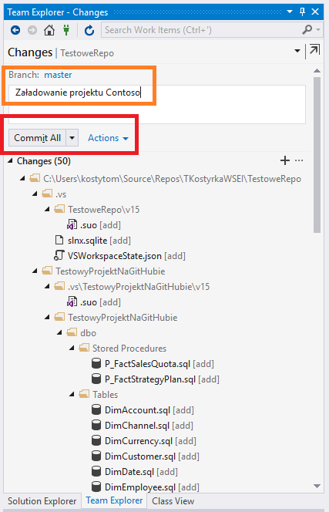
Commit

Slide 18
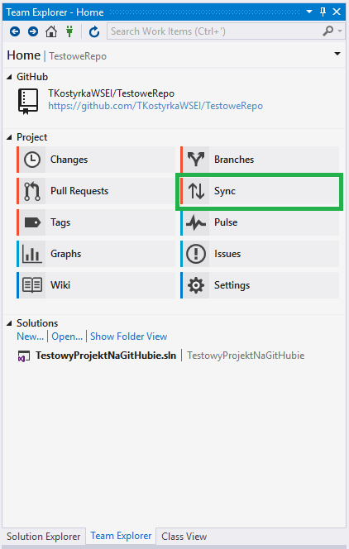
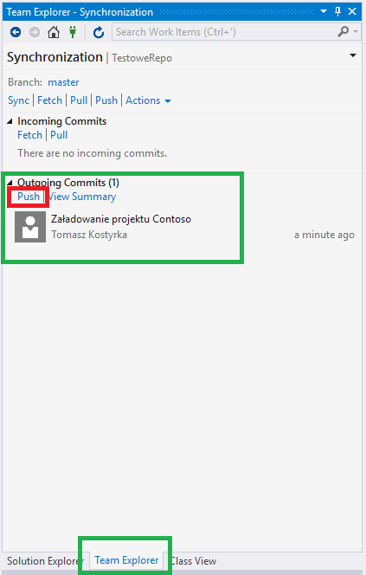
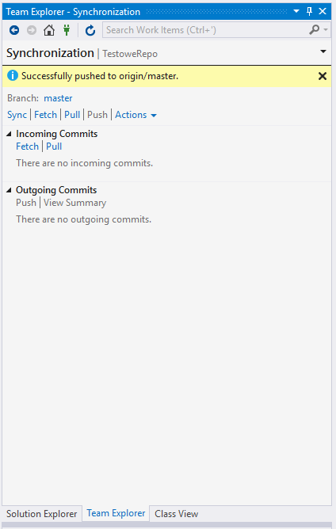
Push

Slide 19
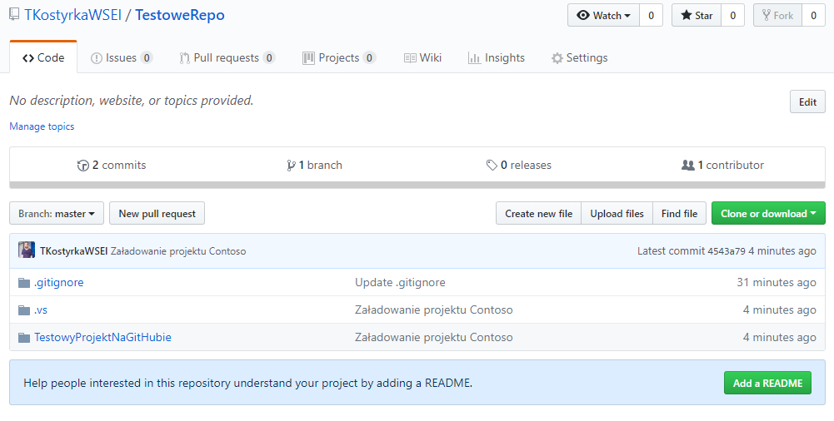

Slide 20
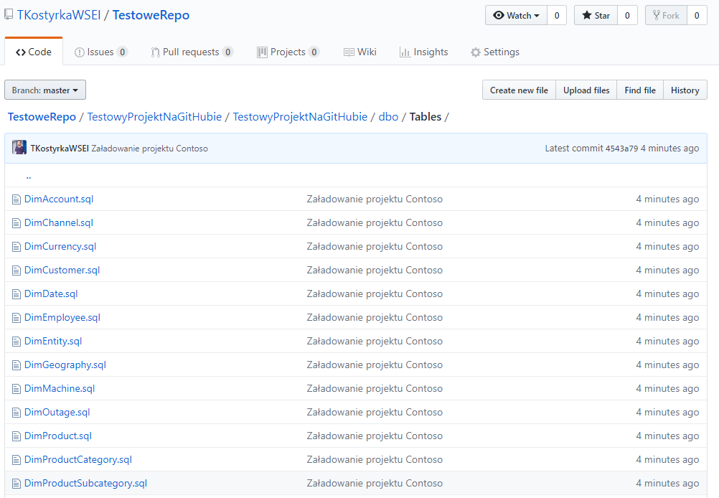

Slide 21
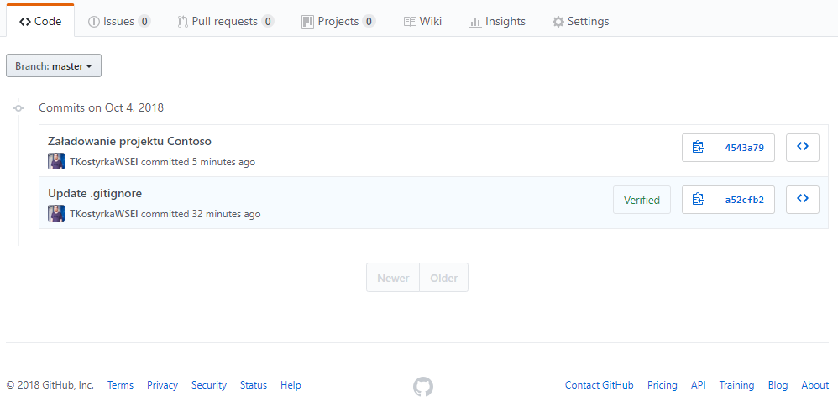

Slide 22
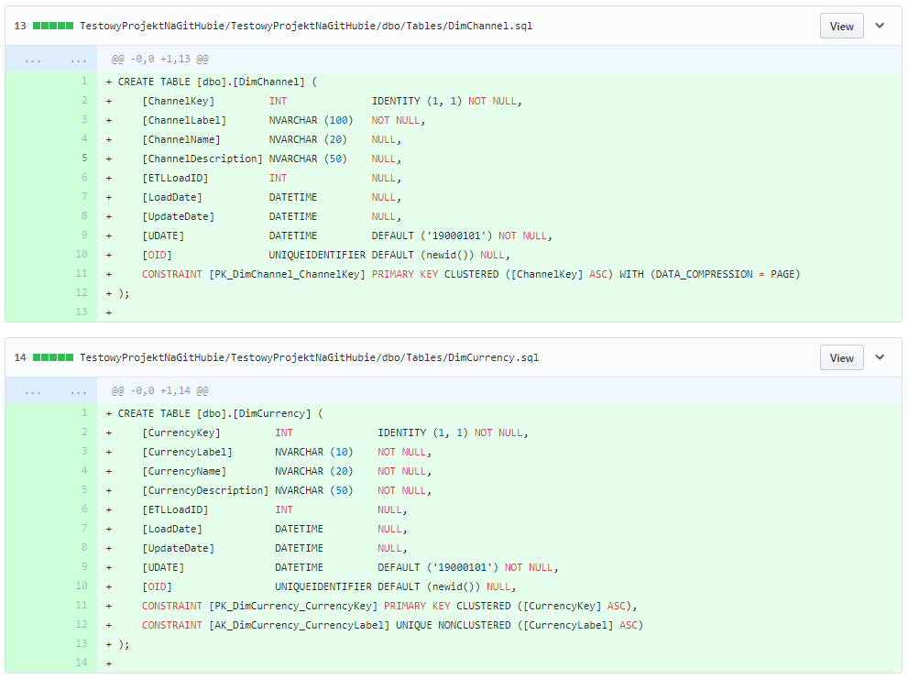

Slide 23
Git Basics

Slide 24
commit
As a noun: A single point in the Git history; the entire history of a project is represented as a set of interrelated commits. The word "commit" is often used by Git in the same places other revision control systems use the words "revision" or "version". Also used as a short hand for commit object.
As a verb: The action of storing a new snapshot of the project’s state in the Git history, by creating a new commit representing the current state of the index and advancing HEAD to point at the new commit.
branch
A "branch" is an active line of development. The most recent commit on a branch is referred to as the tip of that branch. The tip of the branch is referenced by a branch head, which moves forward as additional development is done on the branch. A single Git repository can track an arbitrary number of branches, but your working tree is associated with just one of them (the "current" or "checked out" branch), and HEAD points to that branch.
master
The default development branch. Whenever you create a Git repository, a branch named "master" is created, and becomes the active branch. In most cases, this contains the local development, though that is purely by convention and is not required.

Slide 25
ref
A name that begins with refs/ (e.g. refs/heads/master) that points to an object name or another ref (the latter is called a symbolic ref). Refs are stored in the repository.
head
A named reference to the commit at the tip of a branch. Heads are stored in a file in $GIT_DIR/refs/heads/ directory, except when using packed refs.
push
Pushing a branch means to get the branch’s head ref from a remote repository, find out if it is an ancestor to the branch’s local head ref, and in that case, putting all objects, which are reachable from the local head ref, and which are missing from the remote repository, into the remote object database, and updating the remote head ref. If the remote head is not an ancestor to the local head, the push fails.

Slide 26
pull
Pulling a branch means to fetch it and merge it.
fetch
Fetching a branch means to get the branch’s head ref from a remote repository, to find out which objects are missing from the local object database, and to get them, too.
merge
As a verb: To bring the contents of another branch (possibly from an external repository) into the current branch. In the case where the merged-in branch is from a different repository, this is done by first fetching the remote branch and then merging the result into the current branch. This combination of fetch and merge operations is called a pull. Merging is performed by an automatic process that identifies changes made since the branches diverged, and then applies all those changes together. In cases where changes conflict, manual intervention may be required to complete the merge.
As a noun: unless it is a fast-forward, a successful merge results in the creation of a new commit representing the result of the merge, and having as parents the tips of the merged branches. This commit is referred to as a "merge commit", or sometimes just a "merge„.
resolve
The action of fixing up manually what a failed automatic merge left behind.

