Slide 1
GIT

Slide 2

Tomasz Kostyrka
Senior BI Developer @ProDataConsult
Assistant @WSEI
tomek.kostyrka@gmail.com
tkostyrka@wsei.edu.pl
github.com/TKostyrkaWSEI

Slide 3
Narzędzia
Git
https://git-scm.com/
GitHub
https://github.com/
GitHub Desktop
https://desktop.github.com/
GitHub Extension for Visual Studio
https://visualstudio.github.com/
Visual Studio 2017 Community (lub wyższa)
https://docs.microsoft.com/pl-pl/visualstudio/releasenotes/vs2017-relnotes
Azure DevOps
https://dev.azure.com

Slide 4
Plan
Git

Slide 5
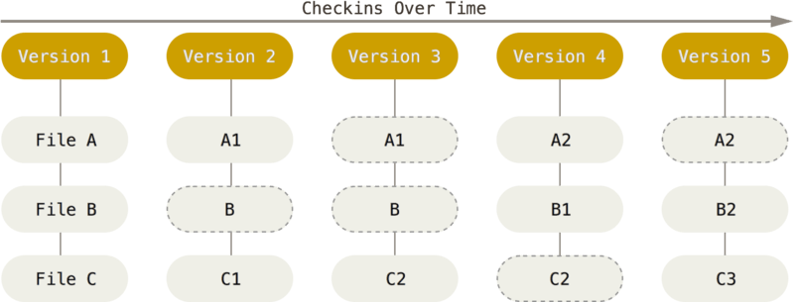

Slide 6
