Slide 1
Creating Content
Geometic Utility Classes
Mathematical Classes
Geometry Classes
GeometryArray Classes
GeometryStrip Array Classes
Indexed Geometry
Appearance and Attributes
Point- + LineAttributes
PolygonAttributes

Slide 2
Creating Content
Objectives
Get an overview on how to handle polygones in Java 3D.
Know the most important attributes that determine the look of a polygone.

Slide 3
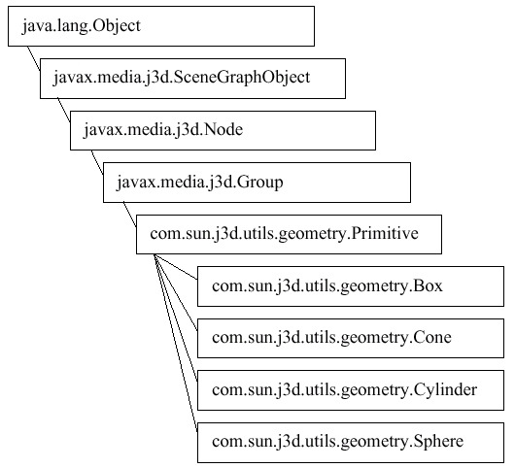
Tutorial Page 2-6
Creating Content
Geometric Utility Classes
Box
(2x2x2 m)
Cone
(Ø2m, height 2m)
Cylinder
(Ø2m, height 2m)
Sphere
(Ø2m)
Default color white

Slide 4
Creating Content
Mathematical Classes (1)
Tutorial Page 2-15
Tuples are simply pairs or triples of numbers.
For each vertex there can be up to four javax.vecmath objects:
  Points for coordinates
  Colors
  Vectors for normals
  TexCoords for texture coordinates

Slide 5
Creating Content
Mathematical Classes (2)
Vectors: mostly used for normals and position information in 3D-space.
Normals: determined using the right hand (remember: we have a right-handed system).
P2
n
P0
P1

Slide 6
Creating Content
Geometry Classes
Tutorial Page 2-20
What to do if our shape is not a box or a cylinder?
Create Shape3D-object, use setGeometry() method!
For a triangle:
  Three-element array
  One point per element

Slide 7
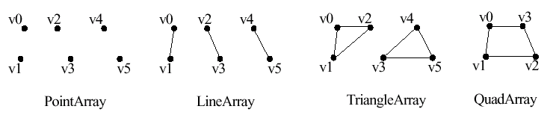
Creating Content
GeometryArray Classes
Tutorial Page 2-21
2-26
Most primitive form to create shapes:
Points or lines are one pixel wide per default.
Colors are interpolated from vertex to vertex if specified.
(see code page 2-24, line 9+10)
P0
P1

Slide 8
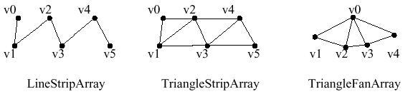
Creating Content
GeometryStripArray Classes
Tutorial Page 2-27
More convenient: share some vertices:
Example Yoyo: Ever tried to model a Jumbo-Jet by hand? Often geometry is generated by mathematical calculations.

Slide 9
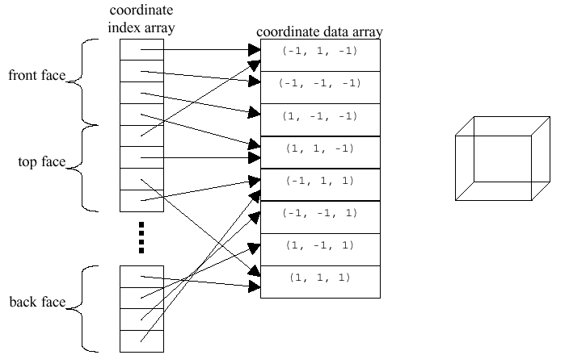
Creating Content
Indexed Geometry
Tutorial Page 2-27
Best re-use of vertices but we lose performance using the index array.

Slide 10
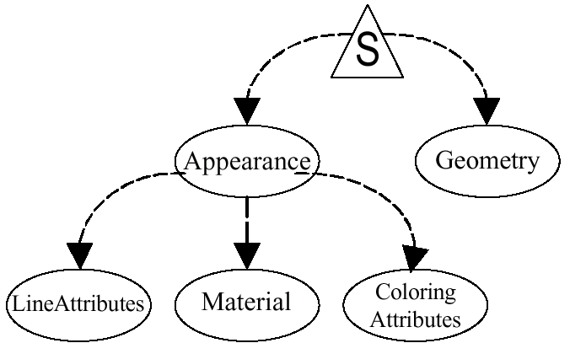
Creating Content
Appearance and Attributes
Tutorial Page 2-34
Appearance class does not specify the appearance directrly but contains many links to appearance objects:

Slide 11
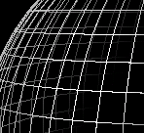
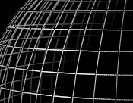
Creating Content
Point- + LineAttributes
Tutorial Page 2-37
Points and Lines are 1 pixel wide by default. Zooming does not affect this.
Let‘s try to change:
  Thikness of the line
  Antialiasing

Slide 12
Creating Content
PolygonAttributes
Tutorial Page 2-38
2-42
We can set the PolygonMode:
  Fill: fill the interior of the polygones
  Line: connect vertices with lines („Drahtigttermodell“)
  Point: draw only points at the vertices
Face culling: Hide front, back or none of the faces of a polygon.

Slide 13
Easier Content Creation
Class Loaders
Handle a bunch of objects
Text in 2D and 3D
Background
Bounding Leaf

Slide 14
Easier Content Creation
Objectives
Be able to load and display non-Java 3D objects in a scene.
Understand background and bounding leaf and why one of the two is not enough.

Slide 15
Easier Content Creation
Class Loaders
Tutorial Page 3-2
Load 3D scene files and create Java 3D representations (branch graph).
  Read and parse file
  Create Java 3D objects
  Return branch group object with all the scene contents
  Insert branch group in the scene
-> J3D API Demos:
  ..\ObjLoad\java ObjLoad ..\geometry\galleon.obj

Slide 16
Easier Content Creation
Handle a bunch of points
Tutorial Page 3-7
First create a GeometryInfo object.
Now many operations can be performed on this object (and on our data):
  Generate Normals
  „Stripifying“
  „Compacting“
Example: GeometryInfoApp.java

Slide 17
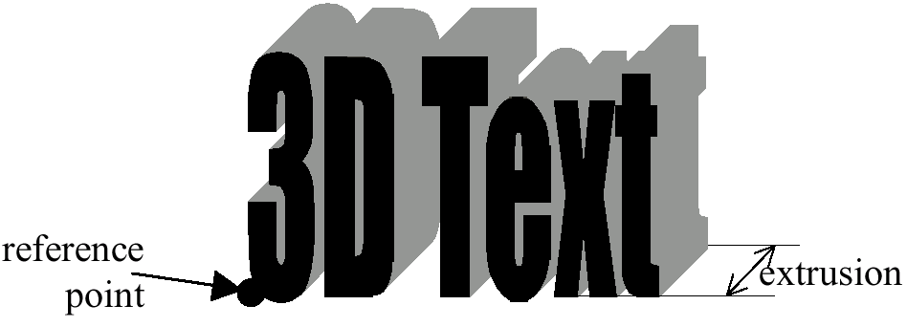
Easier Content Creation
Text in 2D and 3D
Tutorial Page 3-13
3-16
Text2D creates a rectangular polygone and a texture on it.
Text3D creates geometry objects for the text that have an extrusion.

Slide 18
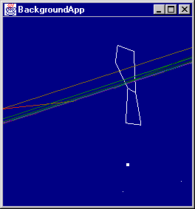
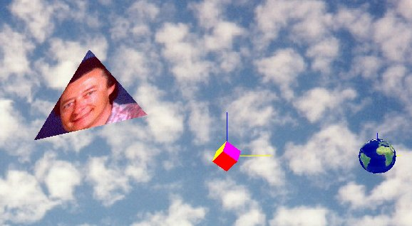
Easier Content Creation
Background
Tutorial Page 3-22
Background can be a solid color, an image and/or a geometry.
Background is infinitely far away, you can not go or see what‘s behind.

Slide 19
Easier Content Creation
Bounding Leaf
Used for different classes: Light, Fog, Behaviour or Background.
Only an intersection with the bounding leaf of such an object makes it visible.

Slide 20
Animation
Interpolators
Alpha Object
Billboard
Level of Detail (LOD)
Morphing

Slide 21
Animation
Objectives
Get an impression of the different forms of animation.
Be able to animate objects using an Interpolator and Alpha object.

Slide 22
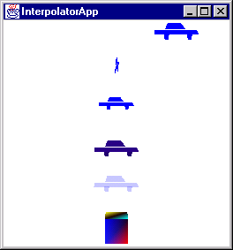
Animation
Interpolators
Tutorial Page 5-11
Change all important 3D-object data easily.
Interpolators do not change the corresponding value automatically -> Alpha object needed.

Slide 23
Animation
Alpha Object (1)
Tutorial Page 5-7
Alpha objects generate events distributed over time.
They are used as trigger events for the interpolators.
Some of the possible wave-forms f(t):

Slide 24
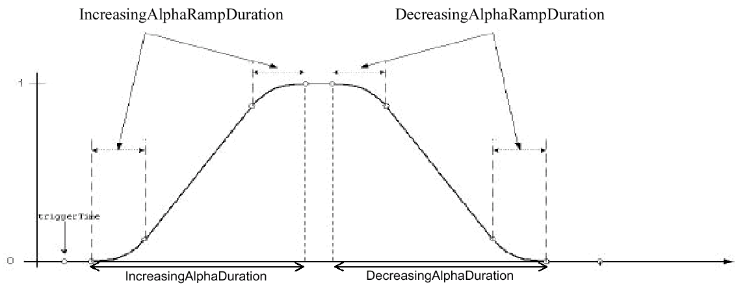
Animation
Alpha Object (2)
Tutorial Page 5-7
AlphaAtOneDuration
TriggerTime
PhaseDelayDuration
AlphaAtZeroDuration

Slide 25
Animation
Put it together
TransformGroup objRotate = new TransformGroup();
objRotate.setCapability(TransformGroup.ALLOW_TRANSFORM_WRITE);
Alpha alpha = new Alpha ();
RotationInterpolator rotInt =
new RotationInterpolator (alpha, objRotate);
rotInt.setSchedulingBounds(bounds);
objRotate
Trigger events
rotInt
alpha
Change
Transform3D

Slide 26
Animation
Billboard
Tutorial Page 5-26
Show complex (background) geometry, e.g. trees.
Troubles with different views.
These objects are flat:

Slide 27
Animation
Level of Detail (LOD)
Tutorial Page 5-30
5-31
As closer you are as more details you want to see -> LOD.
Several childs of a Switch node, choose the right one.
Long developement time for creating the objects with different detail levels.

Slide 28
Animation
Morphing
Tutorial Page 5-36
„Interpolator for geometry“.
You have to define the key frames.
The Morph class will interpolate between the key frames.
-> Try the Java 3D example \jdk1.3\demo\java3d\Morphing\Morphing.java

Slide 29
Animation
Exercises
Tutorial Page 5-36
Find description on the web page (chapter animation):
www.hta-bi.bfh.ch/~rfs/pwf/java3/

Slide 30
Lights
Java 3D Lighting Model
Influence
Different Light Types
Mixing Lights
Material Objects
Other Coloring Possibilities
Shadows

Slide 31
Lights
Objectives
Tutorial Page 6-2
Understand the Java 3D lighting system.
Know about the different ways to give a color to an object.
Recall the theory about additive light mixing.

Slide 32
Lights
Java 3D Lighting Model
Tutorial Page 6-2
There are three different reflections:
  Ambient (caused by ambient light)
  Diffuse („normal“ reflection)
  Specular (highlight reflections of polished material)
No inter-object reflections in Java 3D.
Light sources are not visible itself.

Slide 33
Lights
Influence
Tutorial Page 6-8
6-9
There is no warning for leaving light out of a scene.
There is no warning for not setting a light source its influencing bounds.
Some light types have a attenuation setting.

Slide 34
Lights
Different Light Types
Tutorial Page 6-11 ff
Ambient light
As if the sky was cloudy.
Directional light
For the virtual „sun“.
Point light
For virtual lamps.
Spot light
Virtual spot lamps.

Slide 35
Lights
Mixing Light
Tutorial Page 6-17
Why does an object appear in a certain color?
White sphere, red and blue light -> result?

Slide 36
Lights
Material Object
Tutorial Page 6-21
Color settings of the material object represent „reflection coefficients“.
Shininess is an interesting value.

Slide 37
Lights
Other Coloring Possibilities
Tutorial Page 6-23
No lights needed, but no „shiny“ effects:
  ColoringAttributes
  Per-vertex color (KickCan example: class Floor).

Slide 38
Lights
Shadows
There are no built-in shadows in Java 3D.
Shadows in the tutorial are created using hand-made classes and polygones.

Slide 39
Textures
Basic Principles
Create a Simple Texture

Slide 40
Textures
Objectives
Know what a texture is and why we need it.
Be able to program simple textures.

Slide 41
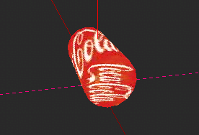
Textures
Basic Principles
Detailed surface structures are hard and expensive to build in 3D -> Texture!
„Texel“ is „texture element“ -> one pixel of a texture.
Texture mapping: Fit image to a given geometry.

Slide 42
Textures
Create a Simple Texture
Load an image
Create a texture
Create 3D-
object with appearance
String filename = "earth.jpg"; TextureLoader loader = new TextureLoader(filename, this);
ImageComponent2D image = loader.getImage();
Texture2D texture = new Texture2D(Texture.BASE_LEVEL, Texture.RGBA, image.getWidth(), image.getHeight());
texture.setImage(0, image);
Appearance appear = new Appearance(); appear.setTexture(texture);
Sphere earth = new Sphere(1.0f, Primitive.GENERATE_TEXTURE_COORDS, appear));

Slide 43
Project
Information Gathering
Set-up
Deliverables

Slide 44
Project
Objectives
Apply all what you have learned.
Learn more of the Java 3D API and 3D computer graphics.
Know what you want to do -> concept, system design, ...

Slide 45
Project
Information Gathering
Search the web, get ideas.
Do a brain storming or something similar -> write down your ideas.
Form project groups.
Discuss your ideas so that you get ready to start with a concept.

Slide 46
Project
Set-up
Participants of the project.
Discussed your idea with the teacher.

Slide 47
Project
Deliverables
The deliverables are: source and documentation of the project.
Documentation as HTML page or paper.
Turn in source and documentation:
  ZIP file by mail (or link for download if size > 1MB)
  or
  CD-ROM

Slide 48
A Bit More...
Spline Functions
3D-modelling
Professional Rendering
POVRay Example

Slide 49
A Bit More…
Objectives
Get a little outlook on what happens outside of Java 3D.
Have an idea of professional tools used in computer graphics.
Hands-on experience with POVRay.

Slide 50
A Bit More…
Spline Functions
Base: Spline Functions
Applications of Spline Functions in: Spline Curves, Spline Surfaces
Advantages: Smooth surfaces (!)
Application in Java 3D:
com.sun.j3d.utils.behaviors.interpolators.TCBSplineInterpolator

Slide 51
A Bit More…
3D-modelling
LightWave (www.newtek.com)
ZOOM

Slide 52
A Bit More…
Professional Rendering
Rendering for films like Toy Story or Titanic is done with rendering products.
Performance is far from real time but the experience pretty close to real world.
Examples of Products:
  PRMan (www.pixar.com)
  BMRT (www.bmrt.org)
  POVRay (www.povray.org)

Slide 53
A Bit More…
POVRay Example
Download POVRay from
ftp.hta-bi.bfh.ch (Windows Version)
Install locally
Create a ready-made scene
Play around

Slide 54
Project
What to do?
A Paper describing a 3D computer graphics related aspect.
A Java 3D program (little demo, game, a start for a bigger project…).
A demo with an other 3D software (PRMan, BRMT, PovRay).
A picture of a 3D-contest (e.g. PovRay).

Slide 55
Project Presentations
Deliverables
Presentations!

Slide 56
Project Presentations
Deliverables
Turn in source and documentation:
  ZIP file by mail (or link for download)
  or
  CD-ROM
Due Date: 2nd March 2001
rfs@hta-bi.bfh.ch

Slide 57
Project Presentations
Presentations!
1 | Daniel Glauser | 3D-Bomberman
2 | Ramon Keller | 3D-Schach
3 | Nicolas Leuba | Fisch-Aquarium
4 | Roger Mathys Pascal Moser | Murmelbahn
5 | Philippe Schnyder Philippe Schoch Markus Trachsel | 3D-Würfel
6 | Stefan Rufer | RenderMan / BMRT

Slide 58
Project RenderMan / BMRT
What is RenderMan?
What is BMRT?
What is Radiosity?

Slide 59
Project RenderMan / BMRT
What is RenderMan?
Open interface by Pixar.
Interface for 3D-model rendering.
Provides extension possibilities for custom shading and gadgets.
This is NOT an implementation.

Slide 60
Project RenderMan / BMRT
What is BMRT?
BMRT is a free 3D-renderer by BlueMountain Corp.
BMRT is partly RenderMan compatible.
Contains various tools. Most important:
  rgl: Simple, fast renderer for previews.
  rendrib: High-end renderer providing ray-tracing, radiosity, programmable shading…

Slide 61
Project RenderMan / BMRT
What is Radiosity?
Imagine: Blue room with white chair → chair appears a bit blue!
Compute diffuse, inter-object reflections
RayTracing uses AmbientLight to simulate this → not too good.
Radiosity approximates diffuse, inter-object reflections.

Slide 62
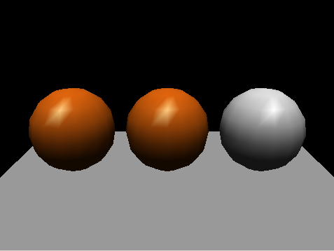
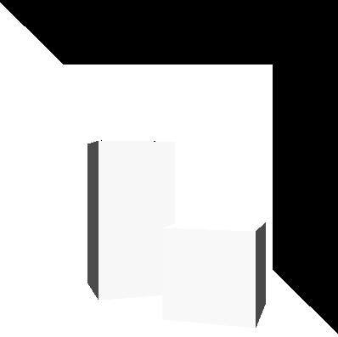
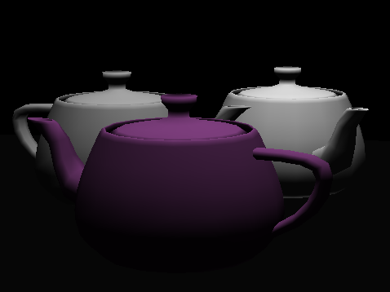
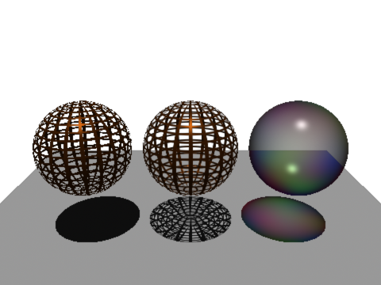
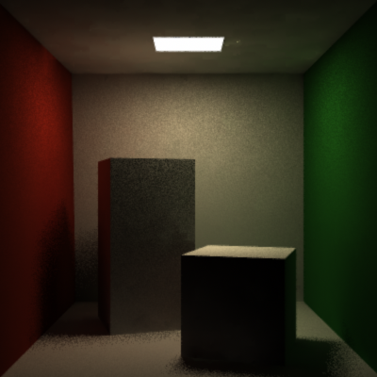
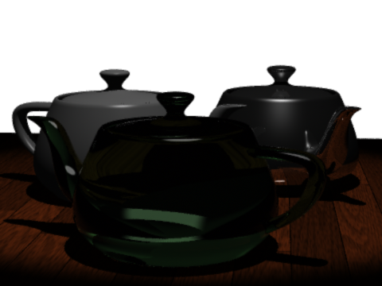
Project RenderMan / BMRT
Radiosity examples
rgl
preview
rendrib
quality

