Slide 1
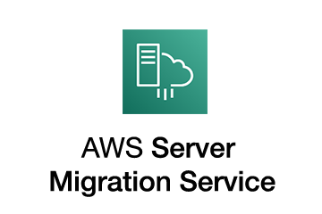
AWS Application Migration Service
Move and improve your on-premises and cloud-based applications

Slide 2
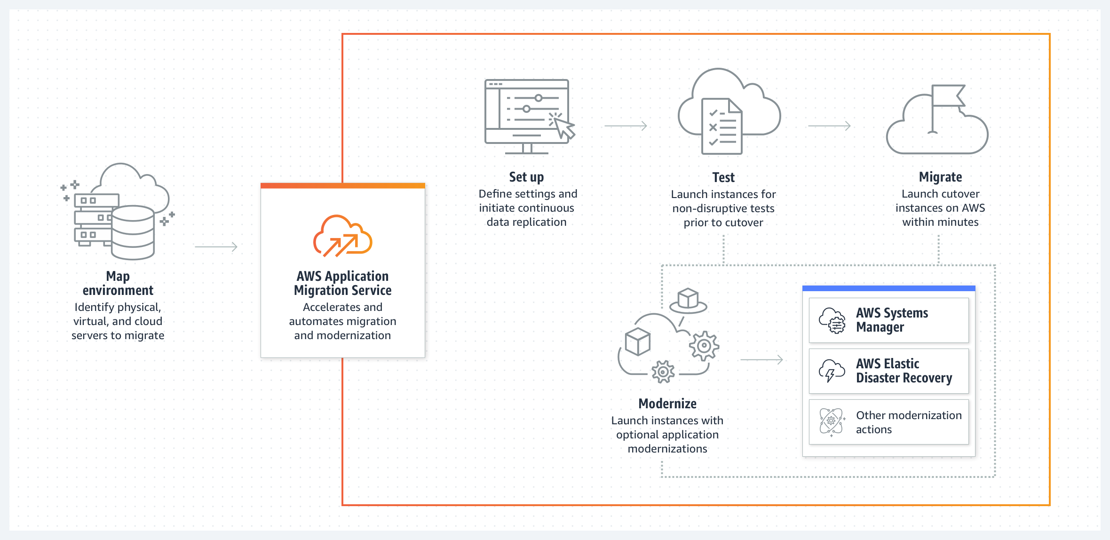
AWS Application Migration Service

Slide 3

AWS Application Migration Service Use cases
Data center to cloud migration
Use AWS Application Migration Service to rapidly move your virtual and physical servers to AWS. The automated rehosting capabilities of Application Migration Service help you avoid complications that can be caused by manual replication, reconfiguration, and rebuilds.
Cross-cloud migration
Easily migrate workloads running on another public or private cloud to AWS. AWS Application Migration Service automatically converts your cloud-based servers to run natively on AWS as EC2 instances.
Cross-region migration
Use AWS Application Migration Service to simplify migration between different AWS accounts, Availability Zones, or regions.

Slide 4
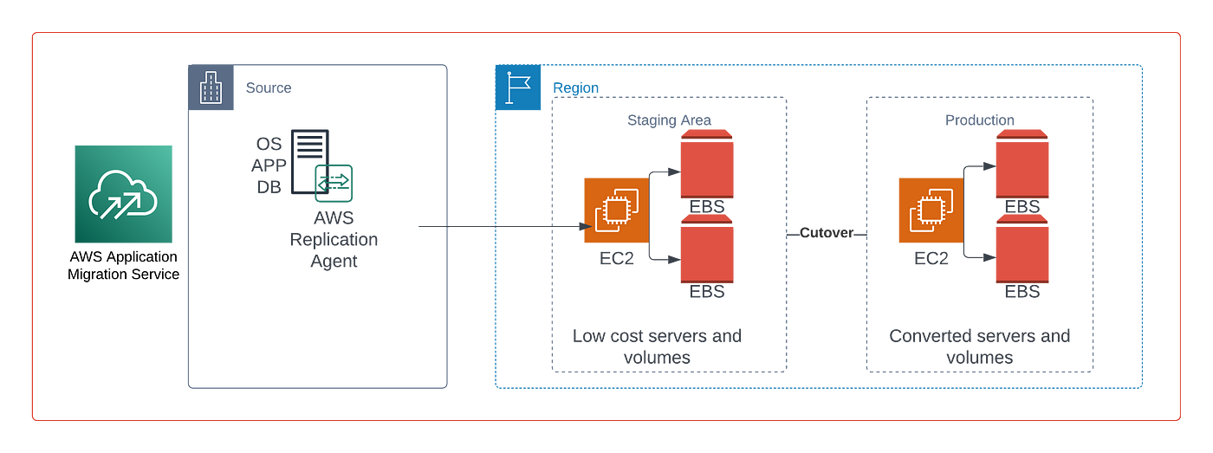
AWS MGN Architecture

