Slide 1

AWS Snow Family
Process data at the edge or move petabytes of data to and from AWS

Slide 2

AWS Snow Family
Purpose-built devices to cost effectively move petabytes of data, offline. Lease a Snow device to move your data to the cloud.
Field-tested for the most extreme conditions, delivering high security and ruggedization into compute and storage-compatible devices.
Device options range to optimize for space- or weight-constrained environments, portability, and flexible networking options.

Slide 3
AWS Snow Family Service Models
AWS Snowcone
AWS Snowcone is the most compact and portable device. Weighing in at 4.5 pounds (2.1 kg) and available with SSD or HDD options, Snowcone is ruggedized, secure, and purpose-built for use outside of a traditional data center.
AWS Snowball
AWS Snowball is available as a Compute Optimized device or a Storage Optimized device. Explore the options best suited for your needs. All devices are suited for extreme conditions, tamper proof, and highly secure.
AWS Snowmobile
AWS Snowmobile is an Exabyte-scale data migration device used to move extremely large amounts of data to AWS. Migrate up to 100PB in a 45-foot long ruggedized shipping container, pulled by a semi-trailer truck.

Slide 4
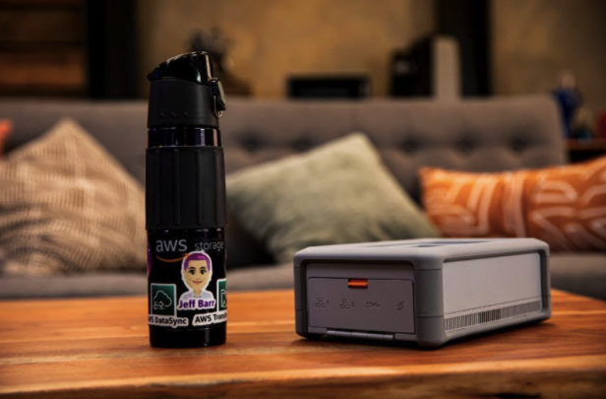
What is AWS Snowcone?
Edge computing – collection and processing of data for real-time insights and then transferring the data to AWS via online and offline methods
Data transfer in factories – data generated by machine sensors can be transferred to AWS
Content aggregation – transferring of media and other scientific data from the edge location to your AWS.
One-time data migration – a simple, fast, and inexpensive transfer of up to 8TB of data into AWS by shipping the Snowcone device to AWS

Slide 5
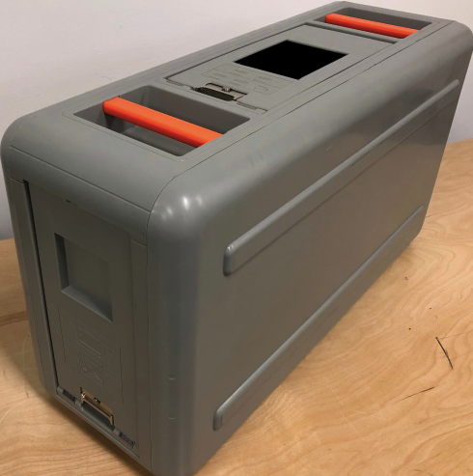
What is AWS Snowball? Use cases
Cloud data migration – you can use Snowball to migrate huge quantities of data into AWS without having to worry about the bandwidth costs.
Secure content dissemination – banks, airlines, studios, hospitals, and other industries that require secure dissemination of data can take advantage of the secure data transfer services of AWS snowball
Machine learning – image labeling, document classification, and other AI applications that require real-time analysis of data can be deployed on AWS snowball. Data can also be transported from remote locations to support in-cloud machine learning
Manufacturing – on-site data in factories can be collected and analyzed to fine-tune the operations for better efficiency. The data can then be migrated to AWS for more comprehensive analytics to discover trends and patterns.
Remote location – AWS snowball can be used for pre-processing applications e.g. image tagging, compression, organization, and validation. The data can be gathered and analyzed remotely to get quick insights and then migrated to AWS later on.

Slide 6
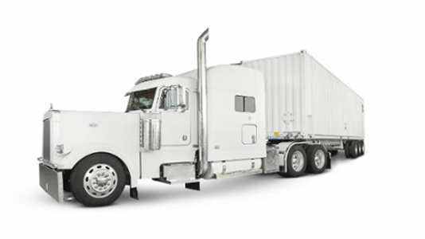
What is AWS Snowmobile?
Shutting down legacy data centers – before you shut down your data center, you will want to make sure you have migrated all your data to the cloud. The AWS Snowmobile will help you move all your data efficiently and inexpensively.
Huge data migration – Snowmobile can help businesses that collect huge amounts (exabytes of data) from their premises to AWS in a low-cost and yet secure and efficient manner. Examples of applications include satellite images, genomic sequences, seismic data, video libraries, image repositories, financial data, etc.

Slide 7
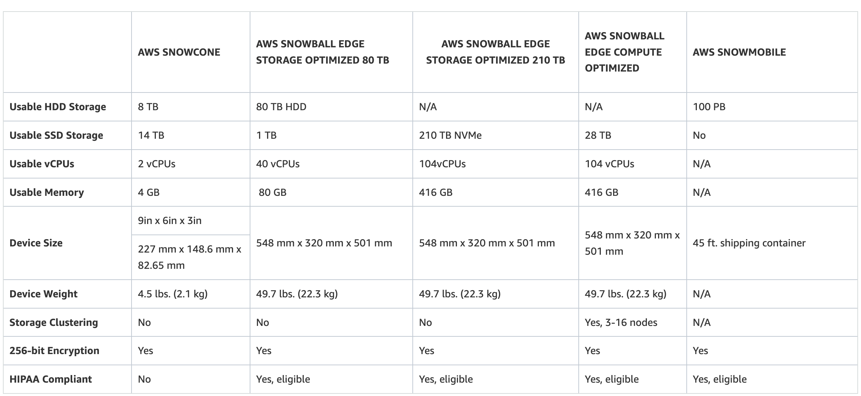
AWS Snow Family Comparison

