Slide 1

AWS Transfer Family
Easily manage and share data with simple, secure, and scalable file transfers

Slide 2
AWS Transfer Family Overview
AWS Transfer Family is a secure transfer service that enables you to transfer files into and out of AWS storage services
AWS Transfer Family supports transferring data over the following protocols:
Secure Shell (SSH) File Transfer Protocol (SFTP): version 3
File Transfer Protocol Secure (FTPS)
File Transfer Protocol (FTP)
Applicability Statement 2 (AS2)

Slide 3
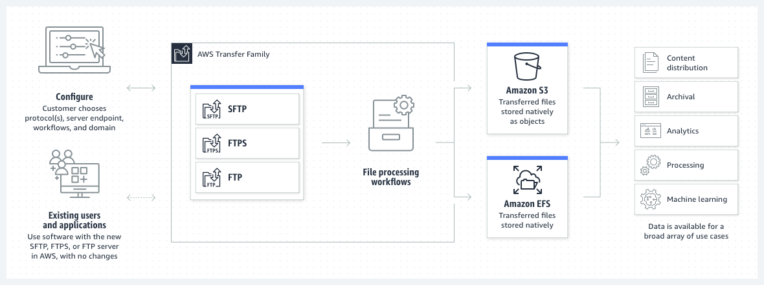
AWS Transfer Family Endpoints for file sharing

Slide 4
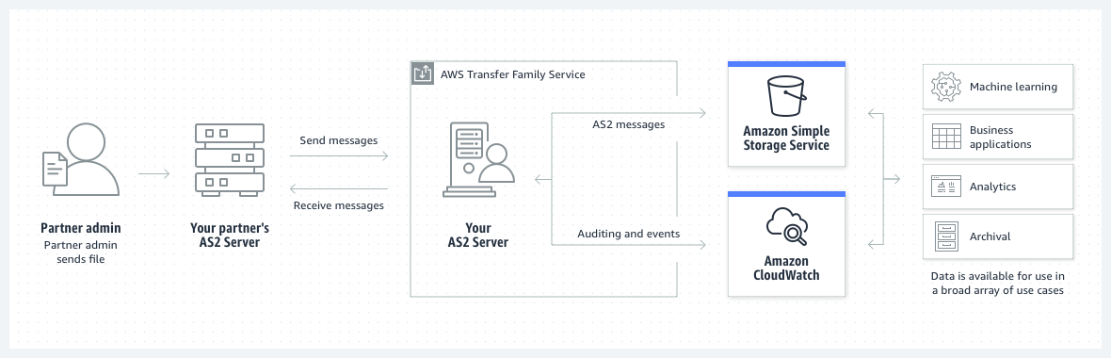
AWS Transfer Family Applicability Statement 2

Slide 5
What is AS2?
AS2 (Applicability Statement 2) is a http based protocol to transmit messages (especially EDI messages) safely, cheaply and quickly.
In the last 20 years AS2 has become the most widely used protocol for EDI in many industries, such as the retail and the consumer goods industry.
To establish an AS2 connection you need two computers, a server and a client. Both connect to the Internet via a point-to-point connection. In order to transmit the desired data, AS2 creates an ‘envelope’ that enables secure transmission via the Internet using digital certificates and encryption.

Slide 6
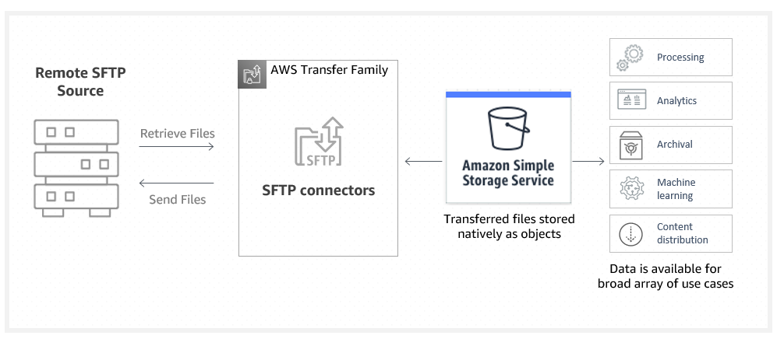
AWS Transfer Family SFTP connectors

Slide 7
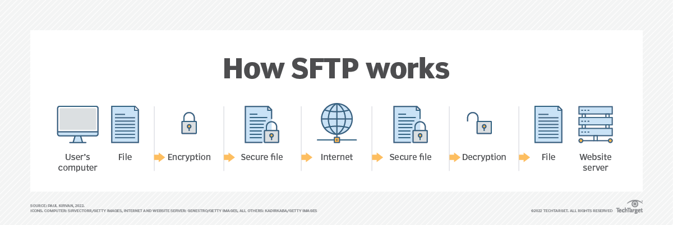
What is SFTP?
Secure File Transfer Protocol (SFTP) is a network protocol for securely accessing, transferring and managing large files and sensitive data.
Designed by the Internet Engineering Task Force as an extension of Secure Shell (SSH), SFTP enables access, transfer and management of files over a network.
It's used for secure file transfers over Transport Layer Security and the transfer of data for virtual private network (VPN) applications.

Slide 8
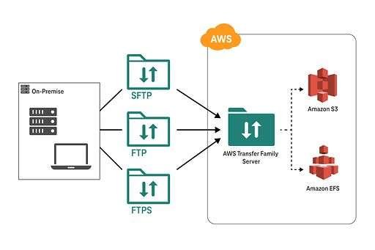
AWS Transfer Family Architecture

