Slide 1
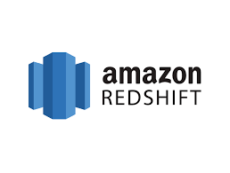
Amazon Redshift
Best price-performance for cloud data warehousing

Slide 2
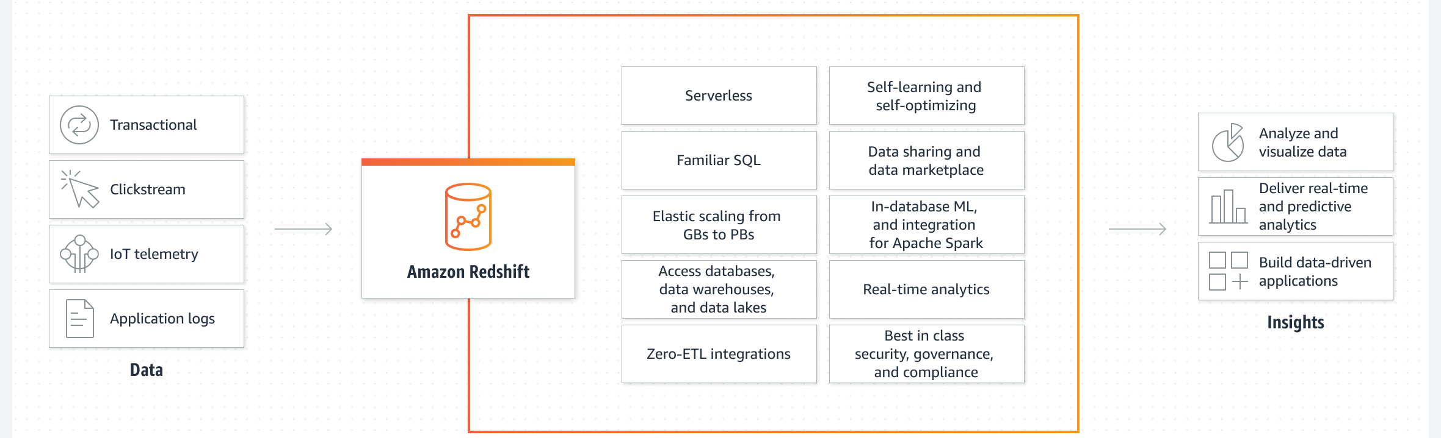
Amazon Redshift Overview
Amazon Redshift is a fully managed, petabyte-scale data warehouse service in the cloud.
Amazon Redshift Serverless lets you access and analyze data without all of the configurations of a provisioned data warehouse
Redshift based on PostgreSQL
It is OLAP

Slide 3
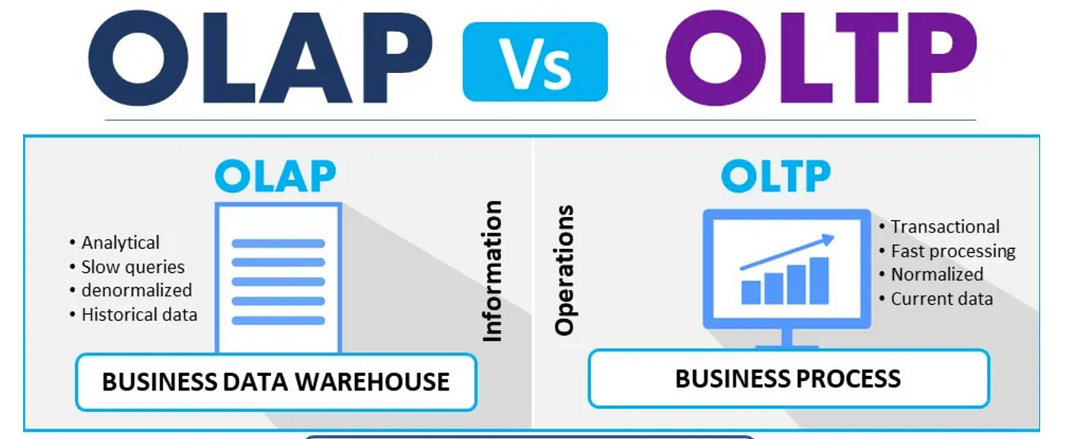
OLAP vs OLTP
OLTP (Online Transaction Processing) and OLAP (Online Analytical Processing) serve distinct roles in data processing and analysis.
OLTP systems are optimized for transactional efficiency, handling a large number of short, atomic transactions to ensure data integrity and operational speed, which makes them ideal for routine operations such as order processing in e-commerce platforms.
On the other hand, OLAP systems are designed for analytical performance, working with complex queries on large datasets to facilitate deep analysis and reporting, commonly used in data warehousing environments where business analysts derive insights from large volumes of historical data.
While OLTP databases prioritize quick and reliable transactional operations with a focus on insert/update operations,
OLAP databases are geared towards optimizing complex query performance, often through denormalized data schemas that support a broad range of queries for business intelligence and analytical reports. In summary,
OLTP is tailored for transactional workloads where efficiency and data integrity are paramount, whereas OLAP focuses on providing comprehensive analytics and facilitating data discovery through multidimensional queries.

Slide 4
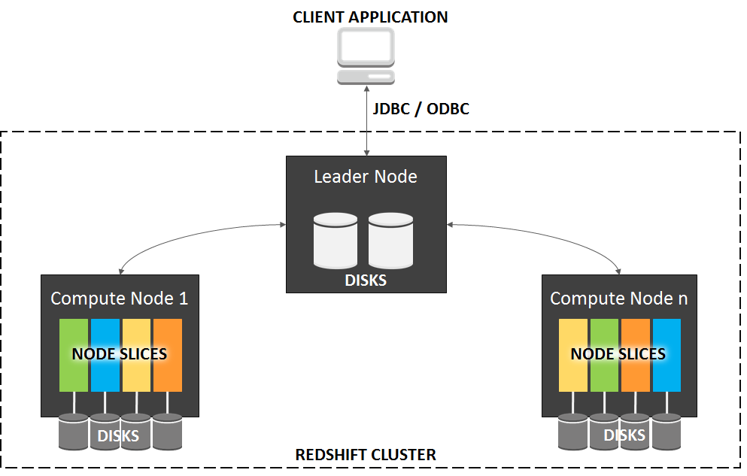
Redshift Cluster
Cluster – a set of nodes, which consists of a leader node and one or more compute nodes.
Redshift creates one database when you provision a cluster. This is the database you use to load data and run queries on your data.
You can scale the cluster in or out by adding or removing nodes. Additionally, you can scale the cluster up or down by specifying a different node type.
Redshift assigns a 30-minute maintenance window at random from an 8-hour block of time per region, occurring on a random day of the week. During these maintenance windows, your cluster is not available for normal operations.
Redshift supports both the EC2 VPC and EC2-Classic platforms to launch a cluster. You create a cluster subnet group if you are provisioning your cluster in your VPC, which allows you to specify a set of subnets in your VPC.

Slide 5
Redshift Node
The leader node receives queries from client applications, parses the queries, and develops query execution plans.
It then coordinates the parallel execution of these plans with the compute nodes and aggregates the intermediate results from these nodes.
Finally, it returns the results back to the client applications.
Compute nodes execute the query execution plans and transmit data among themselves to serve these queries.
The intermediate results are sent to the leader node for aggregation before being sent back to the client applications.
Node Type
Dense storage (DS) node type – for large data workloads and use hard disk drive (HDD) storage.
Dense compute (DC) node types – optimized for performance-intensive workloads. Uses SSD storage.
Parameter Groups – a group of parameters that apply to all of the databases that you create in the cluster.
The default parameter group has preset values for each of its parameters, and it cannot be modified.

Slide 6
Resizing clusters in Amazon Redshift
A resize operation comes in two types:
Elastic resize – You can add nodes to or remove nodes from your cluster.
You can also change the node type, such as from DS2 nodes to RA3 nodes. Elastic resize is a fast operation, typically completing in minutes.
For this reason, we recommend it as a first option.
When you perform an elastic resize, it redistributes data slices, which are partitions that are allocated memory and disk space in each node.
Elastic resize is appropriate when you:
Add or reduce nodes in an existing cluster, but you don't change the node type – This is commonly called an in-place resize. When you perform this type of resize, some running queries complete successfully, but others can be dropped as part of the operation. An elastic resize completes within a few minutes.
Change the node type for a cluster – When you change the node type, a snapshot is created and data is redistributed from the source cluster to a cluster comprised of the new node type. On completion, running queries are dropped. Like the in-place resize, it completes quickly.
Classic resize – You can change the node type, number of nodes, or both, in a similar manner to elastic resize.
Classic resize takes more time to complete, but it can be useful in cases where the change in node count or the node type to migrate to doesn't fall within the bounds for elastic resize.
This can apply, for instance, when the change in node count is really large.

Slide 7
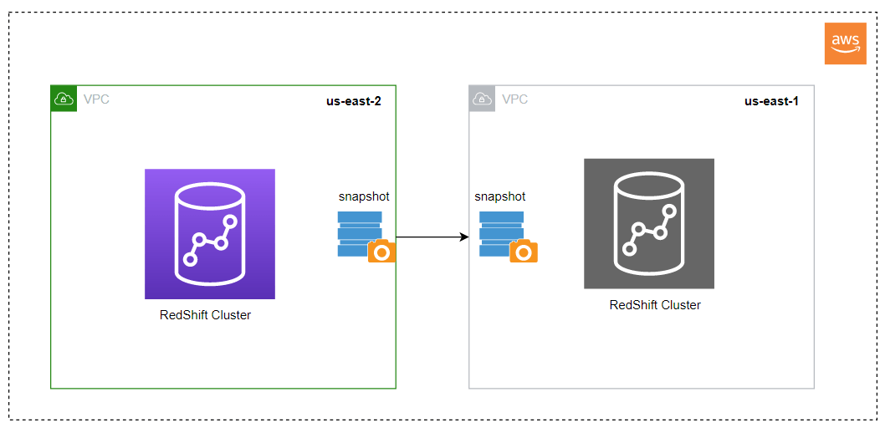
Redshift Snapshots & Disaster Recovery
Point-in-time backups of a cluster. There are two types of snapshots: automated and manual. Snapshots are stored in S3 using SSL.
Redshift periodically takes incremental snapshots of your data every 8 hours or 5 GB per node of data change.
Redshift provides free storage for snapshots that is equal to the storage capacity of your cluster until you delete the cluster. After you reach the free snapshot storage limit, you are charged for any additional storage at the normal rate.
Automated snapshots are enabled by default when you create a cluster. These snapshots are deleted at the end of a retention period, which is one day, but you can modify it. You cannot delete an automated snapshot manually.
By default, manual snapshots are retained indefinitely, even after you delete your cluster.
You can share an existing manual snapshot with other AWS accounts by authorizing access to the snapshot.
You can configure Amazon Redshift to automatically copy snapshots (automated or manual) for a cluster to another AWS Region. For automated snapshots, you can also specify the retention period to keep them in the destination AWS Region. The default retention period for copied snapshots is seven days.
If you store a copy of your snapshots in another AWS Region, you can restore your cluster from recent data if anything affects the primary AWS Region. You can configure your cluster to copy snapshots to only one destination AWS Region at a time.

Slide 8
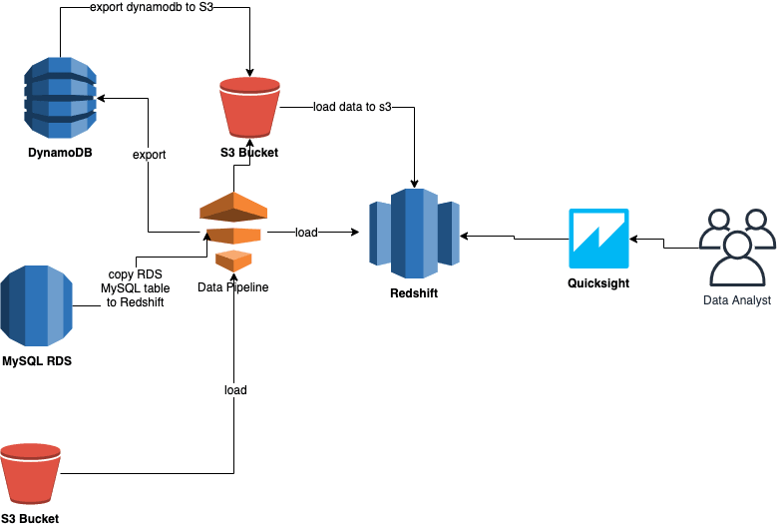
Redshift Load Data: Data Pipeline
Aws provides a set of utilities for loading data To Redshift from different sources
AWS Data pipeline offers a template activity called RedshiftCopyActivity that can be used to copy data from different kinds of sources to Redshift. RedshiftCopyActivity helps to copy data from the following sources.
RDS
EMR
S3

Slide 9
Redshift Load Data: Loading Data to Redshift using Insert Into Command
Redshift’s INSERT INTO implemented based on the PostgreSQL. The simplest example of the INSERT INTO command for inserting four values into a table named employee_records is as follows.
INSERT INTO table(field) values(value);

Slide 10
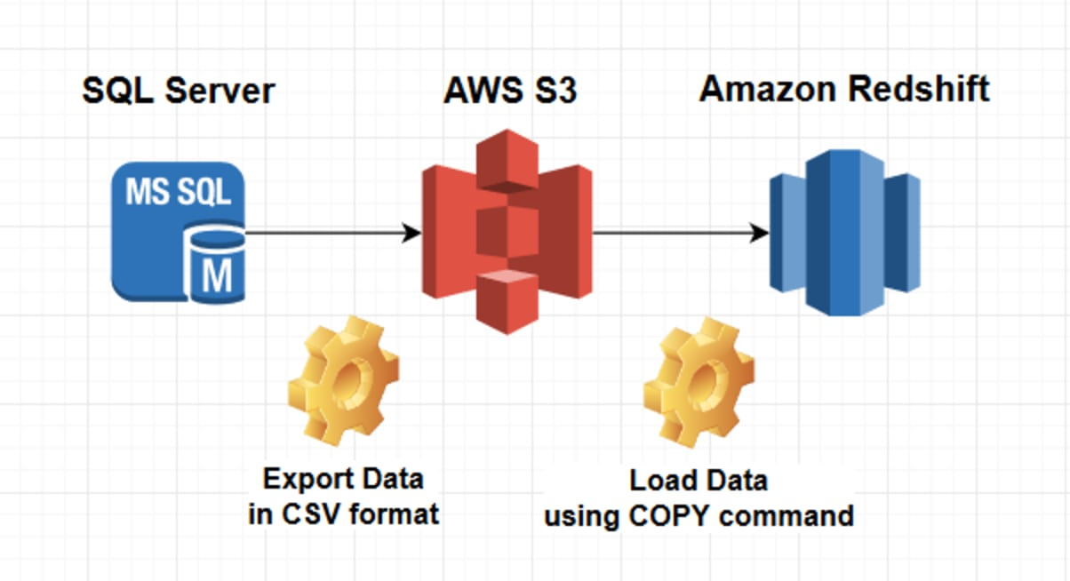
Redshift Load Data: Redshift COPY
COPY table-name [ column-list ] FROM data_source authorization [ [ FORMAT ] [ AS ] data_format ] [ parameter [ argument ] [, ... ] ]

Slide 11
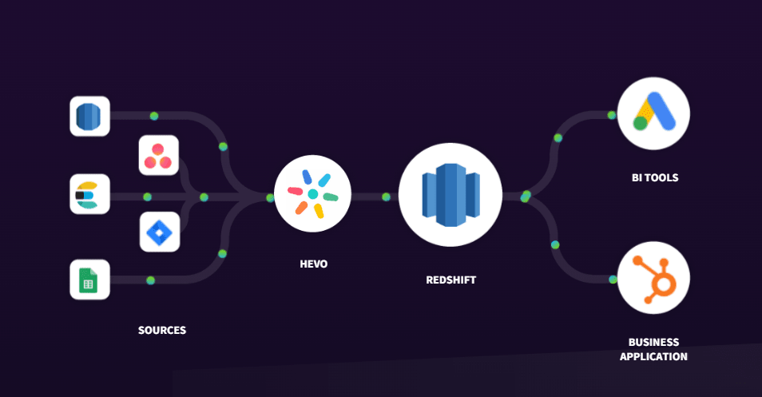
Redshift Load Data: Loading Data to Redshift Using Hevo’s no code data pipeline (skip this)

Slide 12
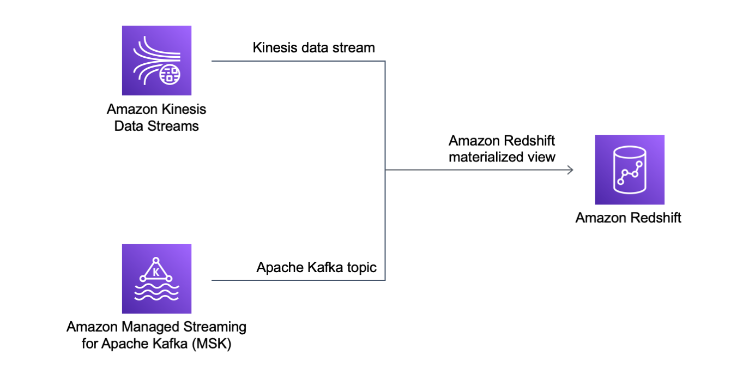
RedShift Streaming Ingestion
Allows you to consume and process data directly from a streaming source to a Redshift cluster using SQL.
Streaming ingestion eliminates the need for staging data in Amazon S3, which gives you a low-latency, high-speed ingestion.
Valid data source:
Kinesis Data Streams
MSK

Slide 13
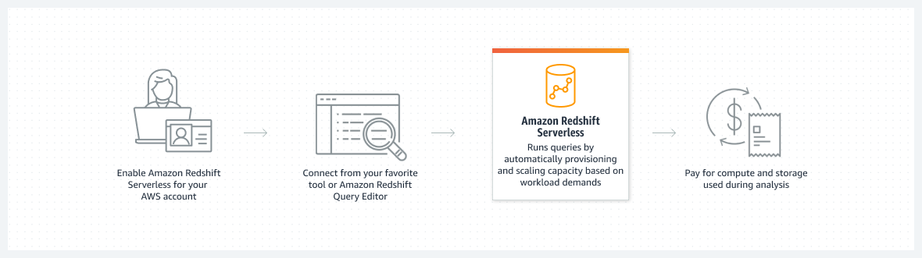
Redshift Serverless
Amazon Redshift Serverless makes it convenient for you to run and scale analytics without having to provision and manage data warehouses.
With Amazon Redshift Serverless, data analysts, developers, and data scientists can now use Amazon Redshift to get insights from data in seconds by loading data into and querying records from the data warehouse.
Amazon Redshift automatically provisions and scales data warehouse capacity to deliver fast performance for demanding and unpredictable workloads.
You pay only for the capacity that you use.
You can benefit from this simplicity without changing your existing analytics and business intelligence applications.

Slide 14
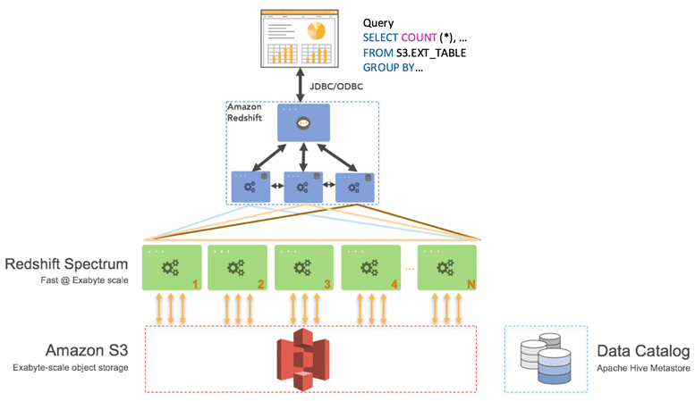
RedShift Spectrum
Enables you to run queries against exabytes of data in S3 without having to load or transform any data.
Redshift Spectrum supports Enhanced VPC Routing.
If you store data in a columnar format, Redshift Spectrum scans only the columns needed by your query, rather than processing entire rows.
If you compress your data using one of Redshift Spectrum’s supported compression algorithms, less data is scanned.

Slide 15
Redshift Use Cases
Business Intelligence and Reporting: Companies can leverage AWS Redshift to power their business intelligence tools, providing high-speed analytics and reporting to help make data-driven decisions based on a comprehensive analysis of large and complex datasets.
Predictive Analytics for Marketing Campaigns: Marketing teams can use AWS Redshift to perform predictive analytics on customer data to tailor marketing campaigns more effectively, utilizing historical data to anticipate customer needs and preferences.
Real-time Gaming Analytics: Gaming companies can employ AWS Redshift to analyze player data in real time, helping to optimize the gaming experience through the identification of patterns and trends, which can inform game development and enhance player engagement.
Healthcare Analytics for Improved Patient Outcomes: Healthcare organizations can utilize AWS Redshift to integrate and analyze large volumes of health data, facilitating research and helping to improve patient outcomes through more informed and data-driven decision-making.
Supply Chain Optimization: Manufacturing and retail companies can harness AWS Redshift to analyze supply chain data, enhancing efficiency by identifying bottlenecks and optimizing logistics and distribution networks through data-driven insights.

