Slide 1
AWS Graviton Processors

Slide 2
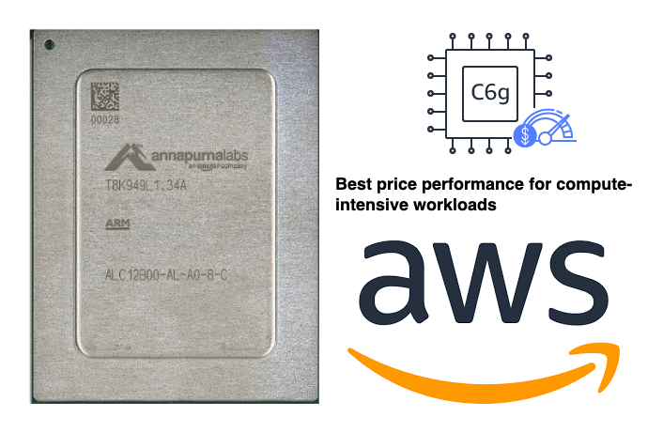
Introduction to AWS Graviton Processors
Introduce AWS Graviton Processors as cutting-edge, ARM-based CPUs developed by AWS.
Historical perspective: Trace the development from the first Graviton processor to the advanced Graviton2.
Highlight key attributes: Exceptional performance per watt, reduced costs, and custom-built for cloud-native applications.

Slide 3
Performance Benefits of AWS Graviton
Detail the performance superiority: Benchmarks showing significant improvement in compute-intensive operations compared to traditional x86 processors.
Focus on energy efficiency: Emphasize the environmental benefits of Graviton's lower power requirements.
Illustrate ideal workload scenarios: Enhanced performance for web servers, containerized applications, data analytics, and gaming servers.

Slide 4
Cost-Effectiveness and Scalability
Break down the cost advantages: Analyze cost-performance ratio, showcasing long-term savings on cloud operations.
Discuss scalability in cloud contexts: How Graviton processors efficiently scale to meet demand spikes without compromising performance.
Real-world case studies: Present success stories of businesses leveraging Graviton processors for diverse applications, demonstrating tangible cost benefits.

Slide 5
Integration with AWS Ecosystem
Explore the seamless synergy with AWS services: Enhanced compute capabilities when used with Amazon EC2 instances, AWS Lambda functions, and AWS container services.
Dive into software ecosystem compatibility: Support for a wide range of operating systems, programming languages, and software stacks.
Future outlook: Discuss the evolving role of Graviton processors in shaping next-generation cloud solutions and AWS's vision for an ARM-based cloud ecosystem.

