Slide 1
AWS Nitro System

Slide 2
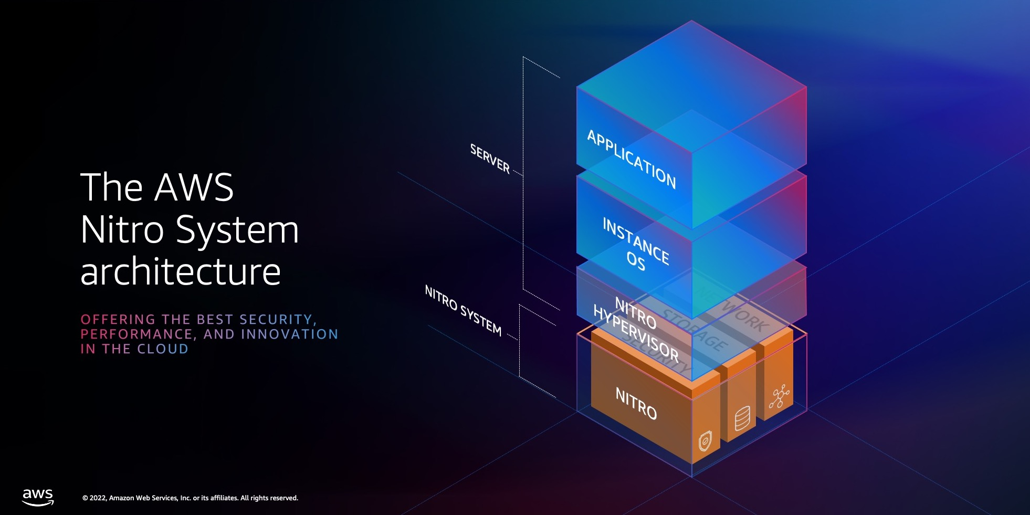
Introduction to AWS Nitro System
Define AWS Nitro System: A combination of dedicated hardware and lightweight hypervisor that delivers enhanced performance and security.
Trace its evolution: From traditional hypervisors to the innovation of Nitro.
Emphasize Nitro's impact: Significant improvements in compute efficiency, consistent performance, and enhanced security for AWS cloud instances.

Slide 3
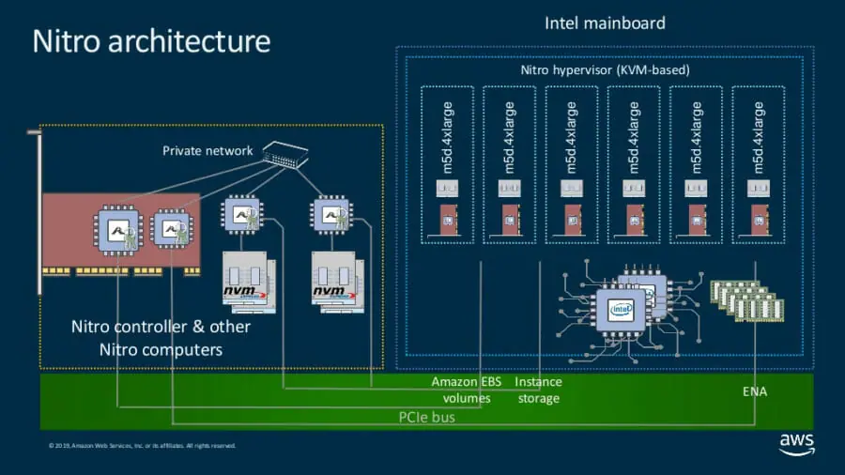
Architecture of the AWS Nitro System
Illustrate the unique architecture: Differentiate between traditional virtualization and Nitro's approach.
Components explained: Dive into Nitro Cards for specific functions (e.g., VPC, EBS), the Nitro Security Chip for hardware security, and the lightweight Nitro Hypervisor for resource isolation.
Highlight architectural benefits: Enhanced resource optimization and reduced virtualization overhead.

Slide 4
Performance Enhancements with Nitro
Detail performance improvements: Higher processing efficiency, better network throughput, and faster storage I/O.
CPU resource optimization: How Nitro maximizes CPU availability for customer workloads.
Case studies: Real-world scenarios where Nitro's performance enhancements have been critical.

Slide 5
Enhanced Security Features of Nitro
Deep dive into security enhancements: Isolated security model, reduced attack surface due to minimized hypervisor functionality.
Discuss the Nitro Security Chip: Hardware-based root of trust, encryption, and secure boot processes.
Broader impact on AWS security: How Nitro elevates the security baseline of AWS cloud services.

Slide 6
Future of Cloud Computing with AWS Nitro
Forecast Nitro’s influence on future cloud technologies: Predictions on how Nitro will shape next-gen cloud services.
1
Potential innovations: Speculate on new AWS services and features enabled by Nitro.
2
Discuss the strategic advantage: How Nitro positions AWS as a leader in efficient, secure cloud services.
3

Slide 7
AWS Nitro Use Cases
High-Performance Computing (HPC): AWS Nitro's enhanced CPU and memory performance make it ideal for HPC workloads. Its ability to deliver high throughput and networking performance is crucial for compute-intensive tasks like scientific modeling, big data analytics, and machine learning.
Secure Data Processing: With the Nitro Security Chip, AWS Nitro offers a secure environment for processing sensitive data. This is particularly beneficial for industries like finance and healthcare, where data security and compliance are paramount.
Enterprise Resource Planning (ERP) Systems: The improved I/O and network throughput capabilities of AWS Nitro are well-suited for ERP systems, which often require robust, scalable, and secure infrastructure to handle large volumes of transactions and data.
Gaming and Media Streaming: AWS Nitro's ability to provide consistent high performance and low latency benefits gaming and media streaming services. It ensures a smooth and responsive experience for users, even during peak demand times.
Machine Learning and AI Workloads: The enhanced computational power and efficiency of AWS Nitro are ideal for machine learning and AI workloads, enabling faster processing of large datasets and more efficient model training and inference.

