Slide 1

AWS Artifact
Access AWS and ISV security and compliance reports

Slide 2
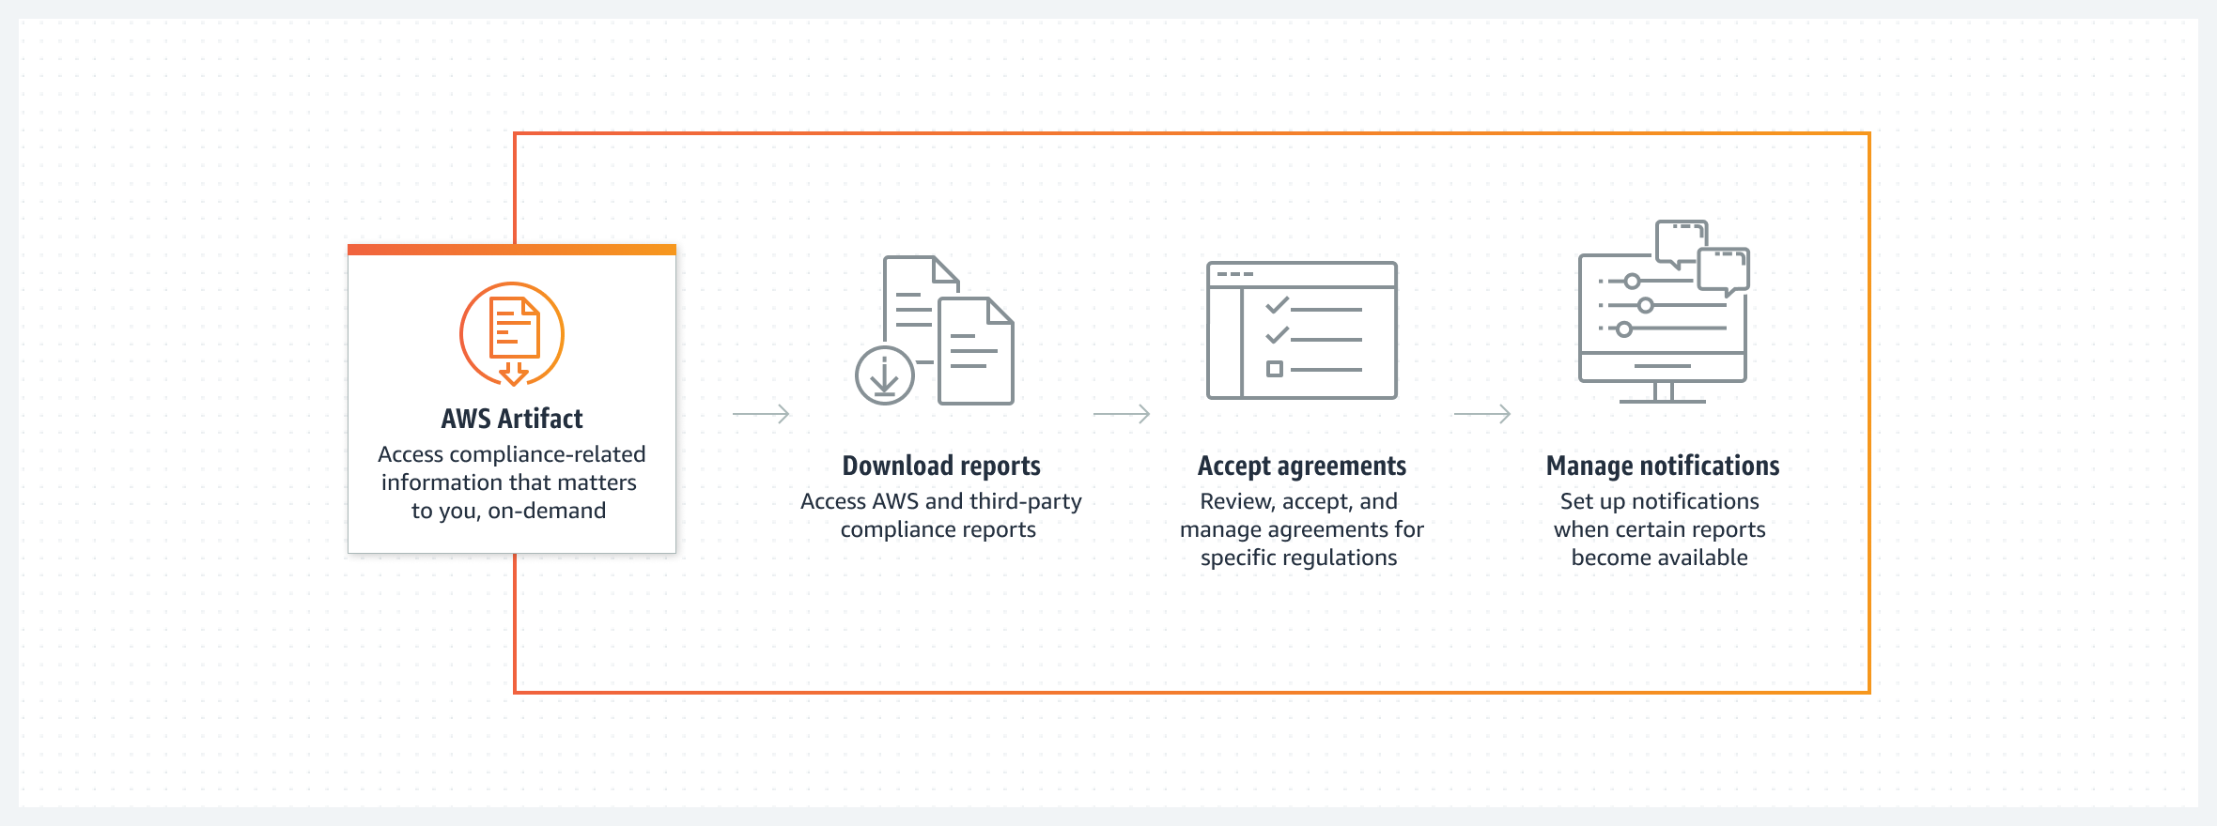
AWS Artifact

Slide 3
AWS Artifact use cases
Understand AWS security and compliance posture
Find auditor-issued reports, certifications, accreditations, and other third-party attestations of AWS in a comprehensive resource.
Manage select online agreements at scale
Review, accept, and manage your agreements with AWS and apply them to current and future accounts within your organization.
Assess third-party security and compliance
Perform due-diligence of ISVs that sell products on AWS Marketplace, with on-demand access to their security and compliance reports.

